Slide 1
DevOps Experts
Class 12
Modi Tamam

Slide 2
Cloud - AWS

Slide 3
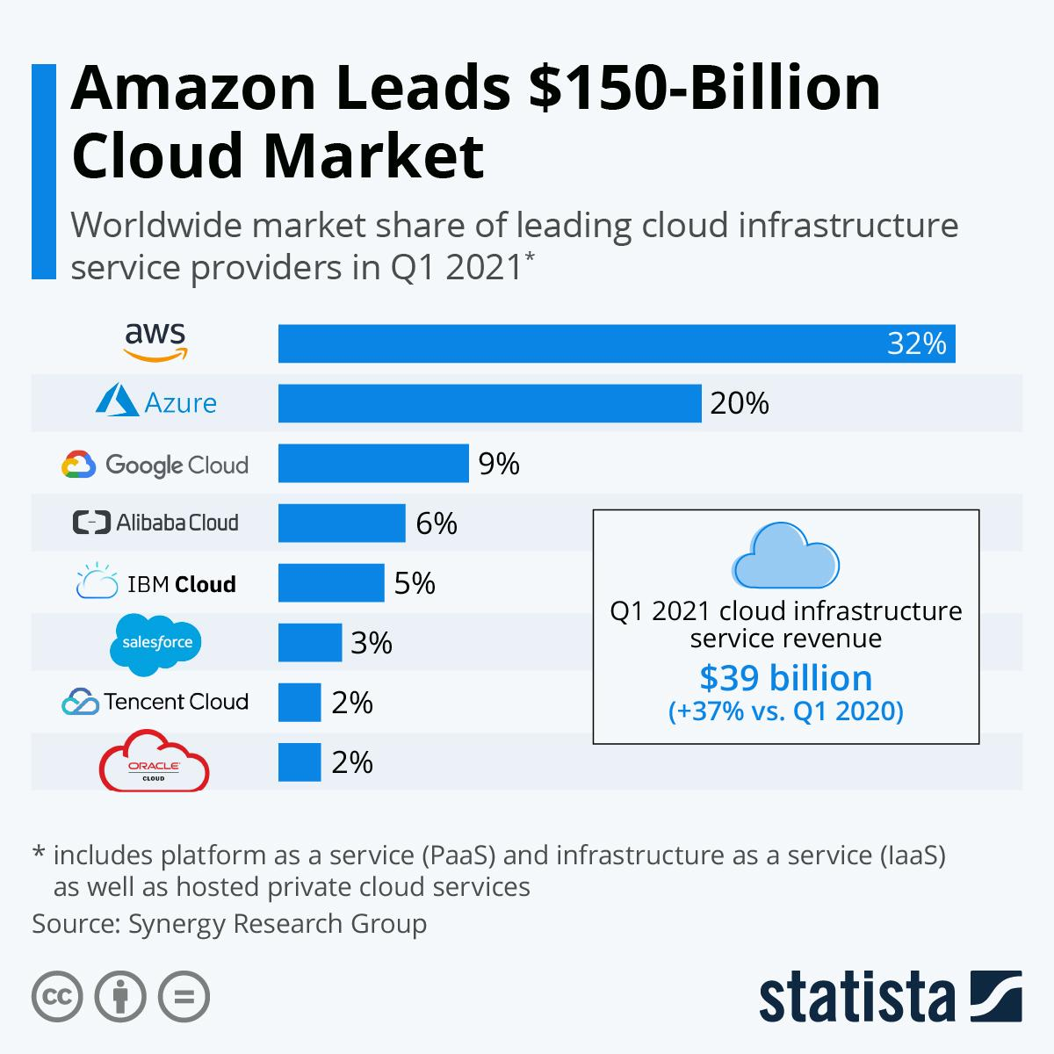

Slide 4
Amazon Web Services
Amazon Web Services (AWS) is a subsidiary of Amazon.com that provides on-demand cloud computing platforms to individuals, companies and governments.
The technology allows subscribers to have at their virtual cluster of computers, available all the time, through the Internet.
Cloud computing is the on-demand delivery of compute power, database storage, applications, and other IT resources through a cloud services platform via the internet with pay-as-you-go pricing.

Slide 5
Aamazon Web Services
AWS provides instances in the following regions:
US East (N. Virginia, Ohio)
US West (N. California, Oregon)
Asia Pacific (Mumbai, Seoul, Singapore, Sydney, Tokyo, Osaka-Local)
Canada (Central)
China (Beijing, Ningxia)
Europe (Frankfurt, Ireland, London, Paris)
South America (Sao Paulo)
AWS is the number 1 cloud computing company worldwide.

Slide 6
AWS EC2
Amazon Elastic Compute Cloud (Amazon EC2) is a web service that provides secure, resizable compute capacity in the cloud.
It is designed to make web-scale cloud computing easier for developers.
Amazon EC2’s simple web service interface allows you to obtain and configure capacity with minimal friction.
It provides you with complete control of your computing resources and lets you run on Amazon’s proven computing environment.
Amazon EC2 reduces the time required to obtain and boot new server instances to minutes, allowing you to quickly scale capacity, both up and down, as your computing requirements change.

Slide 7
AWS EC2
Amazon EC2 changes the economics of computing by allowing you to pay only for capacity that you actually use.
Amazon EC2 provides developers the tools to build failure resilient applications and isolate them from common failure scenarios.
EC2 offers many types operating systems including: ALI (Amazon Linux distribution), RHEL (Red hat enterprise linux), SUSE, Ubuntu and Windows.
EC2 offers many machines types with different CPU, Storage and networking capabilities
Pricing can go as high as $24.48 per Hour For our usage we will use instances which are offered for 1 free year.

Slide 8
Exercise
Launch an EC2 instance.
Deploy Nginx.
Browse to the Nginx home page that you just deployed.

Slide 9
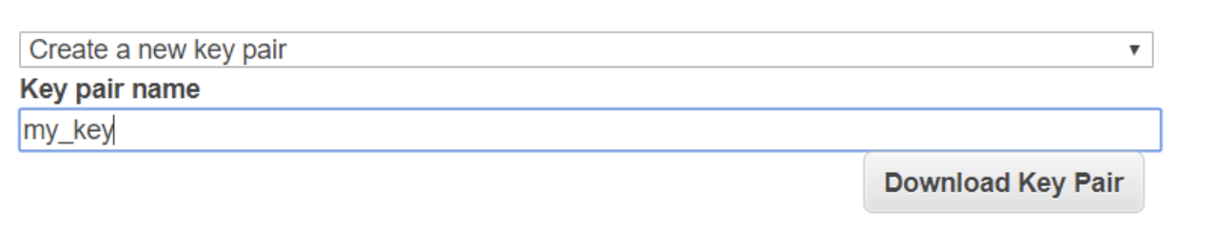
Launching an AWS EC2 Instance
Go to EC2 page (Services EC2) -> Instances (on the left menu panel).
Press Launch instance button Choose -> Amazon Linux 2 AMI, which is free for first year -> keep t2.micro which is free and launch instance by pressing Review and launch button and launch
In order to have the ability to SSH into our server -> we will need to create a key, just choose: Create a new key pair give the key a name press Download Key Pair

Slide 10
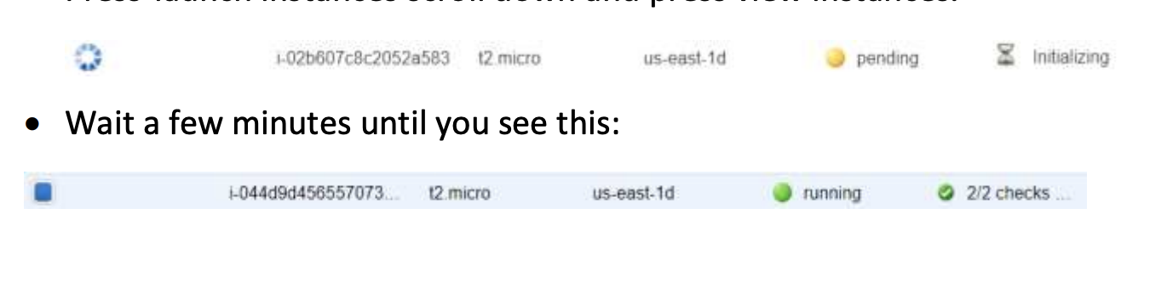
Launching an AWS EC2 Instance
Make sure to keep this key in a secure location, without this key you will not be able to connect to your server!
Press launch instances scroll down and press view instances

Slide 11
Connecting to an AWS EC2 instance
To connect to our EC2 instance, we will need to use the key (.pem) file, we created earlier.
Find the EC2 instance public IP address or public DNS in the EC2 console:
Open CMD / Terminal and navigate to the folder containing the .pem file (using CD)

Slide 12
Connecting to an AWS EC2 instance
Type the following command:
ssh -i <pem_file name> <public ip address>
For example:
ssh -i ec2.pem ec2-user@18.205.46.80

Slide 13
Cloud Deployment
Once we are logged in, let’s install Docker
sudo yum install docker -y
Start Docker service by typing
sudo systemctl start docker
docker run -d --name docker-nginx -p 80:80 nginx
Open a browser and type in the address bar the instance IP address and it won’t work
The reason for that, is because we didn’t exposed the instance port 80 to the world…
To fix the issue, go to Security groups -> Choose one of the launch-wizards
Scroll to inbound and press Edit -> press add rule -> Choose port 80 and source My IP-> Save

Slide 14

Cloud Deployment
It will look as follows:
Go back to your instance -> press Actions drop down -> Networking- > Change security groups-> Choose the wizard you used earlier->Assign security groups
Refresh the browser on your public address…
WE ARE ONLINE

Slide 15
AWS EIP
Go to EC2 page (ServicesEC2) -> Instances (on the left menu panel).
When an instance is launched into EC2, Amazon will randomly assign it a public IP address.
Amazon has a pool of public IP addresses that's been reserved for use within EC2.
An Elastic IP (EIP) is an IP address that you can reserve from AWS for your account.
Once you've created an Elastic IP, you can assign it to any instance of your choice.

Slide 16
AWS EIP
Once you reserve an Elastic IP, nobody else can use that IP address.
There is no cost for Elastic IP addresses while in use.
You only pay for the Elastic IP when it's not attached to an instance.
To associate an EIP, we will first need to allocate an IP address by going to Elastic Ips under Network & Security sub-menu -> Allocate new address-> Allocate.
Go to Actions -> Associate address -> choose your instance and private IP and Associate
Once, you finished with instance, you should disassociate the IP through Actions menu

Slide 17
AWS EBS
Amazon Elastic Block Store is a cloud-based block storage system provided by Amazon Web Services (AWS) that is best used for storing persistent data.
Amazon EBS enables you to keep data persistently on a file system, even after you shut down your EC2 instance.

Slide 18
IAM (Identity and Access Management)
When you first create an AWS account, you begin with a single sign-in identity that has complete access to all AWS services and resources in the account.
This identity is called the AWS account root user and is accessed by signing in with the email address and password that you used to create the account.
IAM works with groups and users.

Slide 19
IAM (Identity and Access Management)
A group is a collection of users who have similar responsibilities.
For example, one group is for administrators (it's called Admins), another one will be for Developers group (called dev)
Each group has multiple users.
Each user can be in more than one group.
Policies are used to grant permissions to groups

Slide 20
IAM Roles
An IAM role is similar to a user, in that it is an AWS identity with permission policies that determine what the identity can and cannot do in AWS.
However, instead of being uniquely associated with one person, a role is intended to be assumable by anyone who needs it.
Also, a role does not have standard long-term credentials (password or access keys) associated with it.
Instead, if a user assumes a role, temporary security credentials are created dynamically and provided to the user.
We can think of IAM Roles as capabilities. You give an IAM User capabilities (e.g. "can create Lambda function", "can upload to S3").

Slide 21

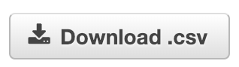
IAM Setup
Go to IAM Service
Go to Users and click “Add User”
Enter a username (preferrably the user’s email)
Check this:
Click Next, Choose Attach existing policies directly
Select “AdministratorsAccess”.
Click Next, next and click

Slide 22
AWS CLI
The AWS Command Line Interface (CLI) is a unified tool to manage your AWS services.
With just one tool to download and configure, you can control multiple AWS services from the command line and automate them through scripts.
The AWS Command Line Interface User Guide walks you through installing and configuring the tool.
After that, you can begin making calls to your AWS services from the command line.

Slide 23
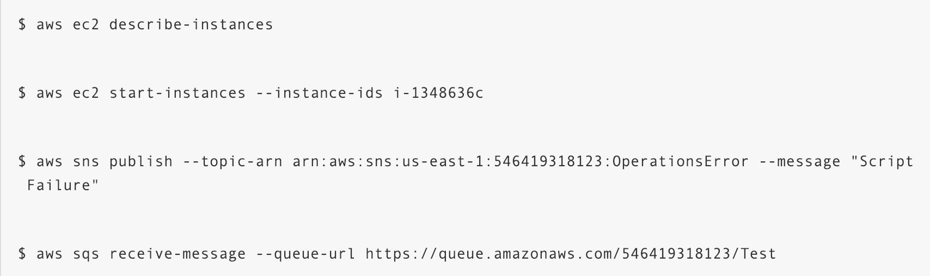
AWS CLI Example

Slide 24
AWS CLI Installation
Install AWS CLI
pip install awscli
aws configure
Enter the access keys credentials we created.

Slide 25
AWS CLI Files
~/.aws/credentials
Contains our secret and access key for different profiles
[default]
aws_access_key_id = AKIA*************
aws_secret_access_key =***************
[prod]
aws_access_key_id = AKIA***************
aws_secret_access_key = ****************
[dev]
aws_access_key_id = AKIA**************
aws_secret_access_key = ******************

Slide 26
AWS CLI Files
~/.aws/config
General AWS CLI configurations such as region and preferred output (json or text lines).
[default]
output = json
region = us-east-1

Slide 27
AWS CLI Command Structure
aws ec2 describe-instances
Command service operation

Slide 28
AWS CLI Command Structure
At any time we can type aws <service name> <operation> help and discover more about how to use the command properly.
If we want to override the credentials stored in ~/.aws/credentials we can always send AWS_ACCESS_KEY_ID and AWS_SECRET_ACCESS_KEY as environment variables.
If we want to specify a profile name in the awscli command we can add to the command --profile <profile name>
If we want to set the output for a specific command we can use --output <output type: text/json/table>

Slide 29
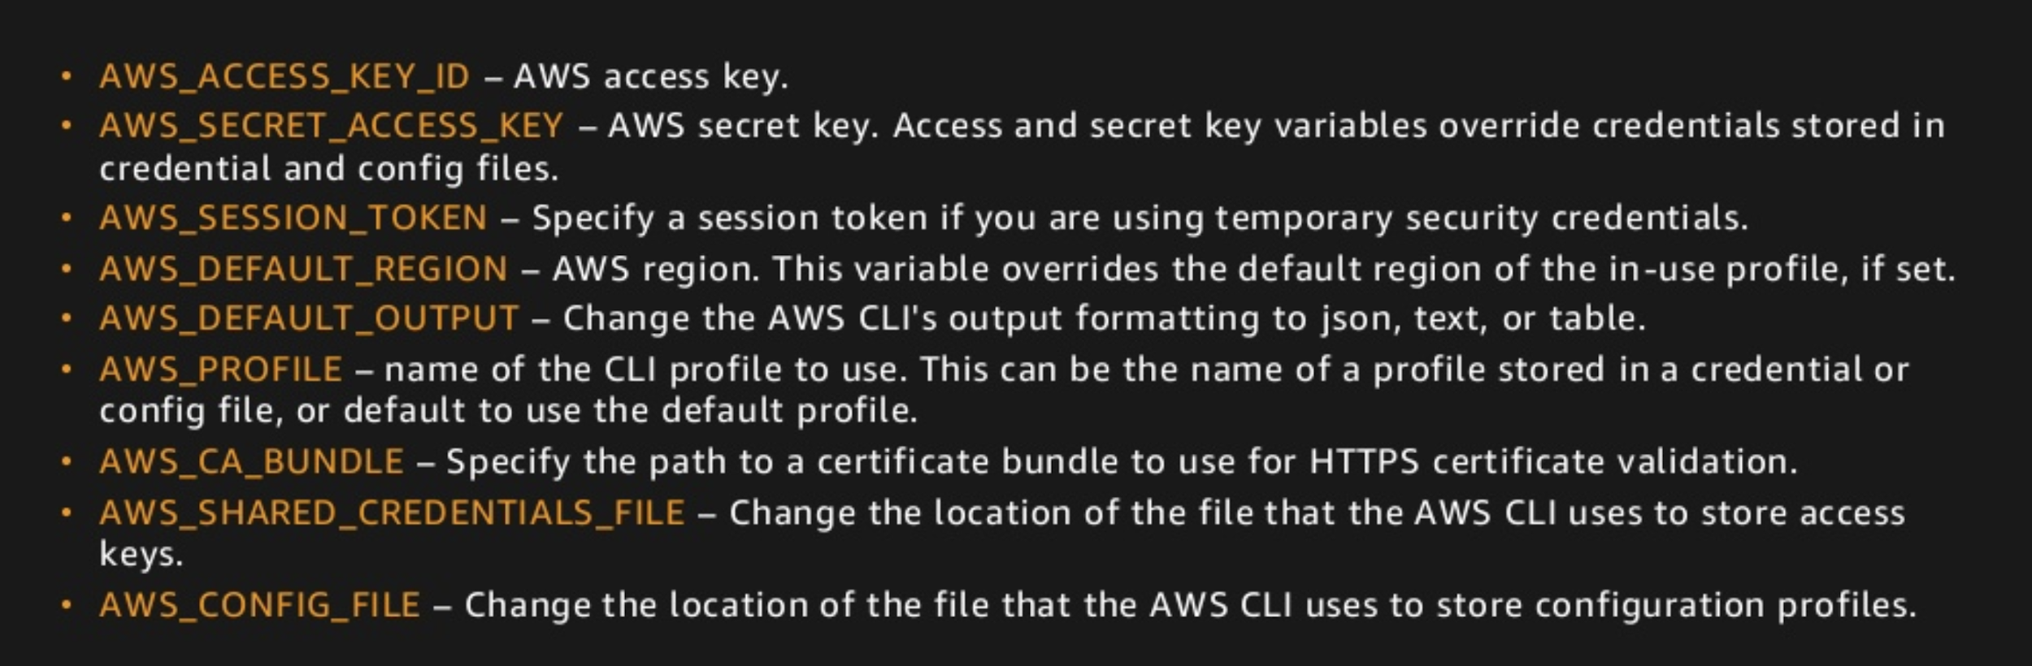
AWS CLI Environment Variables

Slide 30
AWS CLI Filtering and Querying
--filter
Done on the server side
Only available for certain operations
Use this when expecting a large answer
Also support --page-size for paging.
--query
Done on the client side
Available on all commands
Used to show only specific columns

Slide 31
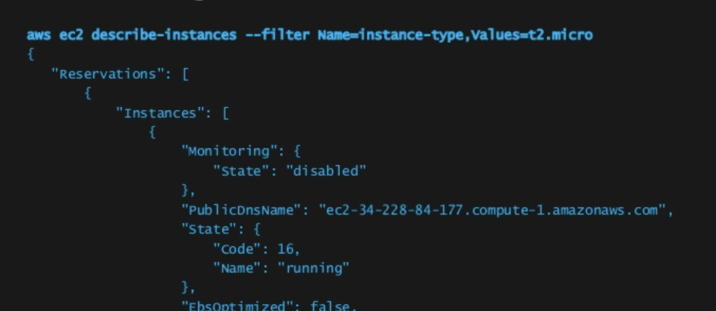
AWS Filtering Example

Slide 32
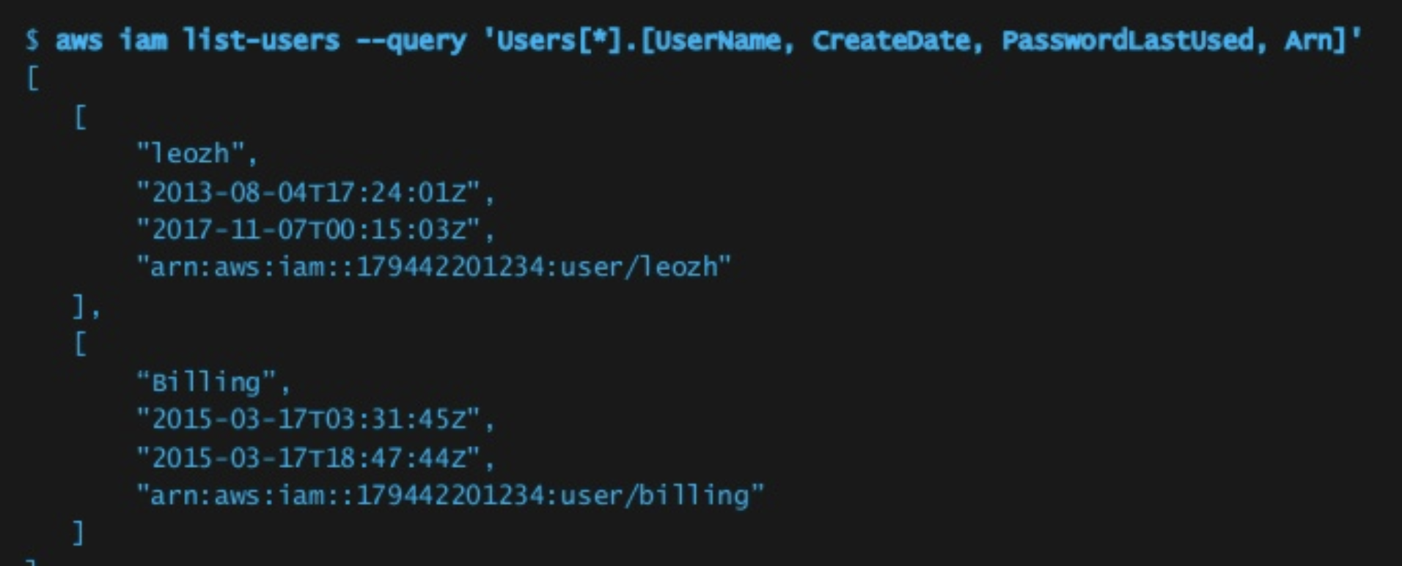
AWS Querying Example

Slide 33
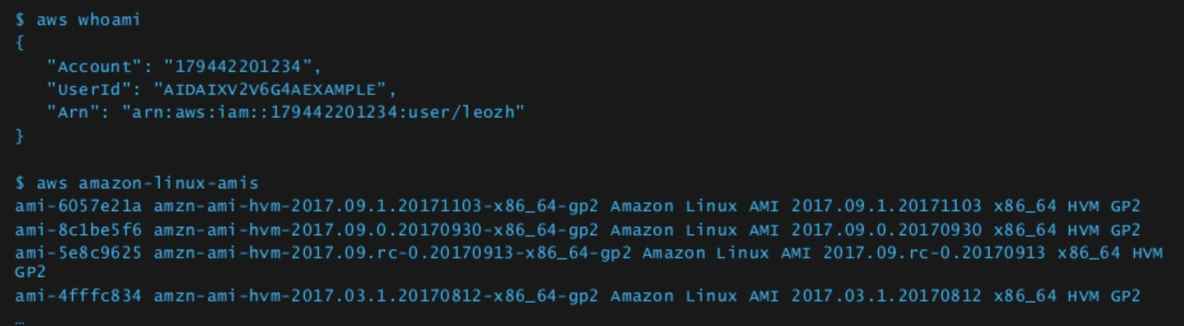
AWS CLI aliases
https://github.com/awslabs/awscli-aliases
Contains common AWS CLI aliases and shortcuts for easier use.

Slide 34
Exploring AWS CLI
List all EC2 Instances.
Find the EC2 instance we created and stop it
Now Start the instance we created.
Create a security group called ‘awscli-sg’
Attach it to the instance we created.
Notes:
aws ec2 create-security-group --group-name MySecurityGroup --description "My security group"
aws ec2 authorize-security-group-ingress --group-name MySecurityGroup --protocol tcp --port 22 --cidr 87.68.160.156\32
aws ec2 modify-instance-attribute --instance-id i-01eaffe7a1c8c927f --groups sg-061b8854b13f66dfa

