Slide 1
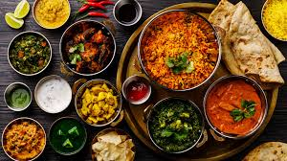
Restaurant Pricing in India

Slide 2
About this Project
in this project we analyzed restaurant data (file zomato.csv) in India, that contains information about restaurants, mainly their locations, menus, guests, cost of a meal for two, and rating. our business question was pricing - we classified restaurant variables in order to predict the cost of a dinner date. This prediction should be helpful to identify restaurants that are over or under priced for restaurant owners and customers.
step 1: cleaning the data - the dataset was text based, and contained several fields (like "url") that had no data gain. all fields were changed to numeric or categorical. the most important fields - cost and rate we normalized for better accuracy.
step 2: data visualization - we added visualizations to better understand data spread and correlation.
step 3: using classification and prediction algorithms - we used four different algorithms, each with its own advantages, in order to get the best result. random forest is a based on trees classification, that combines the classification made by multiple trees. support vector machine is the most suitable algorithm that classifies data points in a multidimensional space. the XGBoost algorithm is a high accuracy predictive model that has a high prediction accuracy rate.
step 4: assessing the outcomes, deciding which model to use for best results.

Slide 3
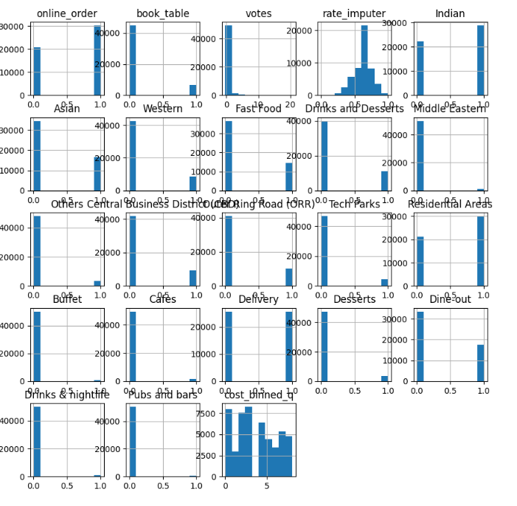
Data features histograms
the data show is after manipulation and dummies separation.

Slide 4
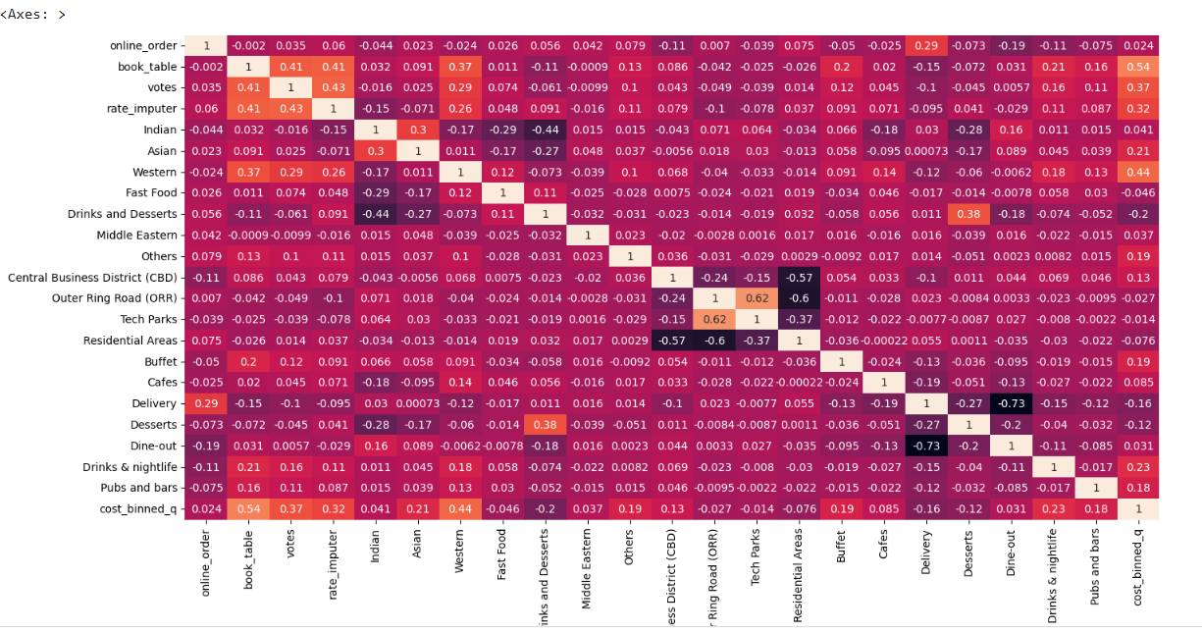
Correlation

Slide 5
Models Scores Comparison
Decision Tree Performance Metrics:
Accuracy: 0.69
Recall: 0.69
F1 Score: 0.69
Random Forest Performance Metrics:
Accuracy: 0.64
Recall: 0.64
F1 Score: 0.64
XGBoost Performance Metrics:
Accuracy: 0.56
Recall: 0.56 F1 Score: 0.56
Support Vector Machine Performance Metrics:
Accuracy: 0.37
Recall: 0.37 F1 S
core: 0.35

Slide 6
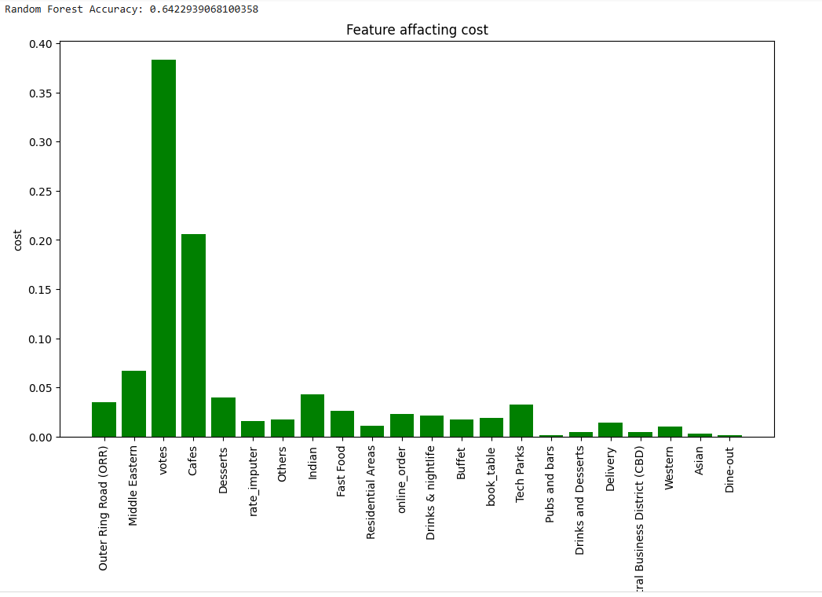
Decision Tree Model

Slide 7
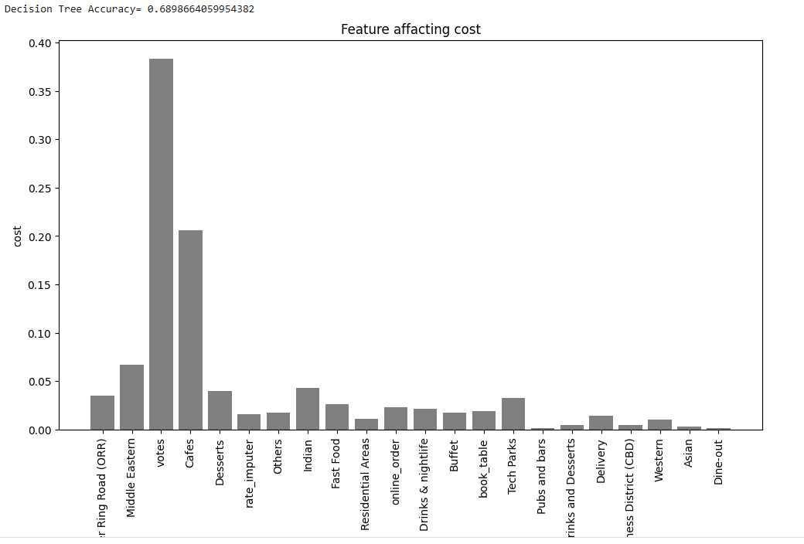
Random Forest Model

Slide 8
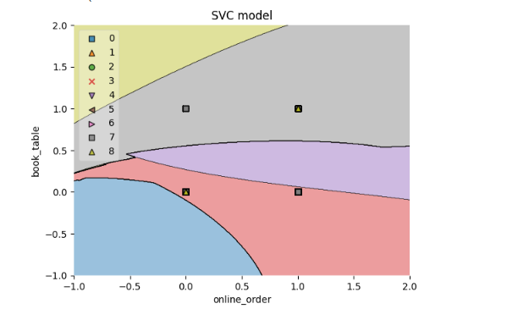
SVC Model

