Slide 1
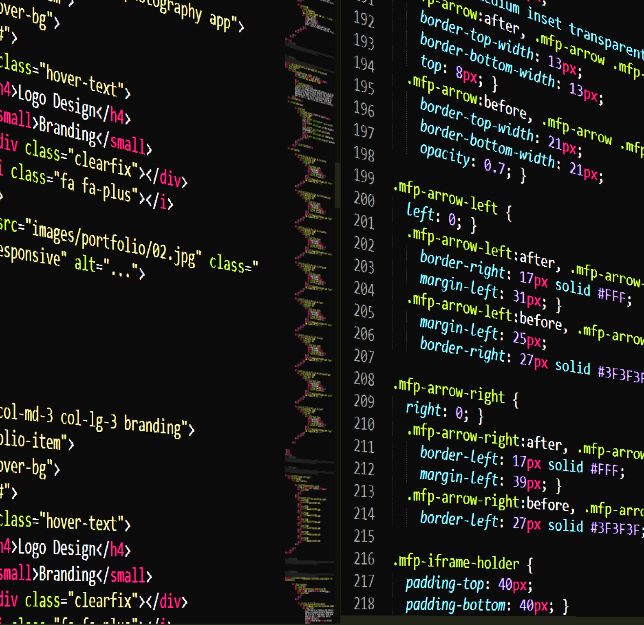
WORKSHOP
CSS PRACTICE
https://negativespace.co/code-html-css-editor/

Slide 2
THE BRIEF
CLASSIC ALBUMS
Essential additions to your music collection
Classic Albums
Essential additions to your music collection
An opinionated collection of the greatest albums of all time.
Each entry in the collection needs to include basic information (artist, track list, etc) along with a short description designed to inspire readers to seek out the album and have a listen.
The site is planned to launch as an MVP, with the bare minimum of features.
Over time, the site is expected to grow, with new functionality to be added incrementally.

Slide 3

MVP
Minimum Viable Product
One album only.
No navigation
No external content, databases, etc.
Album Info
Album name
Year of release
Artist
Image of cover art
Track listing (title and duration)
Description of the album
Other info
Classic Albums branding in header and footer
Links to Privacy Policy and Terms and Conditions
Basic Contact Us link using mailto: protocol
KEEP
IT
SIMPLE,
SUCKA
https://www.wallpaperflare.com/band-music-kiss-wallpaper-yfku

Slide 4
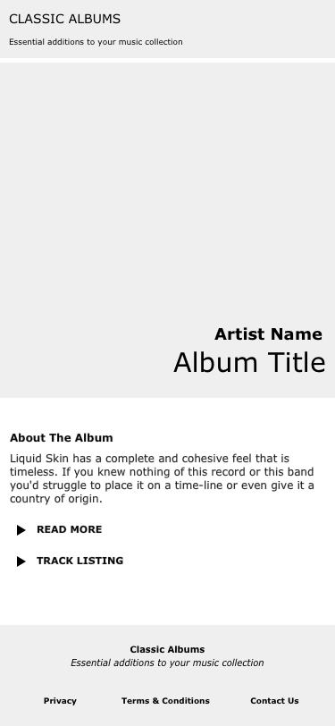
WIREFRAMES

Slide 5
PAGE HEADER
ARTICLE
HERO
SUMMARY
MORE INFO
PAGE FOOTER

Slide 6
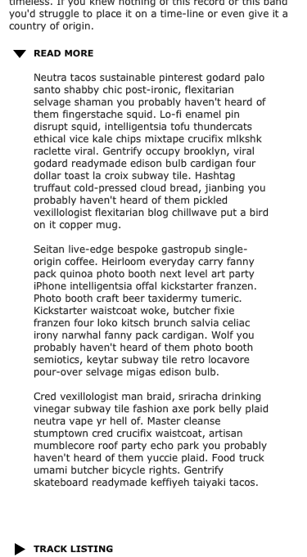
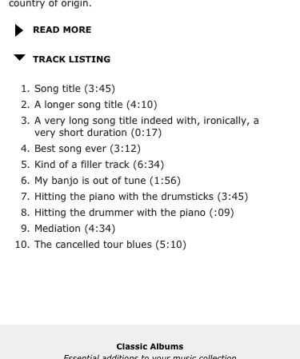
Album Cover Art
Hide/reveal additional text via accordion/toggle UI
Title and Artist overlaid above cover art image

