Slide 1
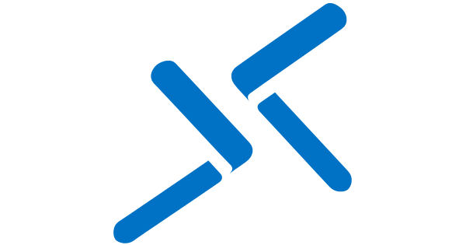


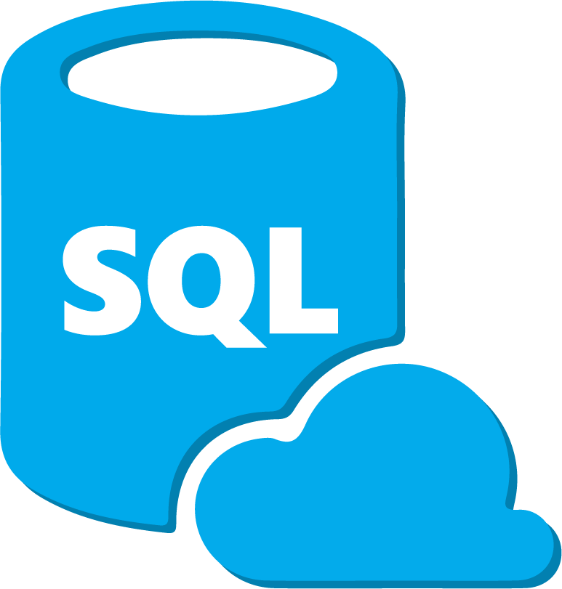





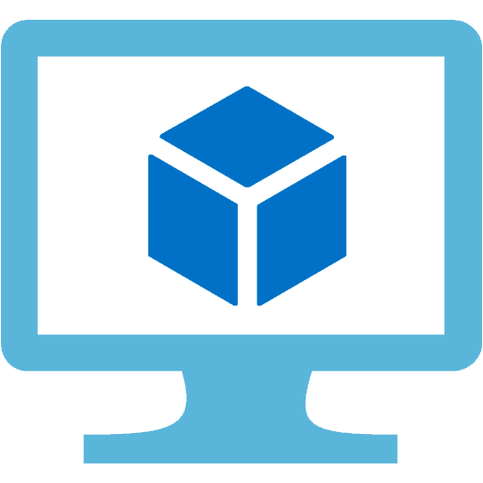

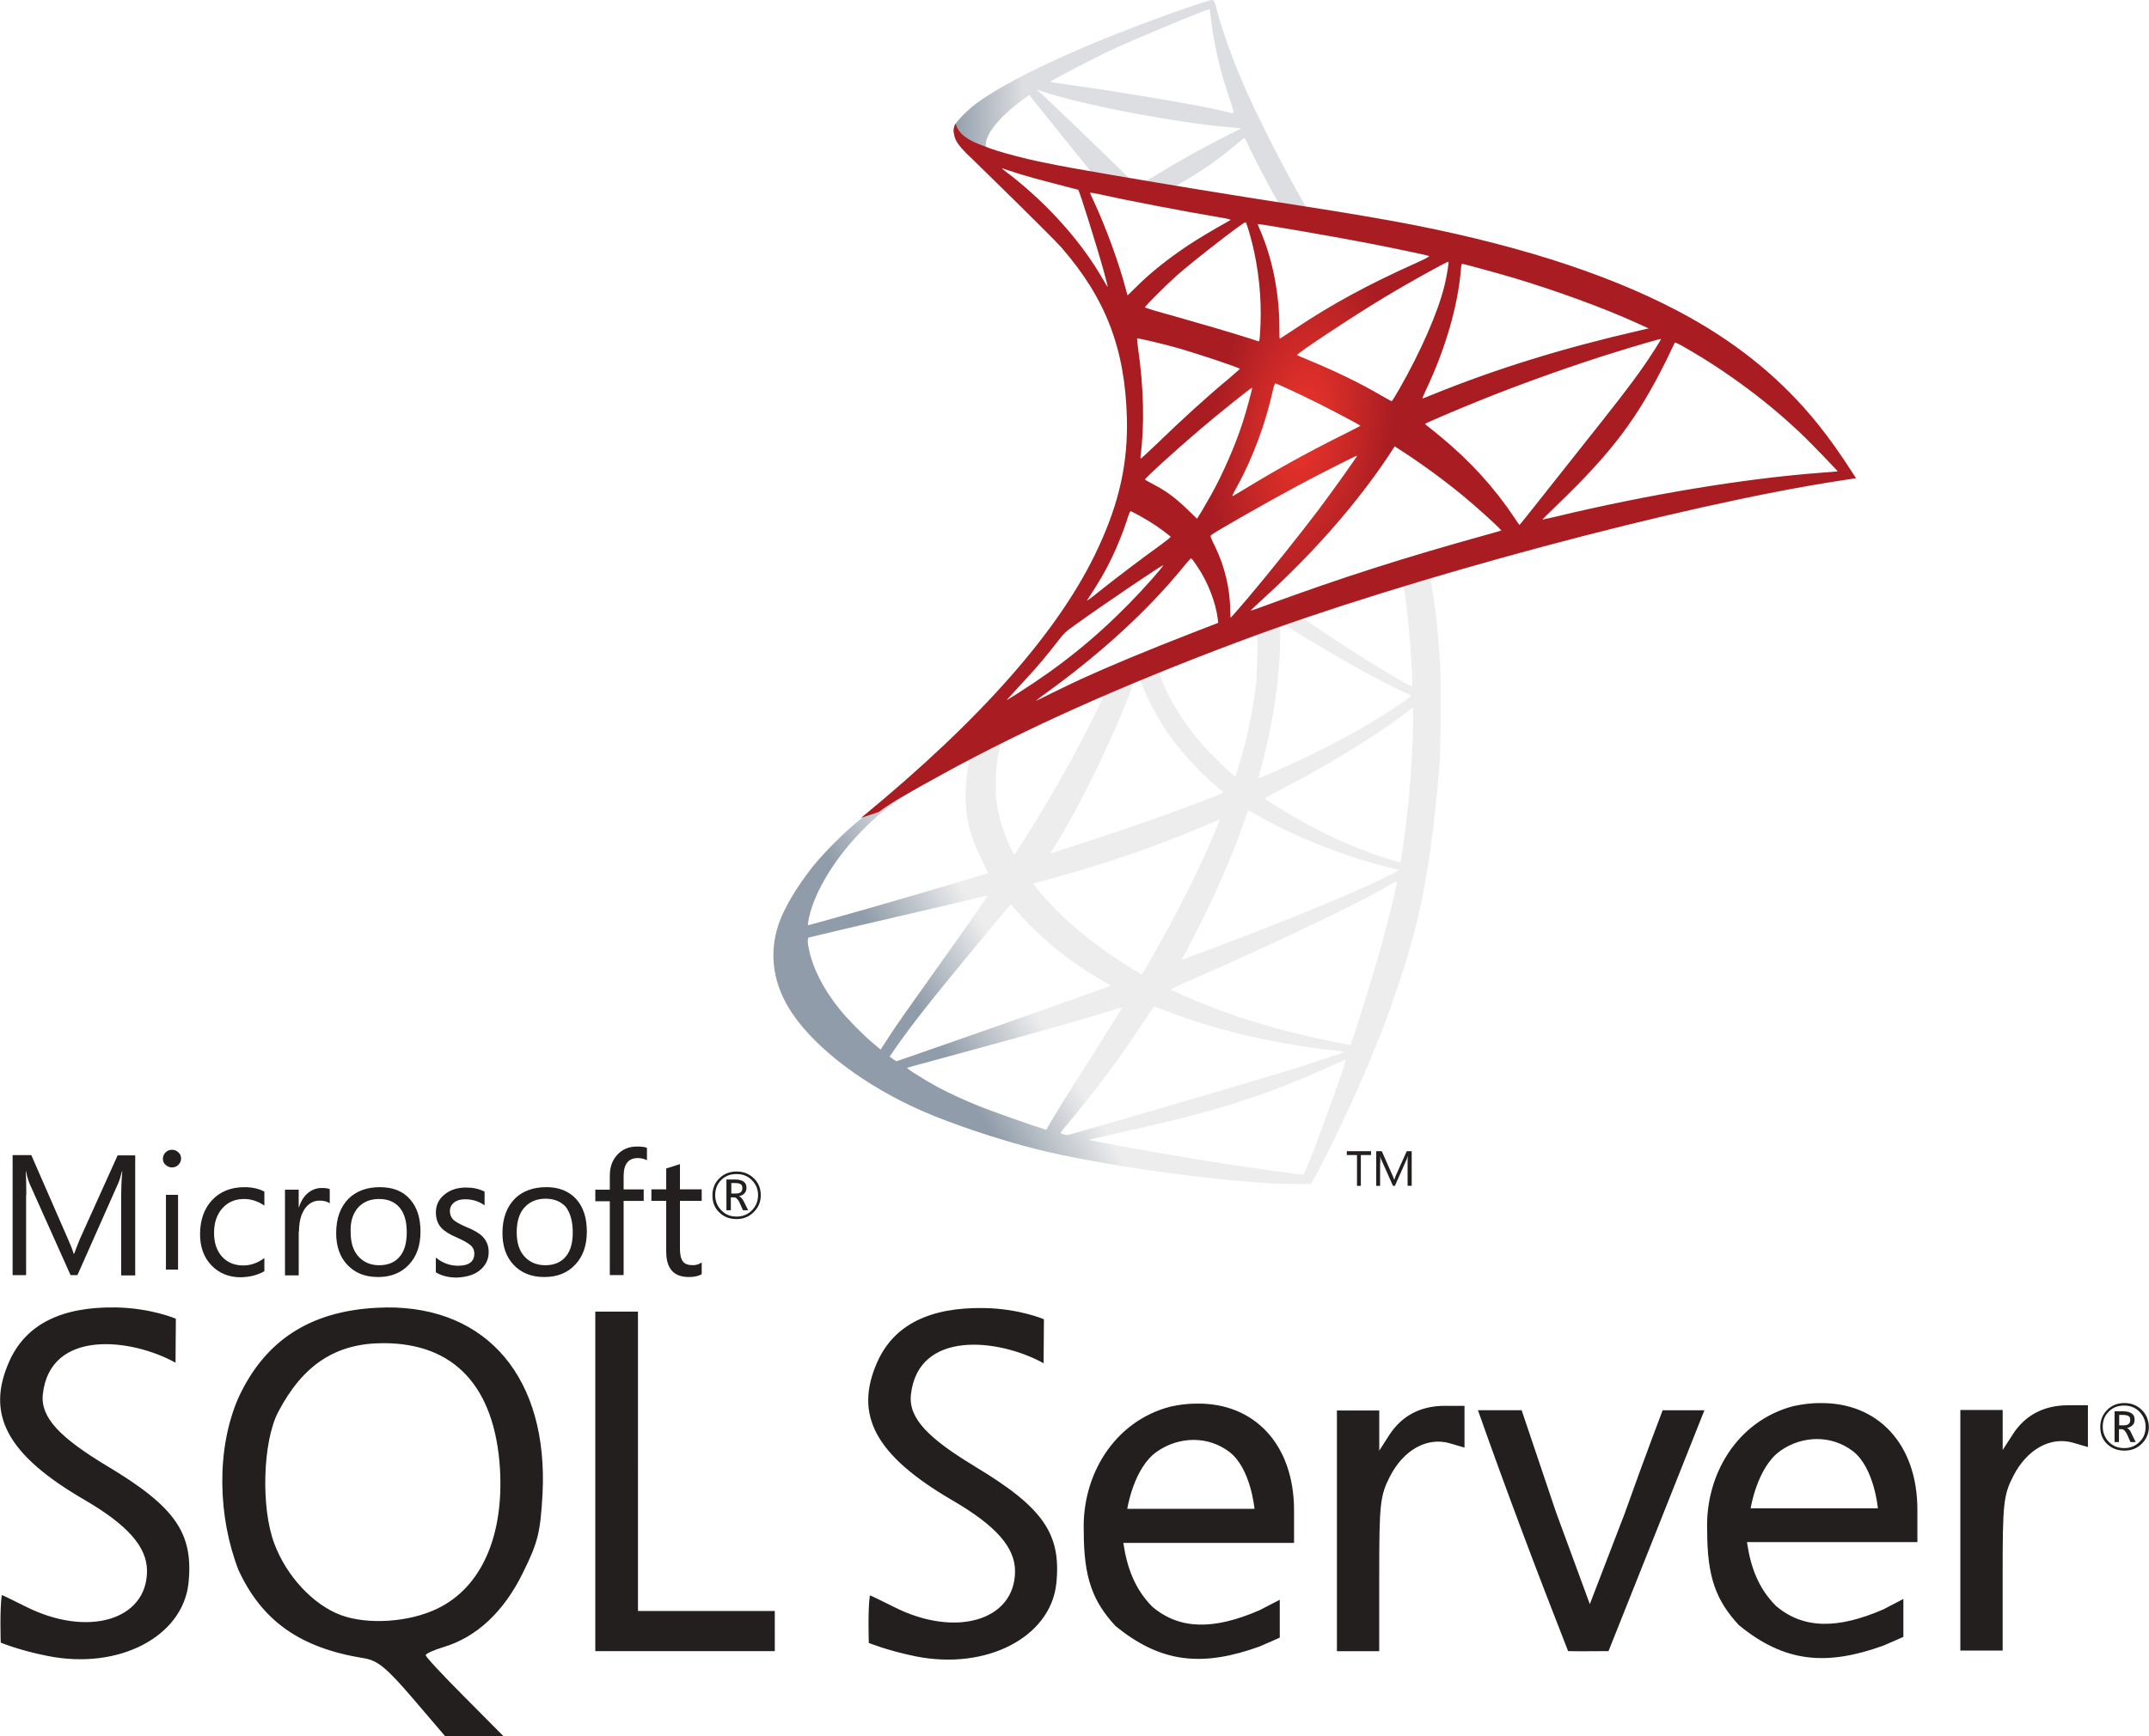

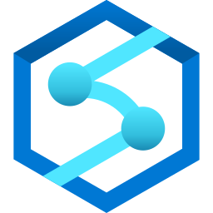
Azure Data Services Go Fast Lockbox
On Premise Network
Azure Analytics Lockbox
Azure Bastion
Meta Data Database
Orchestration Function
Data Factory
ADS Go Fast Web App
Integration Runtime (B)
Transient In
Integration Runtime (A)
Data Lake
Power BI
Gateway
PowerBi.com
Azure ML
Azure SQL
Synapse
Notes:
Each lockbox provides a ready to go environment for storing, exploring, processing and visualizing data. At the core is a multi-zone data lake which allows participants to store and organize both structured and unstructured data. The data lake takes advantage of the infinite scale and rich feature set provided by Azure Storage. Participants are able to explore the data held within their data lake using a variety of different tools. Azure Synapse analytics comes preconfigured and connected to the lake and allows for rich, multilanguage user experience with strong support for both SPARK and SQL. Power BI is also pre-provisioned and allows less technical information workers to explore the lake using low-code / no-code tools. For data scientists, the lockbox contains Azure Machine Learning workspaces which supports many popular data science languages, frameworks and libraries.
Monitoring, management and governance are not forgotten, and the lockbox comes pre-built with best-in-class capabilities in this regard. Azure Purview provides information discovery, automatic classification, cataloging and governance across not only the data lake but also the processing and visualization tools. Azure monitor and Azure advisor ensure that the environment is within cost budgets, aligned to best practices and policies and secure.
It is expected that common activities for lockbox participants will include moving data into and out of the lockbox, and orchestrating processing or transformation of that data. To accelerate and assist with this process the lockbox comes pre-configured with an opensource, meta-data driven data pipelining and orchestration framework known as the Azure Data Services Accelerator. This framework enables both technical and non-technical users to easily configure once-off or re-occurring data ingestion and processing activities via a web based front end. Behind the scenes, the framework is constructed using standard Azure PAAS services which ensure that it is saleable, maintainable and easily extensible.
From a networking perspective, services within the lockbox are network isolated to ensure the highest level of security.

