Slide 1



Briefly
Concise.
Tailored Brief News Articles Feed
Gil Kravitz
Dor Edelman
Ofek Ram Smadja
Maor Halevi
Github Repo

Slide 2

Briefly
Product Concept
Our product is a news platform that offers brief summaries of breaking news from various sources. Users can quickly access news highlights in short snippets, providing a user-friendly and time-saving method to stay informed without extensive reading or navigation. Our goal is to provide a smooth news consumption experience that keeps users informed about the latest news.

Slide 3
Briefly
From Problem To Solution
Problem
Current news applications overwhelm users with generic news feeds and lengthy articles, causing information overload. This makes it difficult for users to stay updated on topics that interest them without spending much time scrolling and reading.
Why It Matters
In today’s fast-paced world, people demand a time-efficient way to stay informed. They want quick access to relevant news without the hassle of navigating through extensive content.

Slide 4
Briefly
From Problem To Solution
Solution - REDUCE. SCROLLING. TIME.
Your most precious asset is time; our platform allows the users to reduce scrolling time and accomplish more in less time. Our solution not only keeps the users informed but does so in a way that respects their time and attention.
What Makes Us Better?
Unique Feature
Technological Edge
Our platform offers personalized feeds to users, delivering concise summaries of the latest news articles. This ensures that users receive content tailored to their interests in a brief and engaging manner.
OUR personalized news summaries feed reduce information overload and enhance user engagement by focusing on what matters most.
Utilizes advanced AI algorithms to curate and summarize news, ensuring relevancy.

Slide 5
Briefly
Market Analysis
Customers
Our target customers include busy professionals, students, and anyone who values time efficiency and wants to stay updated with the latest news. These individuals prefer concise information over lengthy articles, making Briefly an ideal solution for their needs
Market Size
In Israel, the digital news market is robust, with a significant portion of the population consuming news online. According to recent statistics, approximately 60% of Israelis above the age of 20 get their news online. With a population of about 10 million, and approximately 70% in that age range, this represents a potential market of over 4.5 million users who could benefit from a platform like Briefly.

Slide 6
Briefly
Market Analysis
Competitors
Our primary competitors include traditional Israeli news websites like Ynet, Haaretz, N13, and N12, which provide lengthy articles and generic news updates. Additionally, we compete with international platforms like Google News and MSN, which offer aggregated news services but may only sometimes focus on Hebrew content.
Another news platform we compete with is Telegram channels, which provide breaking news titles without further elaboration.
Our unique selling proposition is the delivery of personalized, concise news snippets in Hebrew, catering specifically to the Israeli audience's need for quick, relevant information.

Slide 7
Briefly
Market Analysis
Market Gap Description
There is a clear need for a more efficient way to consume news, one that allows users to quickly access relevant information without the hassle of extensive reading. This gap highlights the demand for a streamlined and user-friendly news consumption experience that respects users time and attention.

Slide 8
Briefly
Roles And Responsibilites
Design . Front-End . Cloud Architecture
Gil Kravitz
Tech-Stack & Tools : Figma ,TypeScript, React-Native , AWS Cloud Services
Designing and developing the front-end of the application.
Planning and implementing the cloud infrastructure using AWS services.

Slide 9
Briefly
Roles And Responsibilites
App Api Service.
Maor Halevi
Tech Stack & Tools : C# (ASP.NET and Entity Framework), Docker, PostgreSQL
Developing and maintaining a scalable and efficient API service.
Containerizing the API service using Docker for easy deployment and management.
Facilitating smooth integration between the front-end and back-end systems.

Slide 10
Briefly
Roles And Responsibilites
Scraping Service.
Ofek Smadja
Tech Stack & Tools : Python + beautiful soup, Docker, PostgreSQL
Developing a robust web scraping service to extract data from various sources.
Containerizing the scraping service using Docker to ensure consistency and reliability.
Optimizing the service to efficiently gather relevant data with minimal latency.

Slide 11
Briefly
Roles And Responsibilites
AI Integration Service.
Dor Edelman
Tech Stack & Tools : Python, Docker, OpenAI, Gemini, PostgreSQL
Developing code that uses AI models for text embeddings using OpenAI and generating article summaries using Gemini.
Leveraging advanced algorithms to enhance the relevance and quality of news summaries and text similarity.
Containerizing AI services to ensure modularity and scalability.

Slide 12
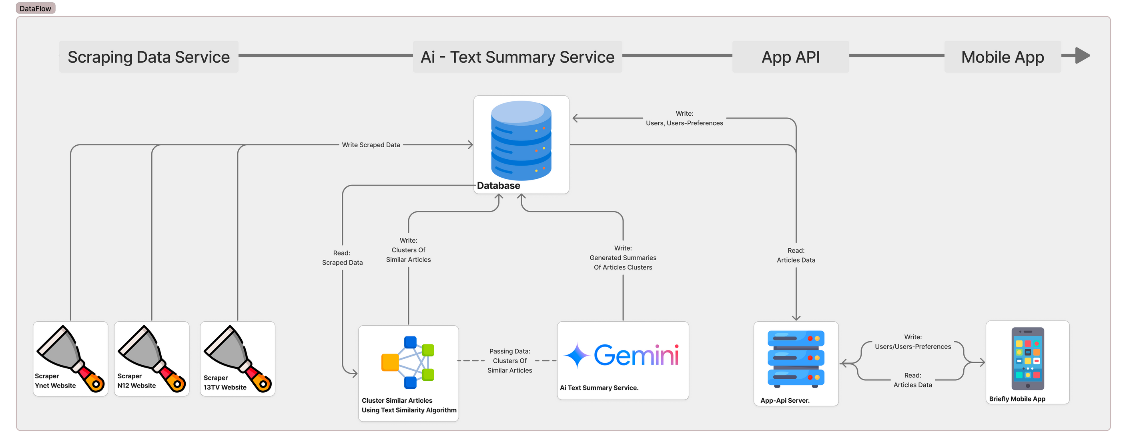
Briefly
Data Flow

Slide 13
Briefly
Data Flow
1. Scraping Data Service
2. Database
3. Cluster Similar Articles Using Text Similarity Algorithm
Scrapers (Ynet, N12, 13TV) :These scrapers collect articles from the specified websites and write the scraped data into the database.
Acts as a central repository for storing scraped data, clusters of similar articles, generated summaries, users, and user preferences.
Reads the scraped data from the database, identifies similar articles using a text similarity algorithm, and writes the clusters of similar articles back into the database
4. AI Text Summary Service (Gemini)
5. App API Server
6. Briefly Mobile App
Receives clusters of similar articles from the clustering component, generates summaries for these clusters, and writes these summaries back into the database.
The App API Server reads article data from the database and serves this information to the mobile app. Additionally, it writes user data and user preferences back into the database.
The end-user interface that reads articles data from the App API server, allowing users to view summarized articles. It also sends user preferences to the App API server

Slide 14
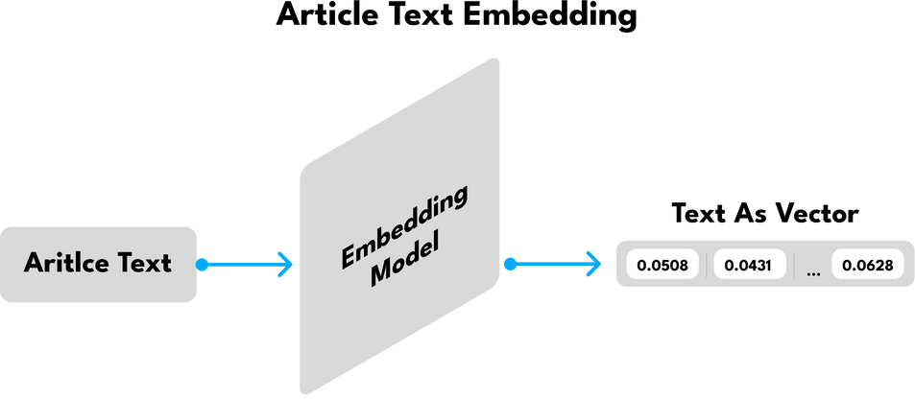
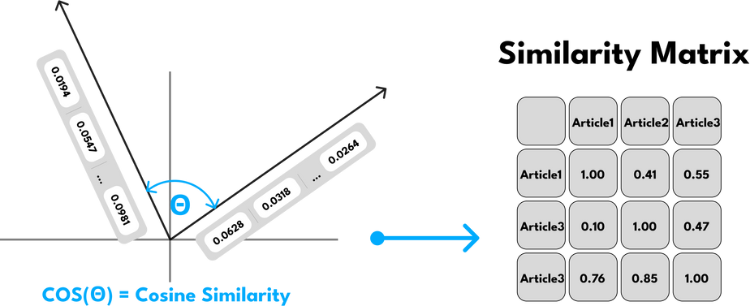
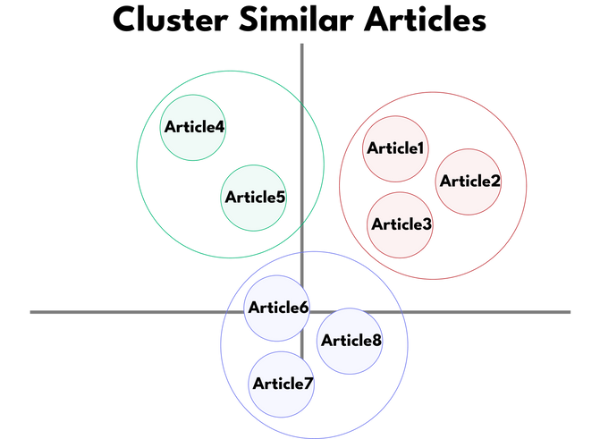

Briefly
The Product Core
Each article get into Open-AI Embedding Model
Cosine similarity is applied to each pair of article vectors to calculate the similarity matrix.
Group articles into clusters when their similarity score exceeds a specified threshold.

Slide 15
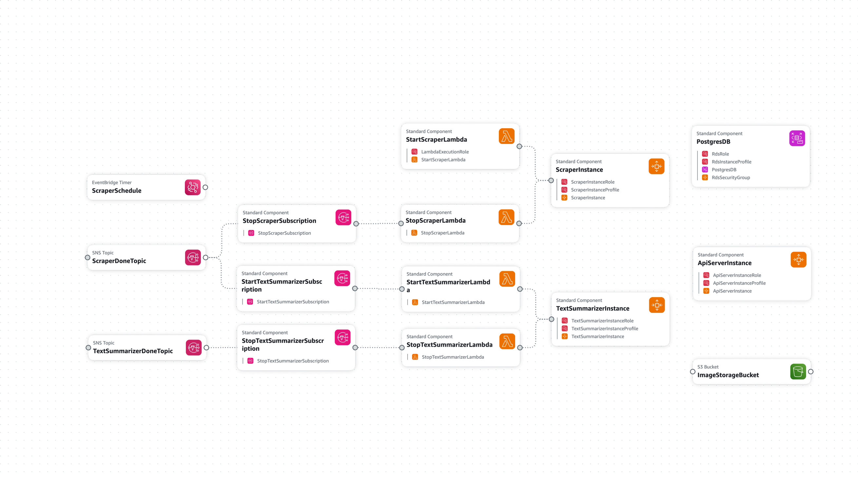
Briefly
Cloud Architecture

Slide 16
Briefly
Cloud Architecture
1. EventBridge Timer
2. ScraperInstance
3. ScraperDoneTopic
triggers StartScraperLambda to start the scraping process.
performs the scraping, and upon completion sends a notification to ScraperDoneTopic
Triggers both:
StopScraperLambda to stop the scraper process StartTextSummarizerLambda to start the summarization process.
4. TextSummarizerInstance
5. TextSummarizerDoneTopic
6. PostgresDB
performs text summarization. and completion sends a notification to TextSummarizerDoneTopic.
triggers StopTextSummarizerLambda to stop the summarizer instance.
stores all essential data including scraped articles, summaries, user data, and preferences, ensuring a smooth flow of information within the system.
7. S3 Bucket
8. ApiServerInstance
stores and manages images related to articles
acts as a bridge between the database and the mobile app, handling data retrieval and storage for user interaction.

Slide 17
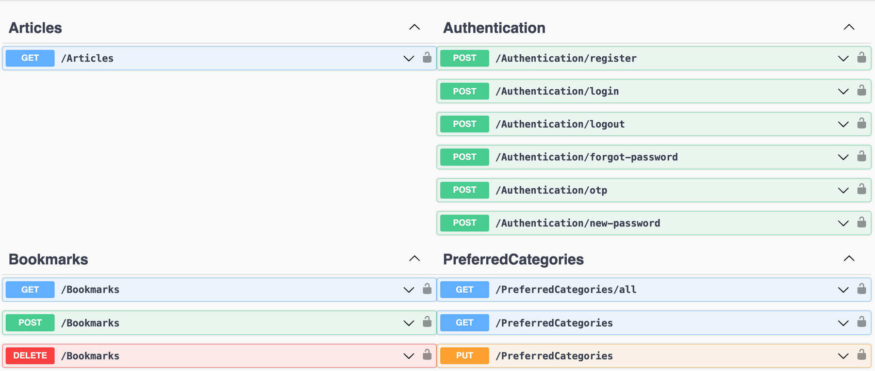
Briefly
API Structure
Backend Swagger Api Documentation

Slide 18
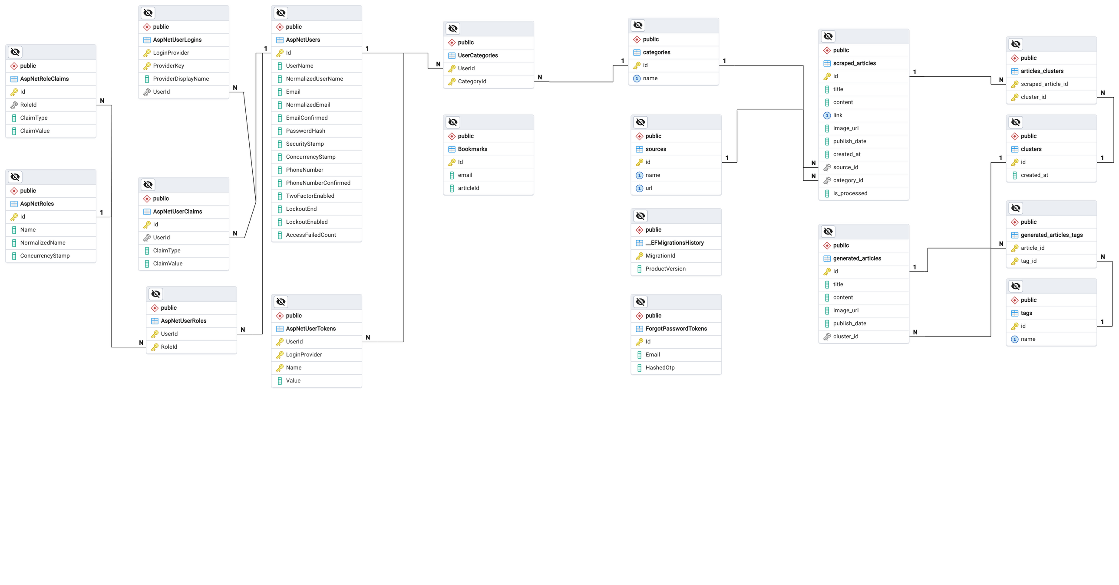
Briefly
Database Structure

