Slide 1
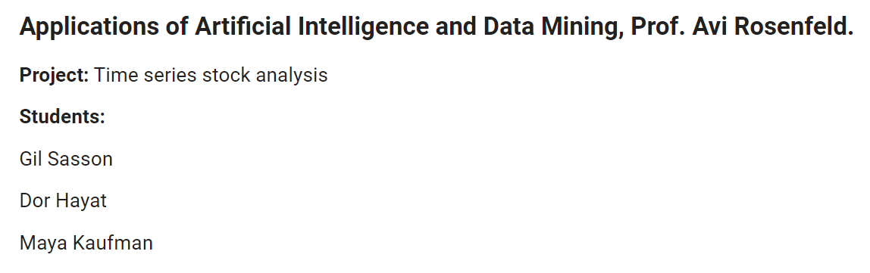
“FAANG” companies (Facebook, Amazon, Apple, Netflix, Google) database
source: https://www.kaggle.com/aayushmishra1512/faang-complete-stock-data

Slide 2

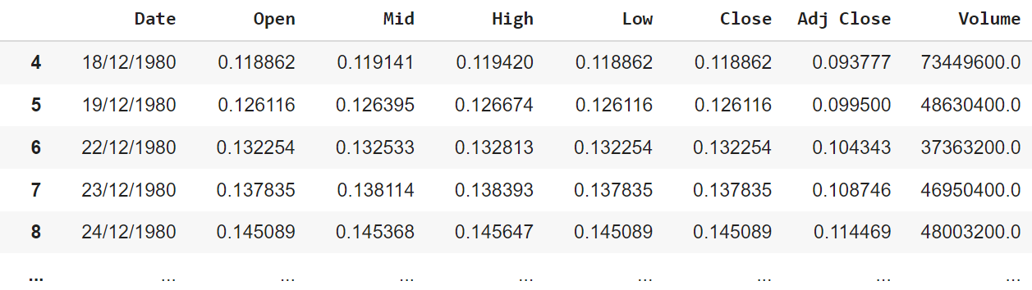

Target (0 or 1)
Predict if the stocks’ price went up the next day.
$$Raise \left[ j \right]=1 if Adj Close \left[j+1\right]>Adj Close [ j ]$$
$$Raise \left[ j \right]=0 if Adj Close \left[j+1\right]≤Adj Close [ j ]$$
Raw data

Slide 3
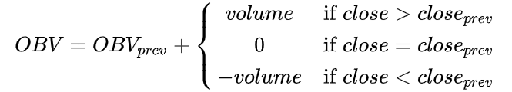
Stock Market Technical Analysis Indicators that were used in this project
On-balance volume (OBV) – Is an indicator intended to relate price and OBV is based on a cumulative total volume [1]
Relative strength index (RSI) – Is intended to chart the current and historical strength or weakness of a stock or market based on the closing prices of a recent trading period [2]
Simple Moving Average (SMA) – Is the unweighted mean of the previous k data-points, we used the Open prices to calculate this indicator [3]

Slide 4
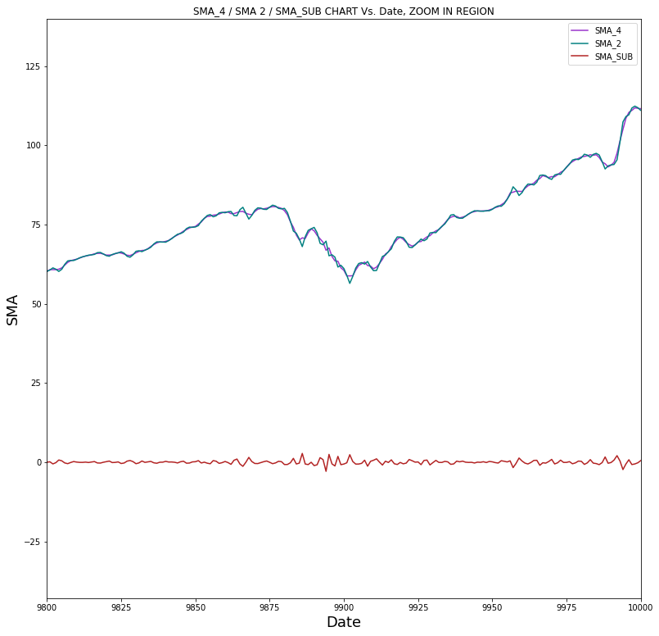
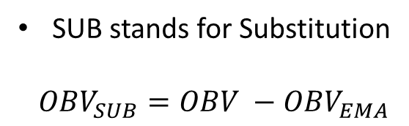
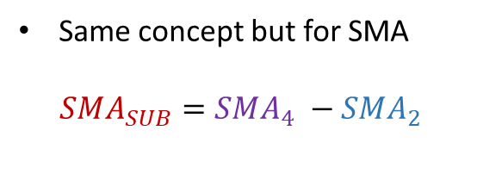
EMA stands for Exponential Moving Average
SUB stands for Substitution
$OBV_{SUB}=OBV −OBV_{EMA}$
Same concept but for SMA
$$SMA_{SUB}=SMA_{4} −SMA_{2}$$

Slide 5
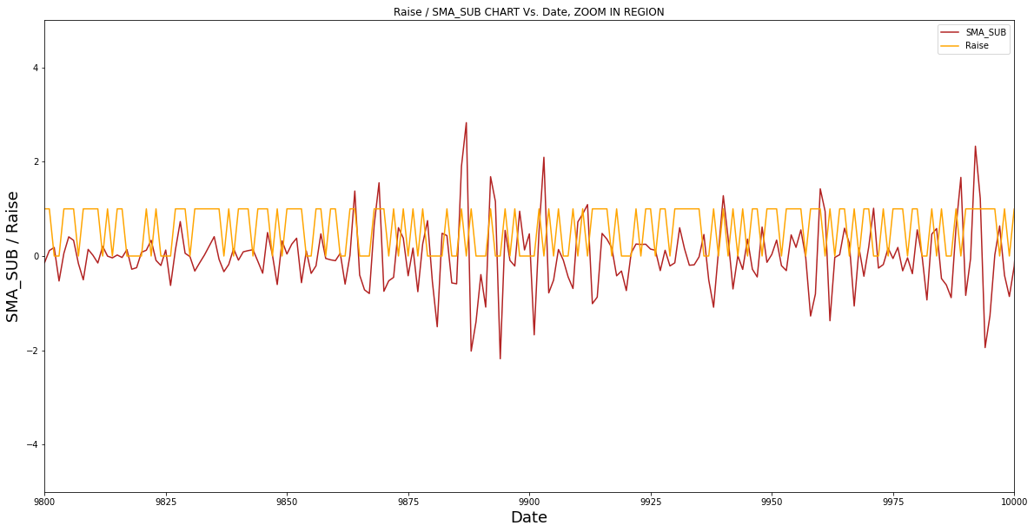
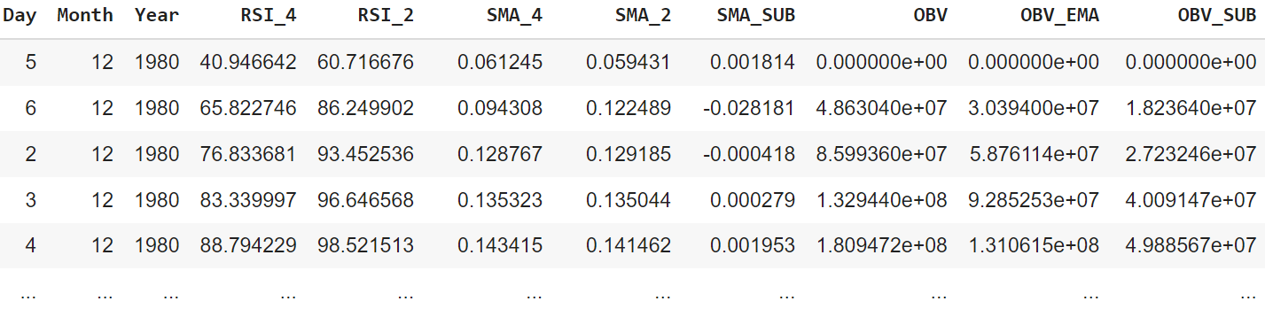
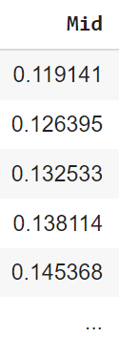
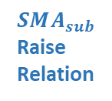
$$SMA_{sub}$$
Raise
Relation
Updated
Tabular
Data

Slide 6
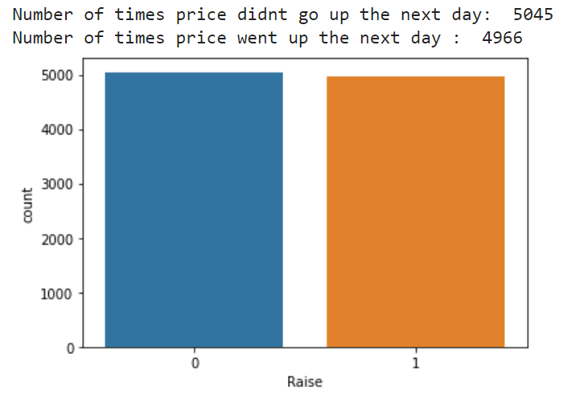
Accuracy without any model (~50%)
Can be compared to the toss of a coin – One side is slightly favored, Since the images on the two sides of actual coins are made of raised metal, the toss is likely to slightly favor one face or the other if the coin is allowed to roll on one edge upon landing. Coin spinning is much more likely to be biased than flipping, and conjurers trim the edges of coins so that when spun they usually land on a particular face [4].

Slide 7

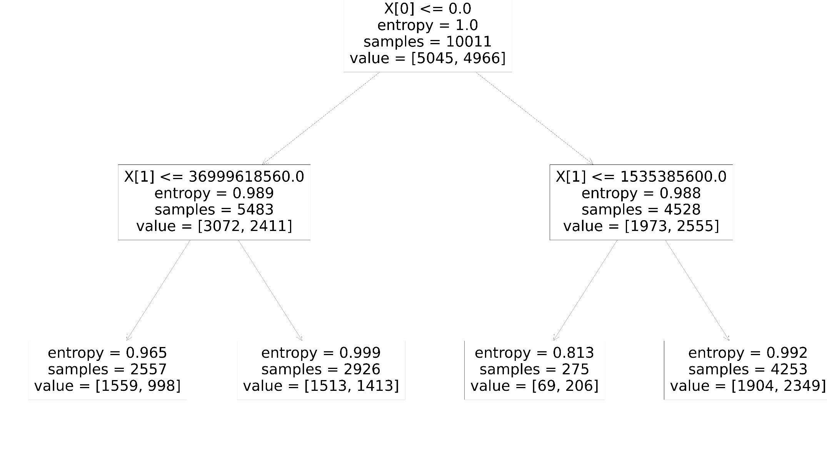






Decision Tree Model
Dealing with overfitting
Few parameters reducing the variance of the Decision Tree
True:
$$SMA_{SUB}≤0$$
False:
$$SMA_{SUB}>0$$
Testing our DT model
Cross validation and confusion matrix, trying different
decision tree depths
with different features
True:
OBV$≤3.7⋅10^{10}$
False:
OBV$>3.7⋅10^{10}$
True:
OBV$≤1.535⋅10^{8}$
False:
OBV$>1.535⋅10^{8}$
Chosen features
SMA_SUB
OBV
1559 > 998
1513 > 1413
69 < 206
1904 < 2349
Price doesn’t go
up the next day
Price doesn’t go
up the next day
Price goes up the next day
Price goes up the next day

Slide 8
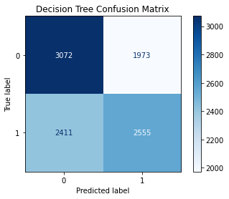
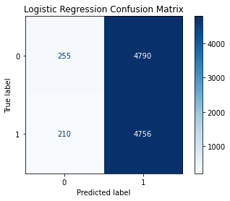
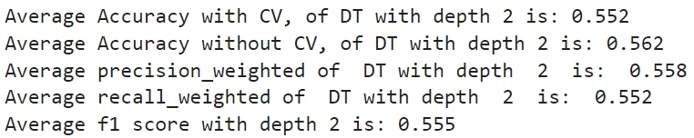
Decision Tree Results
Logistic Regression
Results

Slide 9
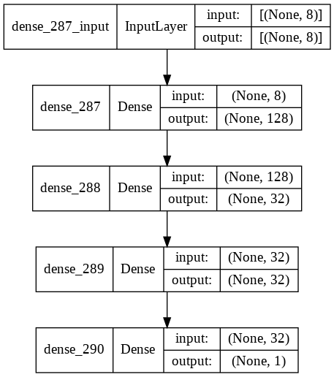
Using Keras to Build and Train Neural Networks
Input size is 8-dimensional
3 hidden ReLU activation layers with a total of 192
hidden nodes (128-32-32)
The final layer has just one node with a sigmoid activation
SGD optimizer with learning rate of 0.001, batch size 128
Binary-cross-entropy loss function
Early Stopping to avoid overfitting
Features, X = [‘Day’, ‘SMA_SUB’, ‘RSI_2’, ‘RSI_4’, ’OBV’, ‘OBV_SUB’, ’Open’, ‘Mid’*]
*Note: $Mid= \frac{Low+High}{2}$

Slide 10
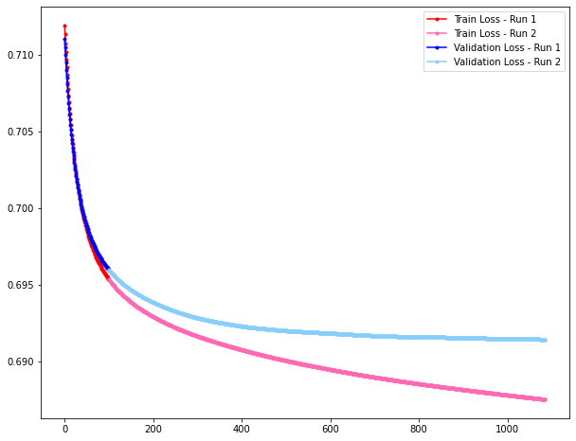


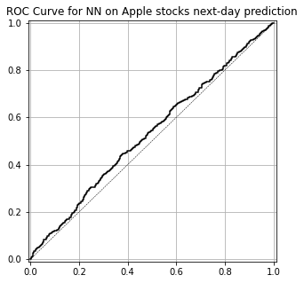
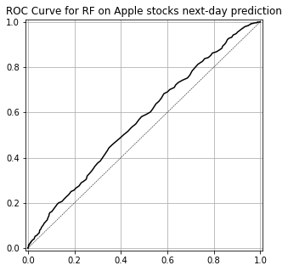
Neural Network & Random Forest results
We used a standard scaler normalizer in order to provide numerical stability during the training of our neural network
We showed that without the aforementioned stock market indicators we get an accuracy of 0.51 using NN
Neural Network model
Random Forest model

Slide 11
References
[1] OBV, https://en.wikipedia.org/wiki/On-balance_volume
[2] RSI, https://en.wikipedia.org/wiki/Relative_strength_index
[3] SMA, https://en.wikipedia.org/wiki/Moving_average
[4] Coin toss, https://en.wikipedia.org/wiki/Coin_flipping

