Slide 1
The evolution of human-specific disease
Sarit Moses & Gil Sasson
Supervised by Dr. David Gokhman
T.A.: Nachshon Aiyges

Slide 2
Background: human specific diseases
Chimps (and other great apes) are the closest to us, evolutionary speaking
They confer the model organism closest to humans
Some diseases are not present in chimps – why?
Could this tell us something about our own evolution and how it happened?
When we make changes in some place, they can affect (positively or negatively) other parts of the system
changes are most likely in regulatory changes and not mutations

Slide 3
Explain the idea of using hybrid human-chimp cells for studying regulatory evolutionary changes

Slide 4
Project outline – here comes infographics about our pipeline
Start from documentation of human specific diseases (varki, gokhman list)
Get list of related celltypes for each of the diseases
Check for GWAS data and ClinVar data to identify Associated genes
Use hybrid data
Find differences between disease-associated genes and non disease-associated genes
We tested 31 diseases in various celltypes, will focus on schizophrenia since this is where we have interesting results

Slide 5
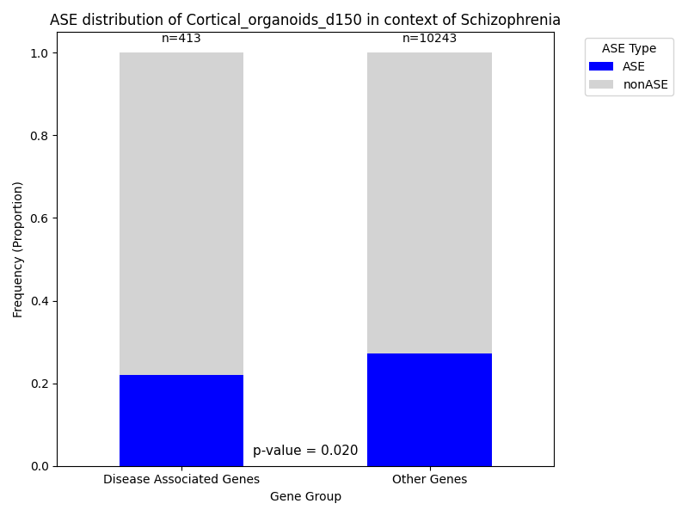
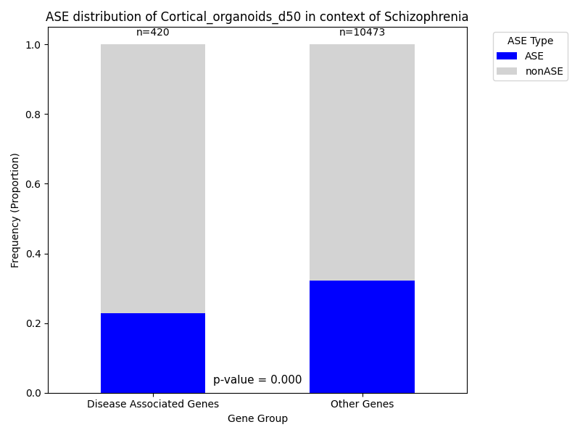
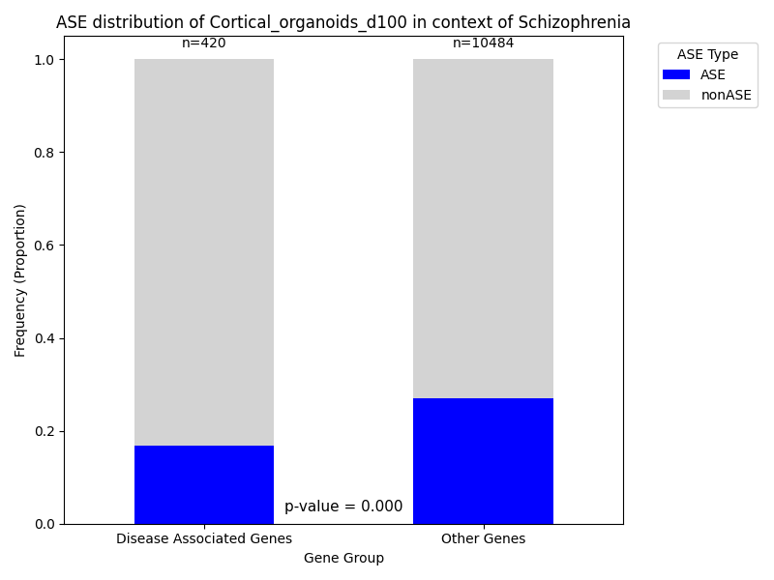
Less ASE genes in the disease-related list

Slide 6
Correlations: the bigger impact, the less chance to find ASE in disease-related genes
Check beta/OR for stronger relationship between disease and gene
Check LFC to check size of ASE impact (use absolute values of LFC)

Slide 7
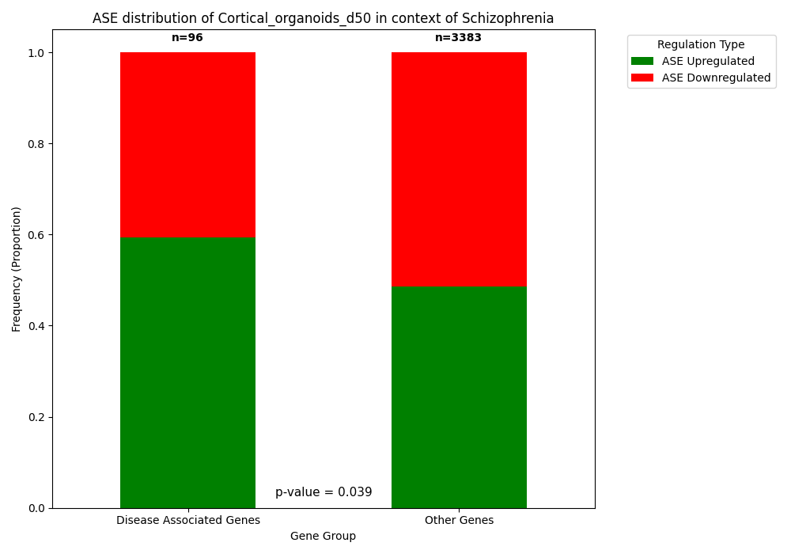
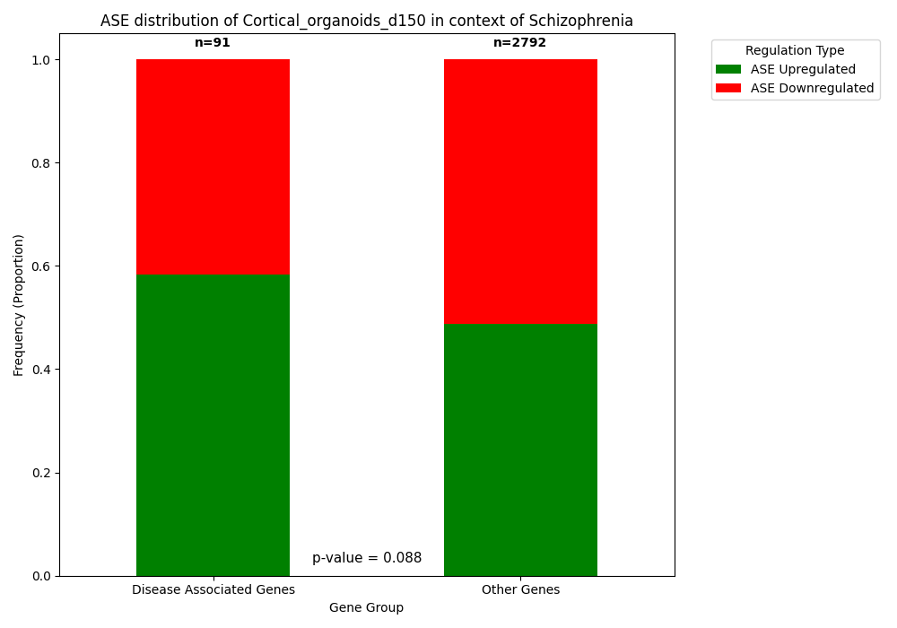
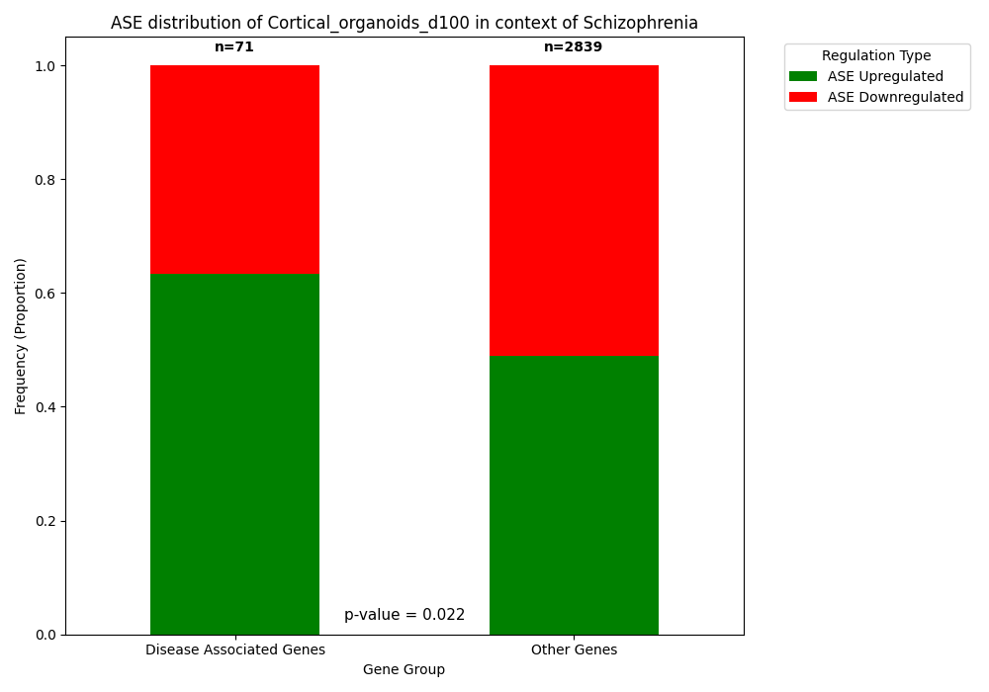
Strong selection against downregulation of genes

Slide 8
Correlation: negative LFC has less chance to find disease-related ASE

Slide 9
The effect is stronger in early-development genes?

Slide 10
discussion
Strong selection against regulatory changes in disease-related genes
The selection is stronger against downregulation – usually genes are related to diseases when they are dysfunctional (LOF = no expression = downregulation)
This effect is strongest in schizophrenia (although exists to some extent in other diseases as well) because of the very strong fitness impact (impacts at a young age and they don’t get marriesd)
Cahnges in early development of the brain = probably has many effects on different pathways, so “positive” changes in one direction caused this appearance of schizophrenia which is “negative”

Slide 11
To be continued
Pathway enrichment analysis
When are these genes expressed (developmental stages)?

Slide 12
thanks

