Slide 1


The evolution of human-specific diseases
Sarit Moses & Gil Sasson
Supervised by Dr. David Gokhman
T.A.: Nachshon Egyes

Slide 2


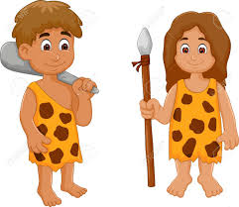
The origin of human-specific diseases
Chimp-
specific
traits
Shared
traits
Human-
specific
traits
Genetic changes → human susceptibility
X
X
X
Environment
Life span
Lack of data
Notes:
Chimpanzees are one of our closet relatives, as a result we share many traits, yet we also have numerous characteristics unique to our species.
Among these unique characteristics are diseases that specifically affect humans.
The primary goal of our research is to better understand how evolutionar have shaped these human-diseases.
These differences can be attributed to several factors, such as distinct environmental exposures, longer lifespans in humans, and limited available data on diseases in great apes.
For example, diabetes is a human unique disease. However, evidence show that apes exposed to human-like diets can develop diabetes.
Nevertheless, numerous other diseases remain unexplained by environmental or lifestyle factors alone, indicating that genetic differences play a crucial role in these diseases.

Slide 3
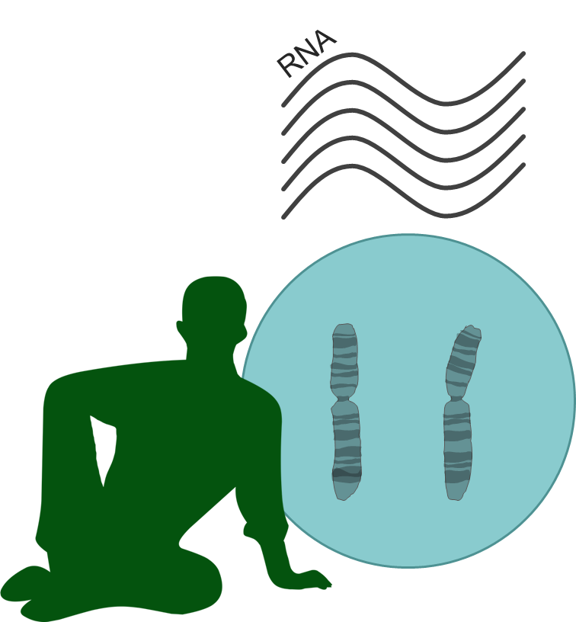
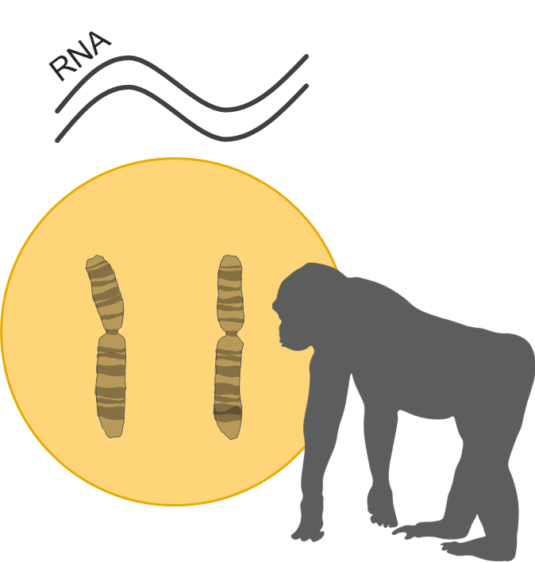
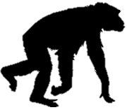
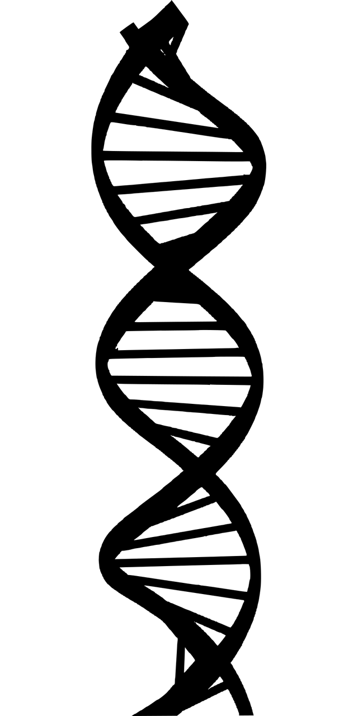
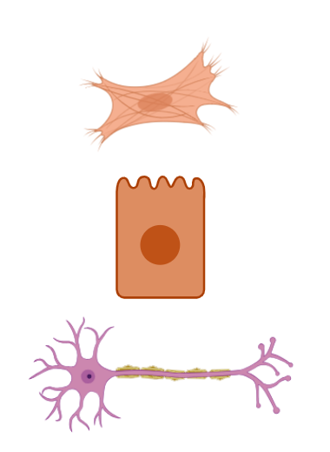



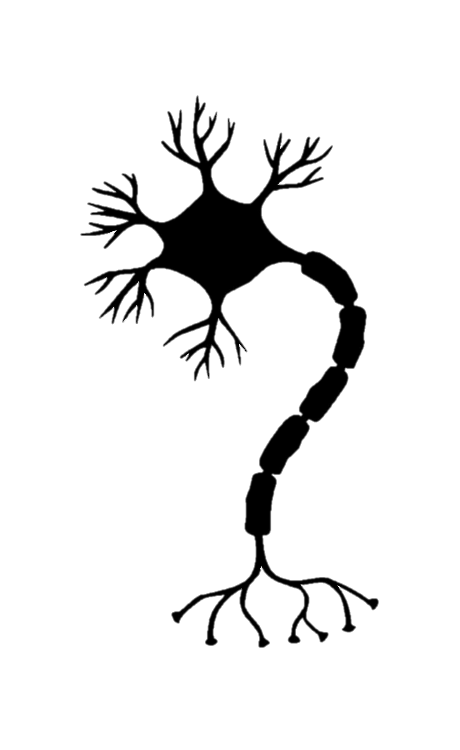
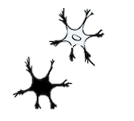

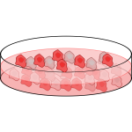
Regulatory changes: the immediate suspect
IPSCs
Evolution
Fusion
Confounders
Environment
Cell-type heterogeneity
Batch
Gokhman et al., Nature Genetics, 2021
Agoglia et al., Nature, 2021
Notes:
Typically, phenotypic differences between closely related species, such as humans and chimps, can be attributed to regulatory changes rather than differences in the coding regions.
Regulatory changes are differences in gene expression levels.
But can we study these regulatory differences?
Observed differences in gene expression could also result from confounding factors, such as environmental variation or technical biases in lab conditions.
To control for these confounders, David’s Lab took pluripotent stem cells derived from humans and chimpanzees and fuse them together, creating hybrid cells containing both genomes.
In these hybrid cells, both genomes share an identical cellular environment. Therefore, any observed difference in gene expression must reflect genetic (rather than environmental) differences.
Because these hybrid cells are pluripotent, they can be differentiated into virtually any cell type, enabling us to study and compare regulatory changes across diverse cell types and developmental stages.

Slide 4
The origin of human-specific diseases
Chimp-
specific
traits
Shared
traits
Human-
specific
traits
Genetic changes → human susceptibility
X
X
X
Environment
Life span
Lack of data
Notes:
Having said that, we can examine the phenotypic component effected by these expression alterations.

Slide 5
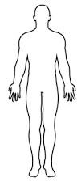
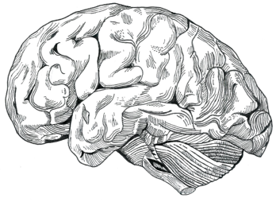
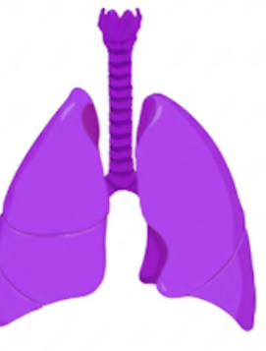
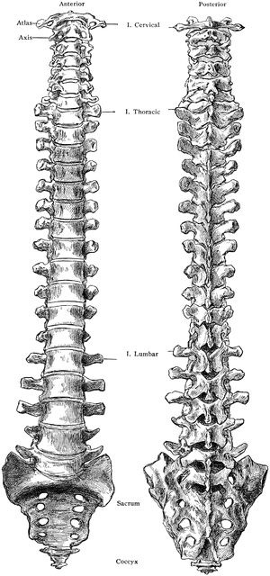

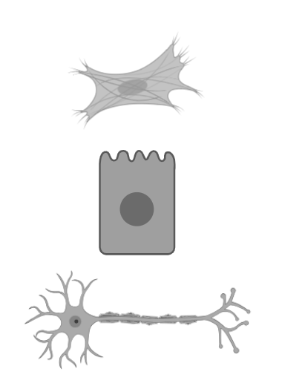
Which diseases can we study using the hybrid system?
Alzheimer’s
Schizophrenia
Bronchial asthma
Sleep apnea
Curate list of human-specific diseases with compatible cell types to the hybrid data we have
Myocardial infractions
Varicose veins
Scoliosis
Osteoporosis
Psoriasis
Carcinoma
Colon diverticulosis
Hemorrhoids
32 diseases
Morning sickness
Premature labor
Notes:
Using our hybrids system, we sought to investigate the genetic basis of human-specific diseases.
To start, we curated a comprehensive list of human-specific diseases, primarily relying on reviews and the existing literature.
we reviewed scientific literature to identify the relevant cell types implicated in each disease.
We then compared these identified cell types against the cell types available in our hybrid cell database.
Following this intersection 32 diseases with matched hybrid cell types. These diseases became our primary candidates for further analysis.

Slide 6

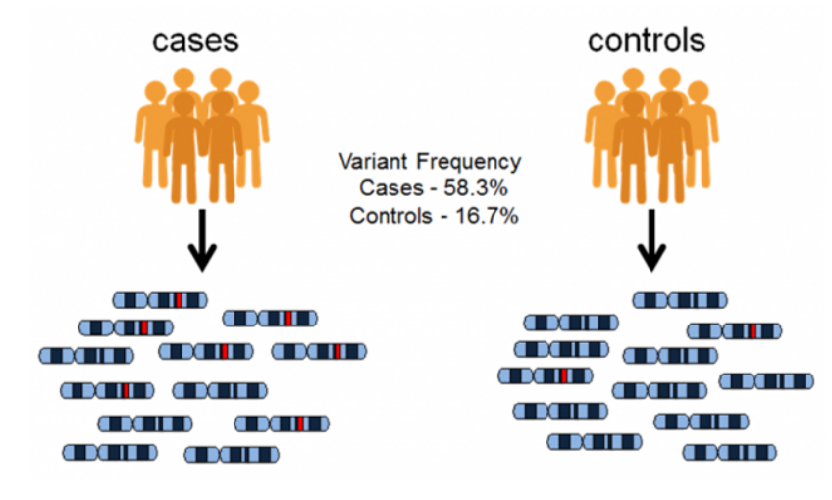
Identifying disease-associated genes
Notes:
After narrowing down our disease list, the next step is identifying the specific genes involved in each disease.
For this task, we utilized the GWAS (Genome-Wide Association Studies) catalog.
GWAS studies identify single nucleotide polymorphisms (SNPs) associated with particular phenotypes.
Each SNP identified through GWAS can be linked to nearby genes, providing a direct association between genetic variants and specific genes relevant to the disease.
By leveraging this catalog, we obtained comprehensive gene lists associated with each of our selected diseases, enabling us to further explore their role in human susceptibility.

Slide 7
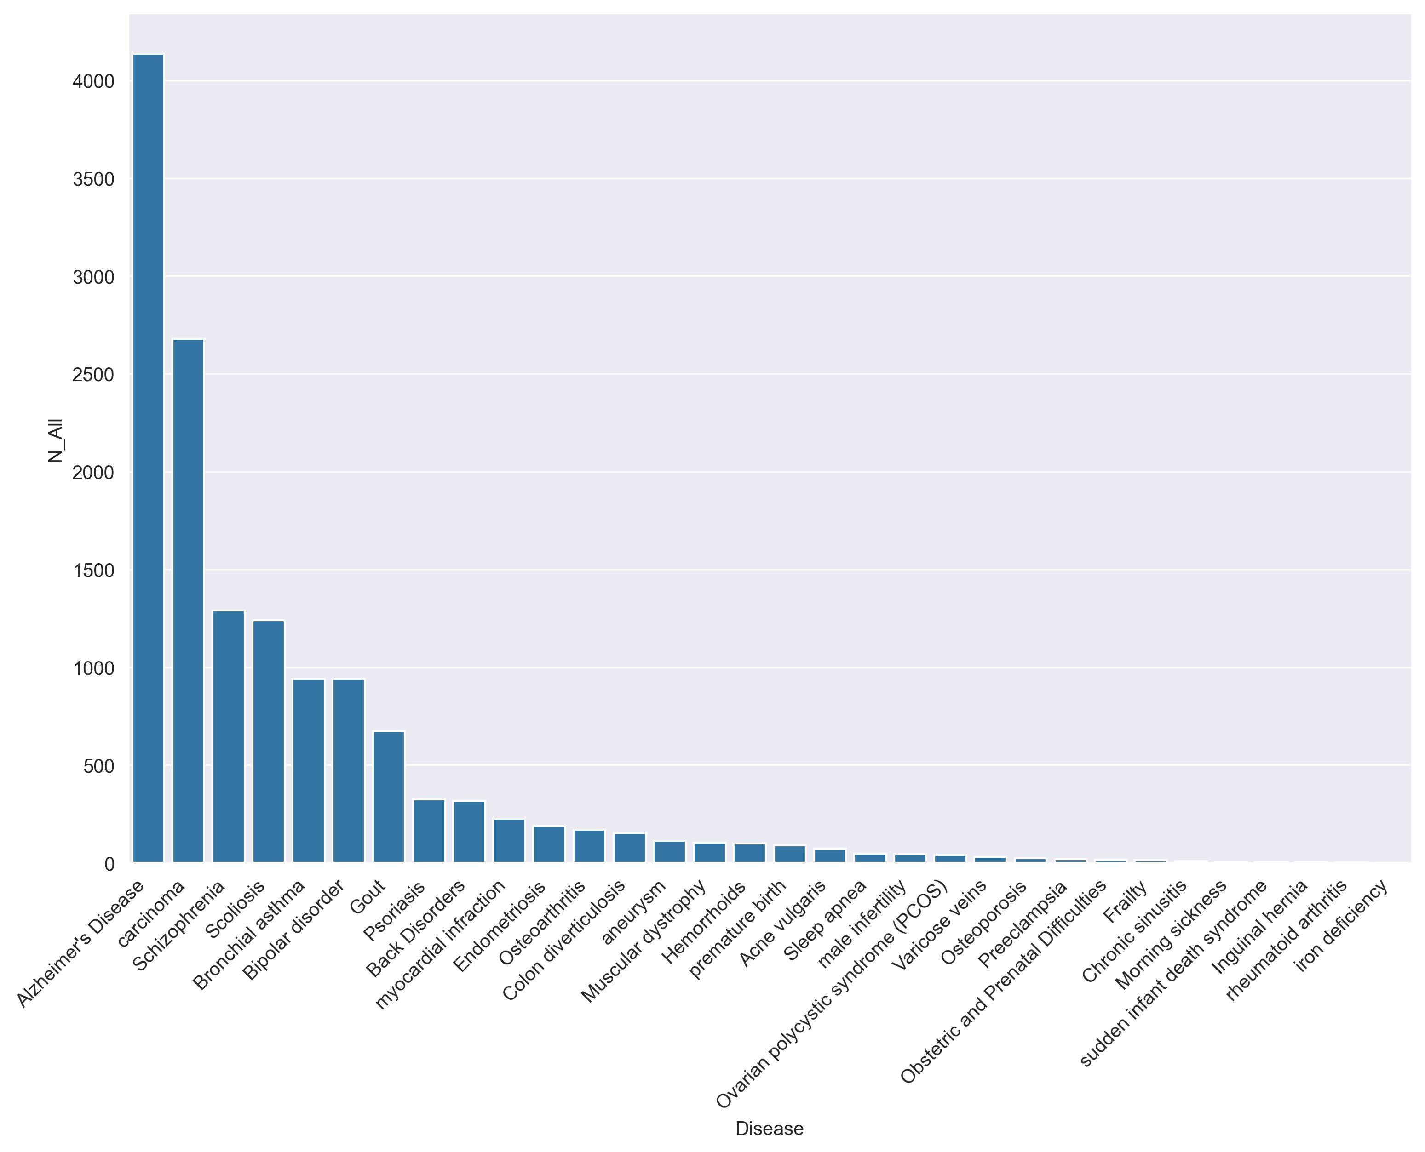
Identifying disease-associated genes
Total number of genes per disease
Notes:
In total, our analysis identified around 14,000 unique disease-associated genes across all diseases examined.
However, we observed substantial variability in the number of genes associated with each individual disease.
Some diseases have a lot more associated genes, potentially due to their polygenic nature—meaning multiple genes contribute to the disease.
Another important factor influencing gene counts is research bias: certain diseases, particularly well-known or high-profile conditions such as Alzheimer’s disease, attract more research effort and consequently yield a greater number of associated genes.

Slide 8
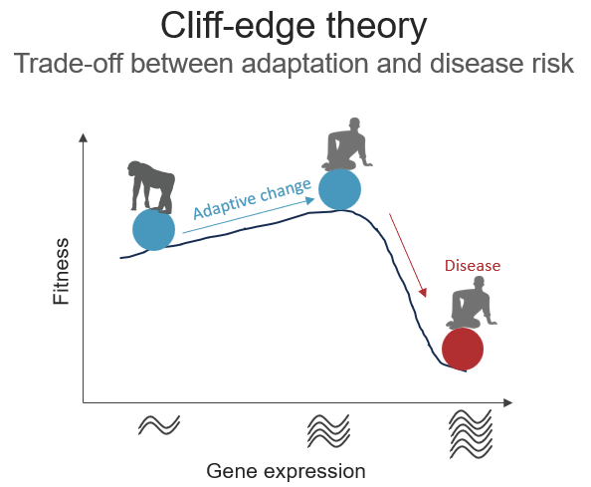
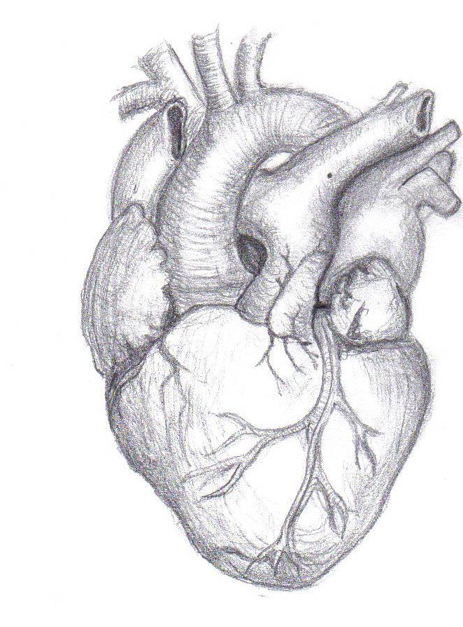
What are we looking for?
Adaptive change
Tradeoff
3x Brain
Alzheimer's disease
Schizophrenia
Chronic back pain
scoliosis
Upright
walking
Endurance
Myocardial infarction
running
More changes
Larger changes
Biased changes
Notes:
Evolution has granted humans with beneficial adaptations such as larger brains, upright posture, and enhanced endurance. However, these advantages also came with trade-offs, including vulnerabilities to diseases such as Alzheimer's, scoliosis, and heart attacks.
One theory proposes that human evolution began from a baseline of gene expression. Over evolutionary time, gene expression shifted in specific directions—potentially moving us closer to a critical point.
Being near these point means even small changes could push us over the edge, making us susceptible to various diseases.
Based on this theory, we would expect 3 possible patterns:
More expression changes:
Larger magnitude changes:
Biased changes- meaning that most of the changes are in the same direction

Slide 9
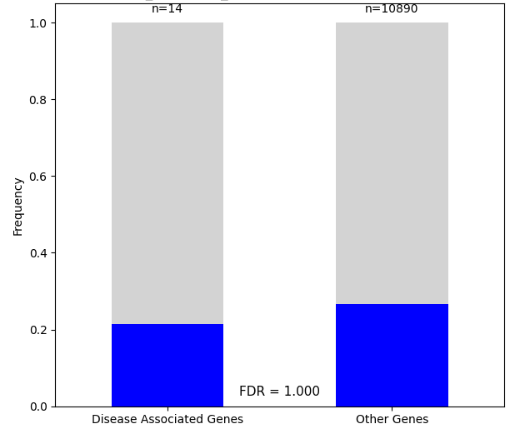
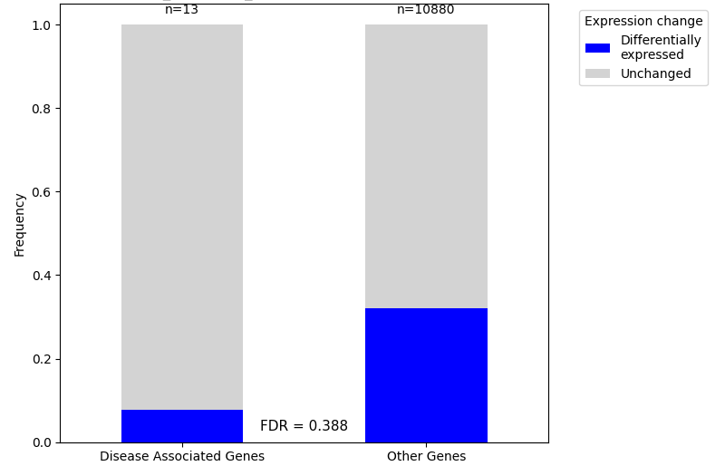
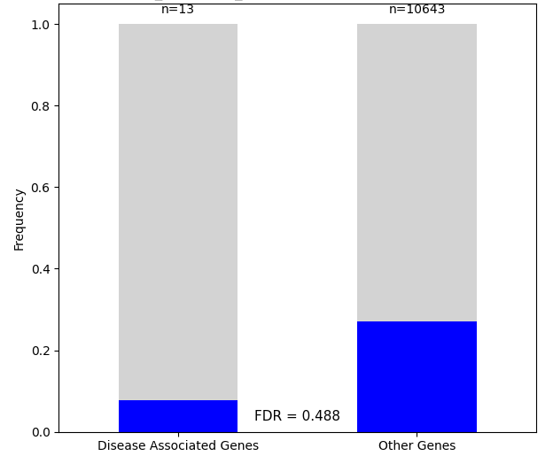
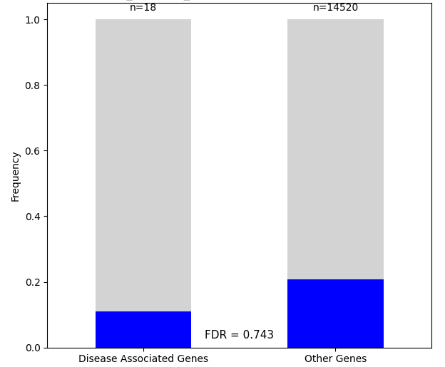
Percentage of differentially expressed genes
Ovarian polycystic syndrome: cortical organoids
Notes:
So the first thing we want to do is see if disease-associated genes have more changes. Changed genes (differentially expressed genes) are colored in blue, and in this example of ovarian polycystic syndrome we can see a lower fraction of DE genes in the disease-related group.
We can do the same comparison for all celltypes in the same disease, and also for all diseases that we have.

Slide 10
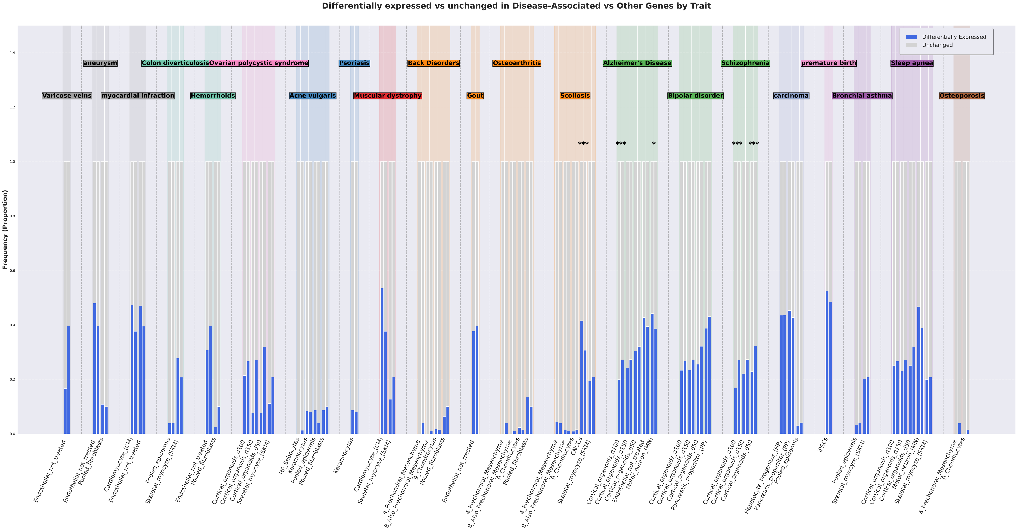
Notes:
We can see here all the different comparisons we conducted for all different disease-celltype combinations. (no need to look into the details here)
Every comparison was done against all genes that are not related to that specific disease.
We used fisher exact test to see if the fractions of the DE genes are significantly different (obviously also FDR) and I want to show you here some of the significant results we got.

Slide 11
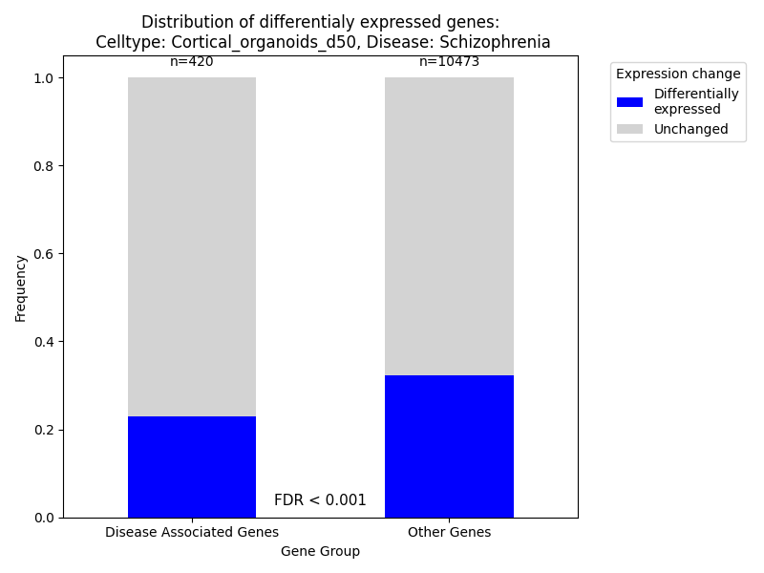
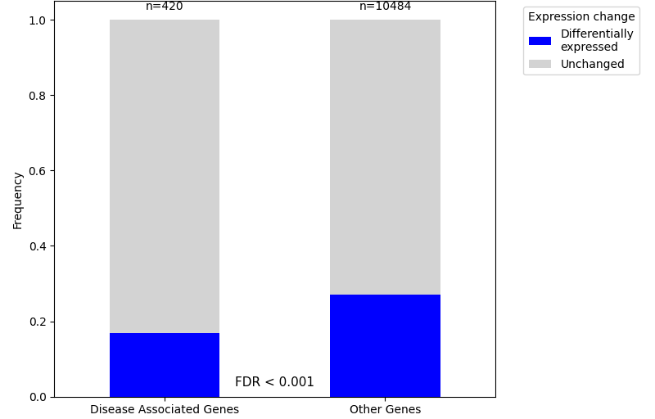
Schizophrenia: fewer differentially expressed genes
Schizophrenia:
Cortical Organoids (day 50)
Schizophrenia:
Cortical Organoids (day 100)
Notes:
Schizophrenia is a mental disease with changes in brain function.
When looking at brain organoids, we see significantly less changes in schizophrenia related genes which means there is selection against changes in these genes. We see that also later in the development of the same brain organoids. This makes sense since schizophrenia has a very high effect on fitness.

Slide 12
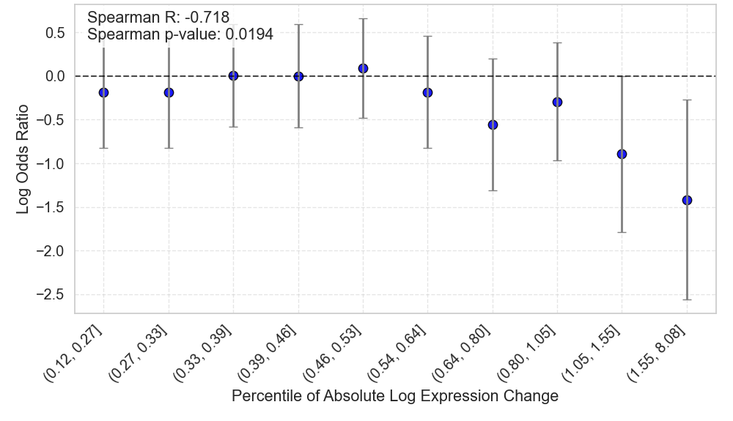
Schizophrenia-related genes are depleted of large expression changes
Cortical Organoids (day 150)
Notes:
Wo don’t only see less changes in schizophrenia, but the size of the changes is smaller. On the x axis here we have percentiles of absolute size of expression chage, and each point is a comparison of the fraction of disease genes between DE genes in this size of expression change and the background which is all non-changed genes. In each point we measure the OR which is the chance to get this size of expression change in disease-related genes: OR above 0 means higher chance to get this DE genes in comparison to no change, and OR below 0 means lower chance to get it in comparison to non-changed genes.
We can see lower OR when the size of change is higher, which means schizophrenia is depleted from large expression changes.

Slide 13
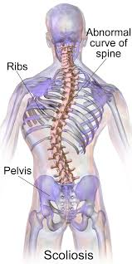
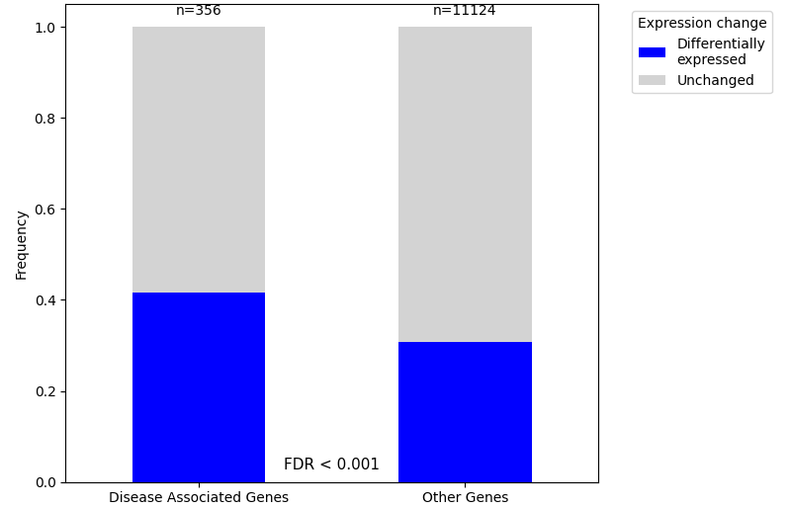
Scoliosis: more differentially expressed genes
Scoliosis:
CNCCs
Option 1: accelerated evolution
Option 2: relaxation of negative selection
Notes:
Another interesting disease was scoliosis. We see significantly more changes in scoliosis-related genes, which can come from two explanations:
We have accelerated intentional changes in these genes because there is some adaptive change that these changes promote, and this aligns with our hypothesis
These changes have a low fitness cost so we see a relaxation of the negative selection against changes in disease-related genes.

Slide 14
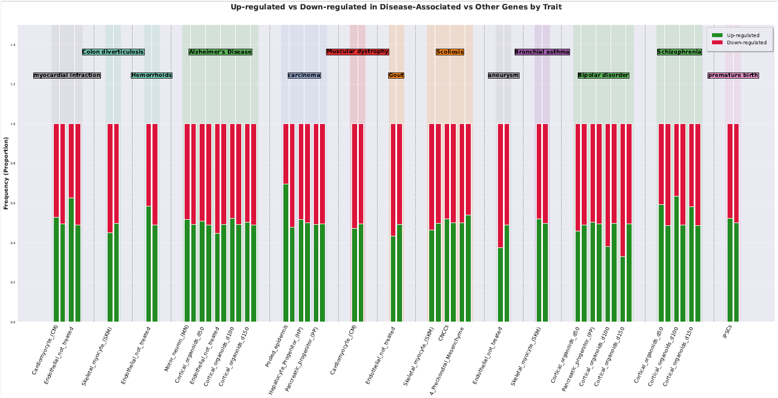
Is the direction of regulation change important?
Notes:
Now we want to check the directionality of changes. We checked the fraction of up and down regulated genes out of the total number of DE genes, in each of the celltypes of each of the diseases, and compared them to the fractions of up/down regulated genes in the DE genes that are not related to that disease. Also here we did fisher exact test and FDR, we had some significant results before FDR but nothing significant after FDR.

Slide 15
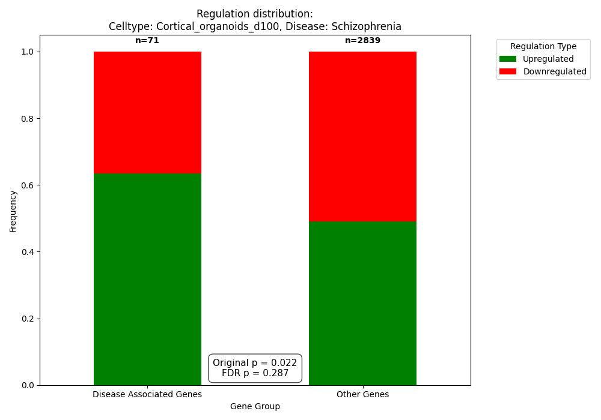

Schizophrenia: positive selection for upregulation of genes
Schizophrenia:
Cortical Organoids (day 50)
Schizophrenia:
Cortical Organoids (day 100)
Notes:
Although nothing was significant after FDR, we do see some of the more extreme changes in schizophrenia again. We see that schizophrenia-associated genes are more upregulated which may hint towards positive selection for upregulation of genes.

Slide 16
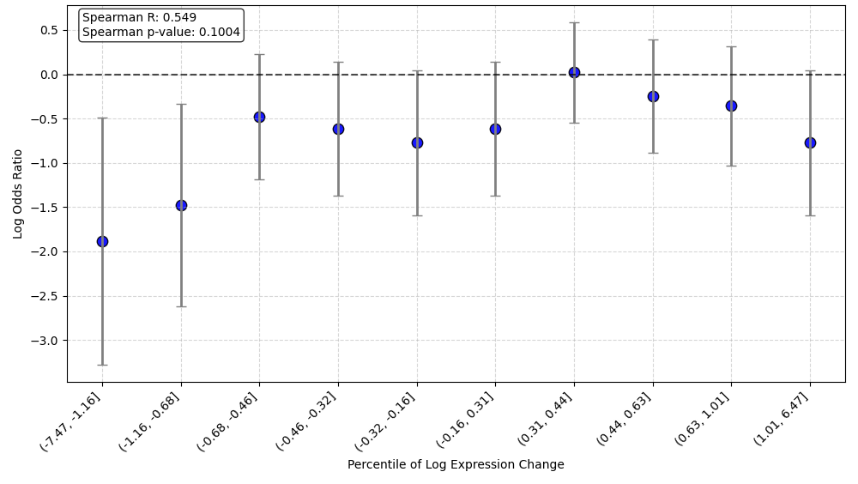
Schizophrenia-related genes are depleted of large negative expression changes
Cortical Organoids (day 100)
Notes:
When looking at the same percentile plot we saw earlier but this time with non-absolute size of expression change, we can see that the depletion of large regulatory changes is stronger at the negative expression changes, so there is less selection against extreme upregulation of genes.
these two results together suggest that there is positive selection towards upregulation of schizophrenia-related genes.

Slide 17
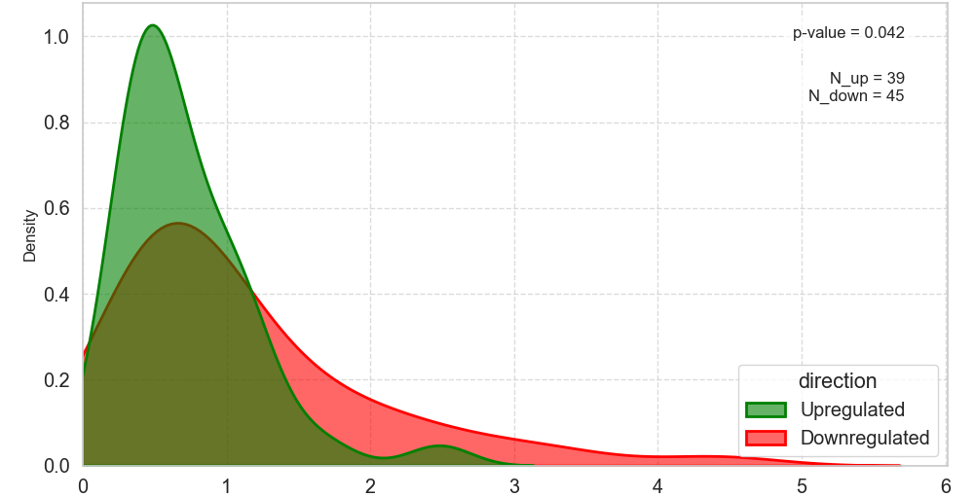
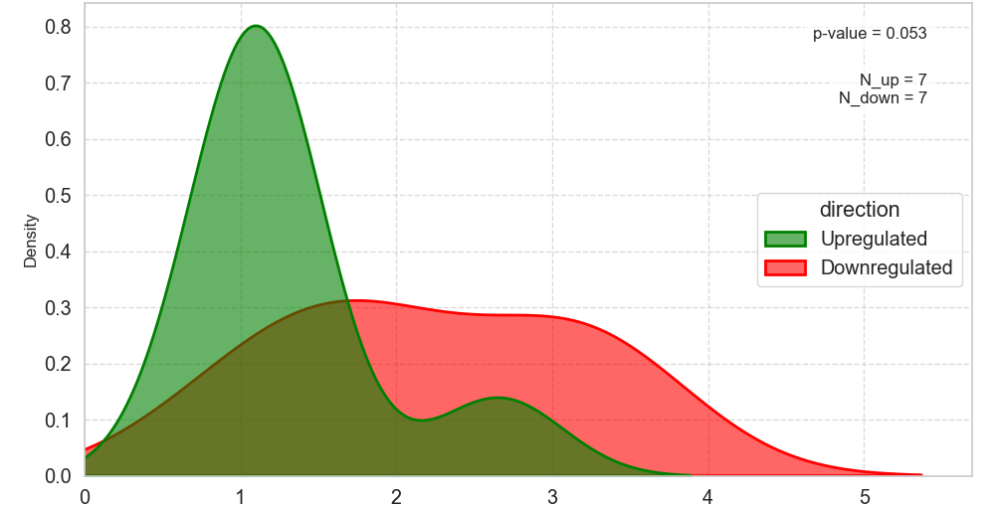
Scoliosis: larger changes in downregulated genes
Scoliosis:
Skeletal myocytes
Scoliosis:
Perichondral mesenchyme
Density
Density
Absolute log fold-change
Absolute log fold-change
Notes:
In scoliosis we do not see a significant difference in the frequencies of up and down regulated genes, but we do see a difference in the size of changes in each of these. In this plot we see the density histogram of absolute expression changes of up and down regulated genes, and we can see that although the number of genes in each group is roughly the same, the size of change is downregulated genes is much larger.

Slide 18
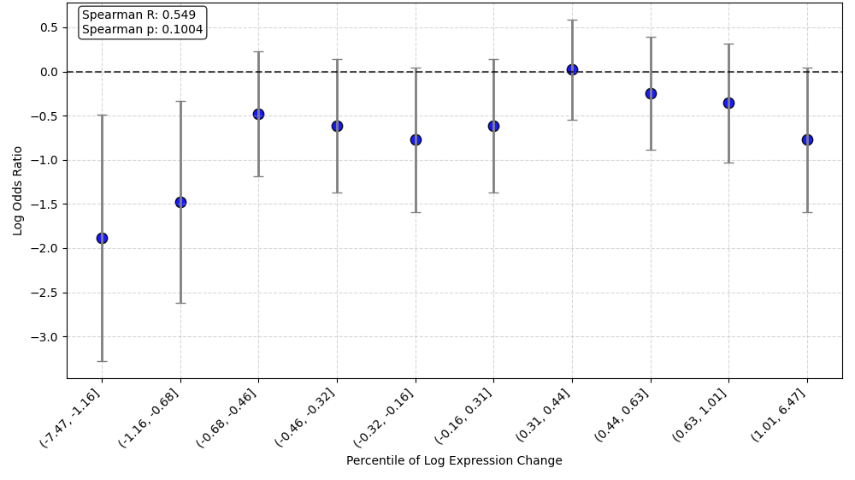
Discussion
Cliffedge theory in scoliosis
Cliffedge theory in schizophrenia
Adaptive change
Adaptive change
Fitness
Disease
Disease
Fitness
Gene expression
Gene expression
Notes:
So what can we interpret from our analysis?
When looking at scoliosis, the “cliff” part of this plot would be downregulation of genes (compared to the human baseling). We can see that our evolution shows many changes that are larger in downregulation of scoliosis-related genes, suggesting that our evolutionary course shows downregulation of these genes to acquire some adaptive trait, which then results in us being closer the the cliff.
In schizophrenia the story is different but shows the same trend – schizophrenia is characterized by upregulation of genes in comparison to the human baseline, which may explain why we see hints to selection towards upregulation of schizophrenia genes in humans in comparison to chimps.

Slide 19

To be continued: Future directions
Understand disease mechanisms: look into the function of differentially expressed disease-related genes
Look for the tradeoff: what was the adaptive change?
Are these evolutionary patterns conserved? Look for similar patterns in other organisms
Notes:
This project can lead to 3 future directions:
We have now a list of all disease-related genes that have changed in evolution. This allows us to look into their function and try to understand the mechanisms of disease,
But also allows us to try and look for the adaptive trait that caused their appearance – find the tradeoff.
Another approach is to try and see if this ecolutionary trend is conserved, by looking into the same kind of comparisons in other species, for example look into mouse-specific disease and so on.

Slide 20


Thanks for listening!

