Slide 1
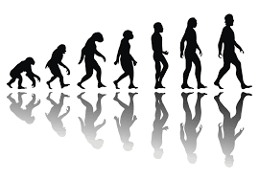
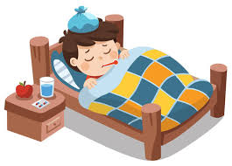
The evolution of human-specific diseases
Sarit Moses & Gil Sasson
Supervised by Dr. David Gokhman
T.A.: Nachshon Egyes

Slide 2
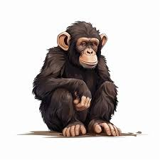
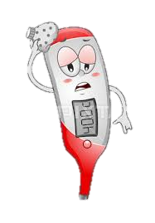
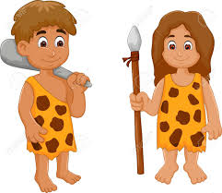
The origin of human-specific diseases
Chimp-
specific
traits
Shared
traits
Human-
specific
traits
Genetic changes → human susceptibility
X
X
X
Environment
Life span
Lack of data
Notes:
Chimpanzees are one of our closet relatives, as a result we share many traits, yet we also have numerous characteristics unique to our species.
Among these unique characteristics are diseases that specifically affect humans.
The primary goal of our research is to better understand how evolutionary processes have shaped these human-diseases.
Differences between humans and great apes can be attributed to several factors, such as distinct environmental exposures, longer lifespans in humans, and limited available data on diseases in great apes.
For example, diabetes is a human unique disease. However, evidence show that apes exposed to human-like diets can develop diabetes.
Nevertheless, numerous other diseases remain unexplained by environmental or lifestyle factors alone, indicating that genetic differences play a crucial role in these diseases.

Slide 3
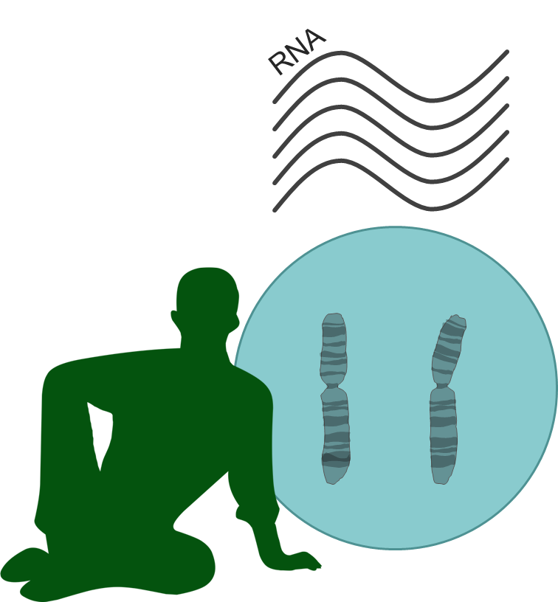
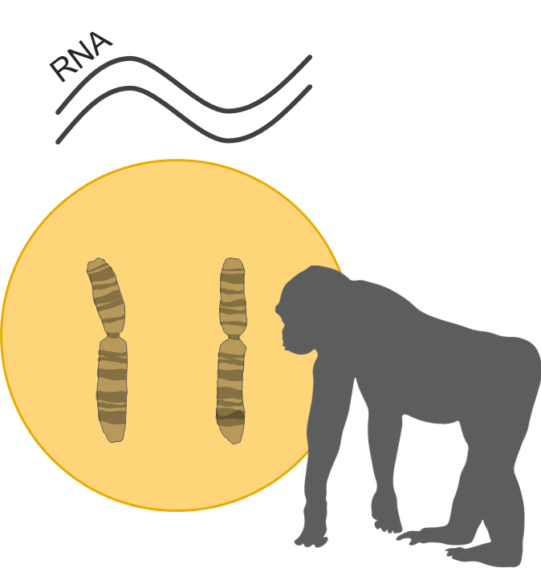
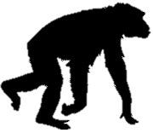
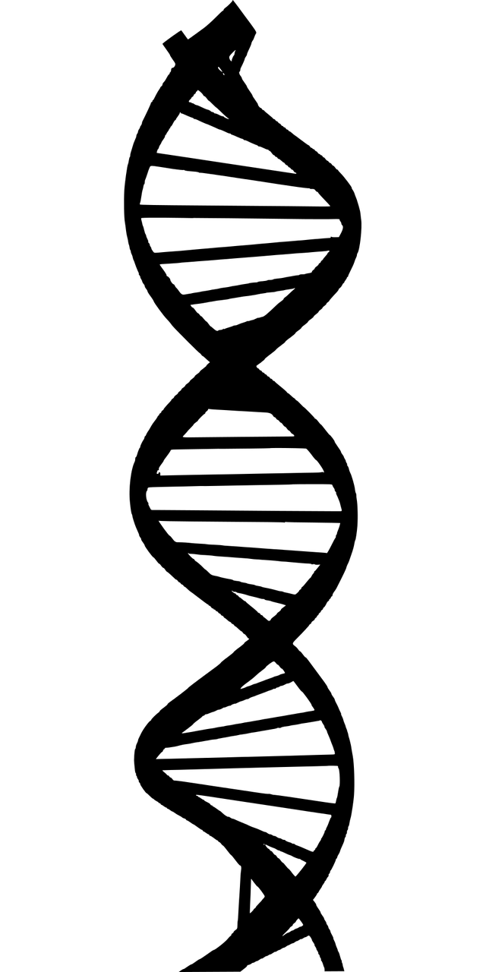
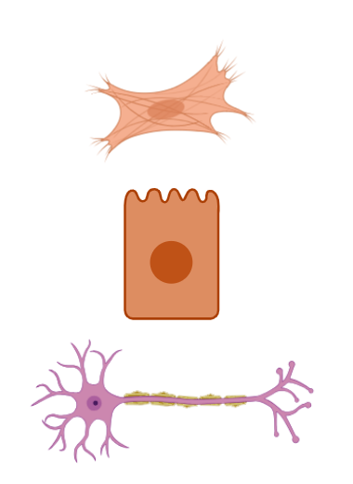



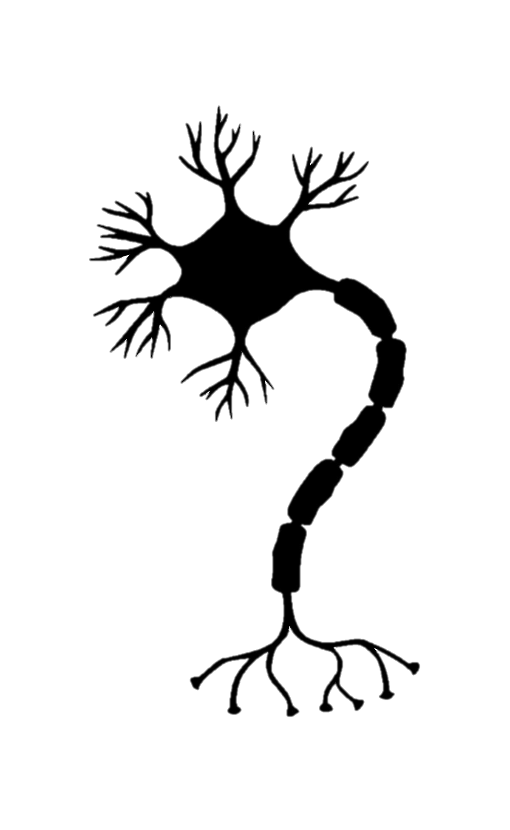
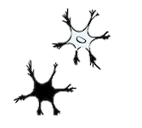

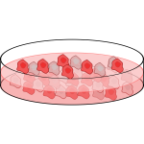
Regulatory changes: the immediate suspect
IPSCs
Evolution
Fusion
Confounders
Environment
Cell-type heterogeneity
Batch
Gokhman et al., Nature Genetics, 2021
Agoglia et al., Nature, 2021
Notes:
Typically, genetic differences between closely related species, such as humans and chimps, can be attributed to regulatory changes rather than differences in the coding regions.
Regulatory changes are differences in gene expression levels rather than differences in the genes themselves.
But can we study these regulatory differences?
Observed differences in gene expression could also result from confounding factors, such as environmental variation or technical biases in lab conditions.
To control for these confounders, David’s Lab took pluripotent stem cells derived from humans and chimpanzees and fuse them together, creating hybrid cells containing both genomes.
In these hybrid cells, both genomes share an identical cellular environment. Therefore, any observed difference in gene expression must reflect genetic (rather than environmental) differences.
Because these hybrid cells are pluripotent, they can be differentiated into virtually any cell type, enabling us to study and compare regulatory changes across diverse cell types and developmental stages.

Slide 4
The origin of human-specific diseases
Chimp-
specific
traits
Shared
traits
Human-
specific
traits
Genetic changes → human susceptibility
X
X
X
Environment
Life span
Lack of data
Notes:
Having said that, we can examine the phenotypic component effected by these expression alterations.

Slide 5
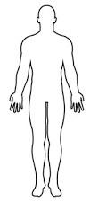
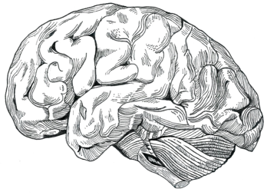
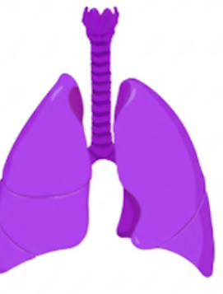
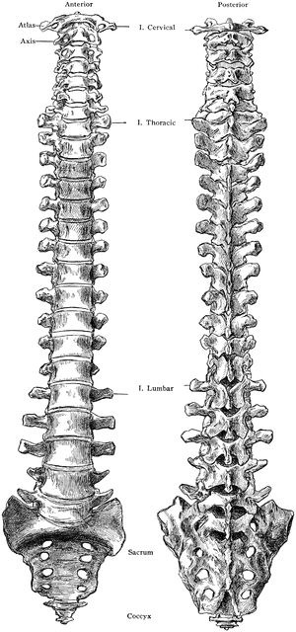

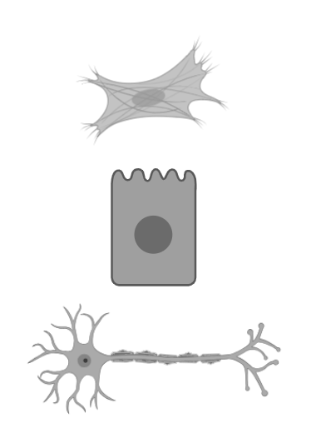
Which diseases can we study using the hybrid system?
Alzheimer’s
Schizophrenia
Curate list of human-specific diseases
Search literature to detect related celltypes
Intersect with hybrid data
Bronchial asthma
Sleep apnea
Myocardial infractions
Varicose veins
56 diseases
Scoliosis
Osteoporosis
Psoriasis
Carcinoma
Colon diverticulosis
Hemorrhoids
Morning sickness
Premature labor
32 diseases
Notes:
Using our hybrids system, we sought to investigate the genetic basis of human-specific diseases.
To start, we curated a comprehensive list of human-specific diseases, primarily relying on reviews and the existing literature. Initially, we identified 56 unique human-specific diseases.
In the next step, we reviewed scientific literature to identify the relevant cell types implicated in each disease.
We then compared these identified cell types against the cell types available in our hybrid cell database.
Following this intersection, we narrowed our list down to 32 diseases with matched hybrid cell types. These diseases became our primary candidates for further analysis.

Slide 6

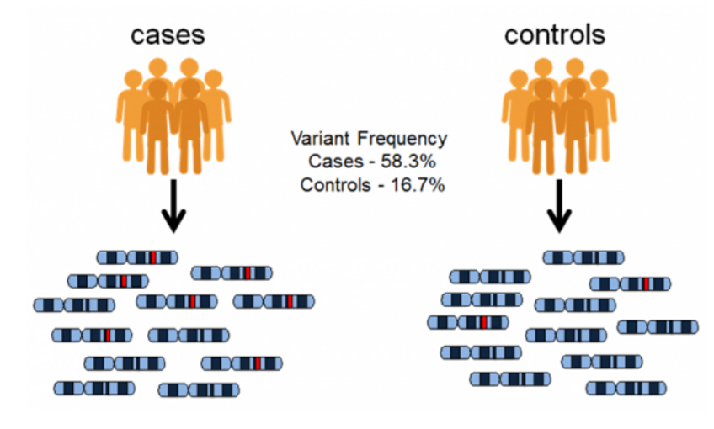
Identifying disease-associated genes
Notes:
After narrowing down our disease list, the next step is identifying the specific genes involved in each disease.
For this task, we utilized the GWAS (Genome-Wide Association Studies) catalog, as our largest source for associating genetic variants with diseases.
GWAS studies identify single nucleotide polymorphisms (SNPs) associated with particular phenotypes.
Each SNP identified through GWAS can be linked to nearby genes, providing a direct association between genetic variants and specific genes relevant to the disease.
By leveraging this catalog, we obtained comprehensive gene lists associated with each of our selected diseases, enabling us to further explore their role in human susceptibility.

Slide 7
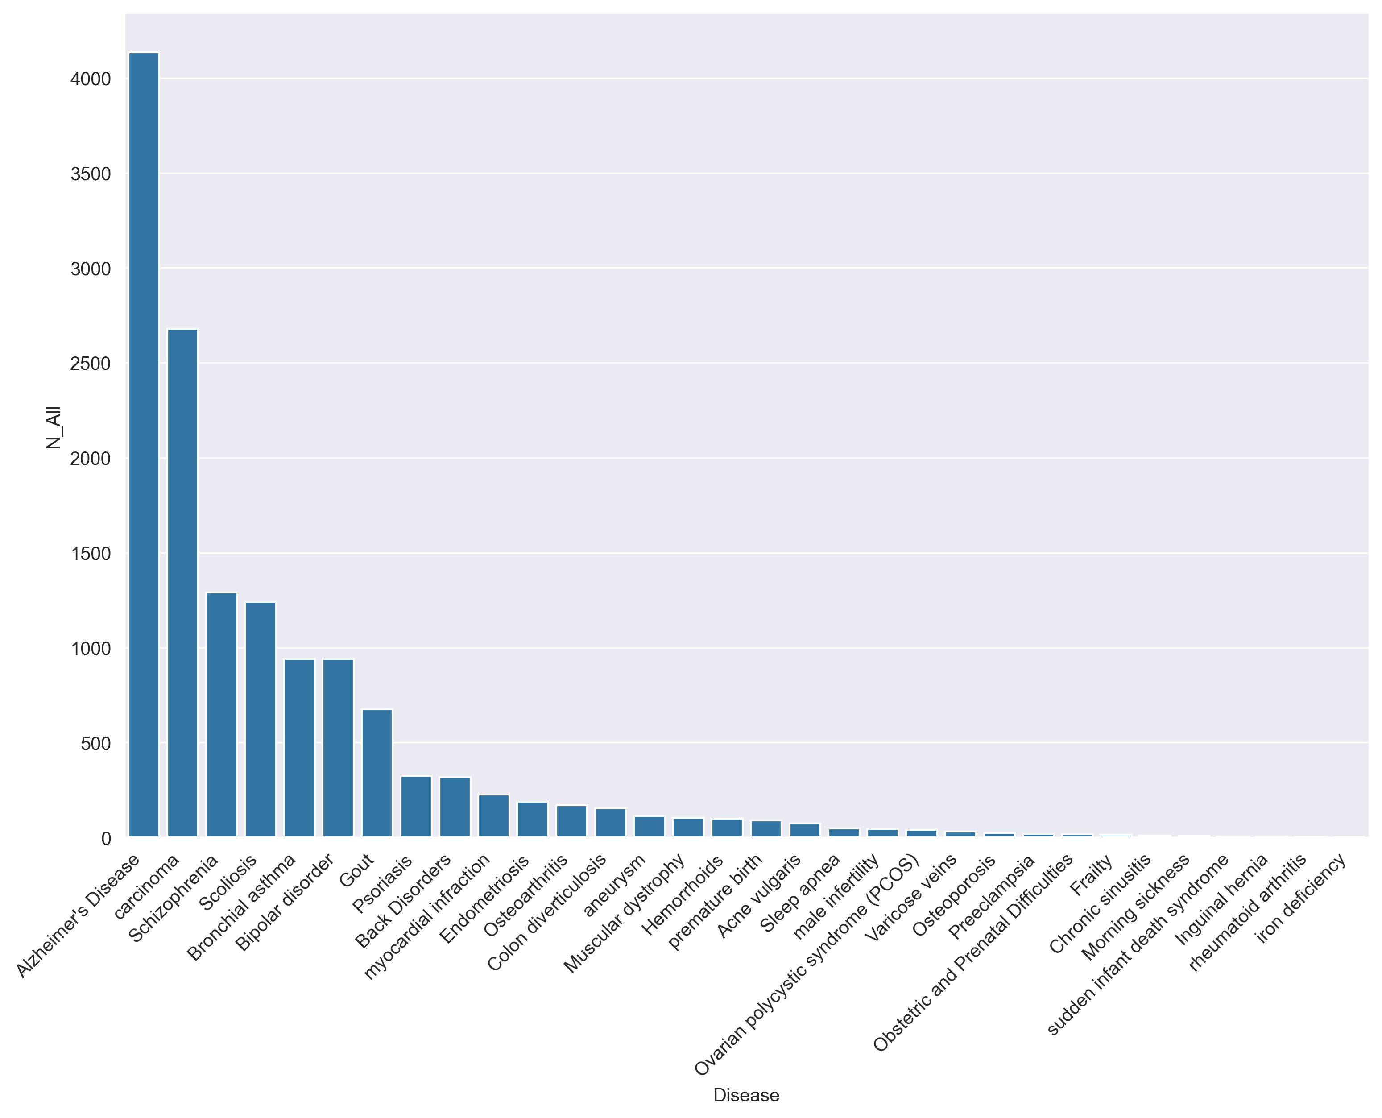
Identifying disease-associated genes
Total number of genes per disease
Notes:
In total, our analysis identified around 14,000 unique disease-associated genes across all diseases examined.
However, we observed substantial variability in the number of genes associated with each individual disease.
Some diseases have a lot more associated genes, potentially due to their polygenic nature—meaning multiple genes contribute to the disease.
Another important factor influencing gene counts is research bias: certain diseases, particularly well-known or high-profile conditions such as Alzheimer’s disease, attract more research effort and consequently yield a greater number of associated genes.

Slide 8
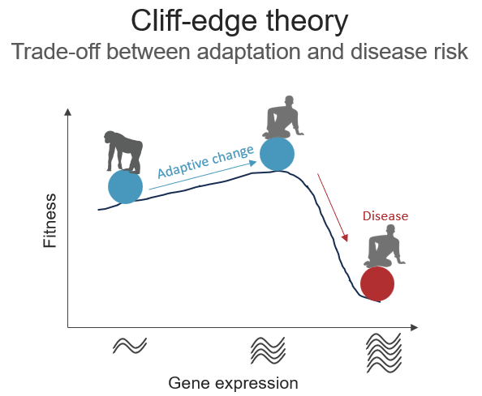
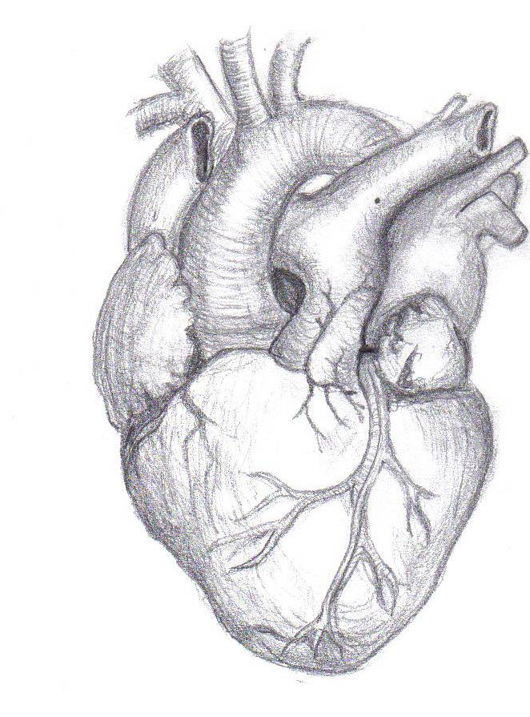
What are we looking for?
Adaptive change
Tradeoff
3x Brain
Alzheimer's disease
Schizophrenia
Chronic back pain
scoliosis
Upright
walking
Endurance
Myocardial infarction
running
More changes
Larger changes
Biased changes
Notes:
Evolution has granted humans with beneficial adaptations such as larger brains, upright posture, and enhanced endurance. However, these advantages also came with trade-offs, including vulnerabilities to diseases such as Alzheimer's, scoliosis, and heart attacks.
One theory proposes that human evolution began from a baseline of gene expression. Over evolutionary time, gene expression shifted in specific directions—potentially moving us closer to a critical point.
Being near these point means even small changes could push us over the edge, making us susceptible to various diseases.
Based on this theory, we would expect 3 possible patterns:
More expression changes: A greater number of genes with altered expression compared to chimpanzees.
Larger magnitude changes: The degree of expression change would be significantly larger in humans relative to our ape relatives.
Biased changes: Expression changes would consistently move in a particular direction rather than randomly fluctuating, indicating an evolutionary bias or selective pressure.

Slide 9
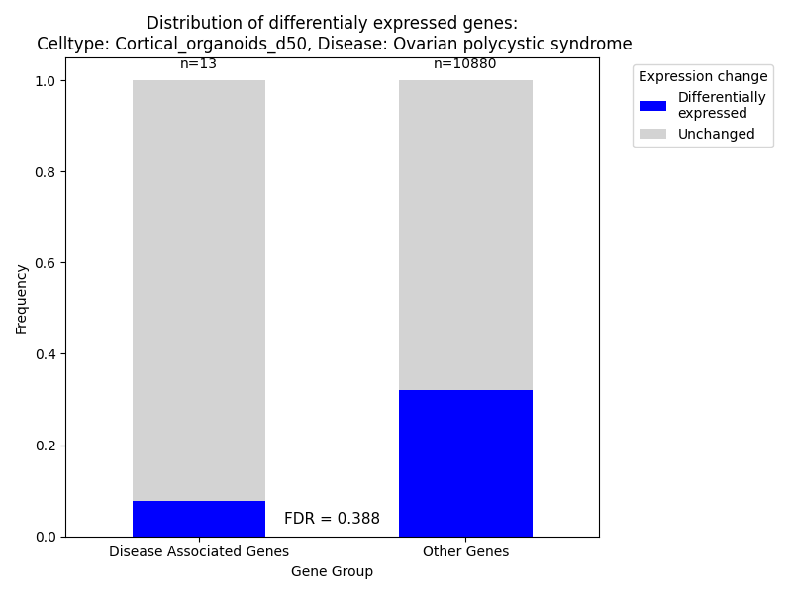
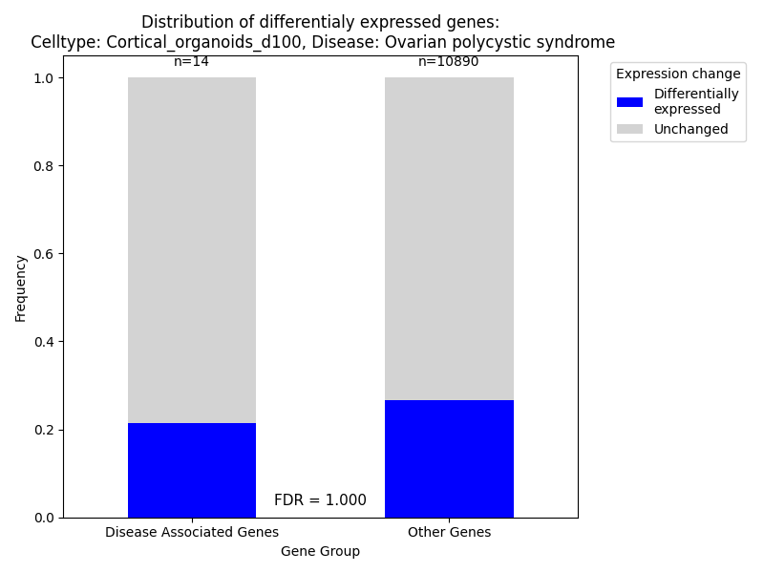
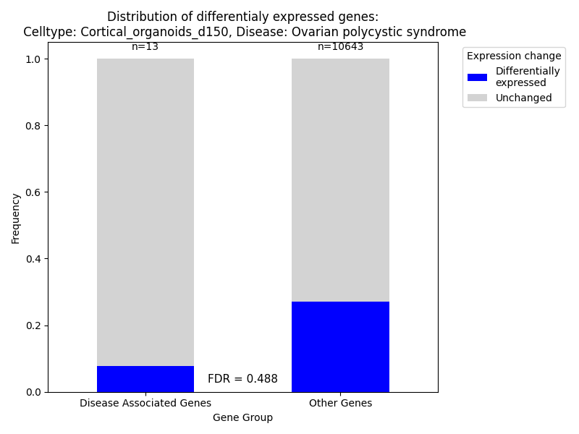
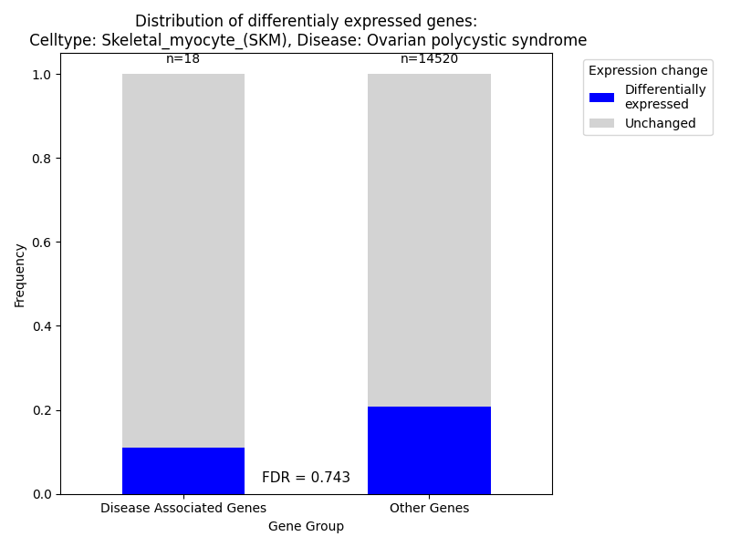
Percentage of differentially expressed genes
Notes:
להציג את כל הדאטה שלנו (meta plot). להגיד שברוב המקרים האנליזה שלנו לא אומרת כלום, יש טרנד כללי? מבחן בינומי לכל המחלות לראות אם יש העשרה לdown? לתת דוגמה אחת לpositive selection (scoliosis) ואחת לnegative. כשמראים דוגמה ספציפית – להראות barplot ואז את הקורלציה שמראה את זה יותר טוב. מצאנו חתימות לסלקציה שלילית. להזכיר בסקוליוזיס מחלה מעניינת כנראה אבולוציה מואצת. אפשר להכניס כאן את הקורלציות של counts. להכניס גם "קורלציה" של scoliosis ולהגיד שהיה תוצאה מעניינת אז תיארנו את הדאטה ברזולוציה גבוהה יותר (בלי היפותזה מראש, לנסות להסביר מה המסקנה)

Slide 10
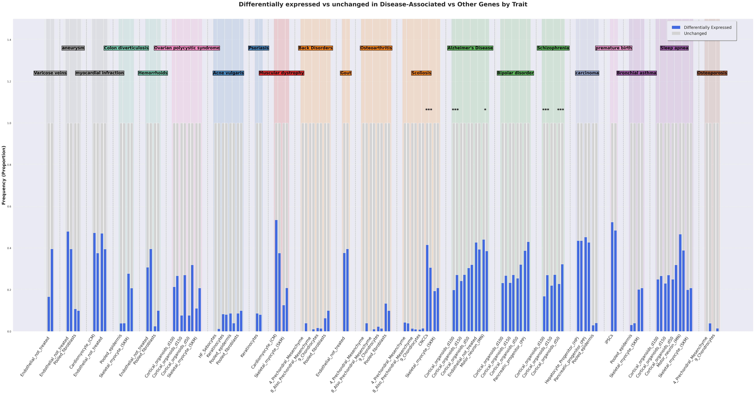

Percentage of differentially expressed genes
Notes:
להציג את כל הדאטה שלנו (meta plot). להגיד שברוב המקרים האנליזה שלנו לא אומרת כלום, יש טרנד כללי? מבחן בינומי לכל המחלות לראות אם יש העשרה לdown? לתת דוגמה אחת לpositive selection (scoliosis) ואחת לnegative. כשמראים דוגמה ספציפית – להראות barplot ואז את הקורלציה שמראה את זה יותר טוב. מצאנו חתימות לסלקציה שלילית. להזכיר בסקוליוזיס מחלה מעניינת כנראה אבולוציה מואצת. אפשר להכניס כאן את הקורלציות של counts. להכניס גם "קורלציה" של scoliosis ולהגיד שהיה תוצאה מעניינת אז תיארנו את הדאטה ברזולוציה גבוהה יותר (בלי היפותזה מראש, לנסות להסביר מה המסקנה)

Slide 11
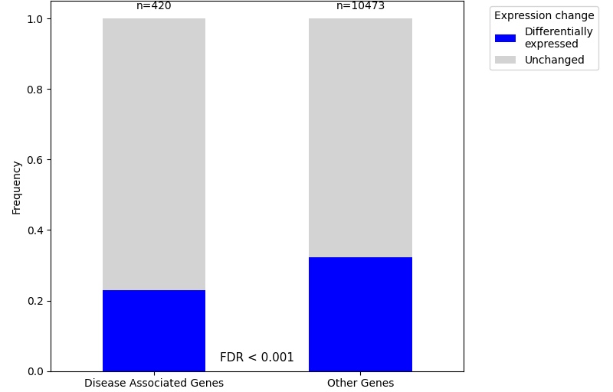
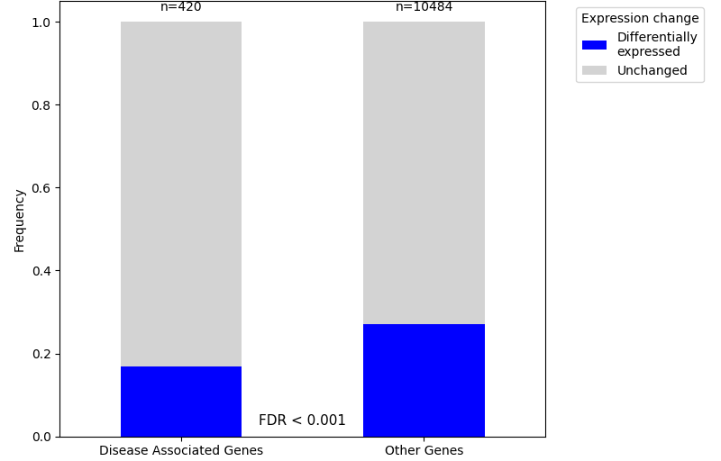
Schizophrenia: fewer differentially expressed genes
Schizophrenia:
Cortical Organoids (day 50)
Schizophrenia:
Cortical Organoids (day 100)
Notes:
Show results of schizophrenia
להוריד כותרות גנים

Slide 12
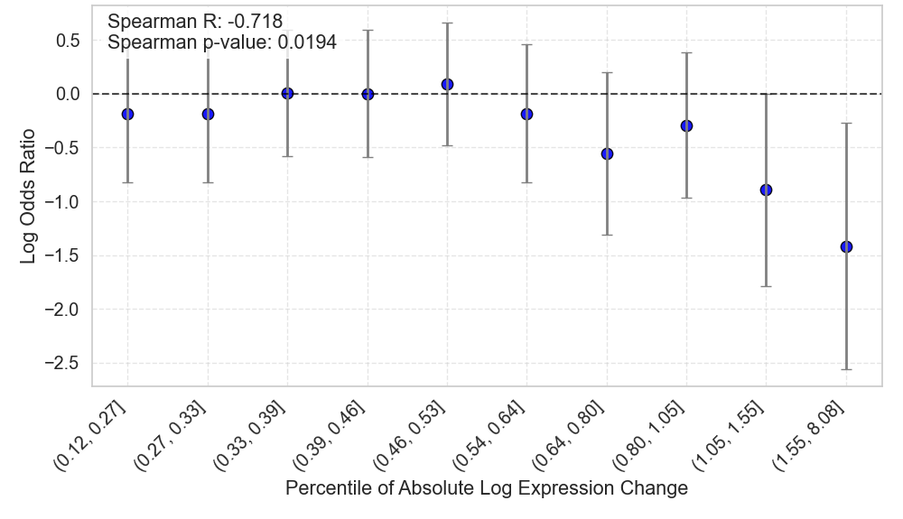
Schizophrenia-related genes are depleted of large expression changes
Cortical Organoids (day 150)
Notes:
ציר X – percentile of absolute log epresssion change
ציר Y – log odd ratio
Spearman p-value

Slide 13
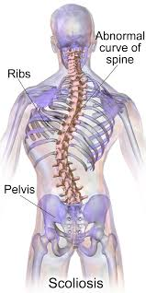
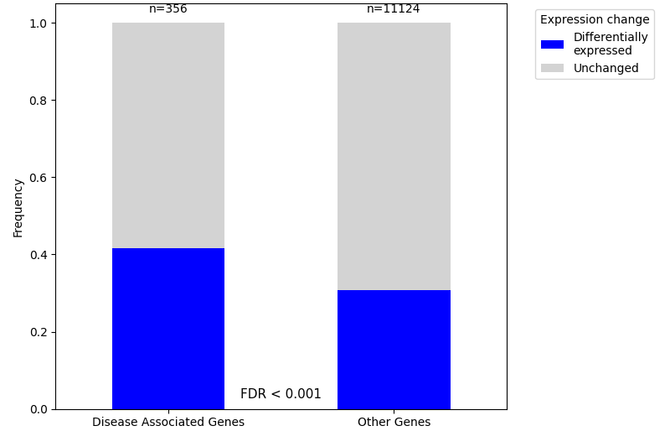
Scoliosis: more differentially expressed genes
Scoliosis:
CNCCs
Option 1: accelerated evolution
Option 2: relaxation of negative selection
Notes:
CNCC in scoliosis: the closest we had to neural crest cells which are the cells that create the spine

Slide 14
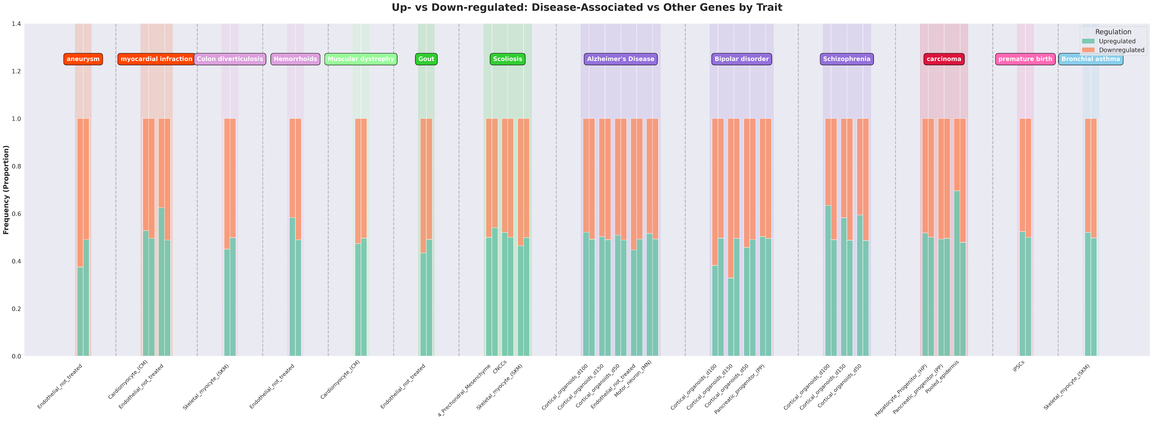
Is the direction of regulation change important?
Notes:
עכשיו אפשר להסתככל על up/down – מעניין כי היינו מצפים שכל השינויים יהיו רנדומליים כלומר בערך חצי חצי (הטלת מטבע). גם כאן להראות את גל המחלות ואז להתמקד בסכיזופרניה (scoliosis?). להראות את ההתפלגויות – רואים כמעט רק up ב-LFC גדול. לשים את השמות של הגנים הרלוונטים (לבדוק מה כל אחד מהם עושה)

Slide 15
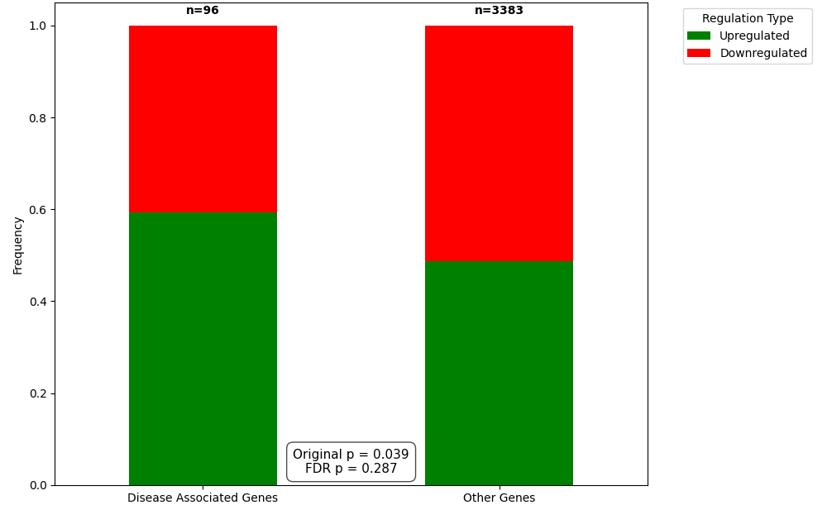

Schizophrenia: positive selection for upregulation of genes
Schizophrenia:
Cortical Organoids (day 50)
Schizophrenia:
Cortical Organoids (day 100)
Notes:
עכשיו אפשר להסתככל על up/down – מעניין כי היינו מצפים שכל השינויים יהיו רנדומליים כלומר בערך חצי חצי (הטלת מטבע). גם כאן להראות את גל המחלות ואז להתמקד בסכיזופרניה (scoliosis?). להראות את ההתפלגויות – רואים כמעט רק up ב-LFC גדול. לשים את השמות של הגנים הרלוונטים (לבדוק מה כל אחד מהם עושה)

Slide 16
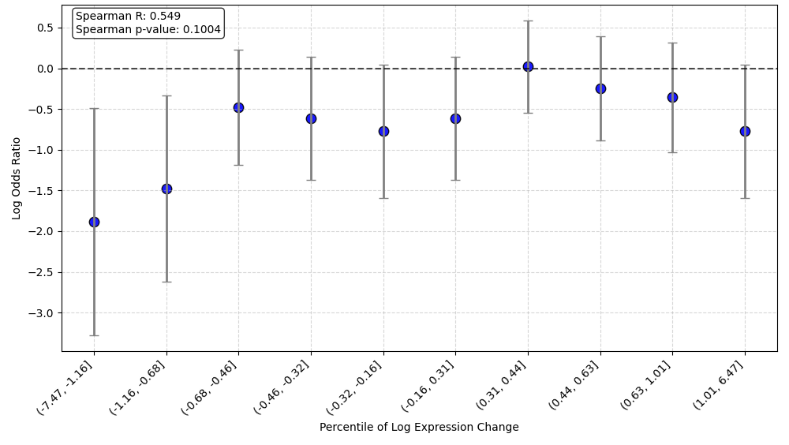
Schizophrenia-related genes are depleted of large negative expression changes
Cortical Organoids (day 100)
Notes:
עכשיו אפשר להסתככל על up/down – מעניין כי היינו מצפים שכל השינויים יהיו רנדומליים כלומר בערך חצי חצי (הטלת מטבע). גם כאן להראות את גל המחלות ואז להתמקד בסכיזופרניה (scoliosis?). להראות את ההתפלגויות – רואים כמעט רק up ב-LFC גדול. לשים את השמות של הגנים הרלוונטים (לבדוק מה כל אחד מהם עושה)

Slide 17
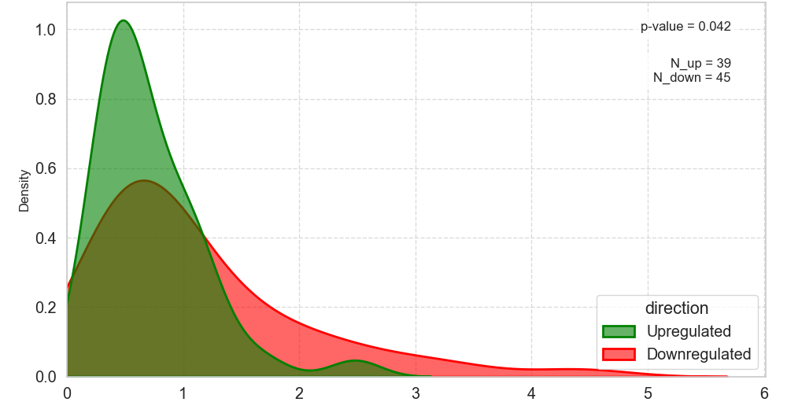
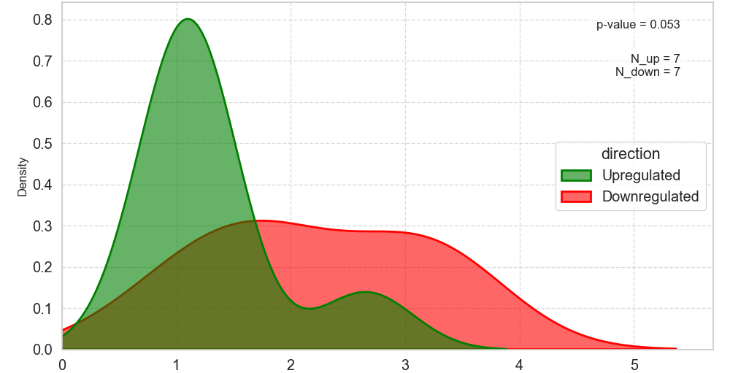
Scoliosis: larger changes in downregulated genes
Scoliosis:
Skeletal myocytes
Scoliosis:
Perichondral mesenchyme
Density
Density
Absolute log fold-change
Absolute log fold-change
Notes:
Skeletal myocytes in scoliosis: undergo changes due to the change in curve, including asymmetry in muscle mass and alteration in fiber type distributions. These muscle imbalance are thought to contribute to the progression or maintenance of the scoliosis curve.
Prechondral mesenchyme in scoliosis: these are cells surrounding cartilage, that have an effect on bone formation (ossification) and can be implicated in the development of scoliosis.

Slide 18
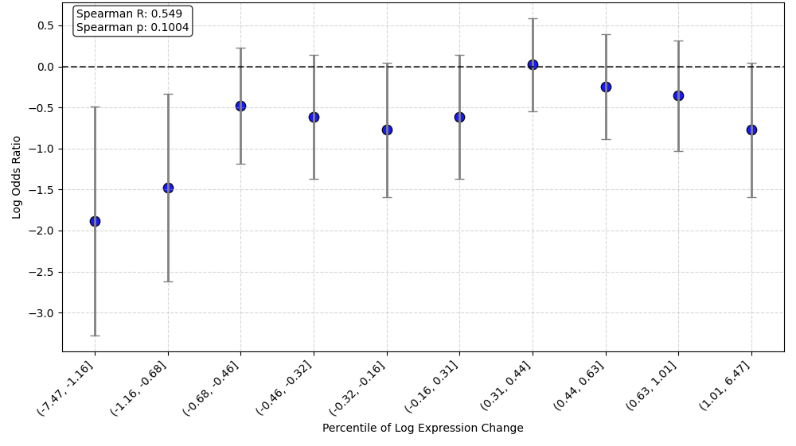
Discussion
Cliffedge theory in scoliosis
Cliffedge theory in schizophrenia
Adaptive change
Adaptive change
Fitness
Disease
Disease
Fitness
Gene expression
Gene expression
Notes:
Schizophrenia upregulatipn: https://febs.onlinelibrary.wiley.com/doi/full/10.1111/j.1742-4658.2011.08390.x https://www.pnas.org/doi/abs/10.1073/pnas.032069099 https://www.sciencedirect.com/science/article/pii/S0006899305018433 https://www.pnas.org/doi/abs/10.1073/pnas.0507666102

Slide 19

To be continued: future directions
Understand disease mechanisms: look into the function of differentially expressed disease-related genes
Are these evolutionary patterns conserved? Look for similar patterns in other organisms
Look for the tradeoff: what was the adaptive change?
Notes:
Schizophrenia upregulatipn: https://febs.onlinelibrary.wiley.com/doi/full/10.1111/j.1742-4658.2011.08390.x https://www.pnas.org/doi/abs/10.1073/pnas.032069099 https://www.sciencedirect.com/science/article/pii/S0006899305018433 https://www.pnas.org/doi/abs/10.1073/pnas.0507666102

Slide 20


Thanks for listening!

