Slide 1
London Flip Finder
Finding London homes that sold for less than they were worth — and putting a number on how much confidence that claim deserves
[ student names — send me the three and I will set them ]
Applied Data Science 83901 · Bar-Ilan University · 2026
59,946 transactions · 2008–2016 · four public sources · 28 features · 14 models
Notes:
Open with the product, not the model: the deliverable is a screen that flags a sale as a flip candidate only when its price falls below a calibrated floor, not a point estimate of value. Deliberately hold the results back — the strip along the bottom states scope only, and no accuracy figure appears until slide 16. Say what the talk will do rather than what it found: value London sales from 2008 to 2016, then put a floor under each estimate. The data is British and the vocabulary is defined in the notebook's second cell — offer to define borough, LSOA, tenure and outcode on demand rather than up front, and do not assume the room knows what leasehold means. Next slide states the work in five lines. Source: notebook cell 0.

Slide 2
OVERVIEW & MOTIVATION
A buyer sees the asking price but not the value — and cannot tell them apart
— Nobody values a home from floor area and a postcode
— A point estimate is not actionable; a buyer needs a floor
— Flag a sale only when its price falls below that floor
— 'Looks cheap' becomes a quantified margin of safety
2
Notes:
Set the business problem before any method, and assume the room did not see the proposal. A sale record on its own tells you very little: floor area, a few room counts, freehold or leasehold, property type, an energy rating, a postcode and a price. Nobody values a home from that alone — what a buyer actually brings to the question is context, and assembling that context is most of the work in this project. The motivation is the second half: even a good valuation is not something you can act on, because a point estimate carries no statement of how wrong it might be. What an investor needs is a floor — a value the property is very unlikely to be worth less than — so that a decision to spend money comes with a quantified margin of safety attached. That reframing is what turns this from a price-prediction exercise into a screen someone could actually use, and it is why section 15 exists at all. Next slide: what we actually built. Source: notebook cell 0.

Slide 3
WHAT WE DID
A sale record is thin, so the work was assembling context around it
— The record gives floor area, rooms, tenure, type, postcode
— We joined four public sources into one 59,946-row table
— Built 28 leakage-safe features, including each property's prior sale
— Trained 14 models on a chronological split
— Then wrapped each estimate in a price floor
3
Notes:
This is the whole project in five lines, before any detail and before any result. Start from the first bullet: a sale record carries floor area, a few room counts, freehold or leasehold, property type, an energy rating and a postcode — nobody values a home from that alone. What a buyer actually brings is context, and assembling it is most of the engineering here: how far the home is from a station and how central that station is, which borough it sits in, what crime the neighbourhood recorded beforehand, what the market was doing in the run-up, what the central-bank rate was on completion day, and what the property itself last sold for. The fourth and fifth bullets are the modelling and the product: fourteen models trained on a time-ordered split, and then a floor placed under each estimate so a sale is flagged only when its price falls below it — that is the difference between 'this looks cheap' and a claim with a margin of safety attached. Deliberately no accuracy numbers yet; they start at slide 16 and are summarised at slide 27. Next slide is the map of how we get there. Source: notebook cells 0 to 2.

Slide 4
INITIAL QUESTIONS
Three questions we started with — and how two of them changed
— What is a property worth, given its context?
— Can we flag sales below a ~90 % floor?
— Does neighbourhood crime price into London property?
— Crime became: a verdict on crime, or on resolution?
— New: why do trees lose to a linear baseline?
4
Notes:
The rubric asks what we set out to answer and how it evolved, and this project has an unusually clear answer on both counts. The first two questions never changed: what is this property worth, and can we put a floor under that estimate which holds at a stated rate. The third is where the project moved. Crime started as a feature we assumed would matter — and it is the reason the modelling window stops in 2016, because the crime file ends there, which costs 81 % of the available sale records. When crime measured as worth almost nothing, the question sharpened rather than closing: was that a verdict on crime, or on the fact that 4,835 LSOAs had been aggregated into 33 boroughs? Sections 8.2 and 14.5 exist to answer that fairly. Two questions arrived mid-project that we did not start with. First, why do gradient-boosted trees lose to a linear baseline on tabular data, which is backwards — that becomes section 12.1 and the largest result in the project. Second, once we noticed the source file is a price history rather than a transaction log, what is a property's own past sale worth as a feature — section 14.6. The Final Analysis slide returns and answers all of these explicitly. Source: notebook cells 0, 25, 31 and 42.

Slide 5
RELATED WORK
Where each idea comes from — no ingredient here is new on its own
— Rosen 1974, hedonic prices — the framing of §5–§9
— Bailey, Muth & Nourse 1963, repeat sales
— Gibbons 2004, London crime — predicts our small effect
— Lei et al. 2018, split conformal — lower tail only
— Romano et al. 2019, conformalized quantile regression
5
Notes:
What is specific to this project is the combination: a hedonic model of London stock in 2008 to 2016, given the property's own sale history, wrapped in a one-sided calibrated floor so the output is a screen a buyer can act on rather than a point estimate. Rosen prices a differentiated good as a bundle of measured attributes each carrying an implicit price, which is exactly what the feature set is; the tree models just drop the linear-in-attributes assumption. The repeat-sales idea is used in opposite directions in the same project: section 12.1 divides out the market level to get a stationary target, and sections 8.3 and 14.6 feed the previous sale price back in as a feature. Gibbons is the closest prior work — a hedonic study of London specifically, finding that criminal damage capitalises into prices at roughly 1 % per tenth of a standard deviation in Inner London while burglary does not — so it predicts what we find, a real but small and category-dependent effect, and is worth citing as the reason the crime block earns so little once location is already in the model. Lei et al. is the reference treatment of split conformal prediction, which section 15 adapts with a ratio nonconformity score, keeping only the lower tail. The Zillow Prize is the practitioner reference point, in the backup slides; its error rates are explicitly not comparable — different market, no listing data, every transaction scored. Source: notebook cell 82.

Slide 6
ROADMAP
Seven phases, and one rule that governs every design decision
Setup
§1–3
Data
§4–7
Exploration
§8
Features
§9–10
Models
§11–13
Decision
§14–15
Assurance
§16–18
One rule throughout: use only what a buyer knew on the transaction date
Four raw sources → 59,946 × 37 master table → 28 features → 60/15/10/15 chronological split → 14 models → conformal floor
6
Notes:
This is the map for the next twenty minutes; point at it again when the talk changes phase. Setup and Data build one modelling table from four raw sources; Exploration asks what actually moves price; Features and Split decide what the model may see; Models and Decision train, rank and score; Assurance is what is asserted and what is still wrong. The rule along the bottom is the one line that nearly every later decision follows from — the shifted rolling medians, the chronological split, the strictly-prior sale lookup and the separate calibration slice are all consequences of it. Note that the phase numbering is the notebook's own, so any slide can be traced straight back to a section. Source: notebook cell 2, the phase table.

Slide 7
§4 · THE SOURCES
Four sources, four different grains — and one column that is refused
Source | Grain | Rows
Land Registry price history | one sale event | 418,201
Met Police crime | LSOA × category × month | 13,490,604
Bank of England base rate | one rate change | 246
TfL stations (Feb 2022 snapshot) | one station | 471
GLA boundaries | one borough polygon | 33
— saleEstimate_* is never read — a rival model's output leaks the target
— Crime is read twice: borough grain to model, LSOA grain to test
7
Notes:
Start with the shapes, because the grains are what make the merge non-trivial: nothing here is one row per property. The price history is one row per sale event, so a flat sold three times contributes three rows — that fact drives section 8.3, the repeat-property diagnostic and the strongest feature block in the model. Crime arrives at LSOA by category by month, 13.5 million rows, which has to be aggregated before it can join anything. The base rate is 246 rows total, a sparse list of change dates that has to be expanded. Stations and borough boundaries are geometry, with no key in common with a sale at all — they can only be joined spatially. The refused column matters: the source file ships saleEstimate_* and rentEstimate_*, another company's valuation model output for the same property, and using it to predict price would be leakage dressed up as a feature, so load_raw never reads those columns. Crime is deliberately read twice, at borough grain for the pipeline and at its native LSOA grain for section 8.2, which asks whether the borough aggregation threw the signal away. Next slide: what each source has to become before it can join. Source: notebook cells 9 and 10.

Slide 8
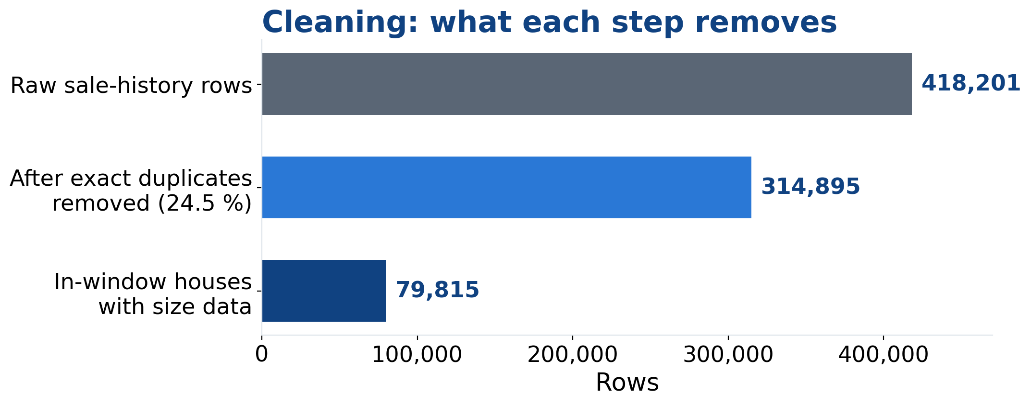
§5 · CLEANING
Each source is reshaped before it is allowed to join
— Crime: summed to borough-months, then rolling(12, closed='left')
— Rates: 246 changes expanded to 3,288 daily rows
— Forward-fill only — an earlier .bfill() leaked rates backwards
8
Notes:
Three independent pure transforms, each taking one raw frame and returning a tidy one, with no cross-source joining yet. Houses is restricted to the window and gains total_rooms; rows with neither floor area nor room count are dropped, taking 82,122 in-window rows to 79,815. Crime is grouped to borough-months and gains a trailing twelve-month sum computed with closed='left', which excludes the current month so the window is strictly historical — 3,564 borough-months across 33 boroughs. The rate curve is the one to dwell on, because it carries a real bug that was found and fixed. The 246 change dates are expanded onto a daily calendar so every sale can match the rate in force on the day it completed. An earlier version called .bfill() to fill the leading gap, which propagated the first in-window rate backwards over every preceding day — stamping a rate onto dates before it had been announced. Forward-fill alone cannot look ahead. The fix seeds row zero from the last change at or before the window opens and then forward-fills only; where no prior rate exists the leading days stay NaN and each model imputes from training data rather than from the future. That is the shape of nearly every decision in this project. Source: notebook cells 11 and 12.

Slide 9
§6–§9 · THE MERGE
Six joins onto one spine — three of them deliberately lagged
Price history 418,201 sales · the spine
Underground + rail stations cKDTree, k=1 → distance + fare zone
Borough and LSOA polygons gpd.sjoin, predicate='within'
Bank of England base rate exact key on date (daily, forward-filled)
Met Police crime key on (month − 1, borough) LAGGED
Borough £/m² level key on (month + 1, borough) LAGGED
The property's own prior sale merge_asof, backward, no exact match LAGGED
Master table 59,946 rows × 37 columns
— No shared key: three join on geometry, three on time
— Every time join is offset off the row's own month
9
Notes:
This is the map of the merge, and the slide to come back to. The price history is the spine: every join adds columns to it and none of them adds rows. Read the middle column as the actual join key. The first three are unlagged because they are static — a station's location and a borough's boundary do not change within the window, and the base rate is matched to the exact completion date from an already-expanded daily calendar. The bottom three are lagged on purpose, and that is the whole leakage story in one place: crime joins on the month before the sale, the borough price level is stamped onto the following month, and the prior sale is an as-of merge that refuses an exact date match. Point out that no two sources share a key with the houses frame — stations and boundaries have no identifier in common with a sale at all, which is why three of the six are spatial joins rather than key joins. The next three slides take the k-d tree, the point-in-polygon join and the lagged keys in turn. Source: notebook cells 13 to 16, and cells 32 to 33 for the prior-sale merge.

Slide 10
§6 · SPATIAL JOIN 1
Nearest station by k-d tree, with the fare zone carried along free
tree = cKDTree(np.c_[stations.geometry.x, stations.geometry.y])
dist, idx = tree.query(np.c_[houses.geometry.x, houses.geometry.y], k=1)
houses['distance_to_underground_m'] = dist
houses['station_zone'] = stations['station_zone'].to_numpy()[idx]
— EPSG:27700 first — degrees distort distance east–west
— The tree splits points on alternating axes; each query is O(log n)
— Avoids 32 M comparisons: 80,000 properties × 400 stations
— query returns the neighbour's index, so its fare zone rides along
10
Notes:
Two spatial joins in the pipeline, and this is the first. Everything is reprojected to the British National Grid before a single distance is computed, because at London's latitude a degree of longitude covers only about 62 % of the ground a degree of latitude does — measuring in degrees quietly squashes geography along the east-west axis. BNG is metric, so a distance of 1000 means a thousand metres in any direction. On the algorithm: a k-d tree recursively partitions the points, splitting on one coordinate axis at each level of depth, so a nearest-neighbour query descends to the leaf containing the query point and then only has to back up into sibling branches that could still hold something closer than the best found so far. That turns a linear scan of every station into a logarithmic descent. Brute-forcing 80,000 properties against 400 stations is 32 million distance calculations for no benefit. The fourth bullet is the part worth stealing: query returns both the distance and the index of the winning station, so attaching that station's fare zone costs one array lookup rather than a second join. The same function runs twice, once against the 270 Underground stations and once against all 399 heavy-rail stations, which is where the two distance features come from. A CRS mismatch raises rather than silently producing degrees. Source: notebook cells 13 and 14.

Slide 11
§6 · SPATIAL JOIN 2
Point-in-polygon puts every sale inside a borough and an LSOA
gpd.sjoin(houses, boroughs[['NAME', 'geometry']],
how='left', predicate='within')
— The same operation twice: 33 borough polygons, then 4,835 LSOAs
— predicate='within' tests containment, not proximity
— Boundary-line coordinates can match two polygons — the first is kept
— Sales outside the GLA boundary are dropped, never imputed
11
Notes:
The second spatial join, and a different question from the first: not how far to the nearest thing, but which region contains this point. A point-in-polygon join tests each point against candidate polygons — in practice a bounding-box index narrows the candidates first, then containment is tested exactly. predicate='within' is doing real work in that line: the alternative predicates would match on intersection or proximity, which for a point on a boundary is a different answer. The same function runs twice against very different polygon counts, 33 boroughs for the model and 4,835 LSOAs for section 8.2 — that 147-fold difference in resolution is the whole subject of the crime argument later. Two edge cases are handled rather than ignored. A property whose coordinates fall exactly on a boundary line can match two polygons and appear twice; the duplicate is detected and the first match kept, with a printed count. And sales that fall outside the GLA boundary entirely match nothing, and are dropped rather than imputed, because guessing a borough would put a fabricated location into a feature the model leans on heavily. Borough is then uppercased and stripped so it joins cleanly against the crime table's own borough strings. Source: notebook cells 13 to 16.

Slide 12
§7 · TIME JOINS
Three joins carry a deliberate offset so no row sees its own month
crime_key = month_year - pd.DateOffset(months=1)
df.merge(crime, left_on=['_crime_key', 'borough'],
right_on=['date', 'borough'], how='left')
— Crime joins on (month − 1, borough), never the current month
— The borough £/m² level is stamped onto the following month
— Rates join on the exact date, from the forward-filled calendar
— Crime stays NaN through 2008 until 12 months accumulate
12
Notes:
The three time joins, and the offset is the point of all of them. Crime is joined on a composite key of borough and a month key that has had one month subtracted from it, so a sale in June reads May's crime and can never read its own month. The LSOA-grain crime join uses the identical offset, so the two grains stay directly comparable when section 8.2 puts them head to head. The borough price level runs the same idea from the other side: the median price per square metre is computed per borough-month and then the period is incremented by one before the join, so each month's level is stamped onto the following month. Rates are the exception that proves the rule — they join on the exact completion date, which is safe only because the daily calendar they come from was built with a forward-fill that cannot look ahead. The last bullet is a deliberate non-decision: early-2008 rows have no twelve-month crime window behind them and stay NaN. Median-filling here would inject a statistic computed over the whole period, including the future, into the earliest rows; instead each model imputes on its own, the boosted trees natively and Ridge through a SimpleImputer fitted on the training split alone. Every join is a left join, so the row count never changes. Source: notebook cells 15 and 16.

Slide 13
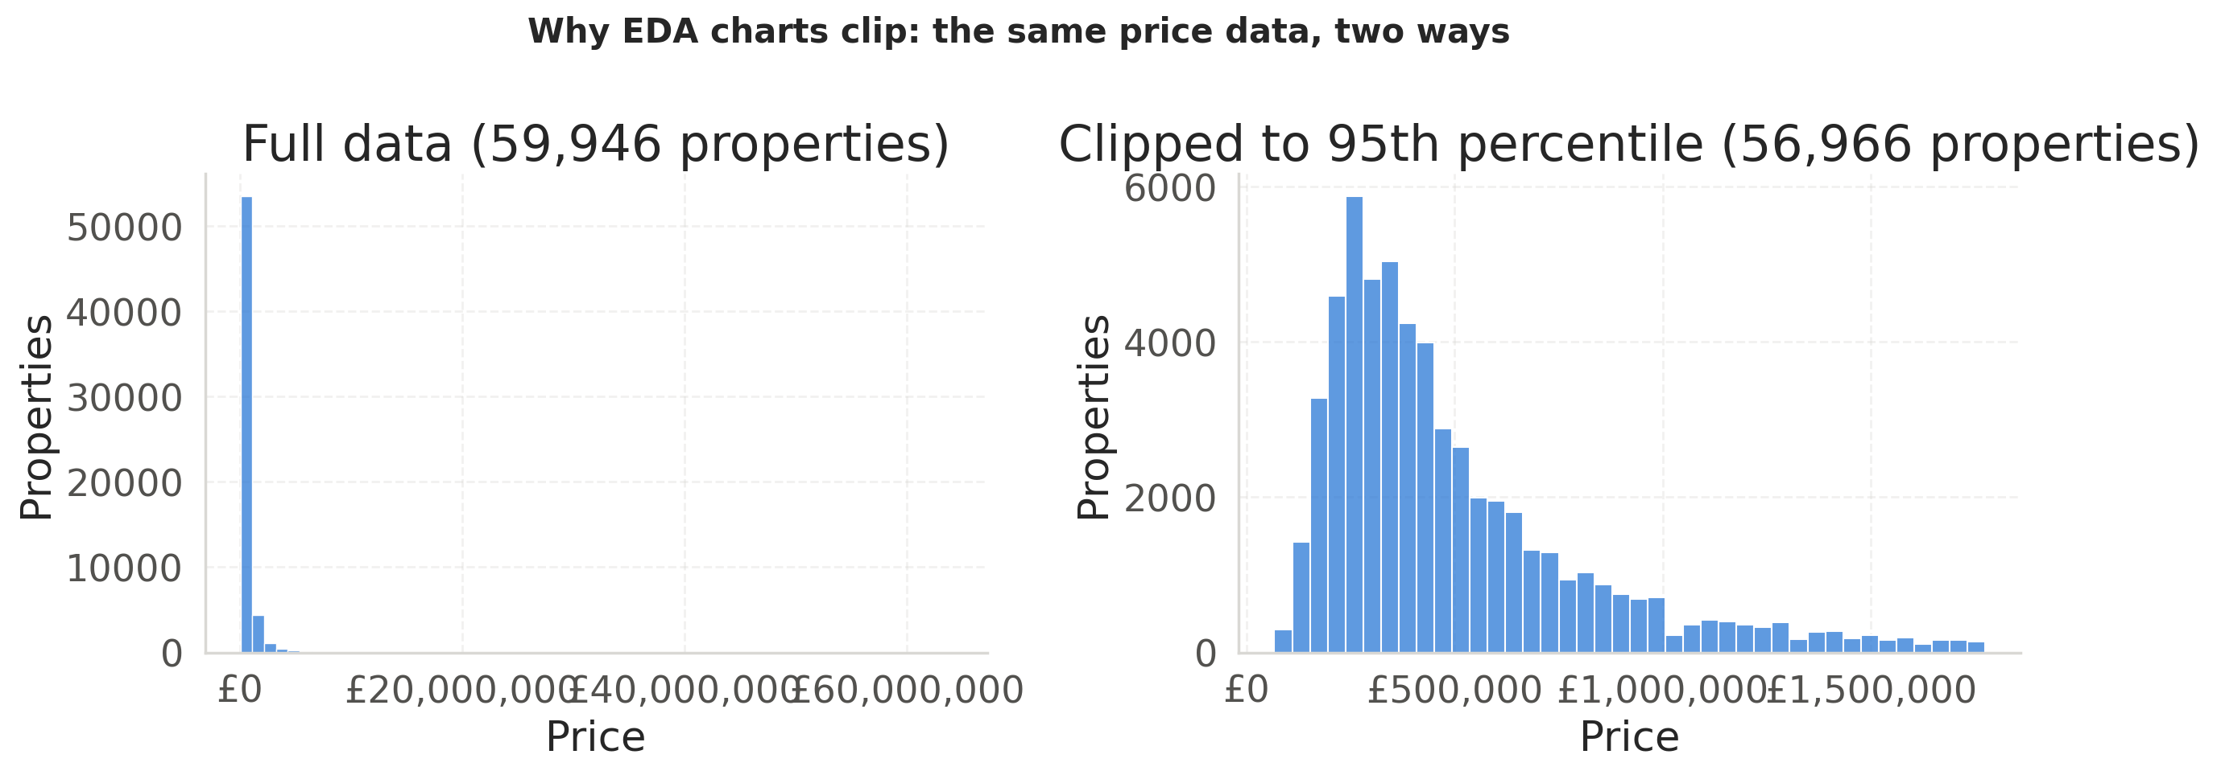
§8 · EDA
Price is right-skewed, which is why every model trains in log space
— Peak £250k–£300k, long tail; a few £20 M sales flatten the axis
— Charts clip at the 95th percentile — models see everything
— Log space makes the loss proportional at £200k and £2 M
13
Notes:
The first of two exploratory slides, and it exists to justify a modelling decision rather than to describe the market. Two panels of the same price column: the full distribution on the left, clipped to the 95th percentile on the right, 59,946 properties becoming 56,966 in the clipped view. The x axis is price in pounds, the y axis a count of properties. On the left the entire market collapses into a single spike against the axis, because a handful of multi-million-pound sales stretch the range to £60 million; clipped, the same data resolves into a proper right-skewed distribution with a visible peak and shoulder. The shape underneath is identical — only legibility changes, which is why every other exploratory chart uses the clipped view, and why the comparison is shown rather than asserted. The modelling consequence is the third bullet: a squared-pound loss on the raw scale is dominated by the expensive tail, where one £3 M house outweighs thirty £100k flats, so every model trains on log1p(price) and inverts with expm1. Anticipated question: does clipping bias the model? No — it is a display choice in the plotting functions only. Source: notebook cells 17 to 21.

Slide 14
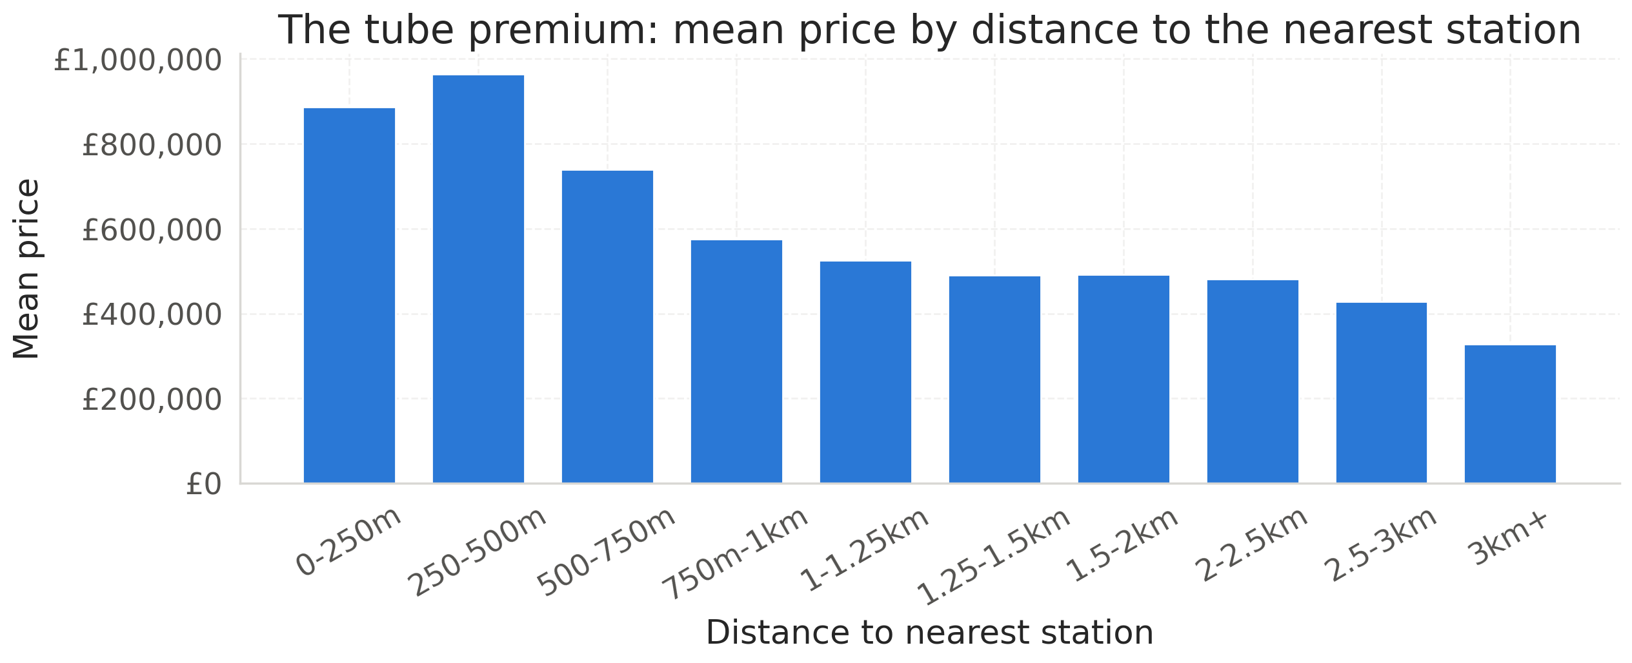
§8.1 · EDA
Location dominates — and the location features are heavily collinear
— £960k within 250–500 m of a station, under £350k beyond 3 km
— Borough spans 5× in median £/m²: £11,000 K&C to £2,300 Bexley
— floorAreaSqM and total_rooms correlate at r = 0.85
14
Notes:
The second exploratory slide, and the one that sets up section 14.5. The x axis is distance to the nearest station in bands, the y axis mean price; the gradient is steep and monotone after the first band — note that the very closest band, 0 to 250 m, is not the most expensive, plausibly a shorter walk traded against living right next to the station itself. The borough figure is the centre-to-edge gradient of the city in one number: Kensington and Chelsea over £11,000 per square metre against Bexley at about £2,300. On the statistical methods considered: this section uses Pearson correlation over the numeric block, group medians for the categorical splits, quartile banding for crime, and in section 8.2 within-group de-meaning and a differenced panel, which are the two standard ways of stripping a confound without fitting a model. The third bullet is the flag to plant: floor area and total rooms correlate at 0.85, and borough, outcode, latitude, longitude and distance-to-centre all encode where, so expect the ablation to find that removing whole feature groups costs almost nothing. Everything here is a marginal association — a different question from whether a feature adds anything the others do not already carry. Backup slides hold the correlation matrix, the borough ranking, the log-log scatter and the rate panels. Source: notebook cells 22 to 24.

Slide 15
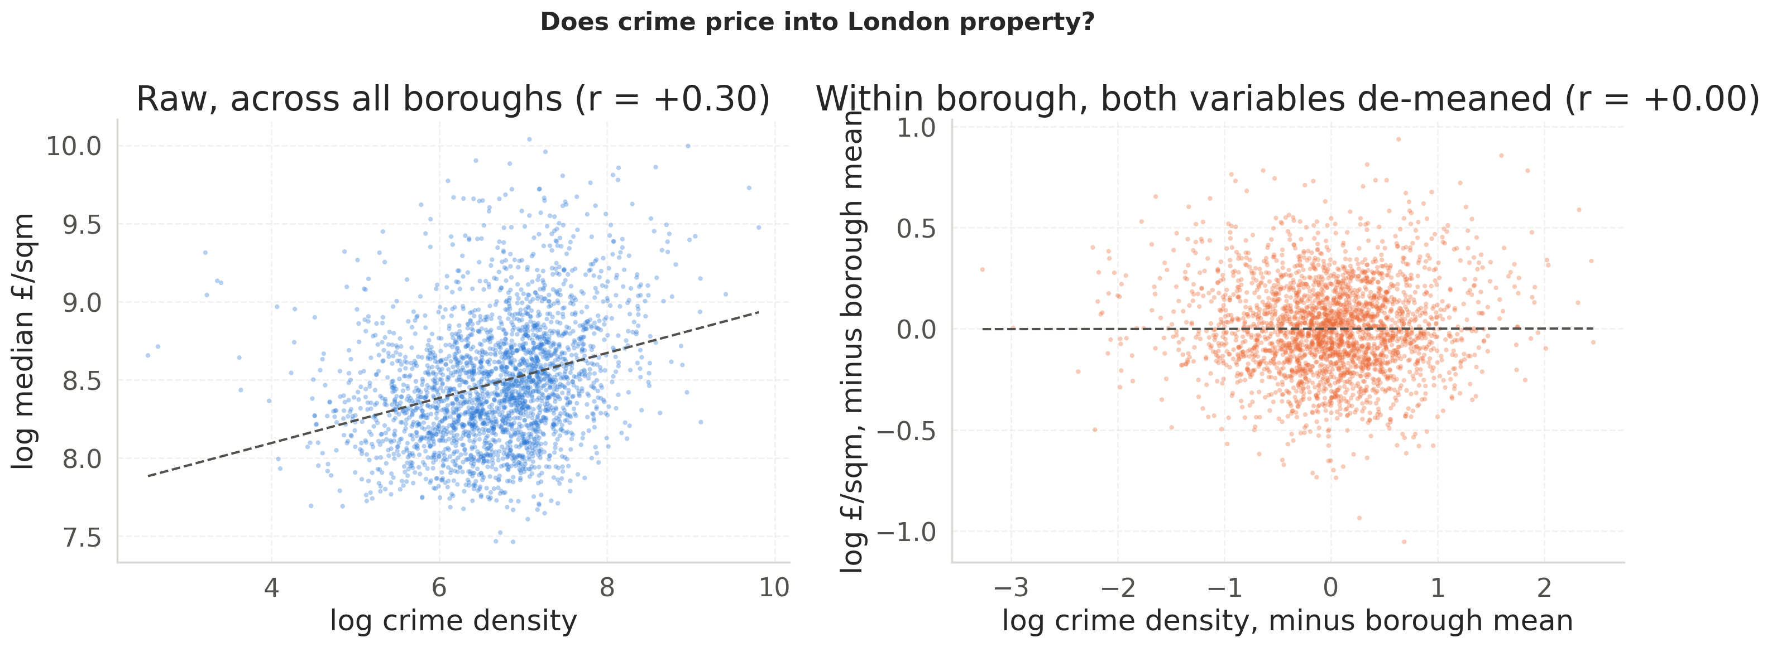
§8.2 · EDA
Higher-crime neighbourhoods cost more, because both track the centre
— Borough grain sums 4,835 LSOAs into 33 — a 147× aggregation loss
— Re-measured at LSOA grain, as a rate, split by category
— Across boroughs r = +0.30, within borough r = +0.00
15
Notes:
Both panels plot log median price per square metre against log crime density, one point per LSOA. On the left, raw across all boroughs, the fitted line slopes up at r = +0.30 — read naively, more crime means more money. On the right both variables are de-meaned within their own borough, and the relationship is gone: r = +0.00, a flat line through a formless cloud. The entire apparent association was which borough a property sits in. Explain why the re-measurement was necessary before the verdict: the pipeline sums 4,835 LSOA codes into 33 boroughs, a 147-fold loss that averages Hampstead together with Kilburn a mile away, and crime_volume is a raw count so a more populous borough scores high automatically — an LSOA count is already close to a per-capita rate because every LSOA holds roughly 1,500 residents. A second, independent check differences over time, asking whether LSOAs where crime fell saw faster price growth: r = −0.01 over 863 LSOAs. The choropleths that set this up, and the differenced scatter, are appendix slides. This is only the exploratory answer — slide 22 puts the same question to the fitted model. Source: notebook cells 25 to 30.

Slide 16

§8.3 & §9 · THE FILE'S OWN HISTORY
The file is a price history, not a transaction list
— Median 6.9 years earlier (p10 2.2, p90 13.8)
— Four features: prev_sale_price, has_prev_sale, years_since, days_since
— merge_asof backward, by fullAddress, allow_exact_matches=False
16
Notes:
This is the structural fact none of the charts surface, and it turns out to matter more than any of them. Removing the 24.5 % of rows that are exact duplicates leaves 314,895 distinct sales, and 66 % of addresses record two or more. Every other feature asks what is a property like this worth; a prior sale asks a much easier question — what was this exact property worth last time, and how far has the market moved since — with quality, layout, street and lease held fixed between the two observations. That is the logic of the repeat-sales index literature, Bailey Muth and Nourse 1963. History is read from the whole 1995 to 2024 file rather than the modelling window, because a 2009 sale's previous sale is usually pre-2008 and clipping first would discard most of the signal. Strictly before is load-bearing and three things could break it: the 102,527 duplicate rows are removed first or an as-of merge can return the very row it is meant to predict, 779 same-day price conflicts are collapsed to their median, and assert_no_lookahead runs as a hard check here and again in the section 17 self-checks. The columns are 38.9 % missing by construction, which is informative missingness rather than a defect — has_prev_sale lets the model treat never sold before as its own case. Slide 23 measures what all this is worth. Source: notebook cells 31 to 34.

Slide 17
§9 · FEATURES
Every feature answers one question: would the buyer have known this?
— Rolling market medians: .shift(1) then roll, dropping this month
— lagged_borough_median_sqm stamped onto the following month
— Crime lags: prior month, plus 12-month sum, closed='left'
— Rates forward-filled daily — the rate on completion day
— avg_room_size ±∞ → NaN, left NaN; imputing here leaks
17
Notes:
This is where most of the leakage risk in a property model lives, so every feature is built to answer one question. The shift-then-roll ordering is the important detail on the first bullet: the shift drops the current month before the rolling window opens, so a month's own median never informs its own prediction. The borough median per square metre is computed for a month and stamped onto the following one, for the same reason. Crime gets two lags and never contemporaneous data — the month immediately before the sale as a short-term safety signal, and a trailing twelve-month sum computed with closed='left' so the current month is excluded, as a stable reputation signal. The last bullet is the subtlest and worth dwelling on: total_rooms can be zero, so floor area divided by rooms yields plus or minus infinity, and those are converted to NaN and deliberately left as NaN. Filling them with the column median here would leak, because this function runs on the whole table before the split, so the median would be computed over validation, calibration and test rows and baked into a training feature. Small, but real. Imputation is deferred to each model, inside a pipeline fitted on the training split alone; gradient-boosted trees handle NaN natively. Also built here: days_since_start and a sine-cosine encoding of calendar month so December and January end up adjacent. Source: notebook cells 11, 12 and 32 to 34.

Slide 18
§10 · PARTITION
Split by time, and give calibration a slice of its own
Split | Rows | Date range
train | 35,967 | 2008-01-01 → 2014-04-17
val | 8,991 | 2014-04-17 → 2015-04-30
calib | 5,994 | 2015-04-30 → 2015-12-17
test | 8,994 | 2015-12-17 → 2016-12-31
— Cut 60/15/10/15 by date, never at random
— Evaluation universe fixed at ≤£4M: 8,840/5,916/8,859 rows
— Only training varies: raw 35,967, capped 35,693, cleaned 35,075
18
Notes:
The split is by time, not at random, because a random split would let the model learn from June 2016 to predict January 2016 — a situation that never occurs in production. Sorting by date and cutting sixty, fifteen, ten, fifteen reproduces the real task: train on the past, forecast the future. Calibration gets its own slice because one validation set cannot serve early stopping, model selection and conformal calibration at once without the 90 % guarantee being partly calibrated on data the model was already tuned against — that is circular. The evaluation universe is fixed for every model: validation, calibration and test rows under the £4 M cap, so leaderboard differences reflect the model and its training data and never a shifting denominator. Only the training data varies across the three variants — and IsolationForest, which flags 618 anomalies at a 2 % target rate, is fitted on the training slice and filters only that, because dropping flagged rows everywhere would be marking your own exam after removing the difficult questions. Dropped to the appendix: the encoding, where categorical levels are pinned from training and coercing those four columns with pd.to_numeric would silently blank all of them. Anticipated question: why validation before calibration in time? It was tested both ways and kept because it gives smaller validation-to-test drift for the tree models — and section 18 discloses that this comparison was itself made by scoring on test. Source: notebook cells 35 to 38.

Slide 19
§11 · DECISION RULES
The metric and the gates are fixed before any model runs
— Headline metric MdAPE — robust to the tail dominating MAE
— Model selection: lowest validation MdAPE, never test
— Feature-group gate ABLATION_GATE_PP = 0.15 pp
— Seed-noise floor: a gain must exceed 2× mean sd
— Coverage target 90 %; every model trained in log space
19
Notes:
Nothing is trained yet. This section fixes the three things that must be settled before any model runs, because deciding them afterwards is how a project talks itself into a result: what each model optimises, what everything is scored on, and what rule decides the winner. MdAPE is the median of absolute percentage errors; MAE is reported in pounds and is intuitive but is dominated by the expensive tail, where a 10 % miss on a £3 M house contributes thirty times more than the same miss on a £100k flat even though both are equally wrong in the only sense the buyer cares about. One regression_metrics implementation is used everywhere — near-identical variants defined across several cells are how a leaderboard silently mixes two spellings of one metric. The 0.15 pp gate is defined in the config cell rather than at its point of use, because two separate studies consume it and both must apply the same bar. The seed-noise floor is the second bar and it does real work on slide 22. The standing protocol: decisions read validation, test is read only to report — and section 18 records the two points where that was not followed. Source: notebook cell 39.

Slide 20
§11–§12 · WHAT WAS TRAINED
Fourteen models, five families — and what each one optimises
Model | Trained on | Objective
Ridge (baseline) | log1p(price) | squared error, alpha=1.0
XGBoost (plain) | log1p(price) | reg:squarederror
CatBoost (plain) | log1p(price) | MAE
XGBoost detrended | log(price / market level) | reg:absoluteerror
CatBoost detrended | log(price / market level) | MAE
— Each family trained on raw, capped and cleaned variants
— Plus luxury-routing MoE and 3-seed ensembles, on both targets
— No neural network: ~60k tabular rows, no text, images or sequence
20
Notes:
This is the full roster before any result is shown. It is a ladder, not fourteen guesses: each rung exists because the rung below it failed in a specific, diagnosable way. Ridge is the baseline — closed-form and hard to overfit, and a baseline should not need tuning to be fair; it doubles as a sanity check, because if a gradient-boosted ensemble cannot beat a straight-line model on tabular data of this shape then the problem is the setup, not the architecture. XGBoost and CatBoost on log price are the standard answer for tabular hedonic data, CatBoost specifically for native categorical handling of property type, tenure, borough and outcode. Rows four and five are the detrended target that slide 15 explains — mention it forward, do not explain it yet. Note the objective column carefully: XGBoost moves to absolute error because squared error in log space fits the conditional mean while the reported metric is a median, and CatBoost is left on MAE unchanged, which isolates whether the deflator or the objective is doing the work. The neural-network omission is deliberate and worth stating: sixty thousand rows of tabular data with no free text, images or sequence structure is where gradient-boosted trees win. Every trainer returns the same ModelBundle.predict signature, which is what lets the leaderboard, the test evaluation and the conformal calibration all run through one code path. Source: notebook cells 39, 41 and 43.

Slide 21
§12.1 · THE FAILURE
A tree's leaf is a constant, so it cannot follow a rising market
Model (validation) | Mean residual | Median residual | Under-predicted
XGBoost (capped) | £74,679 | £38,198 | 70.4 %
XGBoost detrended-market | £24,331 | £8,626 | 54.8 %
Ridge (baseline) | £51,754 | £36,073 | 65.6 %
— On test the plain boosters score 19.57–20.25 % against Ridge's 16.62 %
— Beyond the training range every row lands in the same boundary leaf
— Predicted signature: a large positive mean residual, not noise
21
Notes:
Start with the anomaly: gradient-boosted trees are normally the stronger choice on tabular data of this shape, so a plain Ridge regression beating them reads as a symptom, not a verdict on the architecture. The mechanism is structural. A tree's prediction is a constant per leaf, so once a trending feature such as days_since_start or market_median_rolling_3m exceeds anything seen in training, every such row lands in the same boundary leaf and the model flat-lines at the last price level it learned. It cannot extrapolate a rising market. That mechanism makes a testable prediction — a large, one-directional positive mean residual, where residual is actual minus predicted — and the table measures exactly that, on validation only. Plain XGBoost under-predicts by a mean of £74,679 and under-predicts 70.4 % of rows. Be precise about what the table also shows: Ridge under-predicts too, by £51,754, because the market rose faster than any linear projection of its training window. So the accurate claim is not trees cannot extrapolate and Ridge can — it is that a non-stationary target biases every model here and punishes the trees hardest. What separates them is the size of the level error, not its presence. Crucially this is all measured on validation, so the fix on the next slide never required the test set. Source: notebook cells 42, 44, 45 and 46.

Slide 22
§12.1 · THE FIX
Predict the ratio to the market, and the trees only interpolate
# market_median_rolling_3m is the leakage-safe §9 column
y = log(price / market_level)
model.fit(X_train, y)
price_hat = exp(model.predict(X)) * market_level
— The ratio is near-stationary while the market itself trends
— Mean residual £74,679 → £24,331; XGBoost objective → reg:absoluteerror
— Two deflators enter the pool — slide 20 decides on validation
22
Notes:
The fix does not make the trees better at extrapolating; it removes the need to extrapolate at all. Instead of predicting price, predict the ratio of price to the lagged whole-market median — a column that already exists from section 9 and is leakage-safe by construction. How much is this property worth relative to where the market already is, is close to stationary across time even while the market itself trends, so a tree only has to interpolate within the range of ratios it saw in training. The market level is multiplied back onto the prediction at inference. A second change rides along for XGBoost only, the move to absolute error, for the reasons on slide 12; CatBoost already trained with MAE, so leaving it alone isolates which of the two changes is doing the work. Emphasise that two deflator candidates enter the pool rather than one — the market-wide median and a borough-and-size-scaled alternative — and both are registered in train_all like every other model, so whichever wins validation becomes BEST and flows through the whole downstream. Slide 20 reports that head-to-head. Anticipated question: is dividing by a market median leakage? No — the median is shifted by one month before the rolling window opens, so it contains no information from the month being predicted. Source: notebook cells 42 to 46.

Slide 23
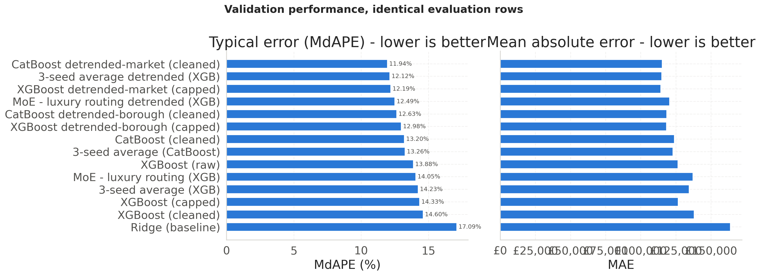
§13 · VALIDATION
Every detrended model outranks every plain one
— Top: CatBoost detrended-market (cleaned) at 11.94 % validation MdAPE
— Ridge 17.09 %; the detrended family sweeps positions one to six
— Luxury-routing MoE 12.49 % loses to its own 3-seed control, 12.12 %
— Built from the results registry, so the table cannot disagree
23
Notes:
Fourteen models ranked by validation MdAPE on the left, mean absolute error on the right, both lower-is-better, every model scored on the same 8,840 validation rows. The single largest effect in the whole leaderboard is the block structure: every model trained on log price over market level outranks every model trained on log price, which confirms section 12.1 diagnosed the right problem. Point out that the two panels do not agree on ordering — they answer different questions, typical percentage miss versus average pound miss, the latter dominated by expensive properties. Selection uses MdAPE as fixed on slide 12; MAE is reported so the disagreement is visible rather than hidden. The table is generated from the results registry, where every row was appended by evaluate() at training time, so the leaderboard cannot disagree with what the models actually scored — a hand-assembled table typed into a DataFrame literal carries no such guarantee. Whichever model tops this table becomes BEST, and nothing has read the test split yet. The full fourteen-row table with R2 and within-25 % is an appendix slide. Source: notebook cells 47 to 49.

Slide 24
§14 · HELD-OUT TEST
Test costs every model 1.3–5.7 pp — and the winner is not the test winner
Model | Val MdAPE | Test MdAPE | Drift
3-seed average detrended (XGB) | 12.12 % | 13.62 % | +1.50 pp
CatBoost detrended-market ← selected | 11.94 % | 13.88 % | +1.94 pp
XGBoost detrended-market (capped) | 12.19 % | 13.88 % | +1.68 pp
Ridge (baseline) | 17.09 % | 16.62 % | −0.47 pp
XGBoost (cleaned) | 14.60 % | 20.25 % | +5.66 pp
— The 0.26 pp gap to the test winner is the selection effect
— Not corrected — revising here makes test a selection signal
— Plain boosters fall behind Ridge on test, confirming §12.1
24
Notes:
The procedure is: pick the winner by validation MdAPE, then score on test; the gap between the two is the honest measure of how much validation performance was selection effect. Validation picked CatBoost detrended-market at 11.94 %, and it scores 13.88 % on test. The best test score belongs to the 3-seed average detrended at 13.62 %. That 0.26 pp gap is the selection effect made visible, and it is deliberately not corrected, because correcting it would mean choosing the deployed model on test — the one thing holding test out was meant to prevent. Every model drifts worse on test, which is expected because validation drove early stopping and its scores are optimistic by construction; the drift column is the size of that optimism. The last row is the confirmation of section 12.1: plain boosted trees land at 19.57 to 20.25 % against Ridge's 16.62 %, so the diagnosis was structural rather than a validation-set artefact. One number worth having ready: Ridge's test R2 is minus 180.118 against 0.539 on validation — a few catastrophic extrapolations on expensive properties, which is exactly why R2 is reported and never decided on. Near-ties at the top should not be over-read: where two models sit within 0.1 pp on validation, that gap does not reliably predict which wins on test. Full fourteen-row table in the appendix. Source: notebook cells 50 to 52.

Slide 25
§14.1 · DIAGNOSTIC
Is the headline number measuring valuation, or memorisation?
Test subset | Rows | MdAPE | MAE | within 25 %
Seen in training | 2,112 | 12.75 % | £118,212 | 79.97 %
Unseen property | 6,747 | 14.30 % | £137,644 | 75.49 %
— The split cuts on time, not property — 23.8 % were seen
— Read the unseen number as generalisation to new stock
— Fix: a group-aware split keyed on fullAddress
25
Notes:
The source file is a price history, one row per sale event, so a dwelling that changed hands three times between 2008 and 2016 contributes three rows. A chronological split cuts on time, not on property, which means a flat sold in 2010 into training and again in 2016 into test appears on both sides of the wall — 2,112 of the 8,859 test rows. That is not automatically cheating: forecasting a known building's next sale price is a real business task and the lagged features remain strictly historical. But it does mean the headline test metric blends two different problems — re-valuing a property the model has already seen, and valuing one it never has — and the second number is the one that generalises to new stock. The gap is 1.54 percentage points, which is modest; if it were large the headline metric would be measuring memorisation as much as valuation. This matters more now than before section 9, because prior-sale features make the model explicitly better on exactly the repeat properties this diagnostic isolates — which is also the clearest single argument for why they work. The fix is improvement number one in section 18. Source: notebook cells 53 to 55.

Slide 26
§14.3 · TARGET TRANSFORM
The coarser deflator wins — a noisy divisor corrupts every label
Target transform | XGB val | XGB test | CatB val | CatB test
regular log(price) | 14.33 % | 19.92 % | 13.20 % | 18.03 %
detrended market-wide | 12.19 % | 13.88 % | 11.94 % | 13.88 %
detrended borough-scaled | 12.98 % | 14.32 % | 12.63 % | 16.00 %
— Market-wide wins on validation for both backends, and on test
— The borough deflator uses far fewer sales per month
— As a divisor its noise enters the label directly
26
Notes:
The open question from section 12.1: once a market-wide deflator fixes the extrapolation problem, does a more granular one do better — deflating by borough and property size rather than the whole market? The intuition says yes, a deflator built from genuinely comparable properties should carry more signal. The data says the opposite, for both backends, and by a wide margin for CatBoost on test. The explanation is on the last two bullets and it is the best transferable lesson in the project. The borough deflator, lagged_borough_median_sqm times floor area, is estimated from one borough's transactions in a three-month window rather than the entire city's thousands of sales. Because the deflator is a divisor, a noisier deflator injects that noise directly into every training label it divides, not merely into one more feature the model could choose to down-weight. And the coarser deflator costs nothing in borough- or size-specific signal, because borough, floorAreaSqM and the borough median all remain ordinary input features — the tree stays free to learn that a borough commands a premium, from uncorrupted labels. The general lesson: a detrending deflator should remove only what the architecture genuinely cannot learn on its own; anything the model can already learn from a feature should stay a feature, not get folded into the label. The winner was chosen on validation; the test columns are shown so you can judge whether the choice generalised, not so it could make the choice. Source: notebook cells 56 to 58.

Slide 27
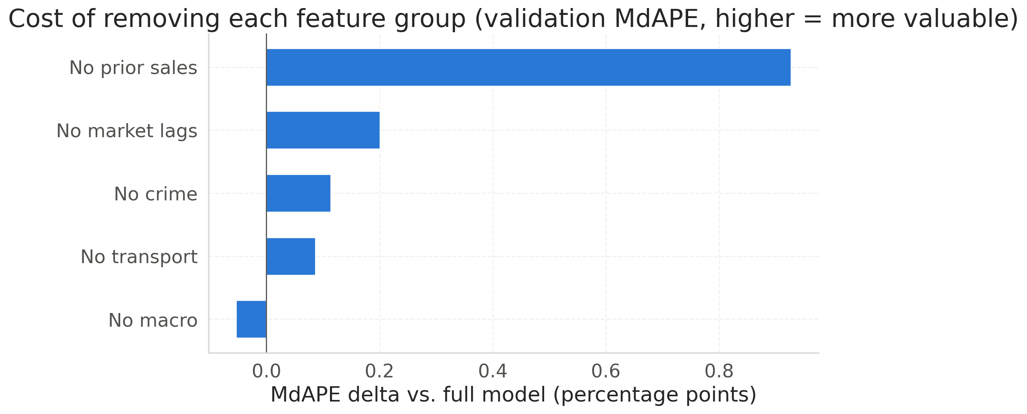
§14.5 · ABLATION
Only the property's own history clears the gate
— Prior sales +0.93 pp; market lags +0.20, crime +0.11, transport +0.09
— Removing interest_rate improves the model — it is already in the target
— Ablates the shipped recipe on validation, because this decides something
27
Notes:
The x axis is the cost in validation MdAPE percentage points of removing each feature group; a longer bar means the group was carrying more weight. The method matters: this retrains the winning recipe — XGBoost on the detrended target, capped variant — once per group, because ablating a plain-target model would measure feature value on a model already handicapped by something else. It is scored on validation, not test, because this study decides something, and although early stopping makes the absolute MdAPE optimistic, every variant carries the identical bias and the gate consumes only the delta. Prior sales at +0.93 pp is six times the next-largest group and the only one comfortably clear of the 0.15 pp gate. Now reconcile with the exploratory analysis, because three of the four external drivers slides 7 and 8 presented as important measure as worth roughly nothing here — that is not a contradiction, the two analyses answer different questions. Transport had a steep bivariate gradient but borough, outcode, latitude, longitude and distance-to-centre already encode where, so it is largely redundant given them. The base rate is one value per month shared by every row, which is exactly the market-level time trend the detrended target and the market lags already absorb, so what remains is noise and removing it helps. One caveat: market lags cannot be fully ablated, because the deflator keeps them in the label, so +0.20 pp is a lower bound. Source: notebook cells 59 to 61.

Slide 28
§14.5 · CRIME VERDICT
Crime fails at its best resolution too, so the window can widen
Crime design | Cols | MdAPE mean | Gain | Seeds won
No crime | 0 | 12.153 % | +0.000 pp | 0 / 5
Borough count (status quo) | 2 | 12.136 % | +0.017 pp | 4 / 5
LSOA by category (best) | 4 | 12.069 % | +0.084 pp | 3 / 5
— Six designs × five seeds, each gain paired within its seed
— Best gain +0.084 pp, under both the gate and the noise
— So drop crime and widen to 1995–2024 — roughly 5× data
28
Notes:
This is the scoping decision the whole dataset size depends on. The crime file only covers 2008 to 2016, and that single constraint is why the modelling window stops there: 59,946 in-window sales against 314,895 distinct sales in the full history, so 81 % of the record is discarded to accommodate one feature block. The ablation on the previous slide removed borough-grain, unnormalised, all-category crime, so before acting on that verdict the same question is asked of crime measured properly — six designs over identical rows and an identical target, with only the crime columns moving. Two details make it a test rather than a formality: five seeds, because a single gradient-boosted fit cannot separate a 0.1 pp effect from run-to-run variation, and each gain paired within its seed before averaging so seed-level variation cancels. The best design is LSOA grain split by category at +0.084 pp — better than borough grain, still below the gate, and more importantly below the noise it was measured through: the seed noise floor is 0.097 pp and this design's own gain standard deviation is 0.187 with only three of five seeds won. Both bars matter; a gain clearing the gate but not the noise floor would mean reading a decision off a number the experiment cannot resolve. Say the fairness point out loud: crime was not dismissed on a technicality. It was measured 147 times more finely, normalised, and split by category, and still did not clear. All six designs are in the appendix. Source: notebook cells 62 to 65.

Slide 29
§14.6 · PRIOR SALES
A past price is only interpretable against how long ago it was paid
Prior-sale design | Gain vs. none | Seeds won
Prior price only | +0.453 pp | 3 / 3
Prior price + elapsed time | +0.913 pp | 3 / 3
Full six-column candidate set | +0.894 pp | 3 / 3
— +0.913 pp — roughly 6× the gate, and winning on every seed
— Adding when the sale happened doubles the value of the price alone
— log_prev_sale_price and n_prior_sales earn nothing and are dropped
29
Notes:
Same protocol as the crime study — same 0.15 pp gate, seeds paired within run — so the two verdicts are directly comparable, and the contrast is stark: crime's best design scored +0.084 pp with a standard deviation larger than its mean, while this scores +0.913 pp with all seeds agreeing. The substantive finding is the middle row. Prior price by itself is worth about +0.45 pp; adding when that sale happened — years_since_prev_sale and prev_sale_days_since_start — takes it to +0.91. A past price is only interpretable against how long ago it was paid: £400k in 2009 and £400k in 2015 say very different things about what a property is worth today. The third row is the rejection: carrying all six candidate columns scores worse than carrying four, so log_prev_sale_price and n_prior_sales earn nothing — a tree splits on order, and the log of a column it already holds is the same ordering. This is the single largest modelling gain in the project, larger than any architecture choice and second only to the target reframing. Worth saying: these features were sitting in the source file from the beginning, and the pipeline read a price history as a transaction log for its entire first version — the largest wins often come from re-reading the data you already have. Caveat to disclose if asked: this cell errored in the notebook's last saved run, so the table is from a faithful re-execution that reproduces every other number in the notebook exactly. Source: notebook cells 66 to 69.

Slide 30
§15 · CONFORMAL
A point estimate is not actionable — the product is a floor
r = actual / predicted # on the calibration split only
q_10 = quantile(r, 0.10) # -> 0.7674
floor = predicted * q_10 # flag when price < floor
— Ratios not differences: errors widen sharply with price
— Calibrated on its own slice — validation drove early stopping
— Lower tail only: a screen needs a floor, not a ceiling
30
Notes:
A predicted price is not enough to justify spending money; what an investor needs is a floor, a value the property is very unlikely to be worth less than. Multiplicative split conformal prediction supplies one. On the dedicated calibration split of 5,916 properties, compute the ratio of actual to predicted price for every property, take the tenth percentile, and the floor for a new property is its prediction times that multiplier — here 0.7674, so the floor sits at about 77 % of the prediction. Why ratios rather than differences: absolute residuals in this market are heteroscedastic and errors widen sharply as price rises, so a £3 M house misses by far more pounds than a £200k flat while being no less accurate in percentage terms; a single absolute quantile would be far too loose at the bottom of the market and far too tight at the top, whereas the ratio form scales the buffer with the price so one calibration serves both tiers. Why calibration is not the validation set: split conformal assumes the calibration residuals were not used to fit the model, and validation was — for early stopping and architecture choice — so a model's iteration count is implicitly tuned to minimise error on exactly those rows and q_10 there would be optimistically tight. Only the lower tail is kept because a flip screen cares about the floor, not the ceiling, which is where this departs from the textbook two-sided interval. Source: notebook cells 70 to 72.

Slide 31
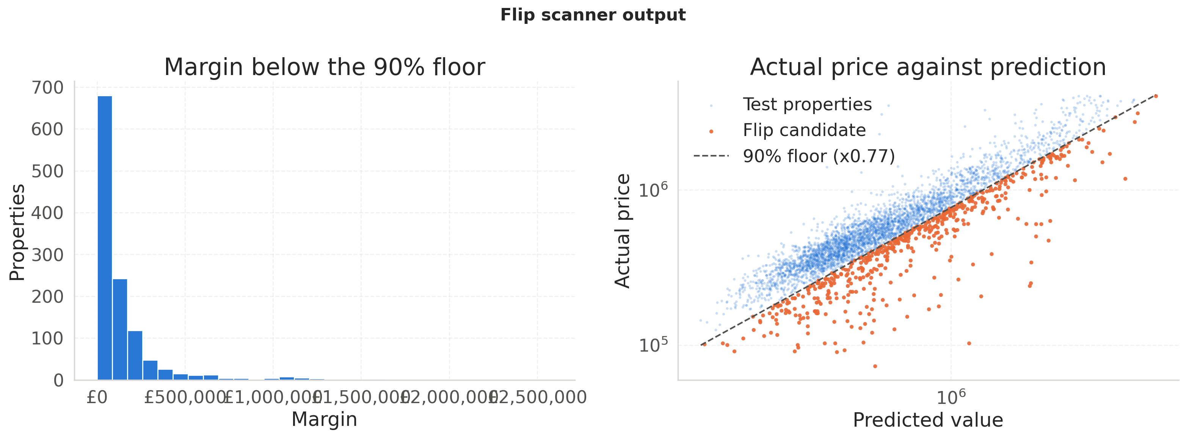
§15 · THE SCAN
The floor holds at 86.61 % on data it was never fitted on
— Target 90 %, empirical 86.61 % on test — reported, not corrected
— 1,186 of 8,859 flagged (13.39 %); median margin £66,124
— A flip rate is a screening rate, not a hit rate
31
Notes:
Left panel: the distribution of margins below the floor across flagged properties, x axis pounds, y axis a count — right-skewed, so most flagged properties sit just below the floor and a few sit far below. That far tail is where the screen is most interesting and also where it is most likely picking up something the data does not record: a short lease, a structural problem, a distressed sale. Right panel: actual price against predicted value for all 8,859 scanned properties on log-log axes, with the calibrated floor drawn through it as a dashed line at 0.77 times the prediction; the orange points below the line are the candidates. The line is not a decision boundary the model learned — it is the conformal bound applied uniformly. Coverage is the number that validates the method: 86.61 % against a 90 % target, a 3.39 point shortfall. That is expected rather than alarming, because the market drifted between the calibration window and the test window, which is precisely the departure from exchangeability a chronological split cannot rule out. It is reported rather than corrected, because correcting it against test would turn test into a tuning signal. The self-checks assert coverage instead on a held-out slice of calibration, where it lands at 88.39 %. Be firm on the last bullet: a flagged property sold below a calibrated valuation floor, and that says nothing about why. Source: notebook cells 71 to 74.

Slide 32
RESULTS
13.88 % typical error — and the reframed target is what got there
Result | Figure
Selected model (chosen on validation) | CatBoost detrended-market — 13.88 % test
Ridge baseline | 16.62 % test
Plain gradient-boosted trees | 19.57–20.25 % test
Strongest feature group | prior sale, +0.93 pp
Weakest feature group | crime, +0.11 pp — below the gate
— The result is the target reframing, not the architecture
— Floor at ×0.7674 covers 86.61 % against a 90 % target
— 1,186 of 8,859 test sales fall below their own floor
32
Notes:
This is the recap: everything the pipeline found, in one place, after the argument that earned it. Read the table top down. The selected model was chosen on validation MdAPE alone and scores 13.88 % on a test split nothing before section 14 had read. Ridge, the linear baseline, scores 16.62 %. The plain gradient-boosted trees land at 19.57 to 20.25 %, worse than the linear baseline — which is the anomaly the whole middle of the talk exists to explain. The bottom two rows are the scoping verdicts: a property's own prior sale is worth +0.93 pp and is the strongest block in the model, while crime is worth +0.11 pp and fails the 0.15 pp gate it had to clear to justify confining the window to 2008-2016. The first bullet is the sentence to land: no architecture change moved the number as much as reframing the target from price to price relative to the market level. The last two bullets are the product: a floor at 0.7674 times the prediction, covering 86.61 % of held-out sales against a 90 % target, flagging 1,186 of 8,859. Next slide qualifies all of it. Source: notebook cell 0, with the figures from cells 51, 60, 63 and 71.

Slide 33
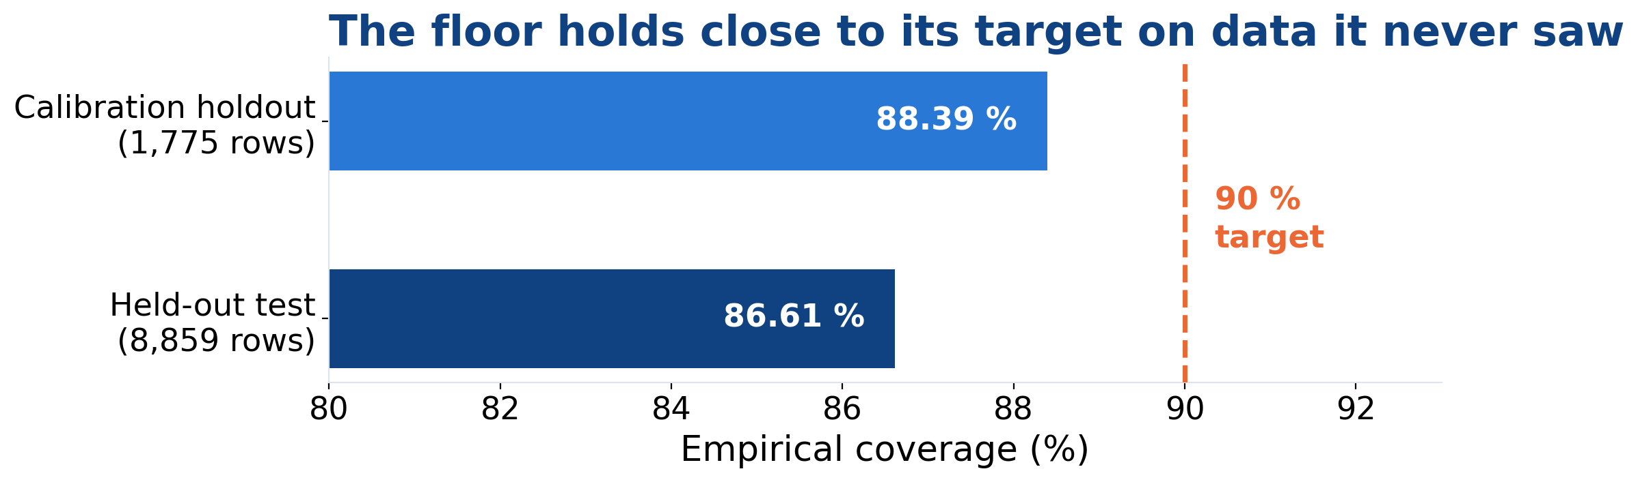
FINAL ANALYSIS
Answering the three questions we opened with
— Value: 13.88 % typical error; 75.5 % of unseen within 25 %
— Crime: no — at LSOA grain, as a rate, split by category
— Learned: the file's own history beat any model choice
33
Notes:
Close the loop the Initial Questions slide opened, in the same order. Question one, what is a property worth: the selected model reaches 13.88 % median absolute percentage error on a test split nothing before section 14 had read, and — the number that matters for generalisation — 75.5 % of properties the model had never seen before land within 25 % of their actual price. Question two, can we put a floor under that: yes, and it is checked rather than assumed. Empirical coverage is 86.61 % on test against a 90 % target, and 88.39 % on a held-out slice of the calibration split that the multiplier was not fitted on. The shortfall on test is market drift between the calibration and test windows, reported rather than corrected because correcting against test would turn test into a tuning signal. Question three, does crime price in: no — and we can say that fairly, because it was re-measured 147 times more finely, normalised into a rate and split by category, and still failed both the 0.15 pp gate and the seed-noise floor. How we justify these answers: every decision was made on validation with the rule fixed in advance, test was read only to report, and the design studies were run under multiple seeds with gains paired within seed. The last bullet is the thing worth remembering — the largest single gain in the project came from re-reading data we already had, not from adding a model on top. Next slide is what this still is not. Source: notebook cells 51, 54, 63, 67, 71 and 80.

Slide 34
§18 · LIMITS AND NEXT
What this is not, and the two changes worth making first
— It scores completed sales, not listings anyone can buy
— Coverage is marginal, not conditional; not per borough
— The evaluation universe is defined using the target
— Next: split by property, keyed on fullAddress
— Next: drop crime, widen to 1995–2024 — ~5× data
34
Notes:
Close on the honest limits rather than the headline. The target is what a property actually sold for, so a sale below its floor in 2016 validates the valuation model but is not something anyone can act on; a live scanner needs a listings feed and a calibration step for the asking-to-sold gap, which is a different distribution. The flip flag is a statistical claim, not a financial one: it says nothing about stamp duty, refurbishment, financing, fees, or why the property is cheap — and properties are usually cheap for a reason the data does not record, a lease with few years left above all. Coverage being marginal means roughly 90 % of properties sit above the floor overall, which does not guarantee 90 % inside any particular borough or price decile; Mondrian conformal is the named fix. The third bullet is the sharpest self-criticism in the project: both the £1,500 per square metre floor and the £4 M cap read price, so the reported MdAPE describes a population you could not actually select in production, where price is the unknown. Also worth mentioning: the window ends a decade ago and four shocks fall outside it — the Brexit referendum, the 3 % stamp-duty surcharge aimed squarely at this kind of purchase, the pandemic, and the 2022 rate cycle. The two next steps are ranked in the notebook; widening the window is described as almost certainly worth more than every other item combined. Backup slides cover the remaining six improvements, the live Rightmove scan, and the related work. Source: notebook cell 80.

Slide 35
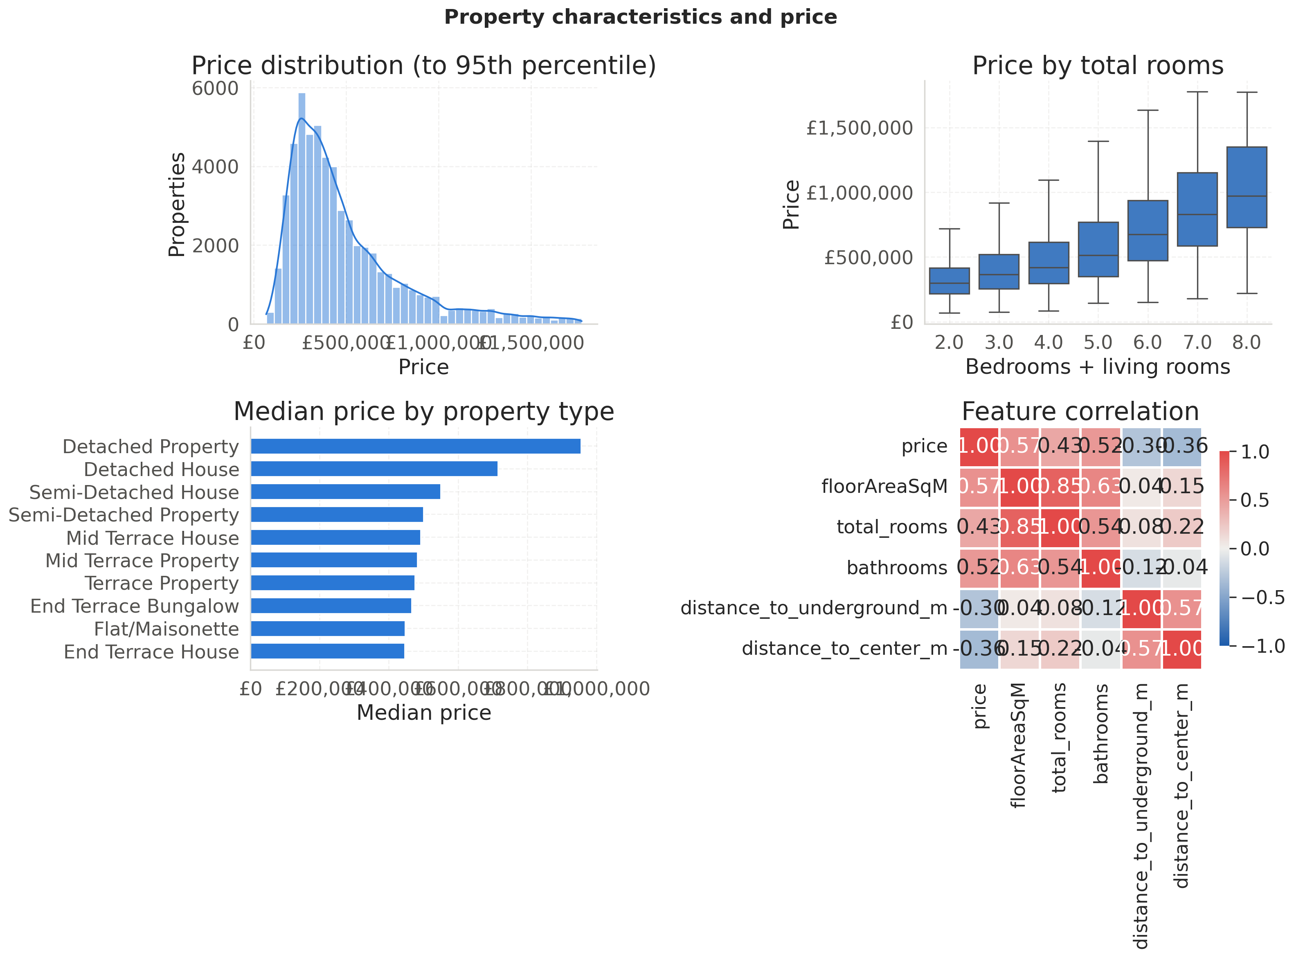
APPENDIX
A1 · Property characteristics and price, all four panels
35
Notes:
The full section 8 figure: price distribution clipped at the 95th percentile, price by total rooms, median price by property type, and the correlation matrix. Median price rises from about £320k at two rooms to roughly £950k at eight, but the boxes widen and overlap heavily at the top end — room count alone does not pin down price for larger properties. Detached properties top the median-price ranking at roughly double the cheapest terraced categories. In the correlation matrix, floorAreaSqM leads the positives at r = 0.57 and bathrooms at 0.52, while distance_to_center_m at −0.36 and distance_to_underground_m at −0.30 lead the negatives. The 0.85 between floorAreaSqM and total_rooms is the collinearity that slide 21 cashes in. Source: notebook cell 20.

Slide 36
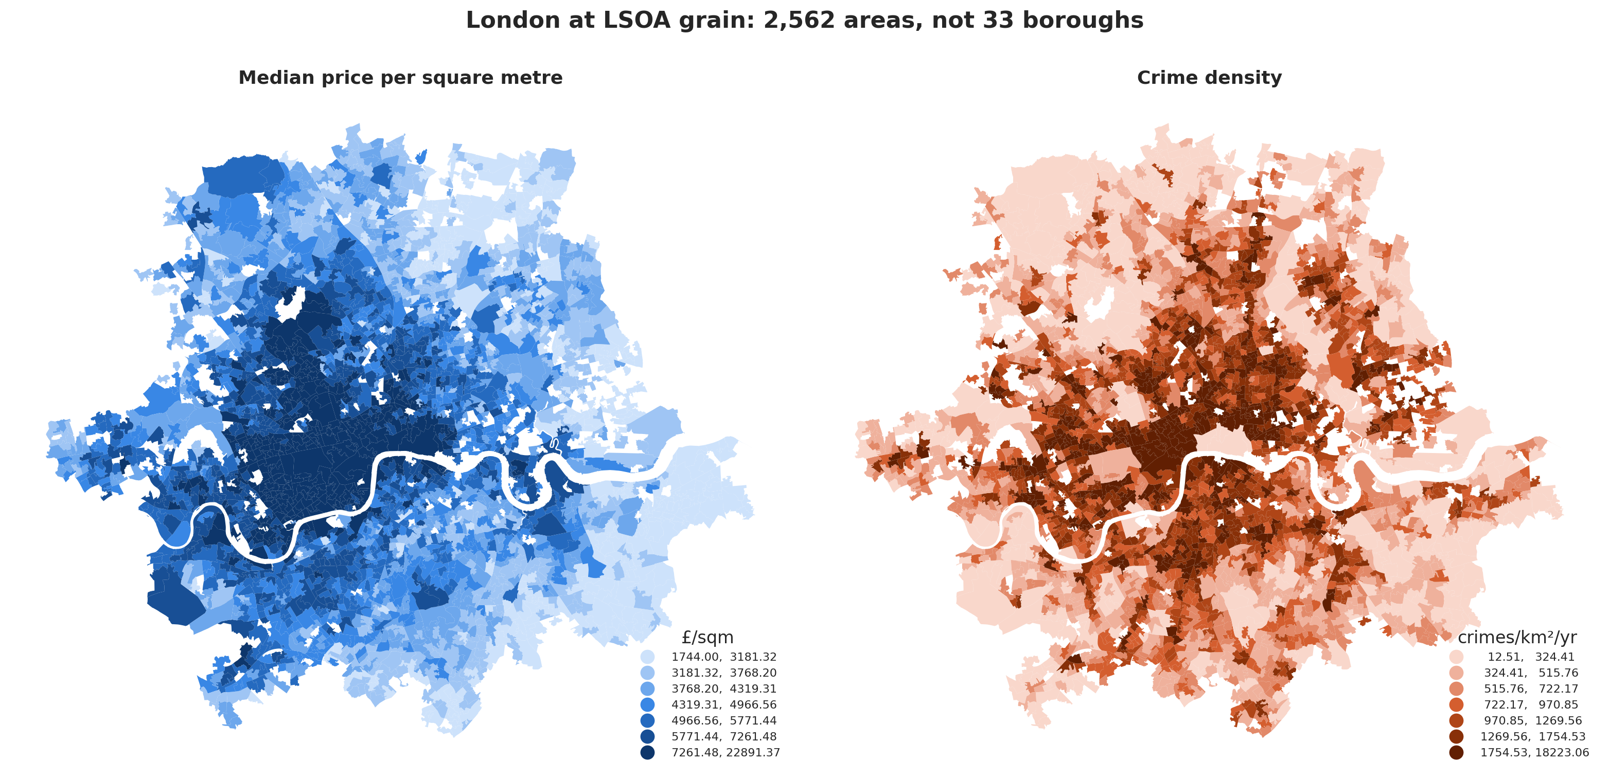
APPENDIX
A2 · The confound, mapped: price and crime at LSOA grain
36
Notes:
Two choropleths of Greater London at LSOA grain, price per square metre on the left in blue and recorded crime density on the right in orange, one hue each so the panels cannot be misread as sharing a scale. 2,562 of the 2,863 Greater London LSOAs record at least five sales in the window and are used here. Both maps run darkest in the middle: central London is simultaneously the most expensive and the most crime-recording part of the city, so the raw association comes out positive and naively more crime looks like more money. This is the confound the within-borough de-meaning on slide 8 removes. Source: notebook cells 26 and 27.

Slide 37
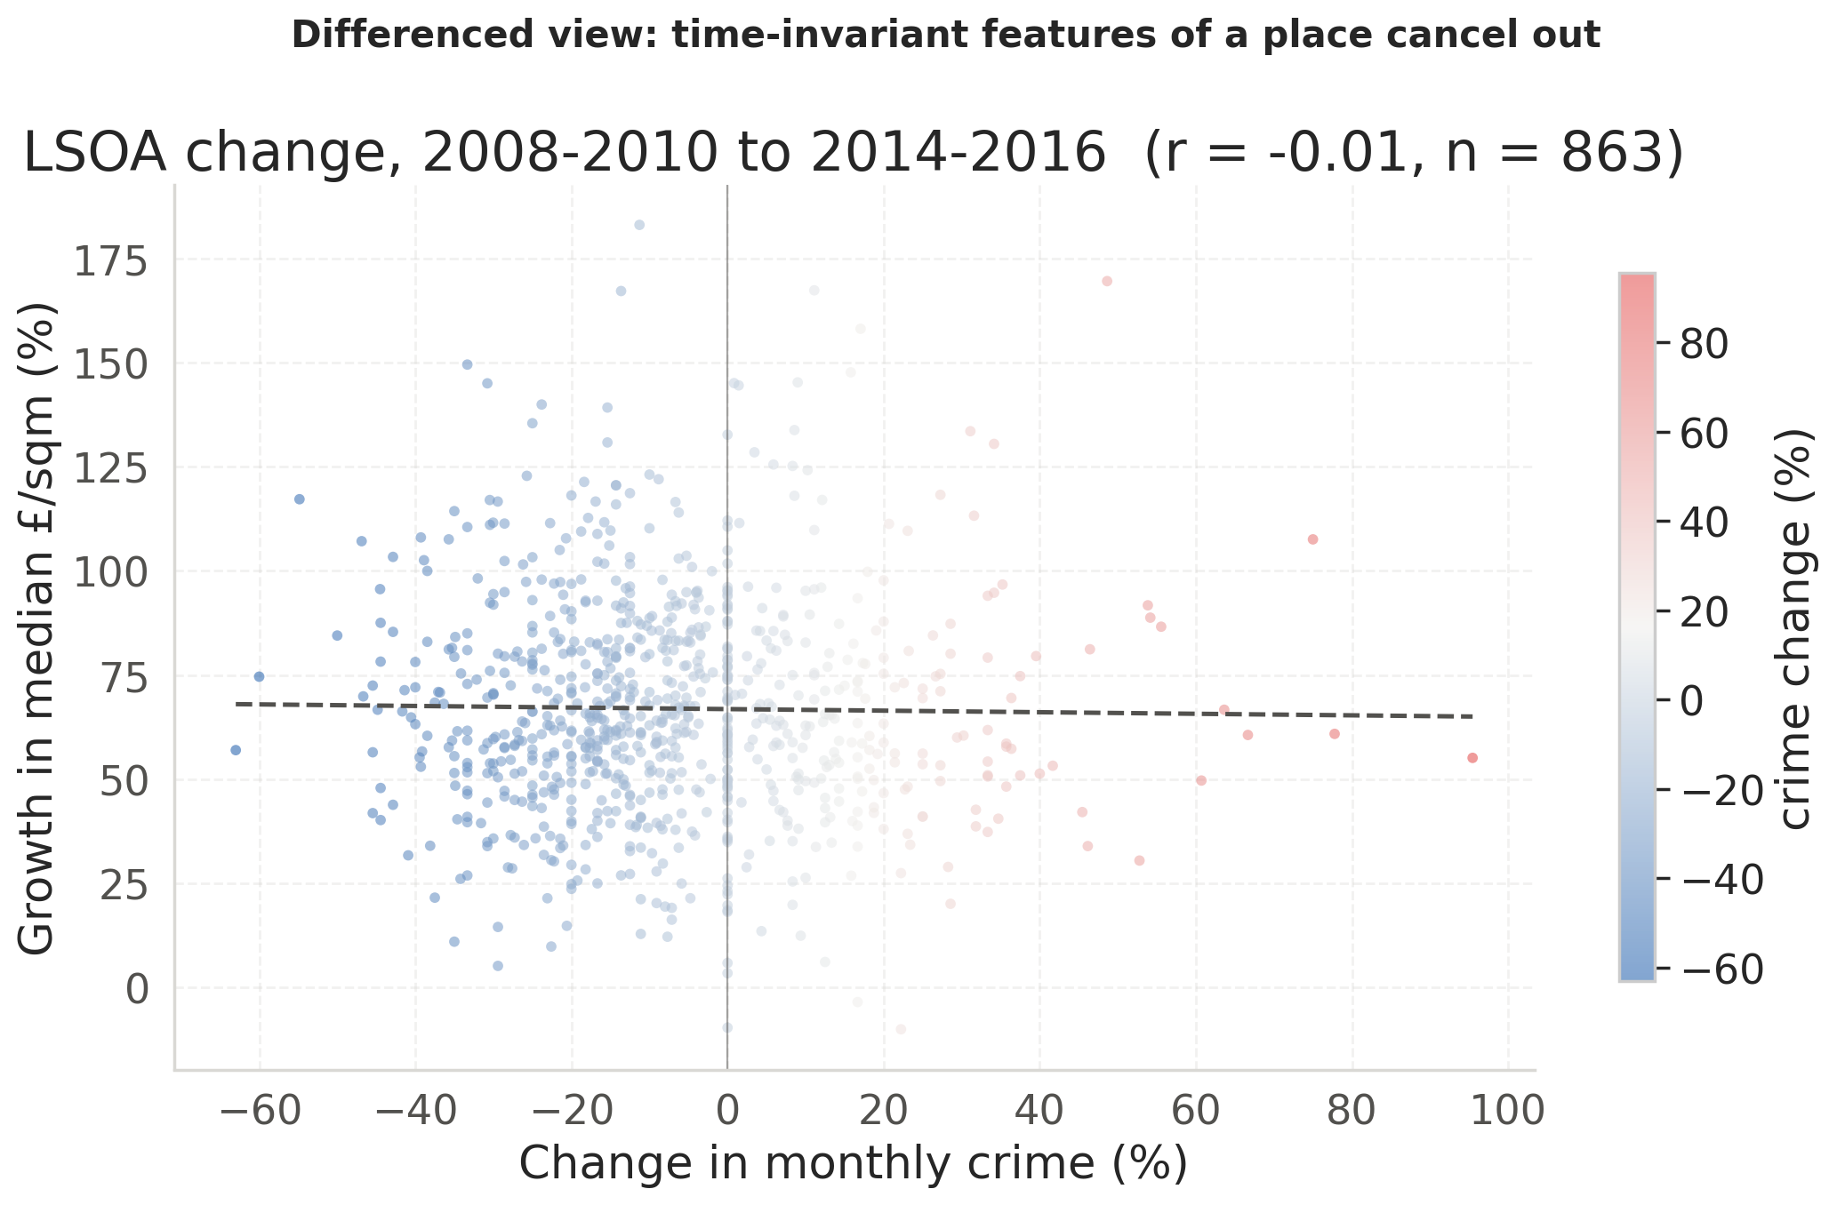
APPENDIX
A3 · The differenced view: crime change against price growth
37
Notes:
A second, independent route to the same verdict. The x axis is the percentage change in monthly crime for an LSOA between 2008-2010 and 2014-2016; the y axis is that LSOA's growth in median price per square metre over the same period; colour encodes the crime change again. Differencing removes every fixed feature of a place at once — architecture, parks, distance to the centre, reputation — and asks a sharper question: did the LSOAs where crime fell see faster price growth than the ones where it rose? The fitted line is flat, r = −0.01 over 863 LSOAs. Whatever the raw scatter measures, it is not crime. Source: notebook cells 29 and 30.

Slide 38
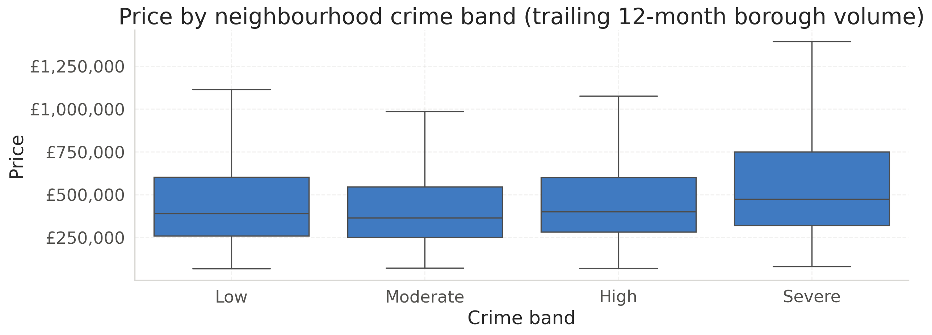
APPENDIX
A4 · The chart that started §8.2: price by crime band
38
Notes:
Median price climbs from the Low band through to Severe, topping out over £470k against roughly £390k in Low. Read naively this says more crime means higher prices, which is backwards from what buyers report caring about. The bands are quartiles of the trailing twelve-month borough crime volume, so the confound is baked in: central boroughs are both the most expensive and the most crime-recording. This is the chart that motivated the whole of section 8.2. Source: notebook cell 23.

Slide 39
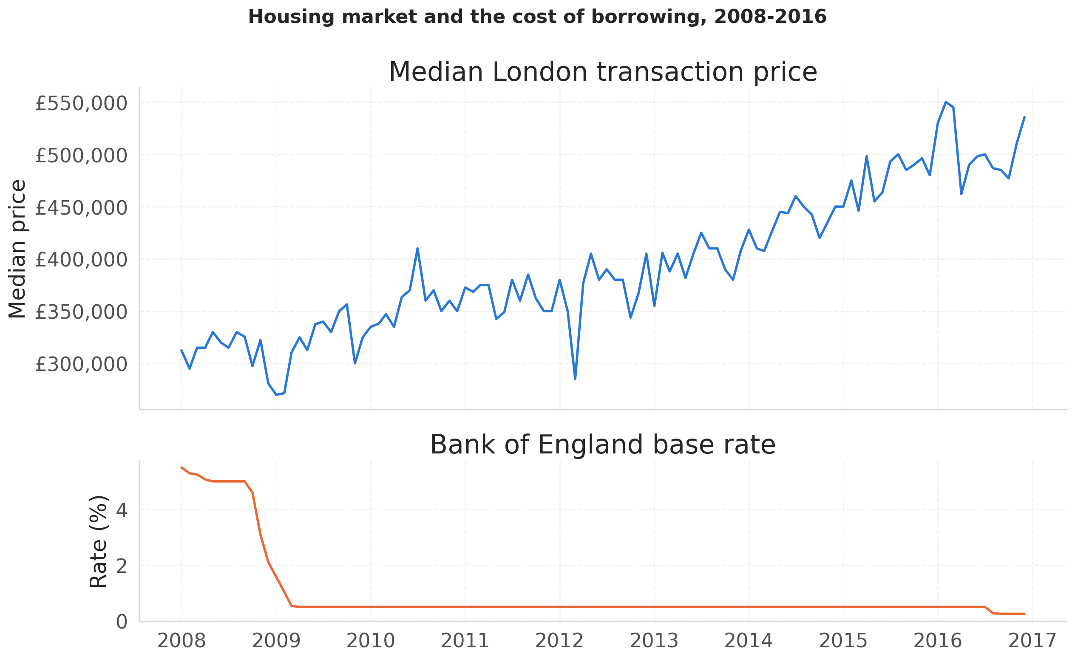
APPENDIX
A5 · Housing market and the cost of borrowing, 2008–2016
39
Notes:
Two stacked panels sharing one x axis: median London transaction price on top, Bank of England base rate below. The base rate collapses from 5.5 % to 0.5 % across 2008-2009 while price dips and then climbs steadily for years afterward. The design decision is deliberate and worth defending: stacked panels rather than one chart with twin y-axes, because a dual-axis chart lets whoever draws it decide where the two lines appear to cross by choosing the scales, manufacturing a visual correlation that may not exist. Note the irony for slide 21 — this is the most visually compelling external driver in the exploratory analysis, and removing interest_rate from the model improves it. Source: notebook cells 22 and 23.

Slide 40
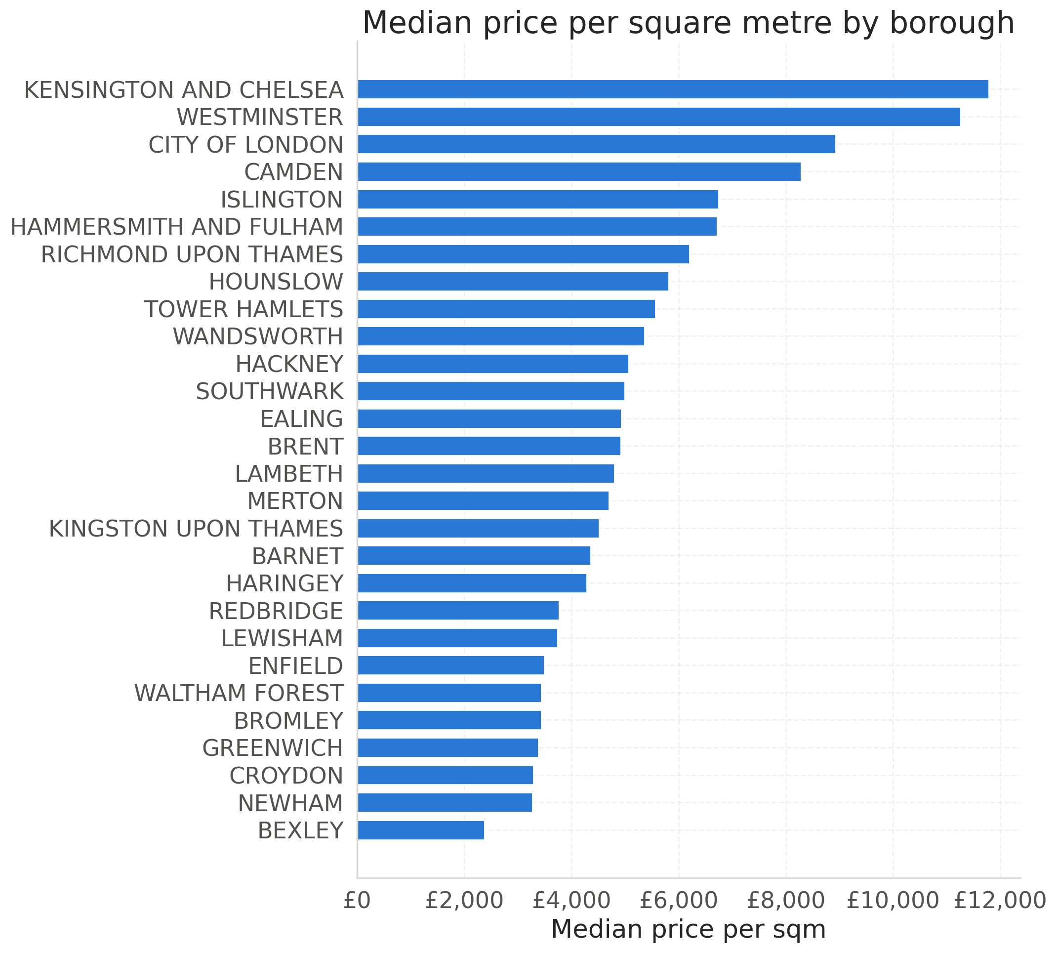
APPENDIX
A6 · Median price per square metre, all 28 boroughs in the table
40
Notes:
The full borough ranking behind the five-times figure quoted on slide 7. Kensington and Chelsea sits at just under £12,000 per square metre; Bexley, on the outer south-eastern edge, at about £2,300. Westminster, the City of London and Camden follow at the top, and Croydon, Newham and Bexley anchor the bottom. The ordering is essentially a map of distance from the centre, which is the point: borough, outcode, latitude, longitude and distance-to-centre are all measuring the same underlying thing. That is why the ablation on slide 21 finds transport worth only +0.09 pp despite its steep bivariate gradient — the location information is already in the model several times over. Source: notebook cell 23.

Slide 41
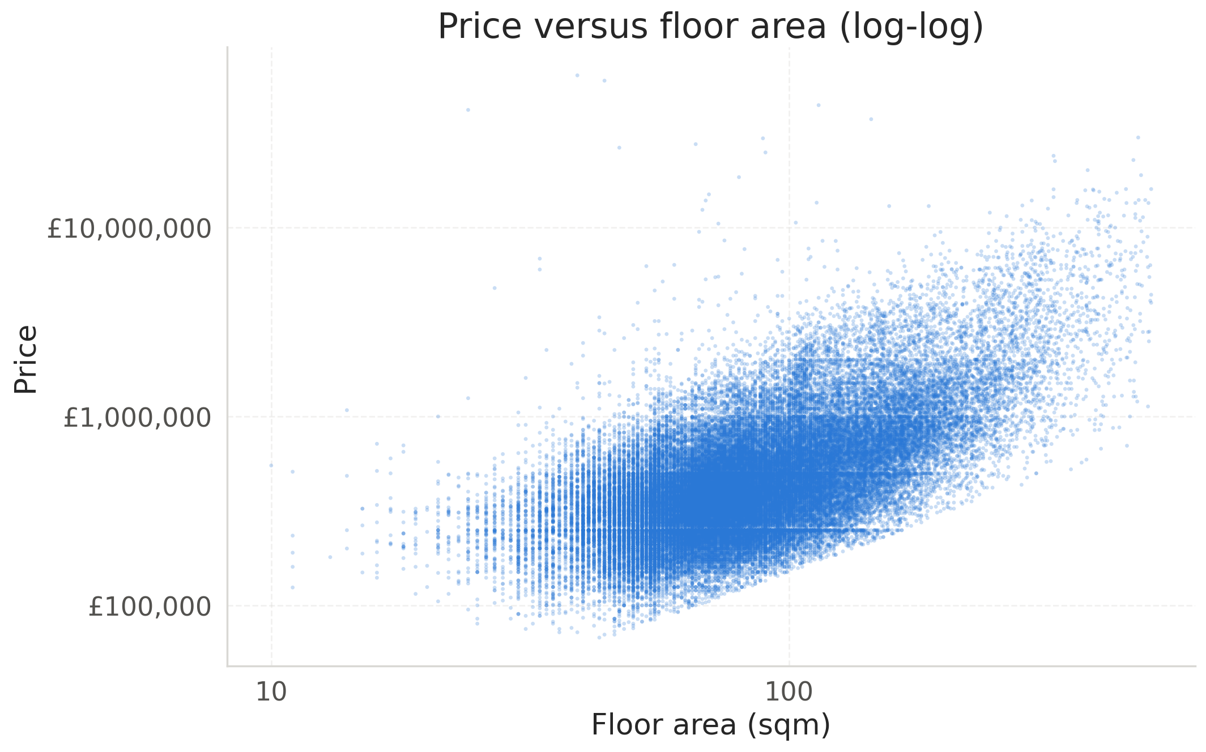
APPENDIX
A7 · Price against floor area on log-log axes
41
Notes:
Price tracks floor area closely on a log-log scale, which is the single strongest physical relationship in the data at r = 0.57 on the raw correlation. The spread widens at the top end, where finish and location start to matter as much as square metreage. The vertical striping at low areas is rounding in the recorded floor-area values. This is the hedonic core of the model: the tree models drop the linear-in-attributes assumption but they are estimating the same implicit prices Rosen 1974 describes. Source: notebook cell 23.

Slide 42
APPENDIX
A8 · Full validation leaderboard, all 14 models
Model | MdAPE | MAE | R² | within 25 %
CatBoost detrended-market (cleaned) | 11.94 % | £115,177 | 0.824 | 80.8 %
3-seed average detrended (XGB) | 12.12 % | £114,888 | 0.834 | 80.3 %
XGBoost detrended-market (capped) | 12.19 % | £114,186 | 0.834 | 80.5 %
MoE – luxury routing detrended (XGB) | 12.49 % | £120,442 | 0.817 | 79.0 %
CatBoost detrended-borough (cleaned) | 12.63 % | £118,386 | 0.819 | 80.8 %
XGBoost detrended-borough (capped) | 12.98 % | £118,293 | 0.830 | 79.2 %
CatBoost (cleaned) | 13.20 % | £123,849 | 0.800 | 79.3 %
3-seed average (CatBoost) | 13.26 % | £122,881 | 0.807 | 79.4 %
XGBoost (raw) | 13.88 % | £126,418 | 0.787 | 78.4 %
MoE – luxury routing (XGB) | 14.05 % | £137,102 | 0.751 | 77.1 %
3-seed average (XGB) | 14.23 % | £134,327 | 0.763 | 77.7 %
XGBoost (capped) | 14.33 % | £126,492 | 0.813 | 77.9 %
XGBoost (cleaned) | 14.60 % | £137,929 | 0.750 | 76.6 %
Ridge (baseline) | 17.09 % | £163,715 | 0.539 | 68.7 %
42
Notes:
The complete section 13 table, every model scored on the same 8,840 validation rows. Note the block structure: positions one to six are all detrended models and positions seven to fourteen are all plain-target ones, with no interleaving. Note also that MdAPE and MAE disagree on ordering in places — the 3-seed average detrended has a better MAE than the model above it, and XGBoost capped has a better MAE than several models that beat it on MdAPE. Selection uses MdAPE as fixed in section 11. Source: notebook cell 48.

Slide 43
APPENDIX
A9 · Full test comparison, all 14 models with drift
Model | Val MdAPE | Test MdAPE | Drift
3-seed average detrended (XGB) | 12.12 % | 13.62 % | +1.50 pp
XGBoost detrended-market (capped) | 12.19 % | 13.88 % | +1.68 pp
CatBoost detrended-market (cleaned) | 11.94 % | 13.88 % | +1.94 pp
MoE – luxury routing detrended (XGB) | 12.49 % | 14.31 % | +1.83 pp
XGBoost detrended-borough (capped) | 12.98 % | 14.32 % | +1.34 pp
CatBoost detrended-borough (cleaned) | 12.63 % | 16.00 % | +3.37 pp
Ridge (baseline) | 17.09 % | 16.62 % | −0.47 pp
CatBoost (cleaned) | 13.20 % | 18.03 % | +4.83 pp
3-seed average (CatBoost) | 13.26 % | 18.47 % | +5.21 pp
MoE – luxury routing (XGB) | 14.05 % | 18.99 % | +4.94 pp
XGBoost (raw) | 13.88 % | 19.57 % | +5.69 pp
3-seed average (XGB) | 14.23 % | 19.75 % | +5.52 pp
XGBoost (capped) | 14.33 % | 19.92 % | +5.59 pp
XGBoost (cleaned) | 14.60 % | 20.25 % | +5.66 pp
43
Notes:
Sorted by test MdAPE. The detrended family occupies the top six places on test just as it did on validation. The drift column is test minus validation and is the size of the optimism validation carried; note that it is 1.3 to 1.9 points for the detrended models but 4.8 to 5.7 points for the plain-target ones, which is itself evidence that the plain models were fitting a level that did not hold forward. Ridge is the only model whose test score improves on validation, at −0.47 pp. Source: notebook cell 51.

Slide 44
APPENDIX
A10 · All six crime designs, five seeds each
Crime design | MdAPE mean | sd | Gain | Seeds won
No crime (0 cols) | 12.153 % | 0.129 | +0.000 pp | 0 / 5
Borough count, status quo (2) | 12.136 % | 0.088 | +0.017 pp | 4 / 5
LSOA total (1) | 12.089 % | 0.038 | +0.064 pp | 3 / 5
LSOA by category (4) | 12.069 % | 0.143 | +0.084 pp | 3 / 5
LSOA + density (5) | 12.131 % | 0.089 | +0.022 pp | 2 / 5
Borough + LSOA (7) | 12.108 % | 0.097 | +0.045 pp | 4 / 5
44
Notes:
Every design refit under five seeds, with each gain differenced against the no-crime baseline within its own seed before averaging. The best gain, LSOA by category at +0.084 pp, is below the 0.15 pp gate. The seed noise floor — the mean of the sd column, 0.097 pp — is the second bar, and the best design's own gain standard deviation is 0.187, larger than the gain itself. No design wins more than four of five seeds. The experiment cannot resolve an effect this size, which is the honest conclusion rather than a null result dressed up as one. Source: notebook cells 63 and 64.

Slide 45
APPENDIX
A11 · Encoding: two representations, both fitted on training only
— Native category dtype for XGBoost: propertyType, tenure, borough, outcode
— Level set pinned from training, so codes stay stable
— CatBoost gets raw strings via cat_features
— Smoothed target encoding for routers, pulling rare levels in
— pd.to_numeric(errors='coerce') would blank all four — self-check #2
45
Notes:
Two representations, both fitted on training data only. The outcode is the first half of a UK postcode, so it is a mid-grained location label sitting between borough and street. Pinning the level set from the training split is what makes a category code mean the same thing at fit time and predict time; without it a category present only in validation shifts every code above it. Smoothing in the target encoder pulls low-frequency categories toward the global mean, so a borough with three sales does not get a confident price estimate. The last bullet records a bug that actually happened: coercing those four columns to numeric with errors='coerce' turns all of them entirely NaN and leaves the CatBoost models and every router training on dead columns — which is why self-check number two exists and asserts that no feature column is all-NaN. Source: notebook cell 35.

Slide 46
APPENDIX
A12 · The remaining ranked improvements, 3 to 8
— Walk-forward backtesting: one cut gives no error bar
— Make the margin a P&L: stamp duty, refurbishment, fees
— Mondrian conformal: multipliers per borough and price decile
— Drop interest_rate; revisit transport as travel time
— Lease length above all; then SHAP over location
46
Notes:
Improvements three through eight from section 18, after the group-aware split and widening the window. Walk-forward or rolling-origin evaluation would give a distribution of MdAPE rather than a single number, and reveal whether performance depends on which slice of the cycle you happened to test on. Turning the margin into a profit-and-loss means adding the costs a buyer actually pays, including the 3 % stamp-duty surcharge that applies to exactly this kind of second-property purchase, after which the scanner can rank by return rather than by pounds. Mondrian conformal calibrates separate multipliers per segment so coverage holds within the boroughs an investor actually shops in, not just on average. Lease length is the most consequential missing column: a leasehold flat with 70 years left is worth materially less than an otherwise identical one with 950, and extending a short lease costs tens of thousands — so this single absent feature is a plausible part of what the scanner currently mistakes for underpricing. Source: notebook cell 80.

Slide 47
APPENDIX
A13 · Pointed at today's market: 29.00 % flagged, and why that is an artifact
— scripts/live_flip_scan scrapes Rightmove, substituting public sources
— 200 listings flagged at 29.00 % against 13.39 % on test
— Higher, not lower — the opposite of asking-versus-sold
— Camden and K&C show predictions 1.7–2.5× asking
— Inconclusive: an HPI-proxy or extrapolation artifact
47
Notes:
This ran outside the notebook — scraping plus a full retrain takes the better part of an hour — so the notebook cell is a static record of the last run rather than something re-executed top to bottom. It substitutes UK HPI for the market medians, data.police.uk for crime as a point-radius rather than a borough sum, the EPC register for floor area, and HM Land Registry Price Paid Data for the prior-sale block matched on postcode and street, then scores the live listings through the same conformal scanner as section 15. The result is worth showing precisely because it does not validate anything: the live flip rate is higher than the test rate, which is the opposite of what the asking-versus-sold gap alone would predict, since an asking price above the eventual sold price should make fewer listings look underpriced. Splitting the predicted-over-asking ratio by borough points at why: predictions 1.7 to 2.5 times asking in a handful of central boroughs are far more consistent with an artifact of the HPI market-level proxy, or with a ten-to-eighteen-year extrapolation on days_since_start, than with genuine mispricing. Treat 29.00 % as inconclusive, not as a finding about the 2026 market. Source: notebook cell 81.

Slide 48
APPENDIX
A15 · Seven assertions, each guarding a defect that was actually present
— No training row postdates a validation row; no dead columns
— Categorical levels pinned; lagged features exclude the present
— Prior sales strictly precede — asserted, one violation is leakage
— Coverage on a calibration holdout: 88.39 %, 1,775 rows
— Persisted: manifest.json, leaderboard.csv, model.joblib
48
Notes:
A notebook with no assertions is a notebook that fails silently, and each of these checks encodes an invariant that a real earlier bug violated. The dead-column check exists because coercing the four categorical columns with pd.to_numeric and errors='coerce' once turned all of them entirely NaN, leaving the CatBoost models and every router training on dead columns. The re-runnability check exists because an EDA cell that rebound a variable name once clobbered the raw station table for every cell below it. The conformal check is the most carefully constructed: the multiplier is refitted on the first 70 % of calibration and scored on the remaining 30 %, because checking coverage on the same rows the multiplier was fitted on is an identity, not a test — and test-set coverage is printed alongside but deliberately carries no assertion, because making a run fail on a held-out metric turns that metric into a tuning signal. All ten checks pass on the current run. The same probes run in the pytest suite against a committed 500-row fixture in about two seconds. On persistence: the predict closures are not picklable by design, so what is saved is the estimators plus everything needed to rebuild the closure — the package is the deployment unit and the notebook is the narrative that produced it. What a green run does not prove: that the model is good, that the features are right, or that the protocol was followed while the notebook was being written. That last one is the next slide. Source: notebook cells 75 to 79.

