Slide 1
DATA ANALYST PORTFOLIO PROJECT
San Francisco Restaurant Hygiene & Safety Analytics
Data-Driven Public Health Surveillance & Risk Mitigation Strategy (2014 - 2016)
Author: Gilang Anugrah | Tools: Python, SQL, DAX, Power BI | Client: SF Department of Public Health (SFDPH)

Slide 2
CONTEXT & BUSINESS OVERVIEW
Executive Summary: Transforming Inspection Data into Action
TOTAL INSPECTIONS
25,834
Across 6,078 unique restaurants
AVG HYGIENE SCORE
91.3 / 100
Citywide standard: Good / Excellent
TOTAL VIOLATIONS
40,673
86% routine maintenance non-compliances
HIGH-RISK EXPOSURE
13.8%
Critical public health hazards (Vermin/Temp)
Business Context & Mission
• Stakeholder: San Francisco Department of Public Health (SFDPH).
• The Challenge: SFDPH oversees 6,000+ commercial food establishments with finite inspector headcounts and tight municipal budget constraints.
• The Core Problem: Prioritizing routine inspections reactively leads to blind spots in severe contamination prevention.
• The Mission: Harness 53,000+ historical records to identify high-risk hotspots, seasonal pest outbreaks, and optimize patrol scheduling.
Key Analytical Discoveries
• Citywide Baseline: 68% of food venues operate at Excellent/Good scores (>=90). Less than 2% fall into severe non-compliance (<70).
• Geographic Disparity: Commercial downtown corridors (Financial District 94104/94111) suffer from 20-23% high-risk rates, vs residential suburbs (~10-12%).
• Summer Seasonality: Vermin & pest infractions surge by +85% in May-June compared to winter months, establishing a clear timing for preventive intervention.
• Enforcement ROI: Mandatory re-inspections for failing venues yielded an average +8.57 score rebound, confirming enforcement efficacy.

Slide 3
METHODOLOGY & TECH STACK
Analytics Architecture: CRISP-DM Framework & Toolchain
Handled grain duplication, corrected (0,0) GPS anomalies, standard 5-digit zip parsing, removed 50 exact duplicates, exported clean CSVs.
Key Technologies:
Pandas, NumPy, KaggleHub
1. Data Cleaning (Python)
Loaded data into SQLite & T-SQL (SSMS). Implemented CTEs, Window Functions (LAG, DENSE_RANK, SUM OVER) for Pareto & seasonality analysis.
Key Technologies:
SQLite, SSMS (T-SQL)
2. Database & SQL EDA
Constructed Star-Schema style summary data model, authored dynamic DAX measures (% High Risk Rate, Compliance Tiers), professional custom palette.
Key Technologies:
Power BI Desktop, DAX
3. DAX & BI Modeling
Translated diagnostic metrics into executive insights, formulated seasonal prevention protocols, and delivered high-impact interactive visuals.
Key Technologies:
Executive Dashboard, PDF/PPTX
4. Decision Delivery

Slide 4
FINDING 1: SCORE DISTRIBUTION
Citywide Compliance: 68% Operate in Good/Excellent Standing
Key Takeaways & The Double-Counting Trap
• Robust Baseline: The median and mean inspection score across SF sits comfortably at 91.3 / 100.
• Concentrated Risk: Severe hygiene degradation is not systemic across the city—only 1.86% (275 sessions) scored in the critical 'Poor (<70)' bracket.
• The Double-Counting Pitfall: In raw data, each row represents 1 violation. Restorans with multiple violations appeared up to 8 times, artificially depressing raw averages to 86.2.
• Session-Level Aggregation: Aggregating to 1 row per inspection session recovered true operational reality (91.3), preventing false regulatory alarms.

Slide 5
FINDING 2: VIOLATION ANALYSIS
Pareto Principle: Top 10 Infractions Account for 58% of Total
Operational Hygiene vs Critical Hazards
• Physical Facility Issues Dominate: #1 most frequent violation is 'Unclean floors, walls, ceilings' (3,545 incidents), followed by handwashing sink accessibility.
• 86% Low/Moderate Risk: The overwhelming majority of recorded non-compliances are structural and sanitary maintenance issues, not active biological pathogens.
• Critical High-Risk Exception: 'High-risk food holding temperature' ranks #10 overall with 1,629 occurrences. This is the single largest biological food-poisoning hazard.
• Action Strategy: SFDPH checklist should decouple minor structural citations from urgent bacterial incubation risks.

Slide 6
FINDING 3: GEOGRAPHIC PROFILING
Geospatial Exposure: High-Density Dining Hubs Carry Elevated Risk
Statistical Thresholding & Risk Zones
• Small-Sample Distortion Avoided: Postal codes with <100 inspections (e.g. 94014, 94120) showed deceptive 50% rates due to sample sizes of 5-8 restaurants.
• Core Business District Vulnerability: Downtown corridors—94104 (Financial South, 22.9%) and 94122 (Sunset North, 20.5%)—exhibit statistically significant higher high-risk proportions.
• Why High-Density Corridors Suffer: Fast kitchen turnover, older infrastructure, and high dining traffic stress cold-storage equipment and pest barriers.
• Resource Reallocation: Moving 20% of inspector hours from low-risk suburbs to 94104, 94122, and 94133 maximizes public health impact.

Slide 7
FINDING 4: TEMPORAL SEASONALITY
Early Warning: +85% Surge in Vermin Infestations During Summer
Predictive Public Health Intervention
• Clear Seasonal Cyclicality: Rodent and insect infestations exhibit intense weather dependency, peaking in May (332 incidents) and June (353 incidents).
• Winter Lows: In contrast, December and January register only 162-190 incidents (a +85% climb from winter to summer).
• The Double Hazard: Summer temperature surges simultaneously degrade outdoor waste and stress refrigeration units, compounding pest attraction.
• Preventive Campaign Window: Rather than issuing fines in July, SFDPH should mandate pre-summer pest control audit notices across all districts in April.

Slide 8
FINDING 5: REMEDIATION IMPACT
Enforcement Efficacy: Failing Venues Rebound by +8.57 Points
Measuring Regulatory Compliance ROI
• Follow-Up Analysis: Evaluated 730 restaurants that scored Poor/Substandard (<80) using SQL Window Functions (LAG) on subsequent re-inspections.
• Statistically Significant Recovery: Average initial score of 72.92 rose to 81.49 on follow-up—an average recovery of +8.57 points.
• 76% Success Rate: Over three-quarters of inspected venues successfully exited the danger zone upon mandatory re-inspection.
• Policy Takeaway: Routine follow-up inspections are not merely punitive; they serve as a powerful behavioral correction mechanism.

Slide 9
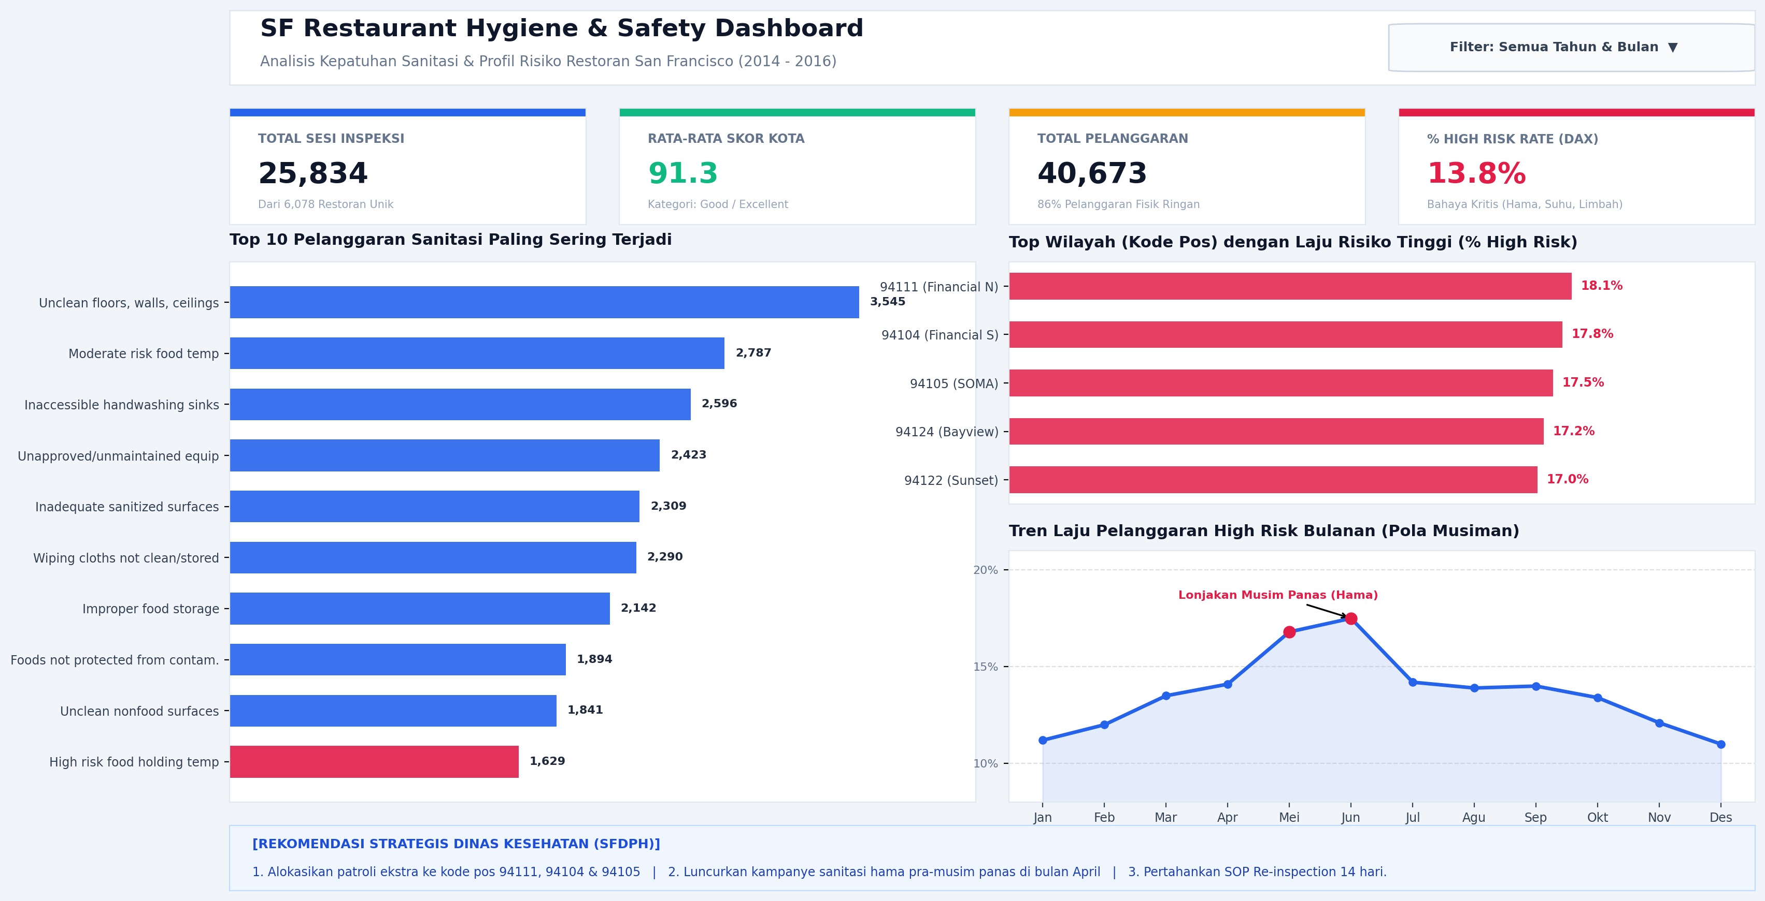
BI DELIVERABLE SHOWCASE
Executive Power BI Dashboard: Interactive Surveillance Center
Dashboard Highlights
• 16:9 HD Widescreen Executive Layout.
• 4 Synchronized KPI Cards with dynamic DAX calculations.
• Cross-Filtering Enabled: Selecting a district updates violations and monthly trends simultaneously.
• Color Hierarchy: Emerald (Safe), Amber (Attention), Crimson (Critical High-Risk).
• Executive micro-copy tailored for non-technical leadership.

Slide 10
DEPARTMENT NEXT STEPS
Strategic Action Plan: 3 High-Impact Recommendations for SFDPH
01
GEOGRAPHIC RESOURCE REALLOCATION —
Shift 20% Inspector Capacity to Downtown Hotspots
Reallocate inspector patrol shifts from low-density, compliant residential areas into high-risk commercial zones (94104, 94122, 94133). Introduce unannounced peak-hour visits during lunch/dinner rushes where food temperature violations peak.
02
PRE-SUMMER PEST ABATEMENT CAMPAIGN —
Mandatory April Notification & Waste Audits
Launch a targeted preventive pest abatement campaign every April, one month prior to the historical May-June infestation surge (+85%). Partner with municipal waste management to inspect outdoor dumpster seals and grease traps.
03
STANDARDIZED 14-DAY RE-INSPECTION PROTOCOL —
Institutionalize Rapid Regulatory Follow-Up
Maintain and formalize the mandatory 14-day re-inspection requirement for any establishment scoring below 80. Data proves that 76% of venues achieve compliance on re-check (+8.57 point gain), preventing repeat contamination.

Slide 11
Thank You!
Questions & Discussion
Portfolio Project: San Francisco Restaurant Hygiene & Safety Analytics
Author: Gilang Anugrah | Data Analyst

