Slide 1

Earn
Members: Mei Wu, Bongani Mbigi, Yiming Su, Gilbert Maldonado

Slide 2
Idea

Slide 3
Android app

Slide 4
Backend

Slide 5
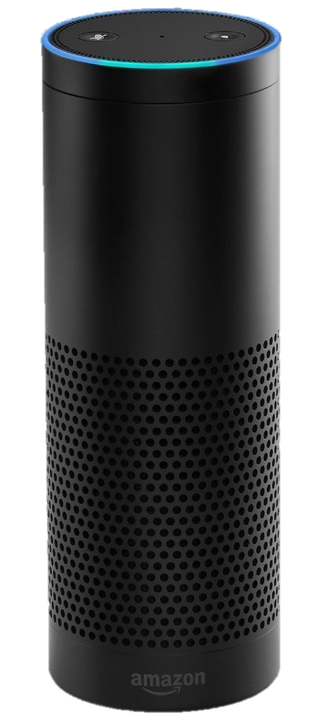
Amazon Echo
Speech processing to create interactive experience with the app
Sets and retrieves data
Utterances to create a great user experience

Slide 6
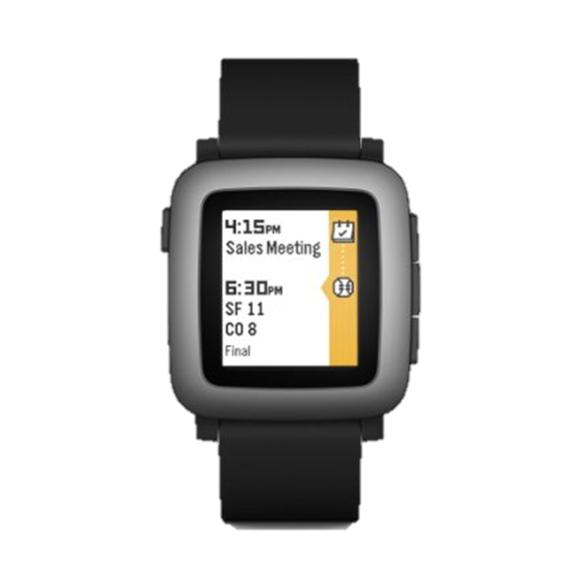
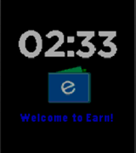
Pebble Time

Slide 7
Citations
https://developer.amazon.com/appsandservices/solutions/alexa/alexa-skills-kit#get-started-now
https://developer.amazon.com/public/solutions/alexa/alexa-skills-kit/docs/defining-the-voice-interface

