Slide 1

PromptPal:
AI Literacy & Enablement for Federated Hermes
CMU MISM Capstone Team
Fall 2025
Notes:
“Good morning everyone, and thank you for being here. We’re excited to present our capstone project: PromptPal — an AI literacy and enablement platform designed specifically for Federated Hermes. Over the past semester, our team collaborated closely with the federated teams to build an adaptive learning system that helps employees confidently and effectively use AI in their daily workflows. Today, we’ll walk you through the problem, our solution, and a live demo of the platform."

Slide 2


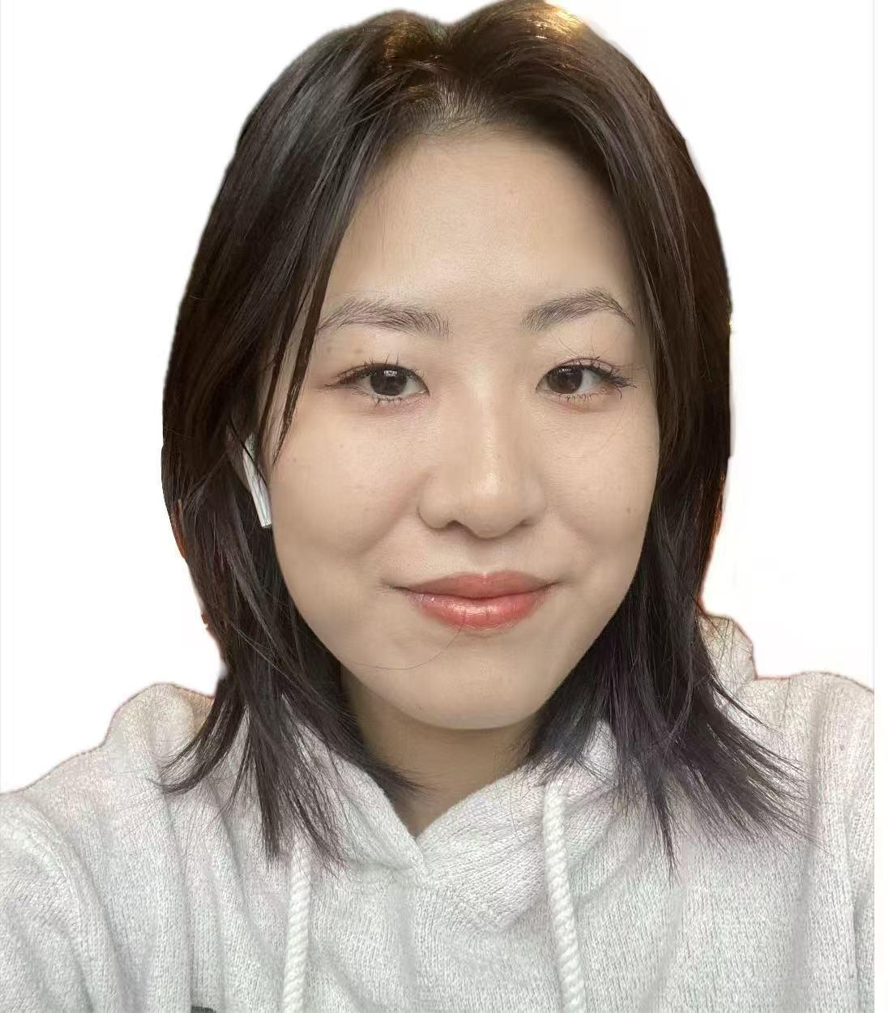

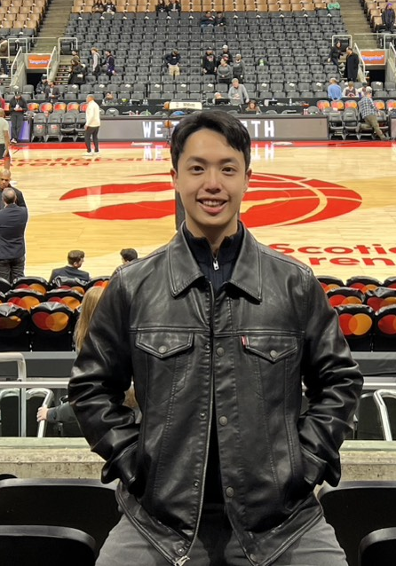
Group Member
Rishabh Devgon
Sunny Lee
Sarah Lang
Jingxuan Li
Gilbert Wu
Advisor: Allison Sagraves

Slide 3
Project Overview
Goal: Develop PromptPal, an AI-powered adaptive learning platform for Federated Hermes that helps employees build practical AI skills through personalized, role-specific, and measurable learning experiences.
Personalized Learning
Tailors AI concepts, use cases, and examples to each employee’s role and learning history; use Weaviate and user memory for step-by-step explanations through the CLEAR framework.
Customized Prompt Guidance
The Navigator Agent generates role-specific, ready-to-use prompts so users don’t need prior prompting skills—just click and use.
Build Your Own Knowledge Base
Employees can upload documents to create a personal, searchable knowledge base that the chatbot and learning agents can retrieve from.
Integrated Quiz & Assessment
Each module includes auto-generated quizzes and exercises to validate understanding and measure proficiency over time.
Notes:
PromptPal integrates FHI’s internal knowledge, learning content, and competency frameworks into a unified training platform.

Slide 4
Why This Matters Now
Industry studies show that AI can lead to a 40% increase in productivity, 25% higher work quality, and a 60% reduction in time spent on writing tasks. Yet AI usage at Federated Hermes is growing — but uneven.
Today, employees use: • Databricks • Power BI • Azure Datalake • OpenAI • Athena (JavaScript AI Portal)
Key challenges: • Low day-to-day AI usage • High time spent on repetitive work (emails, forms, extraction) • Insufficient prompting skills • Limited understanding of how AI fits into business workflows
PromptPal solves these through structured, role-specific learning.

Slide 5
Problem We Are Solving
Employees struggle with:
Using AI tools confidently
Knowing how to prompt effectively
Applying AI to use cases
Managers struggle with:
Visibility into AI proficiency across teams
Standardizing AI training
Difficulty communicating in AI terms
PromptPal is designed to address both sides - helping employees build confidence and capability, while giving managers clarity and consistency in how AI is used across the firm.

Slide 6
Introducing PromptPal
An internal AI Tutor built for Federated Hermes.
Capabilities: • Conversational, adaptive AI tutor • Personalized learning paths (Marketing, Sales, Investments, Ops, IT) • Quizzes + diagnostic assessments • Micro-lessons teaching prompt engineering essentials • Manager dashboard to track AI literacy • Modular agent architecture

Slide 7
How PromptPal Differs From Copilot
Copilot helps employees perform tasks (draft emails, summarize documents, generate code).
PromptPal helps employees learn how to use AI tools effectively — including Copilot — by teaching foundational AI concepts, prompting strategies, and safe/accurate usage patterns.
 | PromptPal | Microsoft Copilot
Primary Purpose | Builds AI literacy through structured lessons, feedback, and quizzes | Executes tasks (emails, summaries, analysis) quickly with AI
Strength | Teaches how to prompt well across workflows | Generates content and automates routine work
Target Audience | All employees, especially non-technical roles needing guidance (Sales, Marketing, Ops, Compliance, IR, HR) | Employees ready to apply prompting skills directly to work tasks
Business Value | Upskills workforce, improves AI consistency, reduces errors, enables firmwide adoption | Increases productivity, reduces time spent on drafting and processing information
Click to edit Presenter Name
Presenter Title

Slide 8
How Employees Use PromptPal Day-to-Day
Quick reference tutor before using Copilot or Athena
Practice better prompting for emails, documents, and meeting prep
Upload documents to learn structured prompts for summary/analysis
Take short quizzes that reinforce correct AI usage
Follow recommended modules tailored to their role
Business Value
Reduces time spent on repetitive tasks
Ensures consistent and compliant AI usage across teams
Upskills employees and accelerates AI adoption
Gives managers visibility into AI proficiency
Click to edit Presenter Name
Presenter Title

Slide 9
Who This Supports
PromptPal delivers value across every major functional group at Federated Hermes, especially non-technical users.
Compliance Analyst | Client Service Associate | Marketing Associate | Operations Associate | HR Coordinator
Investor Relations Coordinator | Administrative Assistant | Project Coordinator | Product Specialist | Portfolio Operations Assistant
Communications Specialist | Training & Development Associate | Sales Representative | Executive Assistant
Athena
(82 users)
scalable to
Firmwide
(2000+)

Slide 10


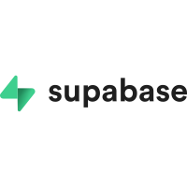
Database / Knowledge Base
Table | Purpose | Key Fields
Users | Stores user profiles and long-term learning state. | user_id, email, role, long_term_summary, prompts, created_at, updated_at
Role_Tasks | Initialize user role and AI tasks | user_id, role_name, task
Progress | Tracks learning progress and quiz performance. | progress_id, user_id, completed_modules, quiz_scores, interaction_log, last_login
Interactions | Full conversation logs | interaction_id, user_id, log, timestamp
User Documents | Metadata for uploaded documents; links to Weaviate chunks. | document_id, user_id, filename, file_type, file_size, upload_date, status, weaviate_doc_id, chunk_count
Sessions | Manages authentication sessions. | session_id, user_id, session_token, expires_at, created_at
user info
conversation

Slide 11

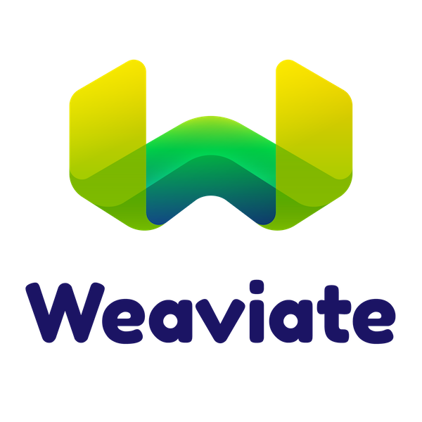

Database / Knowledge Base
Core Concept | Stores foundational AI concepts and explanations. | title, content, topic, tags, role
Use Case | Contains practical exercises and real-world examples linked to CoreConcepts. | application, ai_concepts, business_value, related_concepts
Document Chunks | Vector embeddings of uploaded documents, linked to UserDocuments. | chunk_text, embedding, metadata, doc_reference (weaviate_doc_id)
Prompt Guide | FHI Internal Prompt Engineering Guide | content_id, title, content, section, tags
ai_concepts
use_case
prompt engineering guide

Slide 12
Multiagent Overview
Agent | Purpose | Input | Output / Action
Navigator Agent | Generates personalized learning prompts based on user profile and knowledge base. | - Use cases (in vector DB) - User information (in PostgreSQL) - Past conversation history | Provides 3 + 5 customized prompts for the user to choose from.
Trainer Agent | Delivers contextual learning responses and resources based on user selection. | - Selected prompt - Short-term & long-term memory - User info | Returns learning content (text, URLs, exercises) to the display.
Summary Agent | Summarizes each conversation and updates user memory for personalization. | - Conversation logs - User info | Updates short-term and long-term memory in PostgreSQL.
Document Agent | Manages document uploads, chunking, and retrieval-augmented generation (RAG) queries. | - Uploaded document metadata/content - user ID | Stores document chunks in Weaviate, updates metadata in PostgreSQL, retrieves relevant chunks for queries.
Assessment Agent | Generates quizzes and assessments for users based on topics and modules. | - Topic - module list - user context | Returns a multiple-choice quiz (questions/answers)

Slide 13
Trainer Agent
User Query
Get Summaries
RAG
Build Prompt
Build Prompt
Gemini 2.5 Pro
Save to PostgreSQL
Return JSON to frontend

Slide 14

Our Demo Today Follows the User Journey
We demo with a Sales persona, while highlighting: • How Sales reps use PromptPal for email optimization, meeting prep, product explanations • How Sales managers track team proficiency and assign modules
user login
user click OR write prompt
lesson generated
take learning quiz
User: Sales

Slide 15
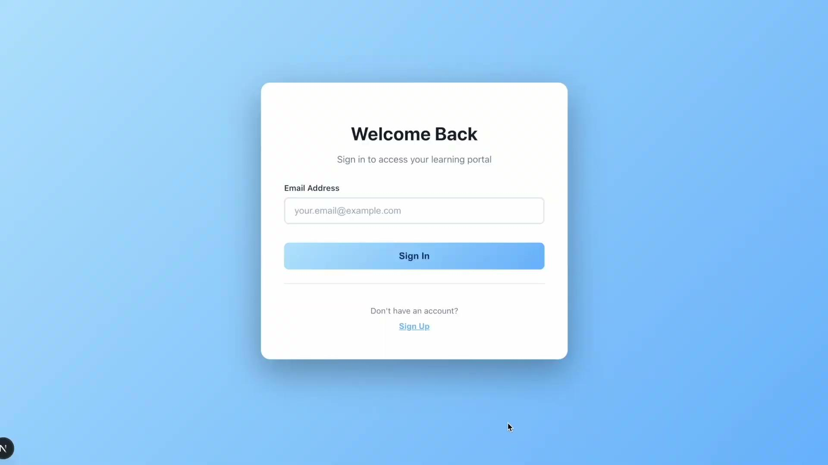
DEMO

Slide 16
Recommendation
For Staff: | For Managers: | For Organization:
• Complete weekly micro-quizzes (2 min) • Use PromptPal before client meetings to: – Create agendas – Summarize client materials – Generate talk tracks • Use PromptPal to optimize emails • Upload templates for more accurate outputs | • Track team proficiency in dashboard • Assign modules for: – Email compliance – Product explanation accuracy – Prompt engineering • Review “AI Skills Report” monthly • Use insights during coaching sessions • Add customized sales prompts to PromptPal library | • Integrate more learning modules • Expand to Investments / Ops / IT • Add internal documents into RAG • Pilot with 82 Athena users → scale to 2,000 employees

Slide 17
Future Enhancements
Expanded Role-Based Paths: New modules for Investments, Compliance, IT, and Portfolio teams
Stronger Manager Analytics: Skill-gap insights, team benchmarking, automated module assignments
Richer AI Tutoring: Advanced prompting lessons, scenario-based practice
Deeper Tool Integration: In-context guidance within Athena and Copilot
Smarter Document Handling: Multi-document comparison, improved templates
Enterprise Knowledge Integration: Connect internal research, compliance manuals, and product documents

Slide 18
Q&A
Click to edit Presenter Name
Presenter Title

Slide 19
Thank You
Click to edit Presenter Name
Presenter Title

