Slide 1


WHO AM I?
Aspiring Machine Learning Engineer, Maxim Nyansa IT Solutions.
Writer for Heartbeat.fritz.ai

Slide 2

GRADIENT DESCENT
GILBERT ADJEI

Slide 3
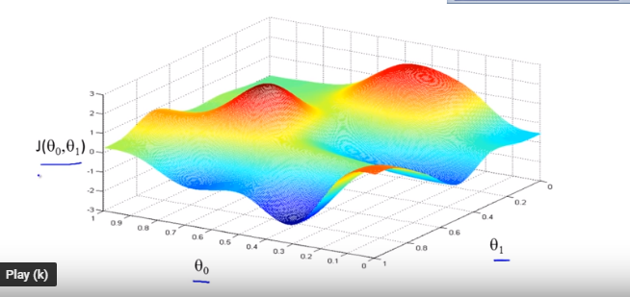
What is Gradient Descent?
Gradient Descent is an optimization algorithm that seeks to find parameters of a function that reduces the cost function.

Slide 4
MORE ON GRADIENT DESCENT

Slide 5
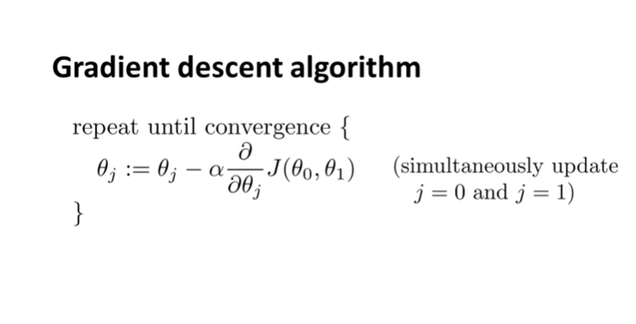
THE MATH

Slide 6
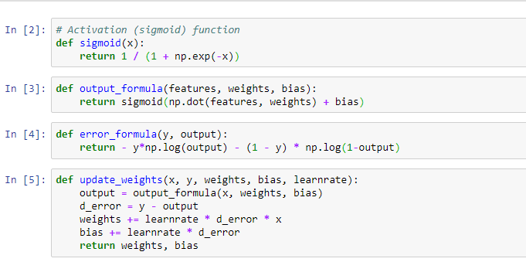
IMPLEMENTATION IN PYTHON

Slide 7
TYPES OF GRADIENT DESCENT
Batch Gradient Descent – The cost is calculated for a machine learning algorithm over the entire training dataset for each iteration of the gradient descent algorithm. One iteration of the algorithm is called one batch and this form of gradient descent is referred to as batch gradient descent.
Stochastic Gradient Descent - In this variation, the gradient descent procedure described above is run but the update to the coefficients is performed for each training instance, rather than at the end of the batch of instances.

Slide 8
OTHER OPTIMIZERS
Adam
L-BFGS
AdaDelta
AdaGrad

Slide 9
SUMMARY
In this presentation we have covered what gradient descent means the types, the math, implementations. Its benefits and the different types of optimizers.

Slide 10




THANK YOU
GILBERT ADJEI
+233 241546346
gilbertadjei800@gmail.com

