Slide 1
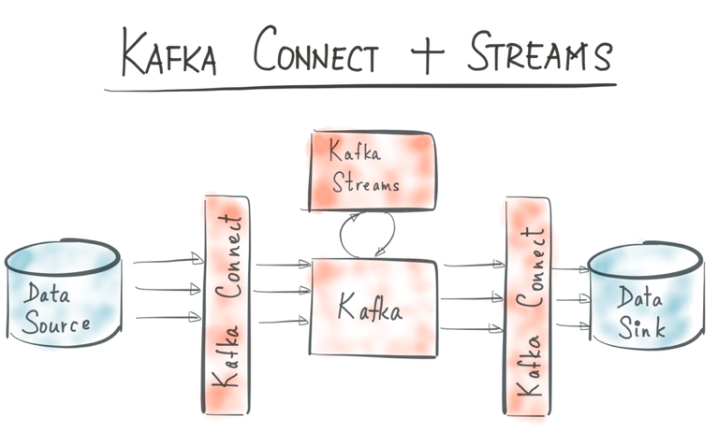
Kafka streams
Real Time Event [Stream] Processing integrated into Kafka
Aggregations & Top-N
Time Windows
Continuous Queries
Latest State (event sourcing)
Turn Stream (of changes) into Table (of most recent or current state)
Part of the state can be quite old
A Kafka Streams client will have state in memory
Always to be recreated from topic partition log files
Note: Kafka Streams is relatively new
Only support for Java clients

Slide 2
Kafka streams
Topic
Filter
Aggregate
Topic
Join
Map (Xform)
Topic
Publish

Slide 3
Example of Kafka streams
Topic
Set Continent as key
SelectKey
CountryMessage
Continent
Name
Population
Size
Update Top 3 biggest countries
AggregateByKey
Total area for each continent
Topic
Join
Size in Square Miles, % of entire continent
Map (Xform)
As JSON
Publish
Topic: Top3CountrySizePerContinent

Slide 4



countries2.csv
Create KStream from KafkaTopic
KStream Builder
Broker
Topic
Producer
Set Continent as key
SelectKey
Count (# of countries per continent)
CountByKey
Topic: RunningPopulationSumPerContinent
Produce running count updates to Kafka Topic
To

Slide 5
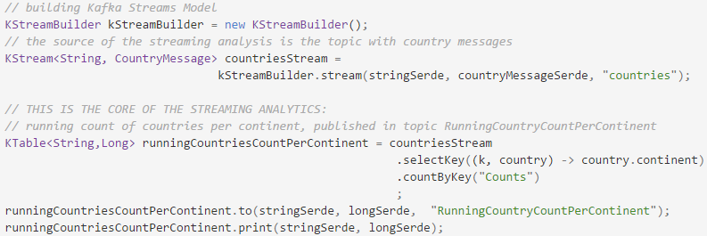
countries2.csv
Create KStream from KafkaTopic
KStream Builder
Broker
Set Continent as key
Producer
Topic: countries
SelectKey
Count (# of countries per continent)
CountByKey
Topic: RunningPopulationSumPerContinent
To
Produce running count updates to Kafka Topic

Slide 6
countries2.csv
Set Continent as key
Broker
SelectKey
Topic
Update Top 3 biggest countries
Producer
AggregateByKey
Map (Xform)
Topic: Top3CountrySizePerContinent
Topic: Top3CountrySizePerContinent
Publish

Slide 7
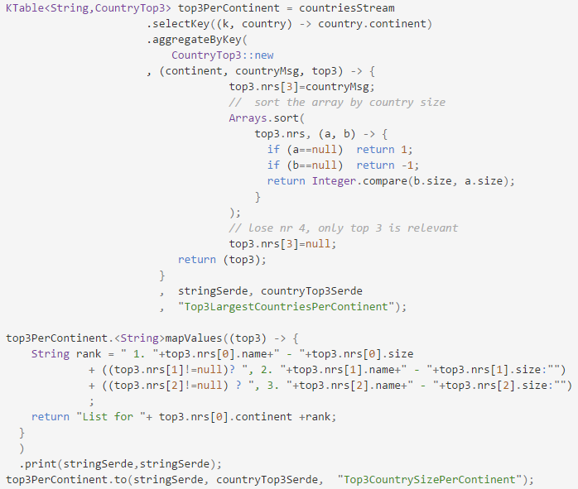
Example of Kafka streams
Set Continent as key
Topic
SelectKey
Update Top 3 biggest countries
CountryMessage
Continent
Name
Population
Size
AggregateByKey
Print
As JSON
Publish to Topic
Topic: Top3CountrySizePerContinent

Slide 8
countries2.csv
Create KStream from KafkaTopic
KStream Builder
Broker
Topic
Producer
Set Continent as key
SelectKey
Update Top 3 biggest countries
AggregateByKey
Topic:
Top3CountrySizePerContinent
To
Print
Produce running count updates to Kafka Topic
Print Top 3 to console

Slide 9
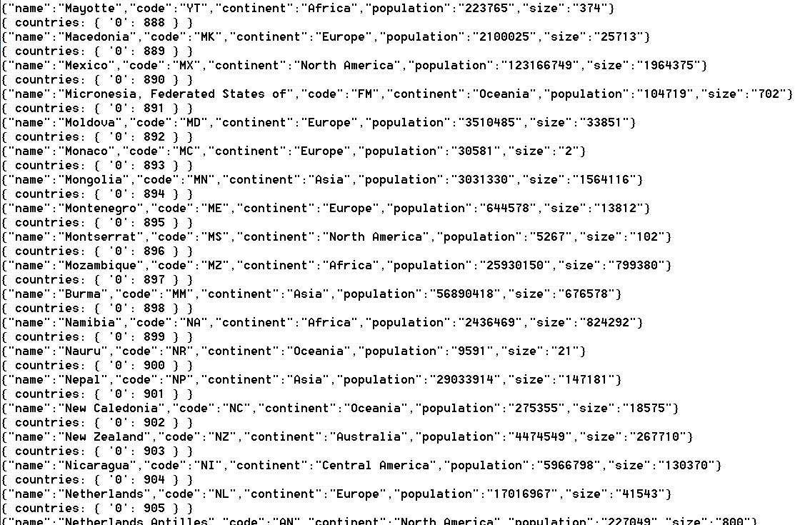
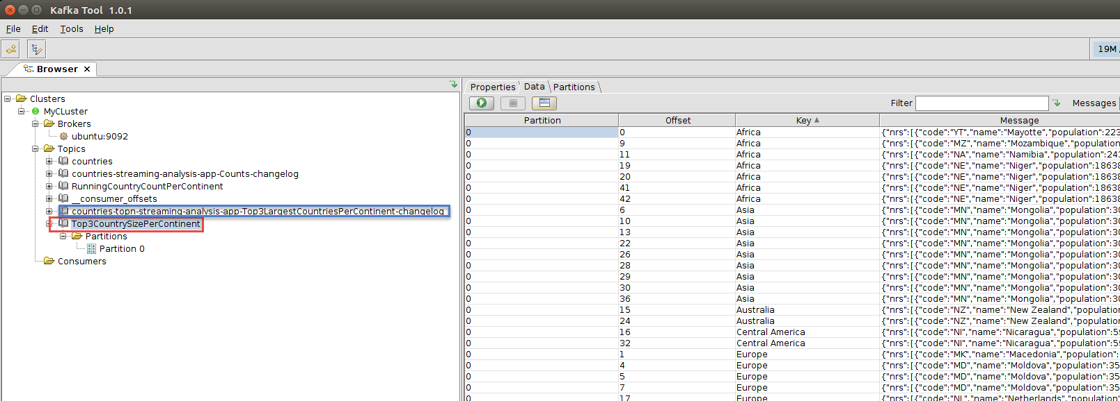
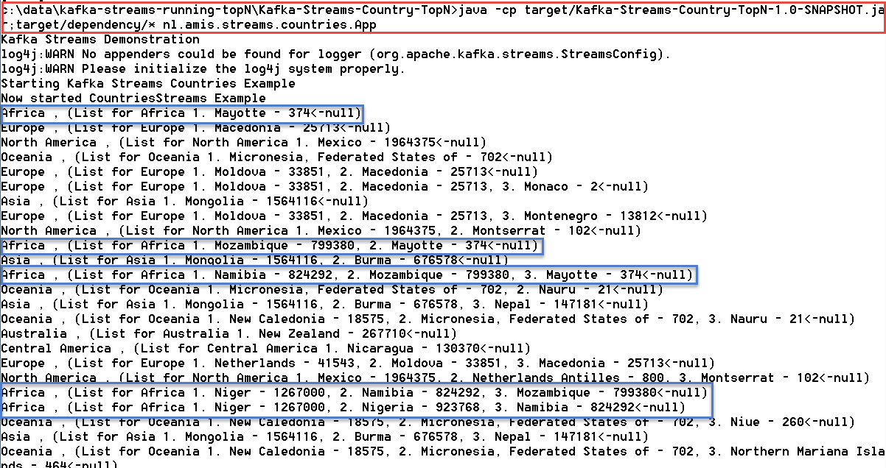
Create KStream from KafkaTopic
KStream Builder
Broker
Topic
Set Continent as key
SelectKey
Update Top 3 biggest countries
AggregateByKey
Topic:
Top3CountrySizePerContinent
To
Print
Produce running count updates to Kafka Topic
Print Top 3 to console

Slide 10


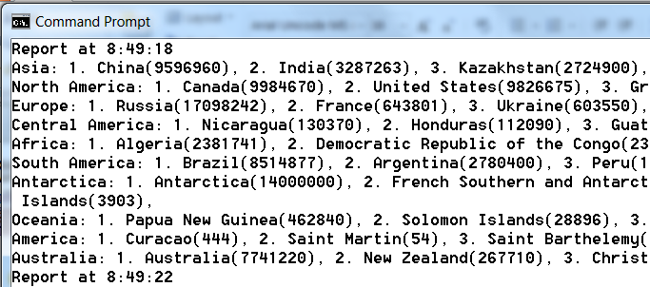

countries2.csv
Kafka Streams
Create KStream from KafkaTopic
KStream Builder
Broker
Topic
Producer
Set Continent as key
SelectKey
Update Top 3 biggest countries
Report
AggregateByKey
Topic:
Top3CountrySizePerContinent
Consumer
To
Print
Produce running Top-N for continent to Kafka Topic
Print Top 3 to console

Slide 11


onMessage
onMessage
Push
index.html
Register SSE client
onMessage

Slide 12
countries2.csv
Kafka Streams (Java application)
Create KStream from KafkaTopic
KStream Builder
Broker
Topic
Producer
Set Continent as key
SelectKey
Update Top 3 biggest countries
onMessage
AggregateByKey
Topic:
Top3CountrySizePerContinent
onMessage
Consumer
To
Print
Push
Consumer
Produce running Top-N for continent to Kafka Topic
Register SSE client
Print Top 3 to console
index.html
onMessage

Slide 13
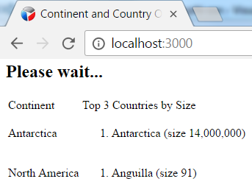
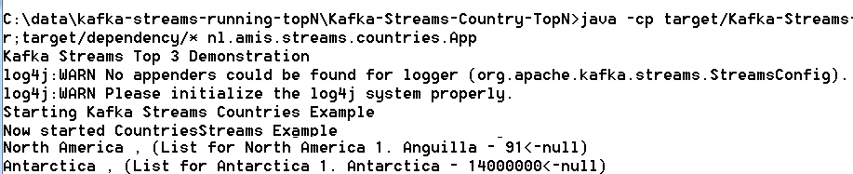
countries2.csv
Kafka Streams (Java application)
Create KStream from KafkaTopic
KStream Builder
Broker
Topic
Producer
Set Continent as key
SelectKey
Update Top 3 biggest countries
onMessage
AggregateByKey
Topic:
Top3CountrySizePerContinent
onMessage
Consumer
To
Print
Push
Consumer
Produce running Top-N for continent to Kafka Topic
Register SSE client
Print Top 3 to console
index.html
onMessage

Slide 14

Connect, create, update

Slide 15
countries2.csv
Kafka Streams (Java application)
Create KStream from KafkaTopic
KStream Builder
Broker
Topic
Producer
Set Continent as key
SelectKey
Update Top 3 biggest countries
AggregateByKey
Topic:
Top3CountrySizePerContinent
To
Print
Consumer
Produce running Top-N for continent to Kafka Topic
create, update
Print Top 3 to console

