Slide 1
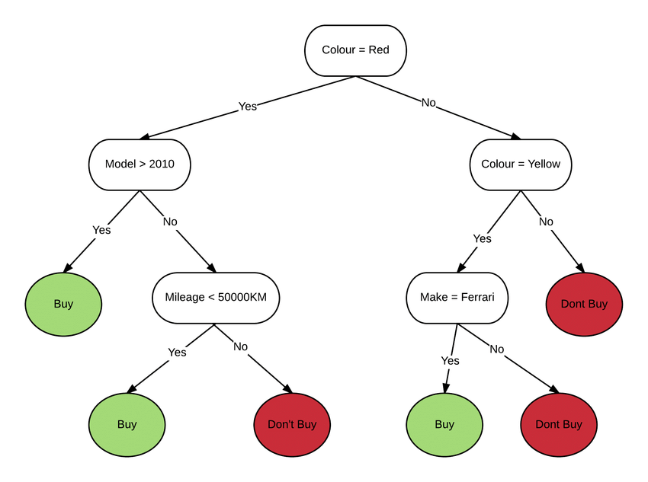
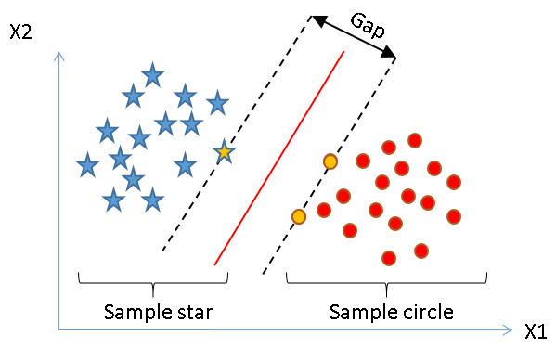
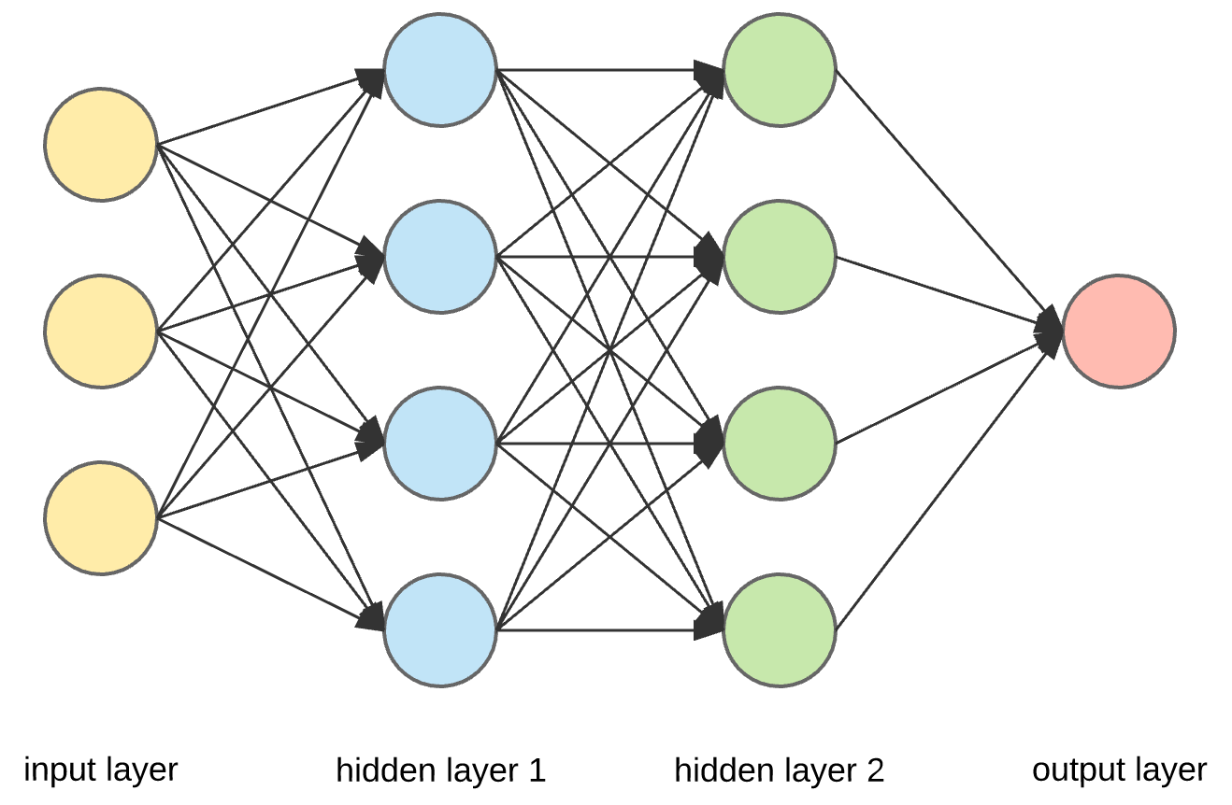
Machine Learning Fundamentals
Gilberto Cunha
grncacad@gmail.com

Slide 2





Tools we’ll be using

Slide 3
CONTENT
Brief introduction to ML
1
Supervised classification data
2
Supervised classification models: an overview
3
Supervised classification model evaluation
4
What is it ML?
Why use it?
Drawbacks
ML systems
Typical ML workflow
Dataset
Data visualization
Data splits
Models
Data visualization
Data splits
Accuracy
Confusion matrix
True vs predicted distributions

Slide 4
Brief Introduction to ML

Slide 5
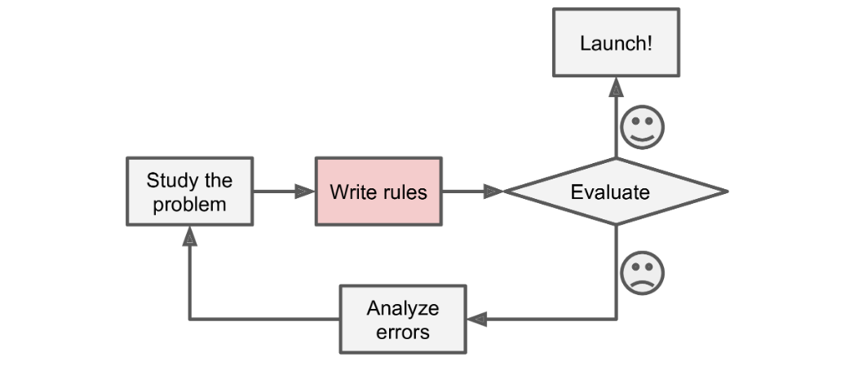
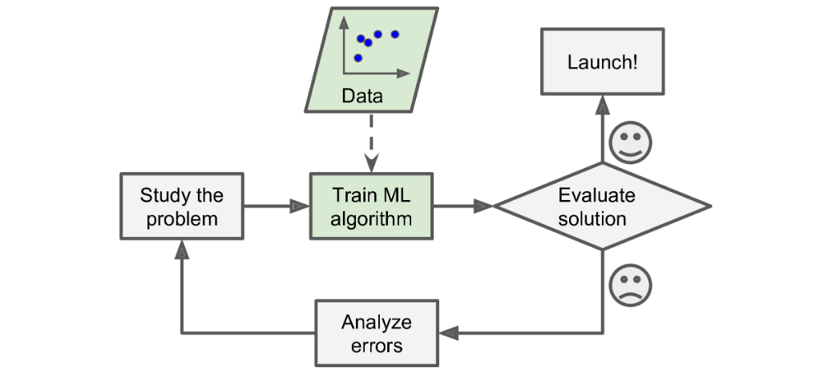
What is ML
In short:
Data driven algorithms!
Figure 1: Traditional algorithm
Figure 2: ML algorithm

Slide 6
Why use it?
No clear recipe for solving a problem
Recipe for solving a problem is too complicated
Extract insights from large amounts of data

Slide 7
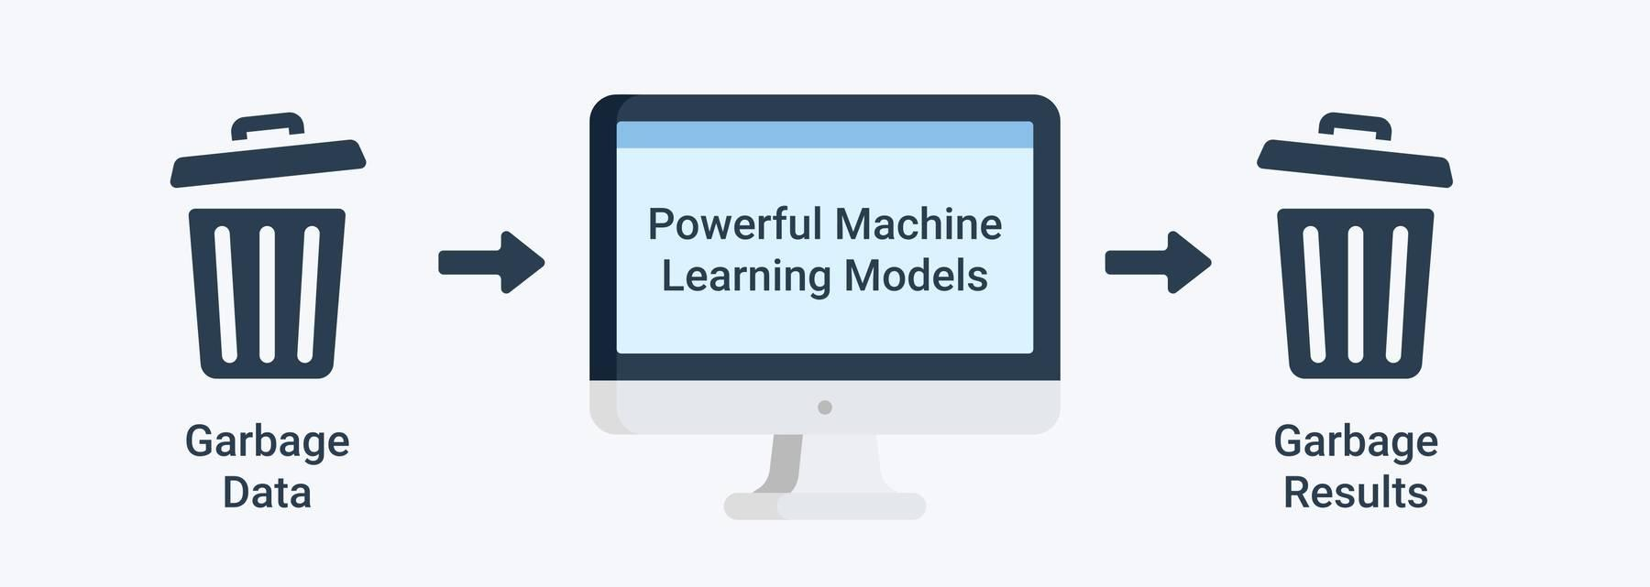
ML drawbacks
Most models are data-hungry
Training data should be representative of real data
Bad data
Model under and overfitting
Figure 4: Garbage in, garbage out principle

Slide 8
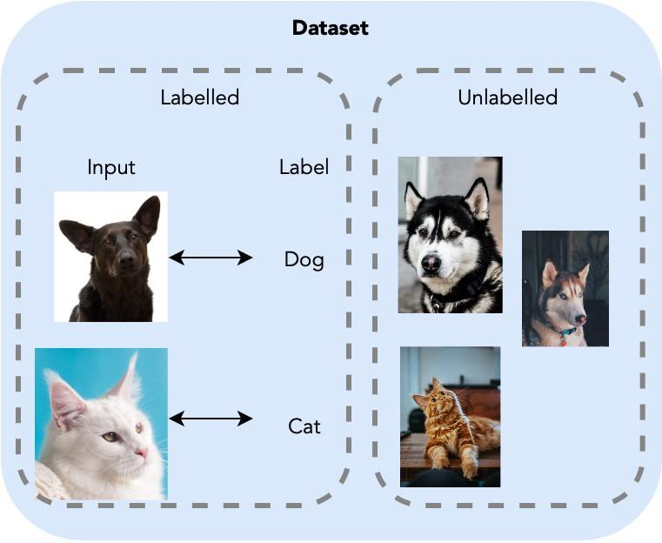
ML systems
Supervised learning
Unsupervised learning
Semi-supervised learning
Reinforcement learning
Inside each of these categories there are multiple types of problems that can be solved!
We’ll be looking at supervised classification.
Figure 5: Supervised vs unsupervised datasets

Slide 9
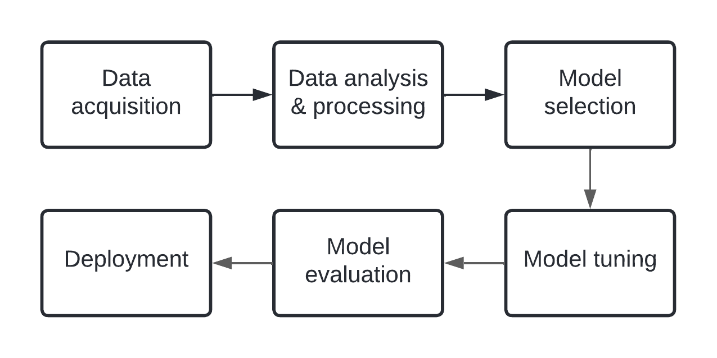
ML Workflow
Figure 6: Typical ML development workflow

Slide 10
Supervised classification data

Slide 11
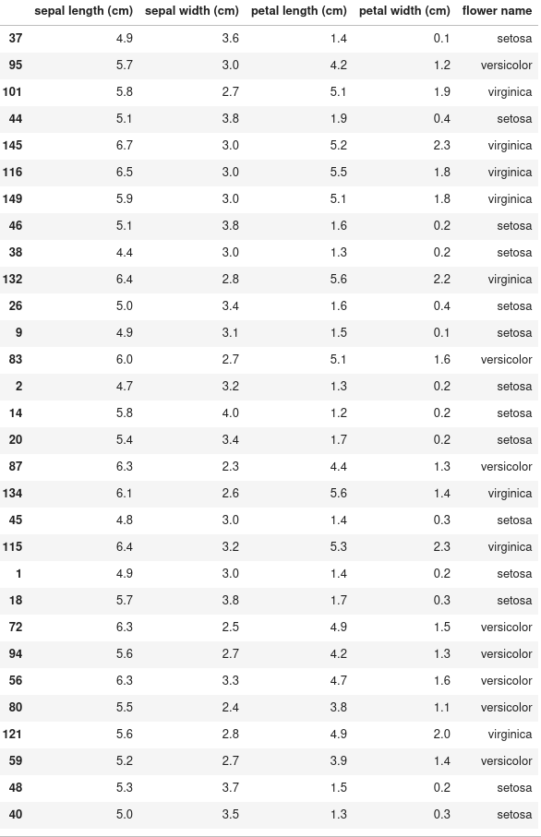
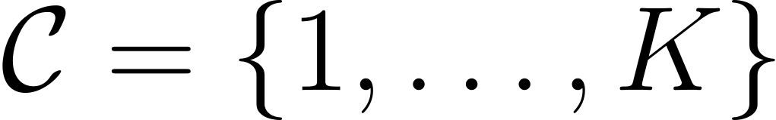
Dataset
Features: data point description.
Classes: data point possible classifications:
Labels: data point true classes:
Dataset: collection of features and labels:
Figure 7: Iris dataset

Slide 12
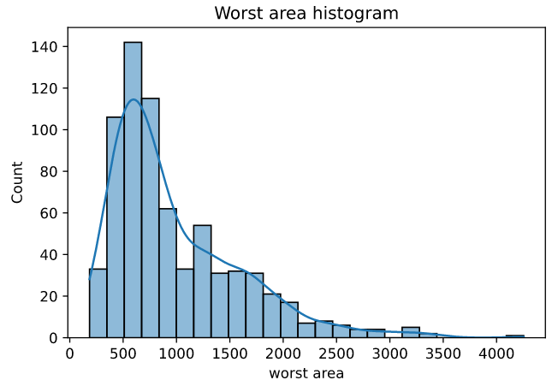
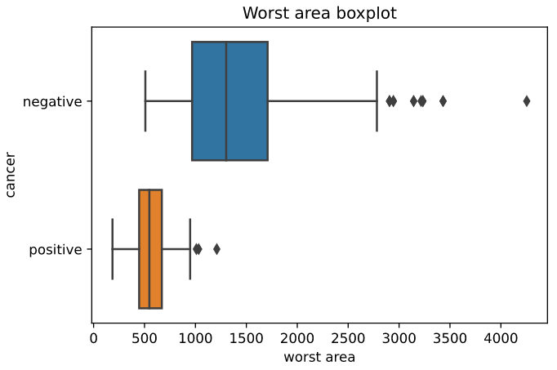
Data visualization
Great tool for understanding your data.
Python libraries make it very simple:
Matplotlib
Seaborn
Figure 8: Histogram using seaborn and matplotlib
Figure 9: Boxplot using seaborn and matplotlib

Slide 13
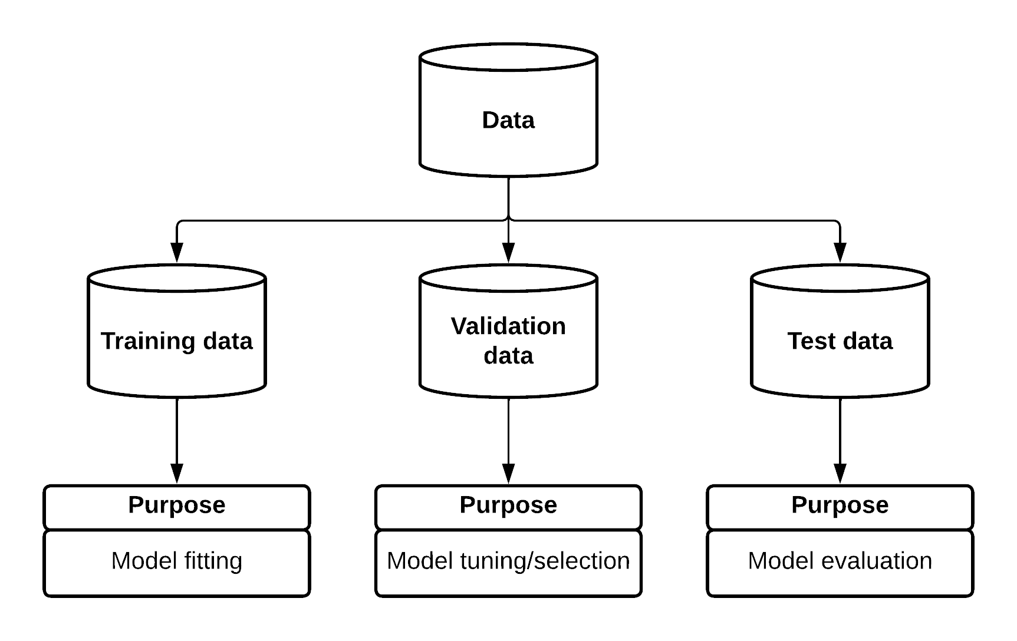
Data splits
Time to get coding! Let’s go through Part 1 of the hands-on notebook!
Figure 10: Data splitting

Slide 14
Supervised classification models:
an overview

Slide 15
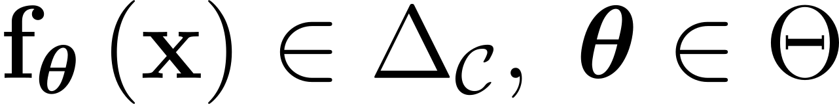
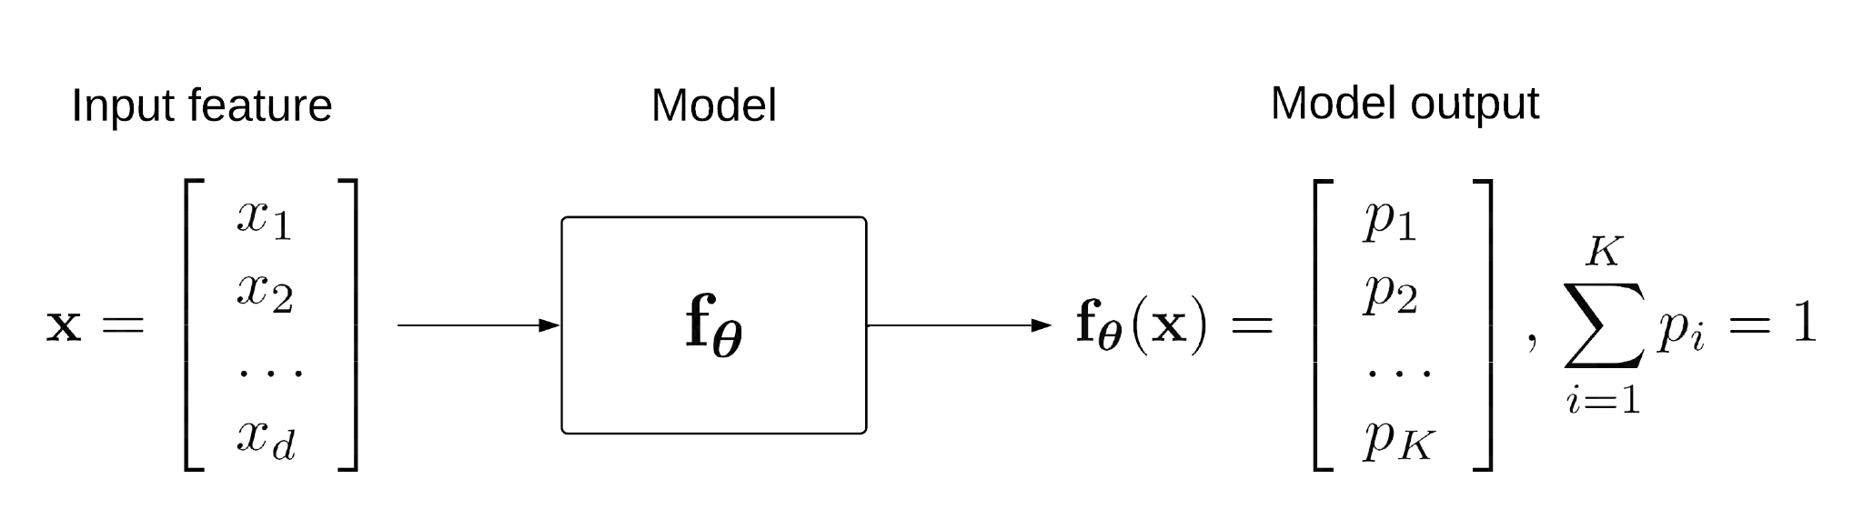
Model
Model: function mapping feature into probability distribution over classes.
Figure 11: Model prediction representation
Take the class with highest probability to represent the predicted class!

Slide 16
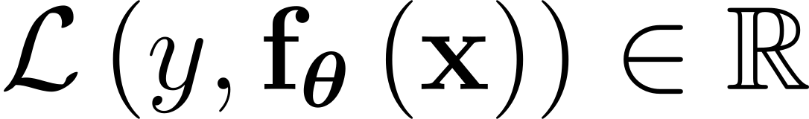
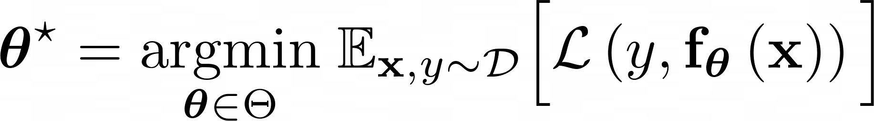
Model training
Loss: function evaluating model’s prediction. The lower the better.
Training: find model parameters that minimize loss in dataset.
The sklearn python library allows us to build and train (fit) models with very few lines of code!

Slide 17
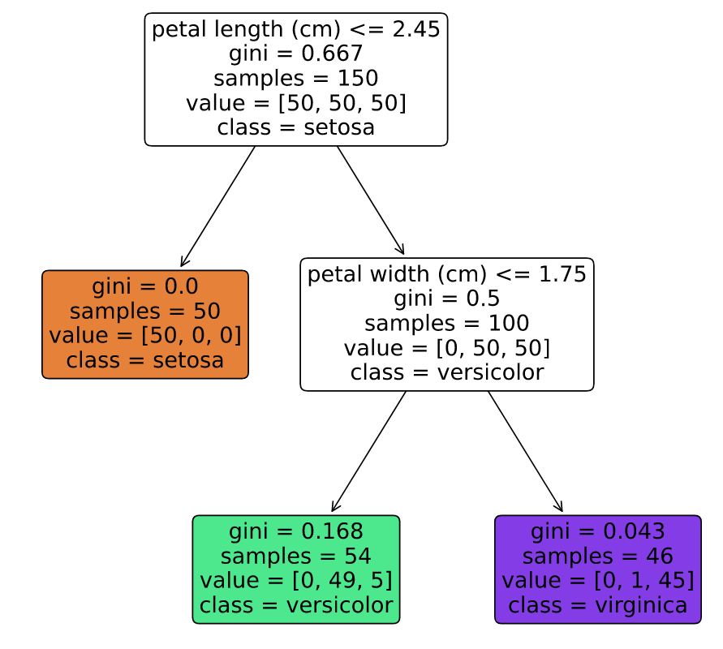
Example: Decision Tree
No
Yes
Binary tree
Each decision node (non-leaf node) contains a split, dividing the dataset into two
Majority class vote to decide data point class in leaf node
Training involves finding the best splits for the dataset: gini and entropy scores
No
Yes
Figure 12: Decision tree for the iris dataset

Slide 18
Model tuning
Time to get coding! Let’s go through Part 2 of the hands-on notebook!
Some model parameters are used to guide the fitting process, and therefore are not optimized in this process: hyperparameters
Different hyperparameters lead to performance differences. Model tuning tries to find the best hyperparameters.
Typically involves running multiple models with different hyperparameters and choose the best performing ones: these models are fitted with training data and evaluated with validation data.
Once the best model has been chosen, it is usually fitted on joint training and validation data and is then ready to be evaluated on test data.

Slide 19
Supervised classification model evaluation

Slide 20
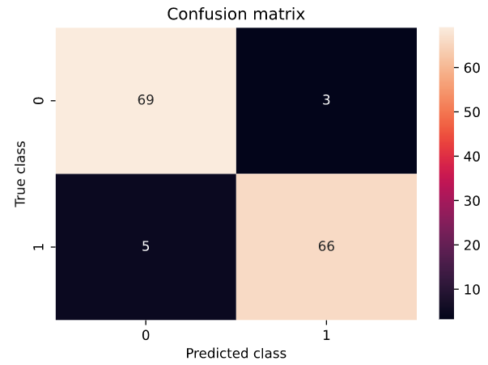
Accuracy
Confusion matrix
The number of correctly classified data points.
Not very descriptive, and not very useful for unbalanced data
How much the model confuses one class with another.
Groups these into four groups:
False negatives: incorrectly predicted negative data points
True negatives: correctly predicted negative data points
False positives: incorrectly predicted positive data point
True positives: correctly predicted positive data points
Figure 13: Confusion matrix

Slide 21
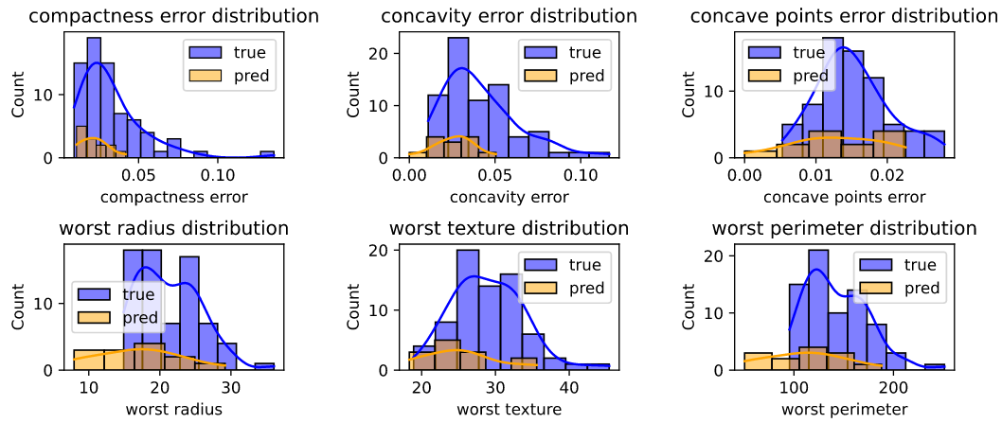
True vs predicted distributions
Time to get coding! Let’s go through Part 3 of the hands-on notebook!
Similar to the distribution plots we saw in the data visualization section.
Shows differences in the distributions predicted by our model vs the true distributions (for each class)
Figure 14: True vs predicted histograms

Slide 22
Thank you!
And good luck on your Machine Learning journey

