Slide 1
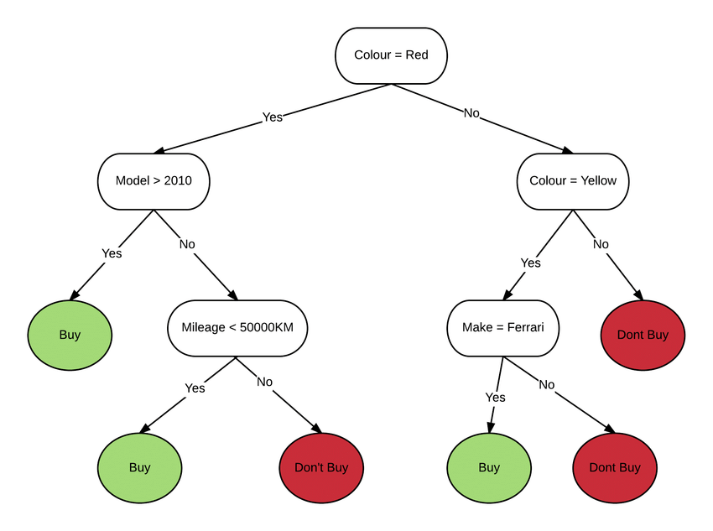
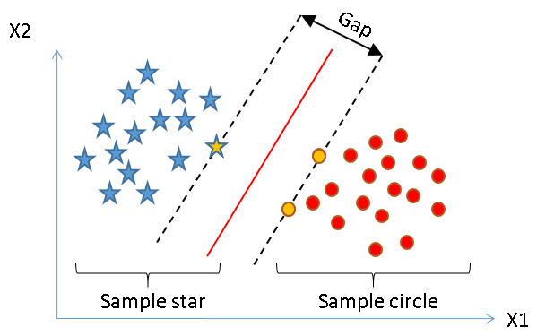
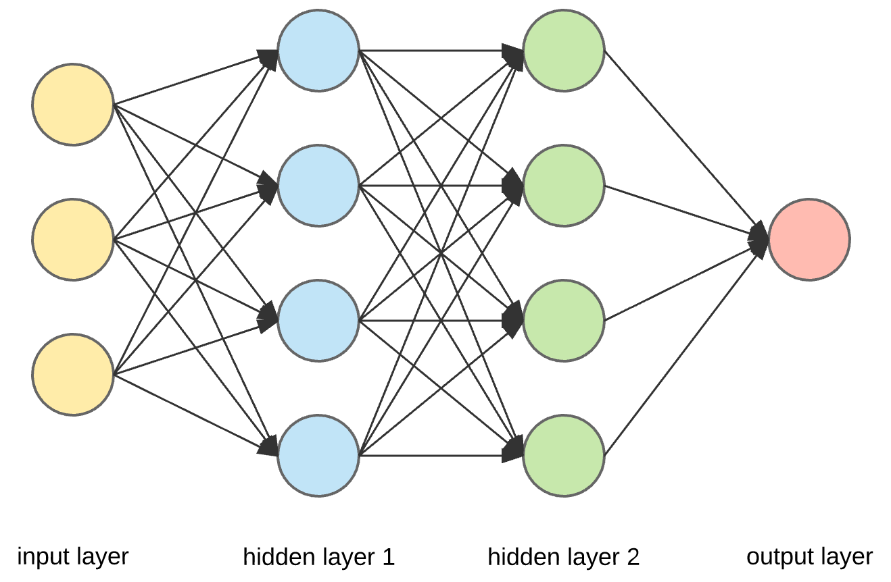
Machine Learning Fundamentals
Gilberto Cunha
grncacad@gmail.com

Slide 2





Tools we’ll be using

Slide 3
CONTENT
Brief introduction to ML
01
ML Landscape
02
03
Supervised Classification
What is it ML?
Why use it?
Drawbacks
ML systems
Typical ML workflow

Slide 4
Brief Introduction to ML

Slide 5
What is ML
Data driven algorithms!

Slide 6
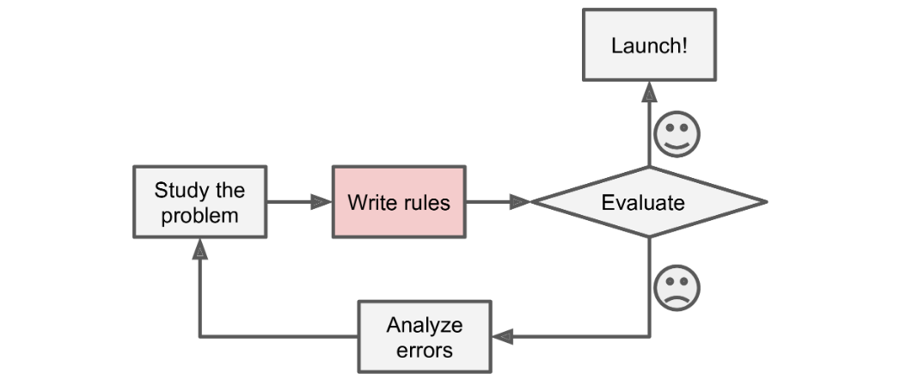
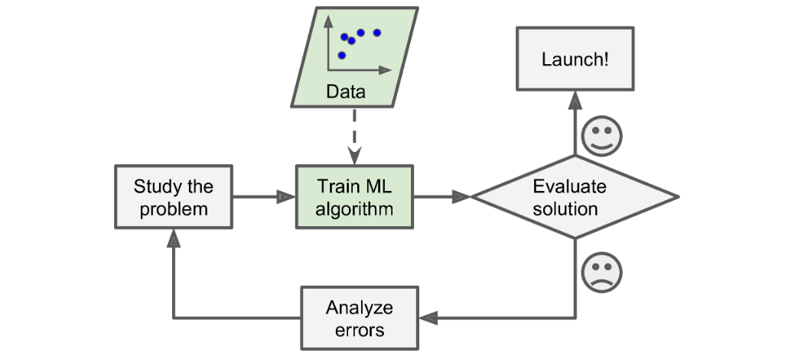
Why use it?
Figure 1: Traditional algorithm
No clear recipe for solving a problem
Recipe for solving a problem is too complicated
Extract insights from large amounts of data
Figure 2: ML algorithm

Slide 7
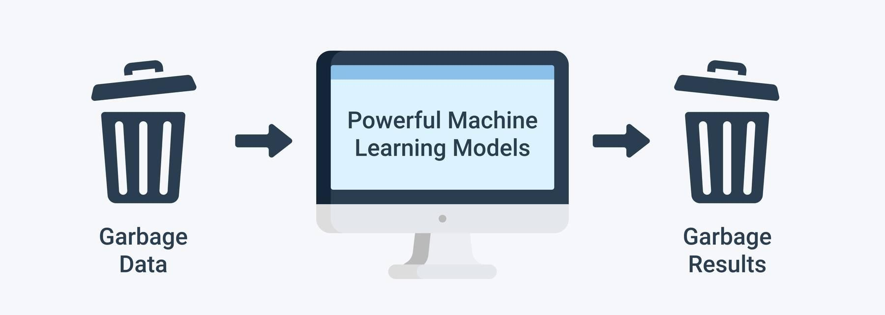
ML drawbacks
Most models are data-hungry
Training data should be representative of real data
Bad data
Model under and overfitting
Figure 3: Garbage in, garbage out principle

Slide 8
ML Landscape

Slide 9
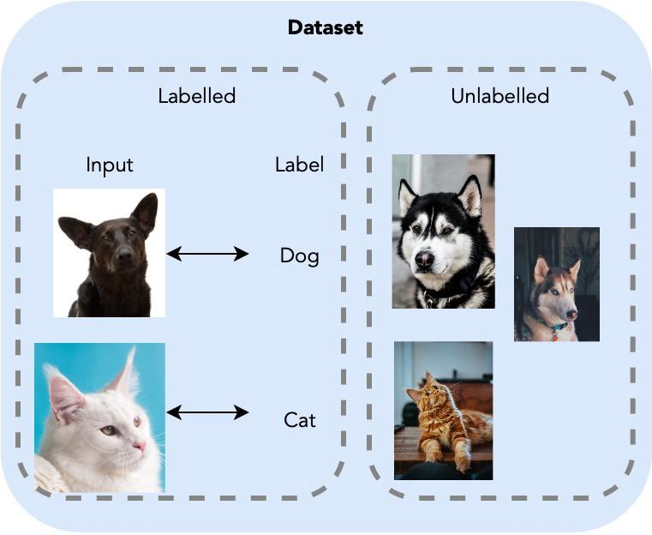
ML systems
Supervised learning
Unsupervised learning
Semi-supervised learning
Reinforcement learning
Figure 4: Supervised vs unsupervised datasets

Slide 10
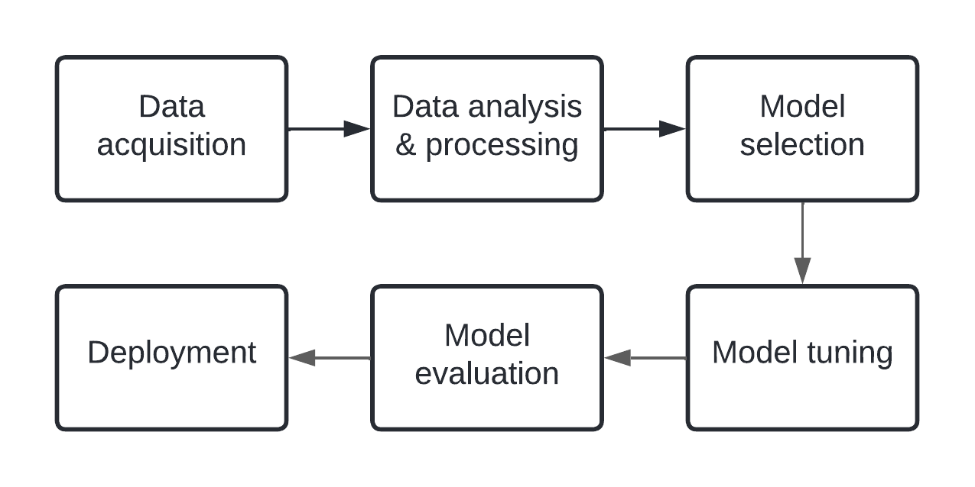
ML Workflow
Figure 5: Typical ML development workflow

Slide 11
Supervised classification data

Slide 12
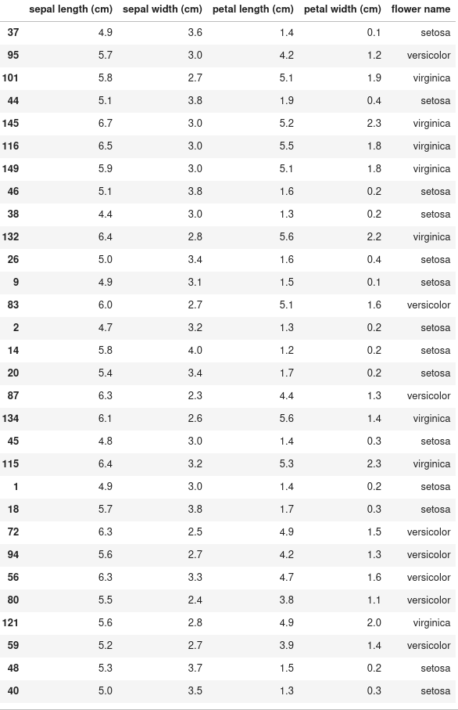
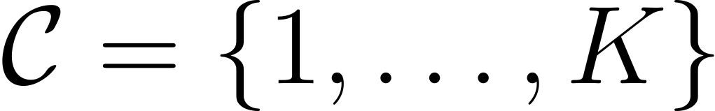
Dataset
Features: data point description.
Classes: data point possible classifications:
Labels: data point true classes:
Dataset: collection of features and labels:
Figure 5: Iris dataset

Slide 13
Data visualization
Great tool for understanding your data.
Awesome python libraries make it very simple:
Matplotlib
Seaborn

Slide 14
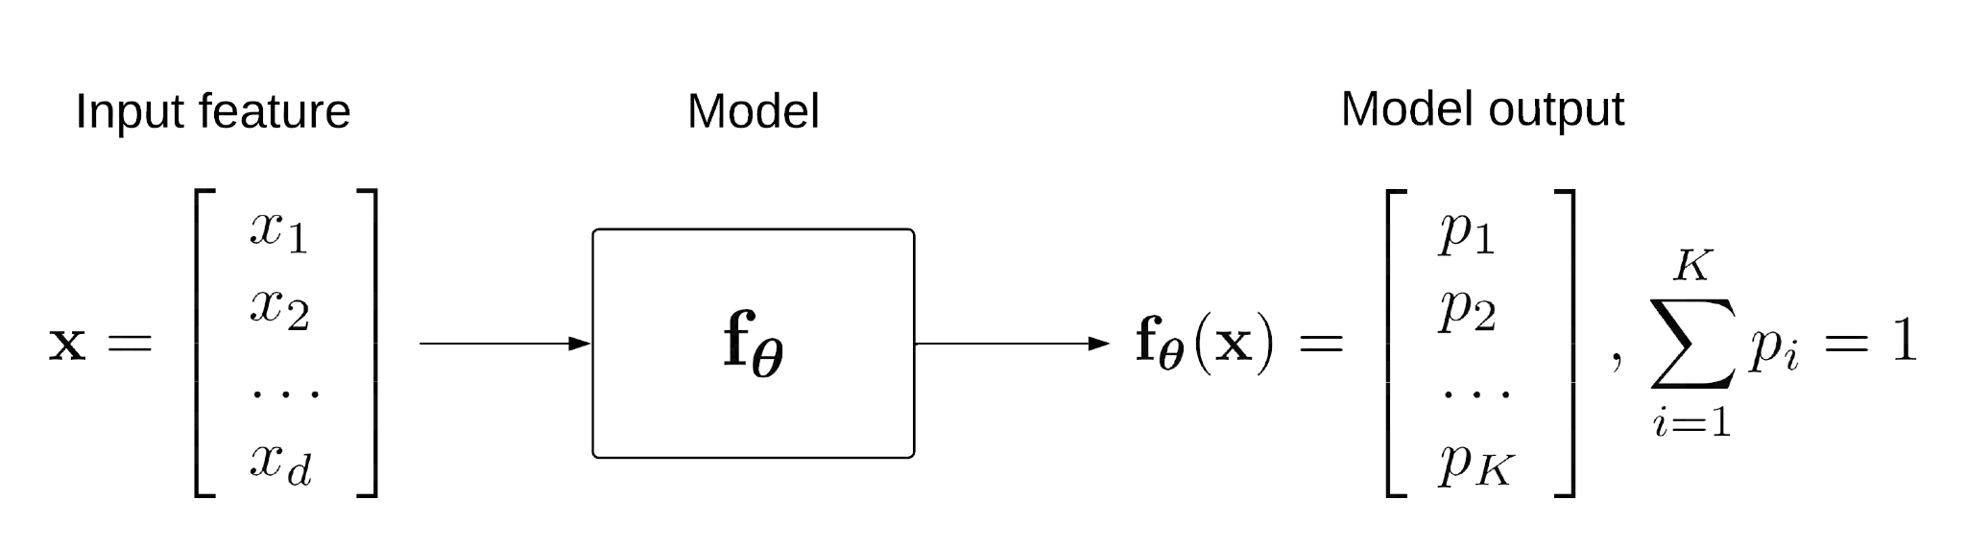
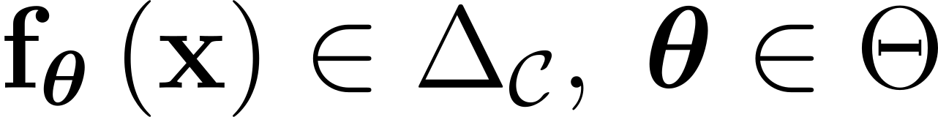
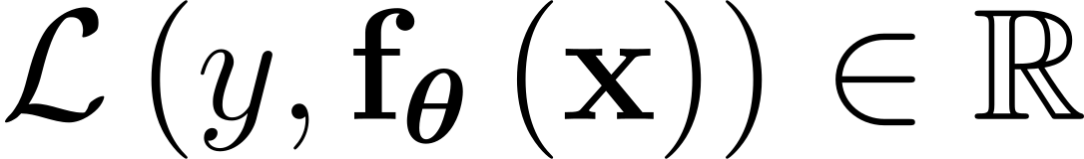
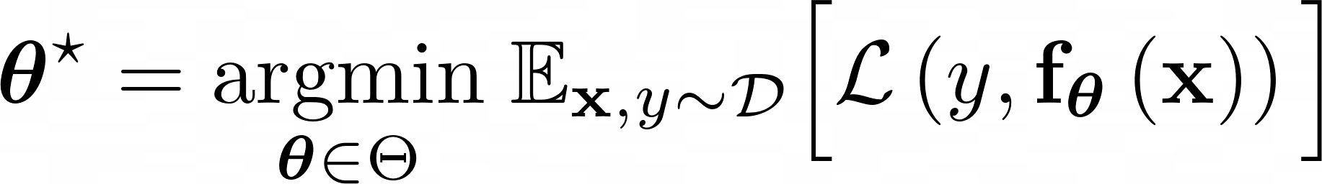
Model
Figure 6: Model prediction representation
Model: function mapping feature into probability distribution over classes.
Loss: function evaluating model’s prediction. The lower the better.
Training: find model parameters that minimize loss in dataset.

