Slide 1
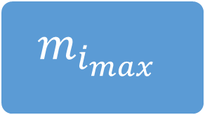
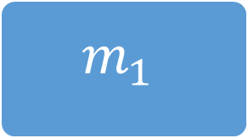

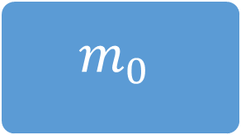



$$m_{0}$$
$$κ\left(0\right)$$
$$m_{1}$$
$$κ\left(0\right)$$
$$⋮$$
$$κ\left(0\right)$$
$$m_{i_{max}}$$

