Slide 1

What should HIV look like
HIV

Slide 2
What do you call HIV?
HIV

Slide 3


Treatment Ladder
Treatment Steps
Suppression
Technology can assist the person up the steps to treatment with education, automation and information.
Retention
Treatment
technology
Each step has it’s unique technical challenges.
Access
Prevention
Each step requires that the patient has reached the previous step.
Ability/Means
Motivation
Awareness
Engagement

Slide 4

Risk “Hole”
Technology can also be seen as preventing or mitigating the risks that the patient faces.
High risk Group
Exposure
Infection
Transmission
Severe Illness
Death

Slide 5

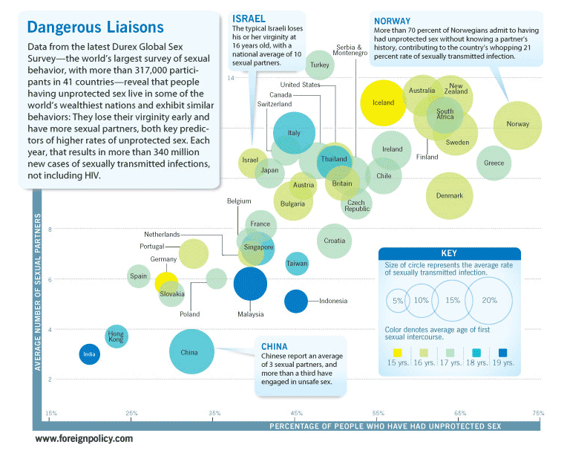



Are you afraid of
Do you worry about
HIV
SNAKES
GUNS
HIV
6
700,000
250,000
700,000
Estimated deaths per year globally.
Estimated deaths per year globally.

Slide 6











people
14
16
20

Slide 7












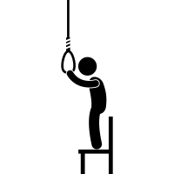




context

Slide 8







event
?
HIV
?

Slide 9

Objects
+
CD4
HIV
HIV
+
+
HIV
CD4
CD4

Slide 10




treatment
PrEP
PEP
ART
HIV+
HIV-
HIV?

Slide 11


















signs
HIV
HIV+ Privacy
Transgender
Spouse Privacy
Youth Privacy

Slide 12















symptoms

Slide 13


relation

Slide 14
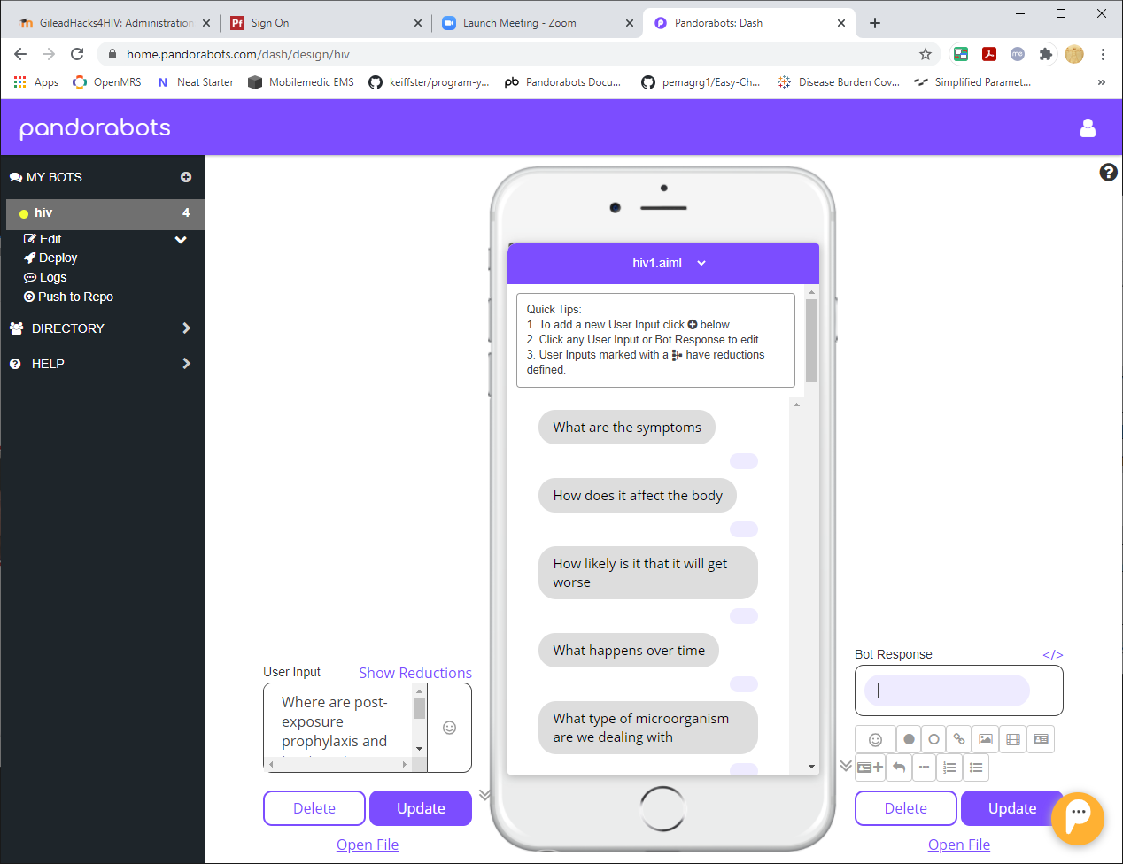




How likely am I to get HIV
????
What do I say to my patient when they ask : “How likely am I to get HIV”
????

