Slide 1
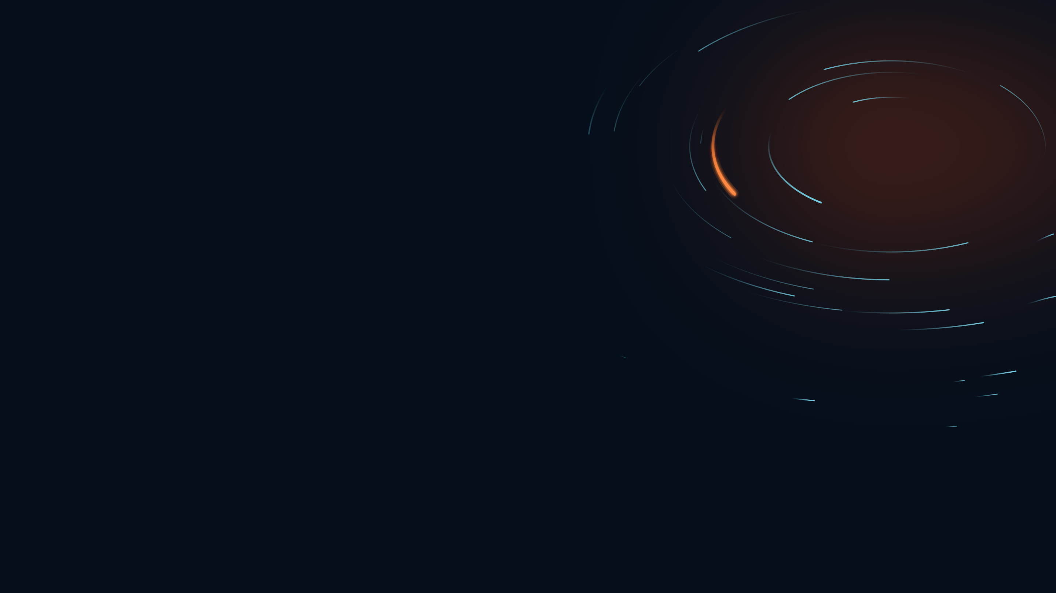

Ocean Motion ANALYTICS
The water your plant
drinks, forecast.
PITCH DECK · DESALINATION
Prepared for [Client] · September 2026

Slide 2
CONTENTS
What we'll cover.
01 What your intake actually sees
02 How we model it, end to end
03 Characterising your site
04 A forecast that runs every day
05 The next thirty years

Slide 3
SECTION 01
What your intake
actually sees.

Slide 4
SECTION 01
Three variables. One of them
arrives without warning.
THE WEDGE
CONTEXT
CONTEXT
Turbidity
Temperature
Salinity
Shamal-driven, episodic, and it arrives over hours. It is also what actually hurts: pretreatment overload, SDI spikes, coagulant dosing, shortened filter runs, production cuts. Nobody forecasts it for you.
Real SWRO economics — flux, specific energy, salt and boron passage. But you already measure it, and tomorrow looks much like today. The value in temperature is seasonal, which makes it a study rather than a daily number.
The slowest of the three, and measured. The salinity question with teeth is not tomorrow's value — it is recirculation: whether your own outfall, or the plant next door's, reaches your intake.
we keep temperature and salinity on the dashboard because they are nearly free once the model runs — but turbidity is the reason to have one

Slide 5
ONE SHAMAL, ONE INTAKE
21 January 2022. The wind turned
at midday. By midnight the water
was brown.
3 → 18
12 h
4 ×
NTU NEAR THE BED,
AGAINST A 3 NTU BACKGROUND
FROM THE WIND PEAK
TO THE PLUME AT SURFACE
LONGER ABOVE 10 NTU NEAR THE BED
THAN AT THE SURFACE
modelled at 24.37 N · 54.05 E · 6 m — and the satellite that would have told you about it sees only the surface, the smaller half

Slide 6
SECTION 02
How we model it.

Slide 7
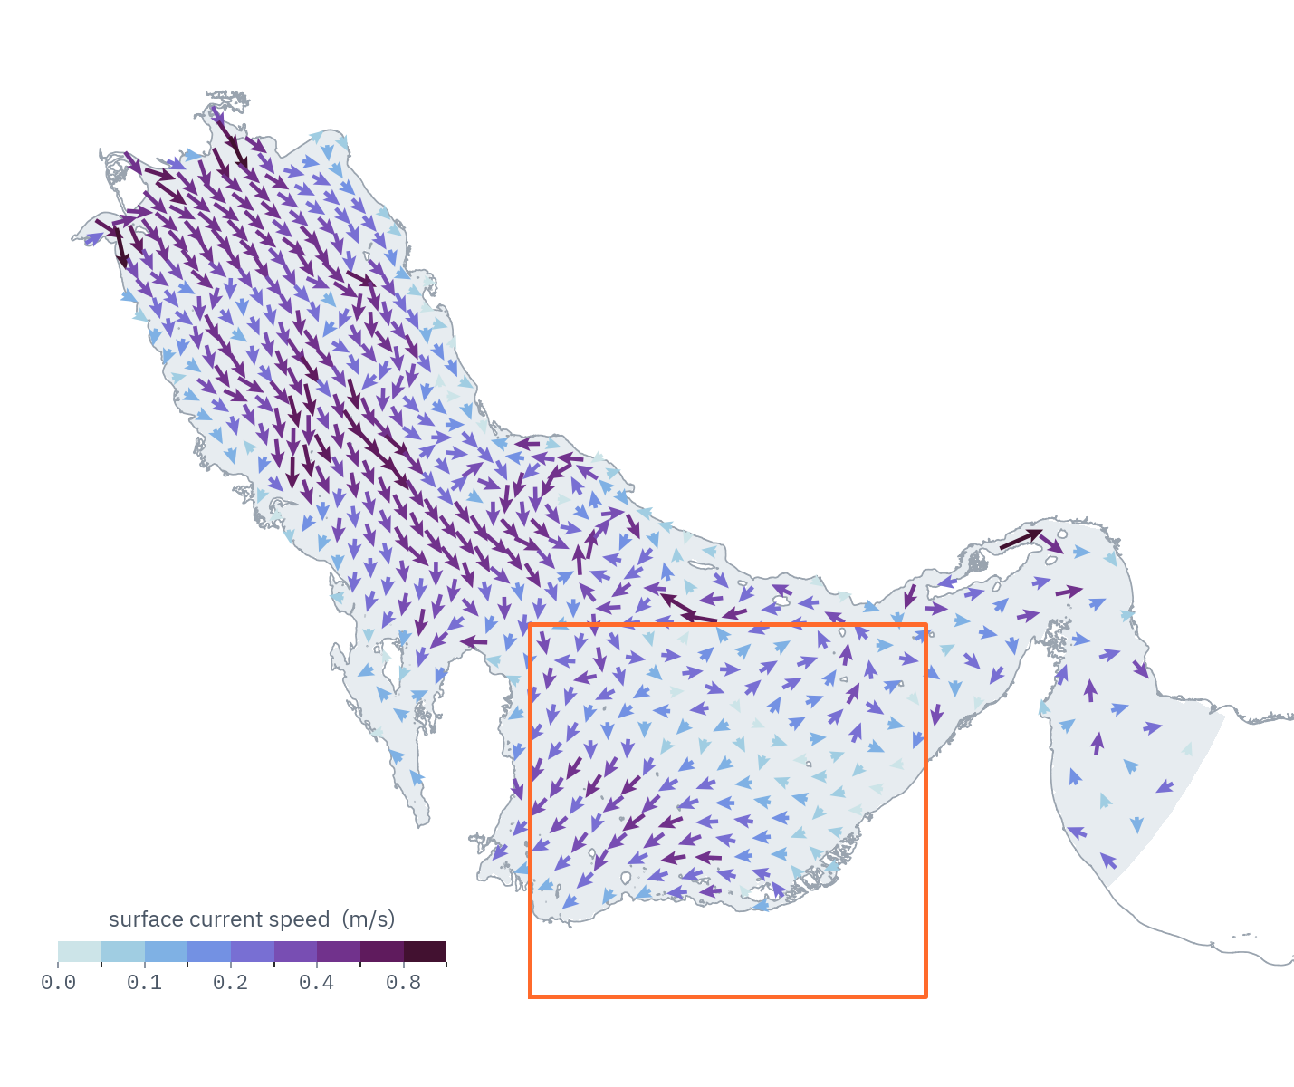
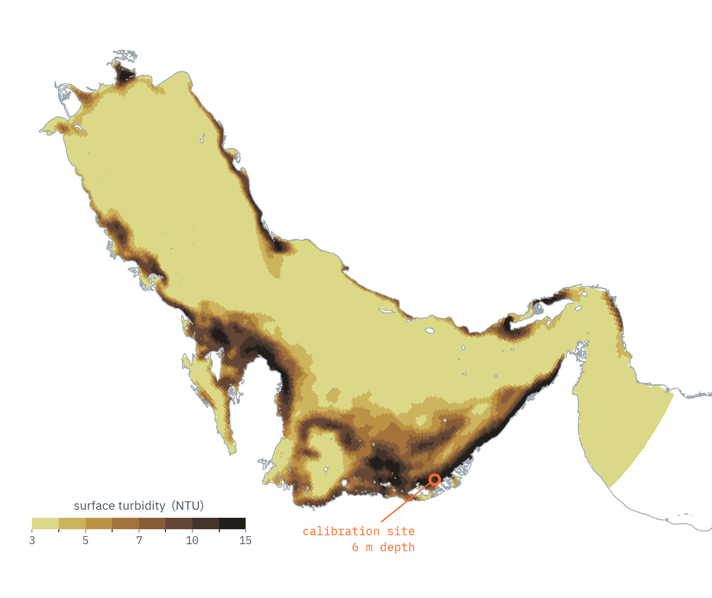
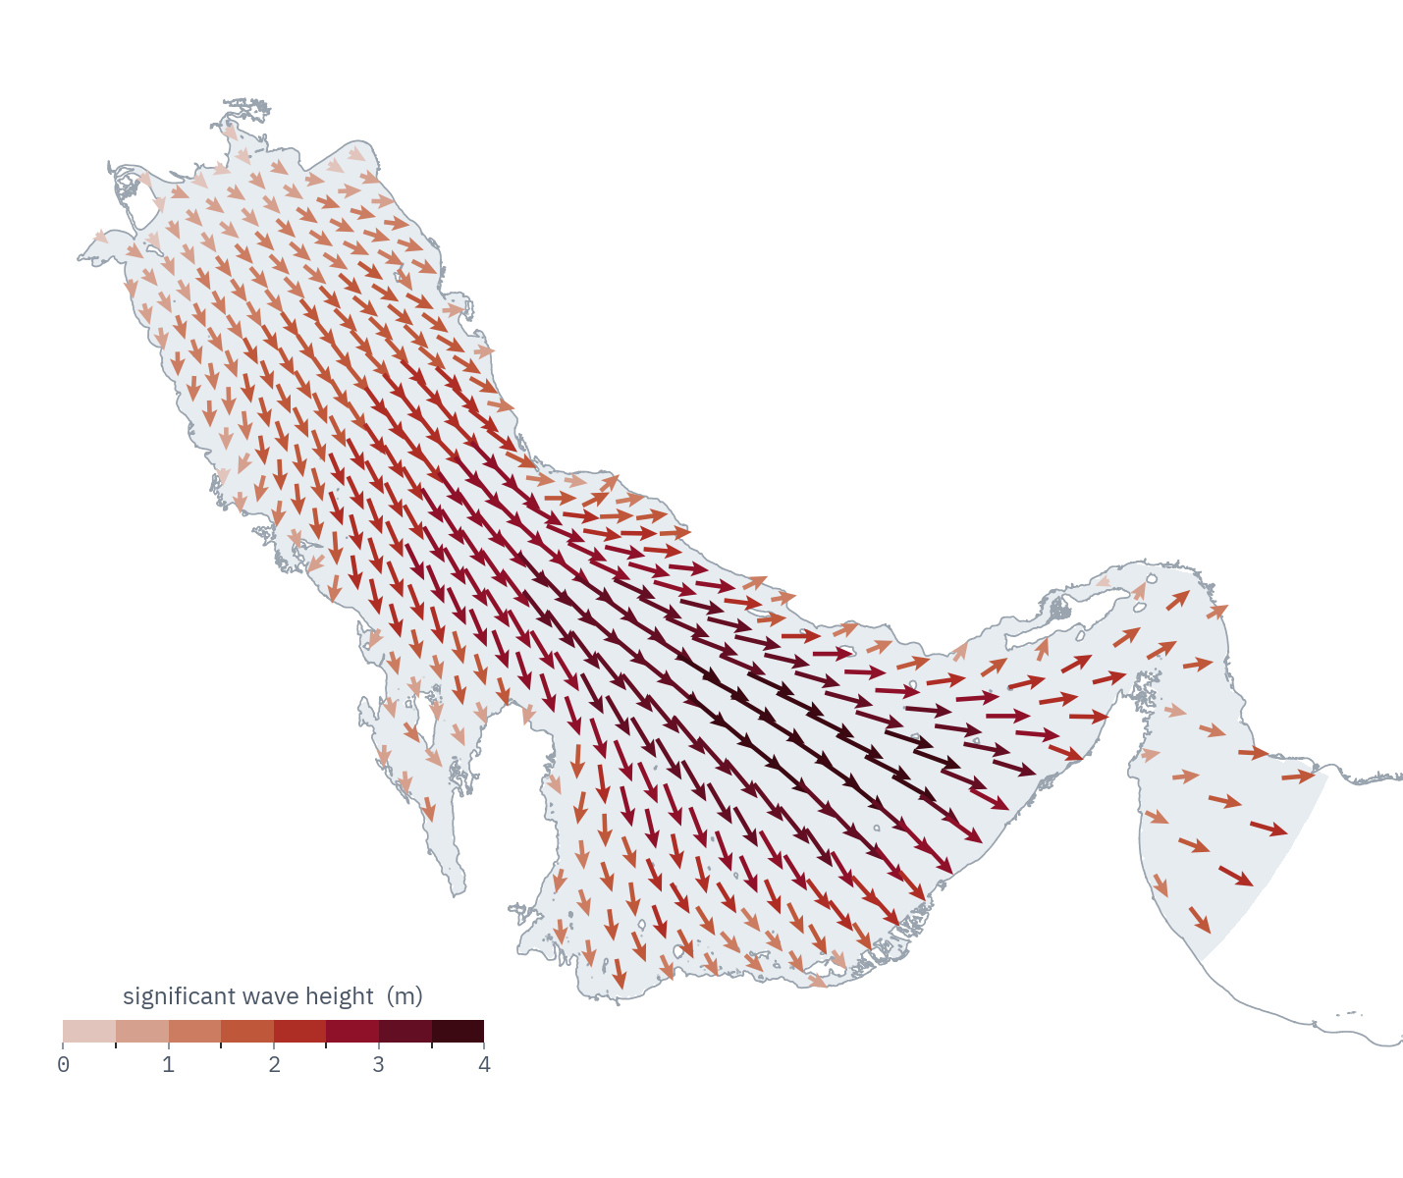
Five models,
one chain.
CROCO
run offline, after both have finished
INPUTS
ERA5 / GFS
0.25 deg · hourly
GLORYS / MERCATOR
bottom currents
sediment model
1/12 deg · daily
TPXO10
10 tidal constituents
surface currents + water level
WAVEWATCH III
CMEMS spectra
25 points at Hormuz
grid 291 x 131
orbital velocity
3.5 km · 15 levels · shared
every arrow is a file on disk — there is no step here you cannot ask to see

Slide 8
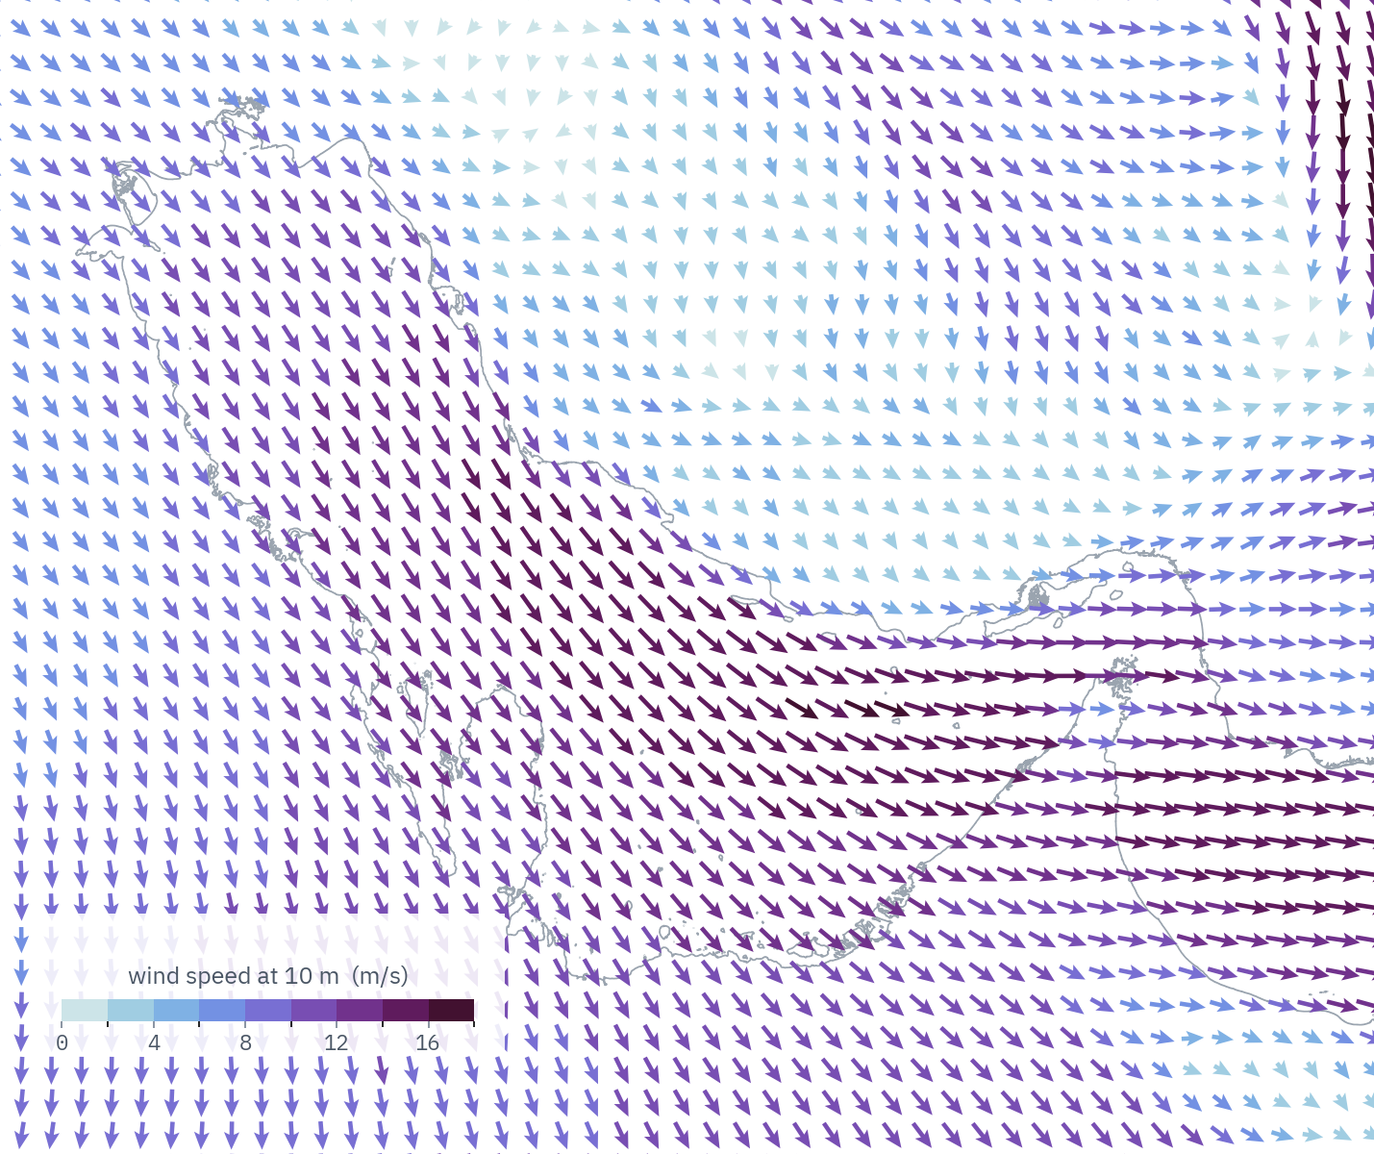
ATMOSPHERE
BOUNDARIES
GRID
CIRCULATION
WAVES
TURBIDITY
21 Jan 2022 · 08:00 UTC
We start with weather
anyone can audit.
ATMOSPHERIC FORCING
hindcast forecast
WIND ERA5 GFS
0.25 deg hourly 0.25 deg 3-hourly
OCEAN GLORYS MERCATOR
TIDE TPXO10 TPXO10
WAVES CMEMS spectra CMEMS WAV
public, global, and honestly coarse — the same four inputs drive the hindcast and the daily forecast

Slide 9
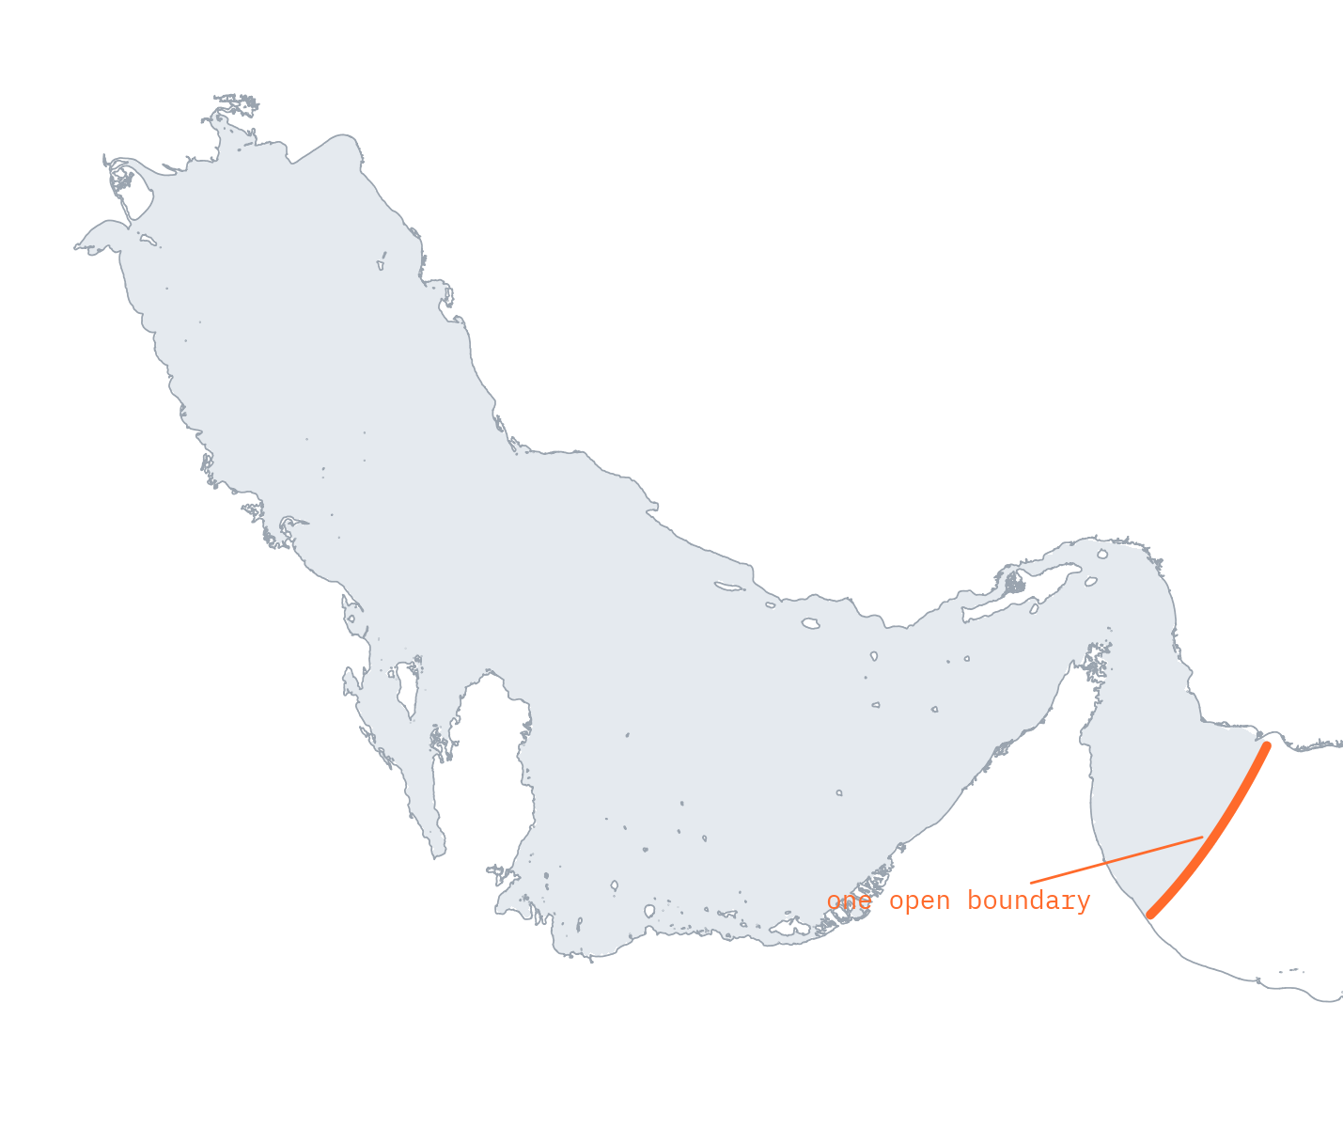
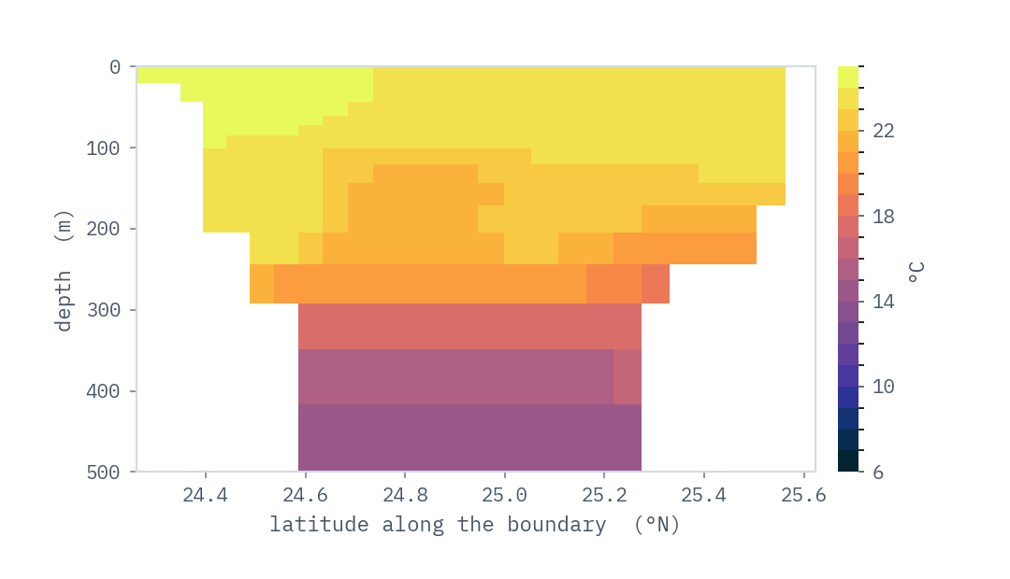
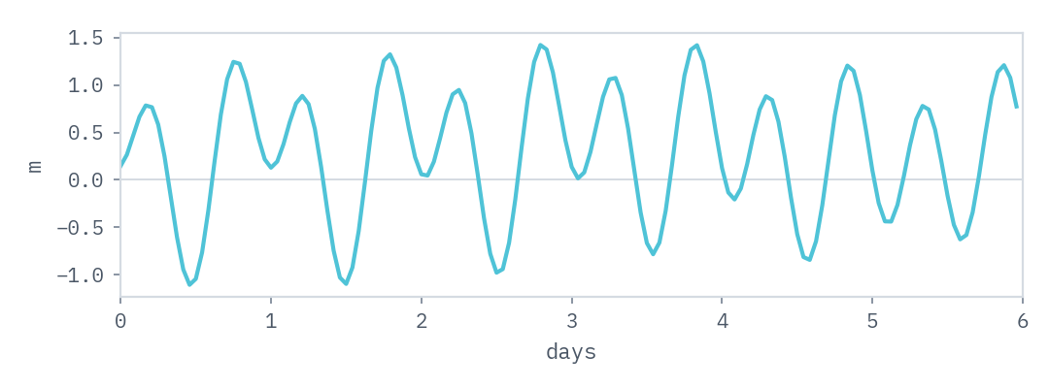
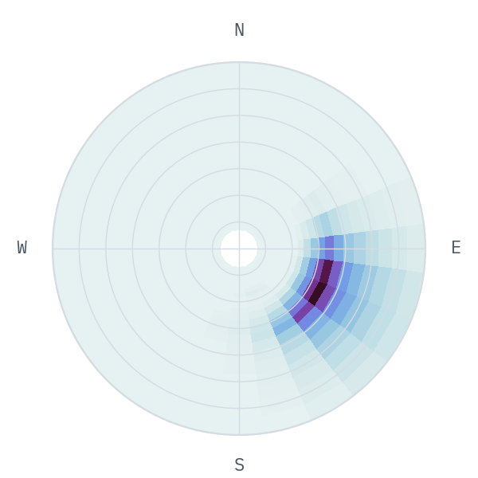
ATMOSPHERE
BOUNDARIES
GRID
CIRCULATION
WAVES
TURBIDITY
21 Jan 2022
The Gulf has
one door.
OPEN BOUNDARY
BOUNDARY east only · 26 wet cells
DEPTH 27 to 1518 m
OCEAN GLORYS 1/12 deg · 50 z-levels
TIDE TPXO10, 10 constituents
WAVES 25 CMEMS spectra
everything else is coastline — which is what makes a Gulf hindcast a tractable problem

Slide 10
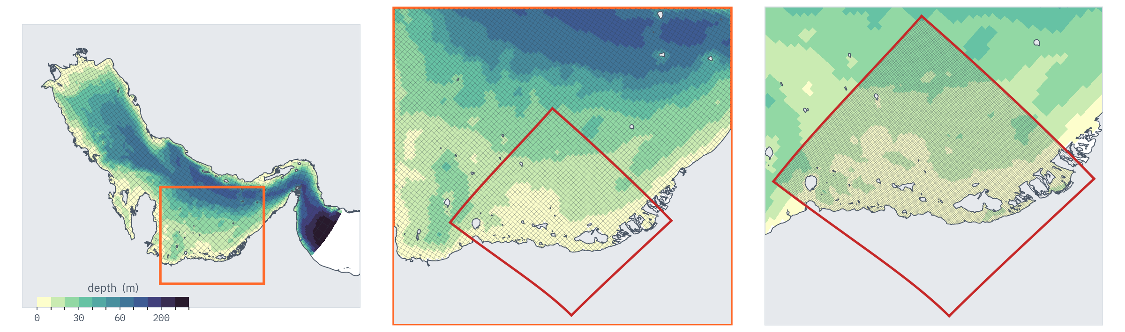
ATMOSPHERE
BOUNDARIES
GRID
CIRCULATION
WAVES
TURBIDITY
We refine until the site
is resolved.
MODEL GRID
PARENT 291 x 131 · 3.5 km · 15 levels
NEST 140 x 128 · 1.2 km · 3x refinement
METHOD AGRIF two-way nesting
further nests wherever a site needs one
the whole Gulf
the southern shelf
a nested grid
3.5 km · every 4th line
3.5 km · every cell
1.2 km · every cell
the nest outline is the grid's own edge, not a box — and the same machinery refines again wherever a client needs it

Slide 11
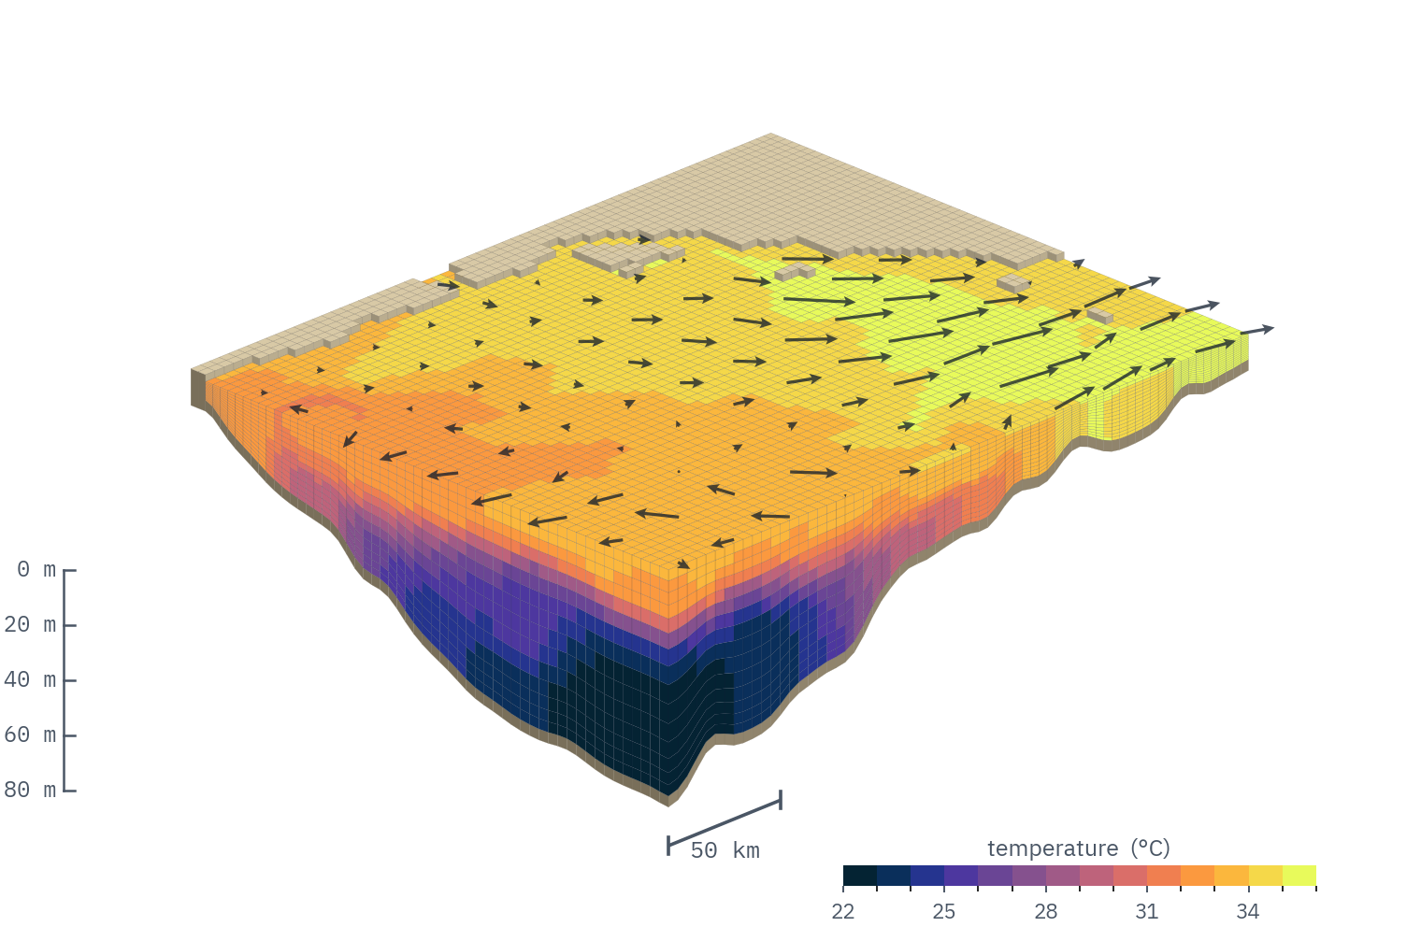
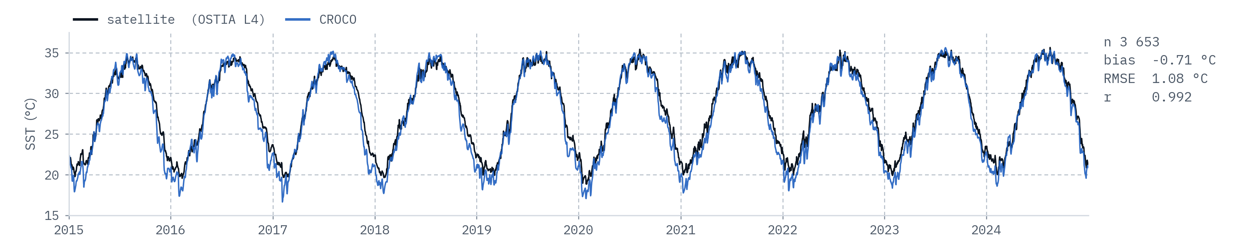
ATMOSPHERE
BOUNDARIES
GRID
CIRCULATION
WAVES
TURBIDITY
Then we solve
for the water.
CIRCULATION MODEL
MODEL CROCO v1.3.1
SOLVES u, v, w, T, S, turbulence
LEVELS 15, terrain-following
MIXING GLS + KPP
OUTPUT hourly, every level
solved on 15 layers, not one — and held to ten years of satellite SST, not just the week we are talking about

Slide 12
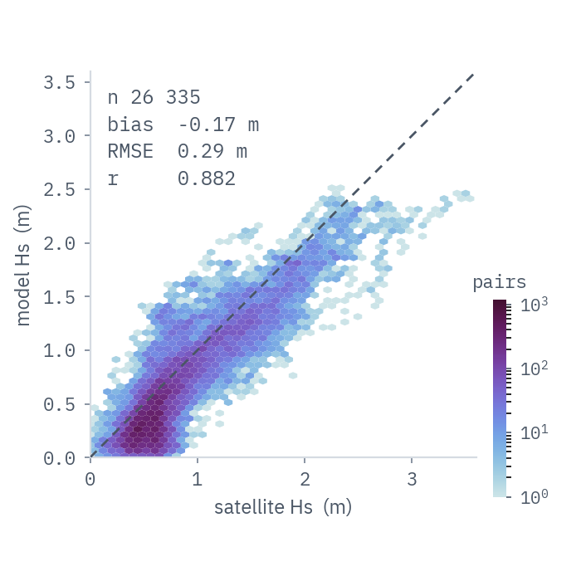
ATMOSPHERE
BOUNDARIES
GRID
CIRCULATION
WAVES
TURBIDITY
21 Jan 2022 · 14:00 UTC
Waves ride the currents
we just solved.
WAVE MODEL
MODEL WAVEWATCH III v6.07.1
GRID 291 x 131, the CROCO mesh
SPECTRUM 32 frequencies x 24 dir
FORCED BY ERA5 wind + CROCO currents
25 CMEMS spectra at Hormuz
one-way, CROCO into WW3, never back — and checked against 26 000 altimeter passes

Slide 13
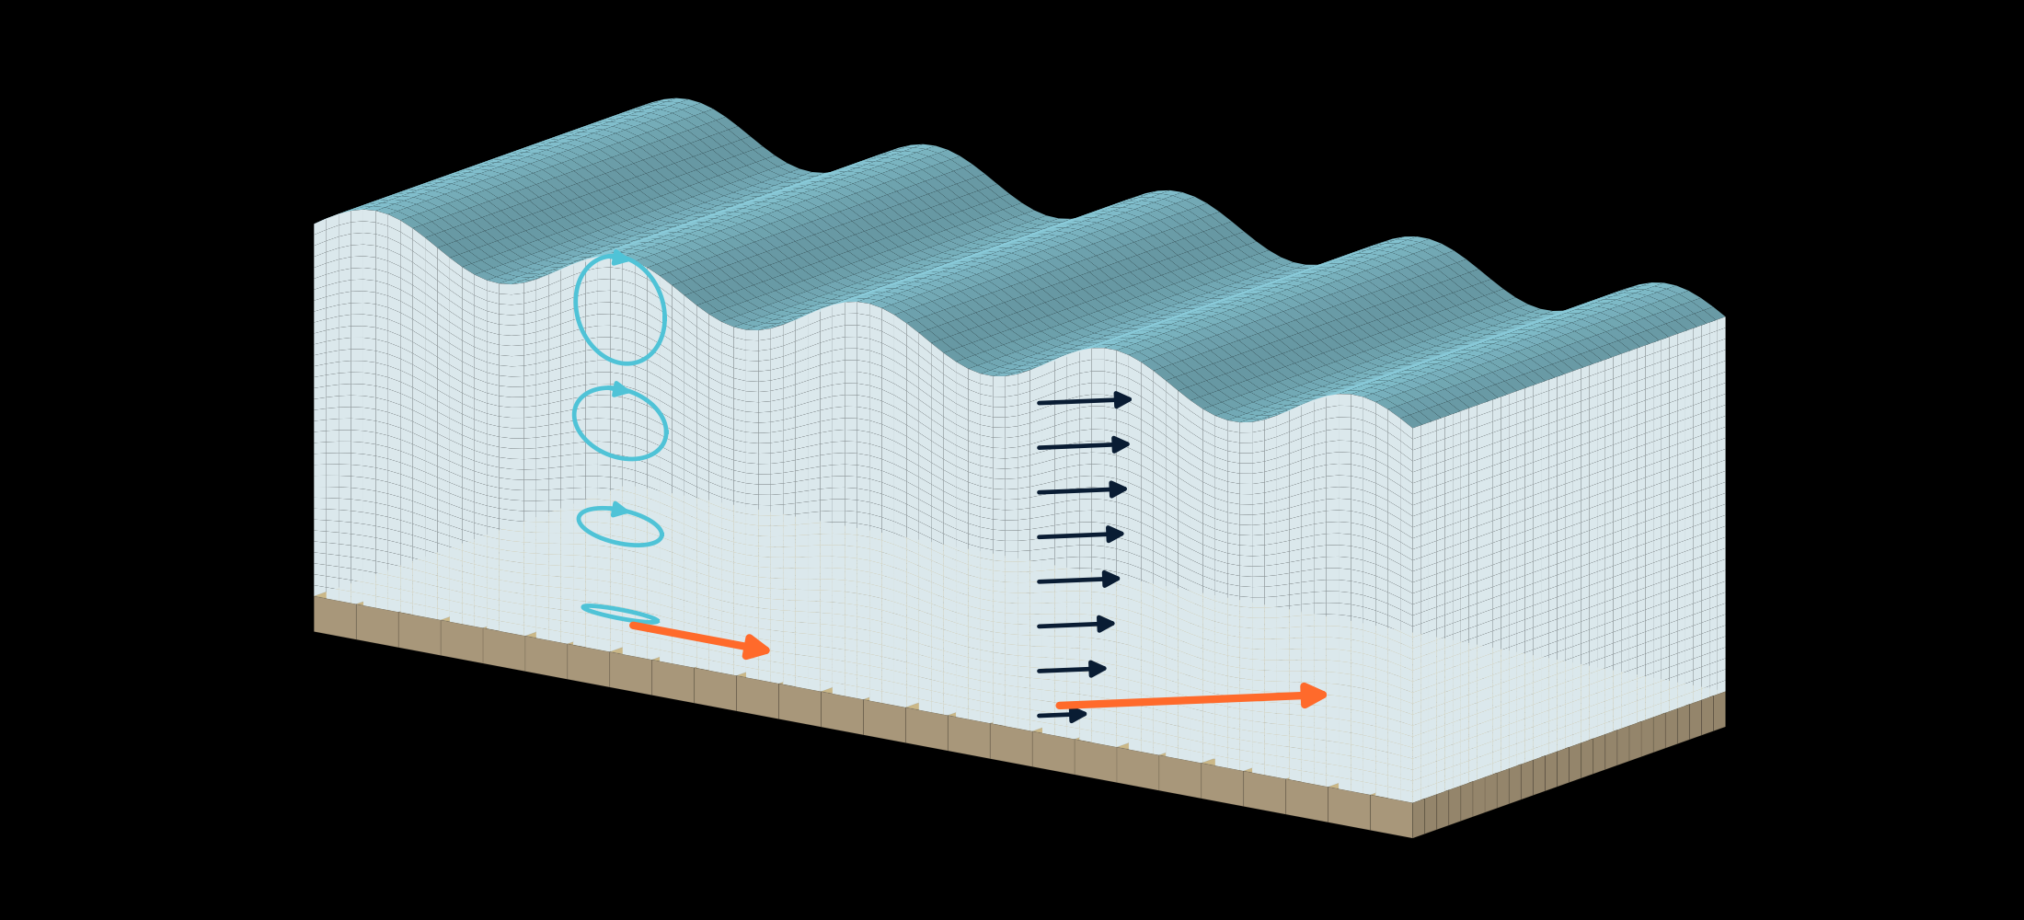
ATMOSPHERE
BOUNDARIES
GRID
CIRCULATION
WAVES
TURBIDITY
The seabed does nothing
until it does everything.
waves
current
strongest at the surface,
slowed by friction at the bed
orbital motion
flattens onto the bed
wave-driven
bed stress
current-driven
bed stress
waves and currents rarely line up — the model combines them non-linearly, so the pair bites harder than either alone

Slide 14
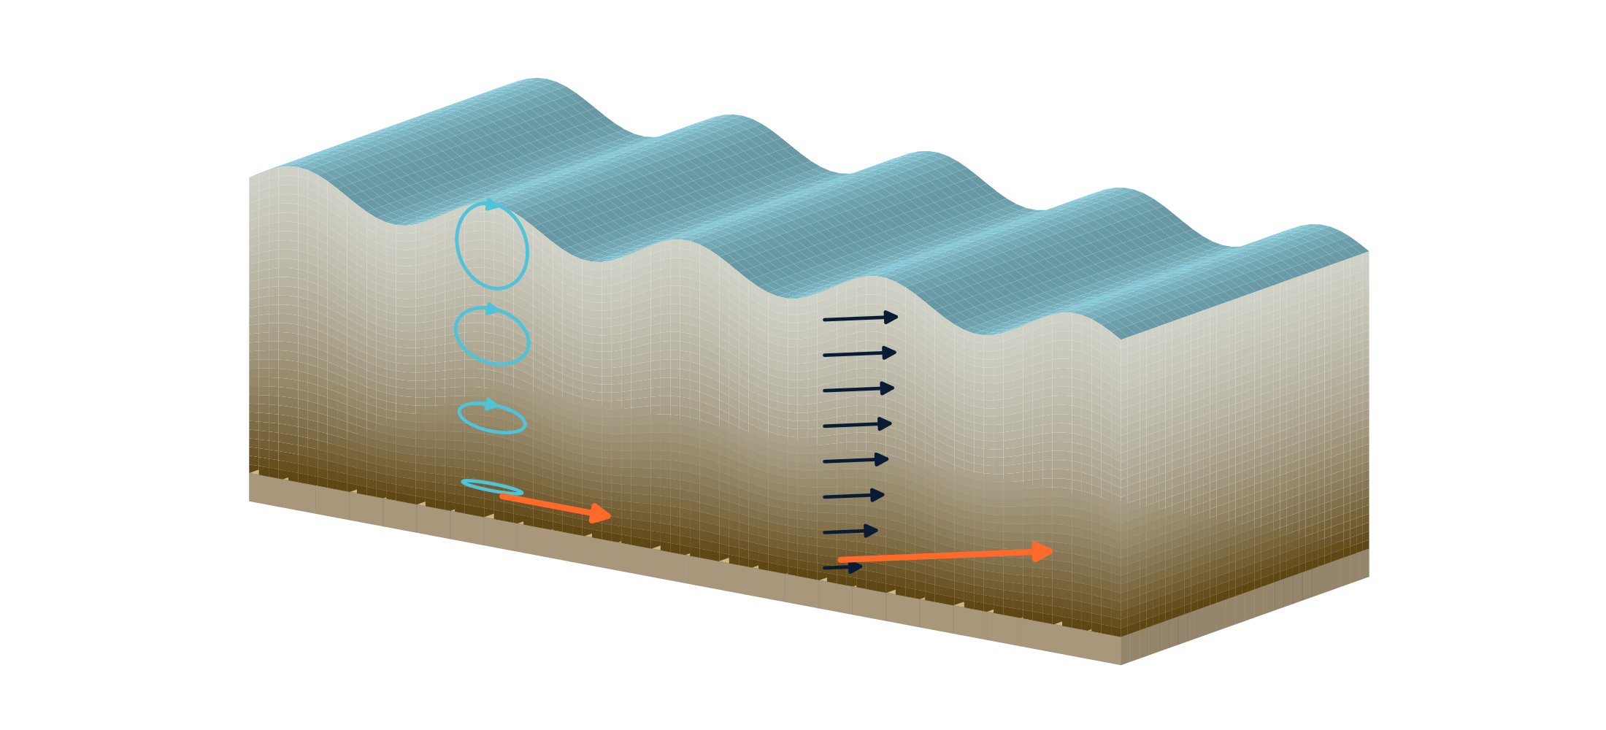
ATMOSPHERE
BOUNDARIES
GRID
CIRCULATION
WAVES
TURBIDITY
Past a threshold, the bed
lets go.
CALIBRATION PARAMETERS
CLASSES two, solved together
fine ≈ 22 µm · coarse ≈ 64 µm
CRITICAL STRESS 0.10 / 0.25 N/m²
SETTLING 2e-4 / 2e-3 m/s
EROSION RATE 3e-4 / 3e-3 NTU·m/s
BACKGROUND 3 NTU
central member — the ensemble
sweeps erosion rate only
waves
current
strongest at the surface,
slowed by friction at the bed
orbital motion
flattens onto the bed
suspended sediment —
most of it near the bed
wave-driven
bed stress
current-driven
bed stress
erosion begins once the combined stress exceeds the bed's critical value; settling never stops, so what you see is the difference

Slide 15
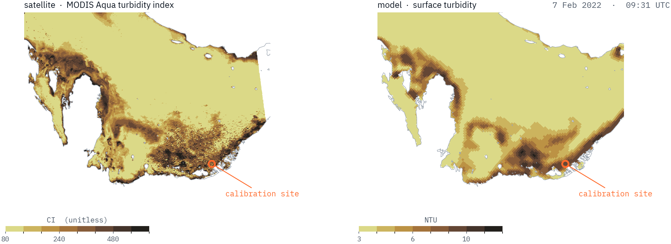
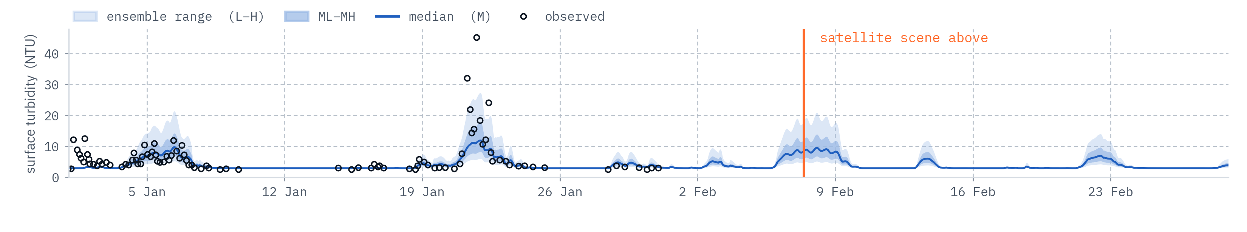
ATMOSPHERE
BOUNDARIES
GRID
CIRCULATION
WAVES
TURBIDITY
7 Feb 2022 · 09:30 UTC
All of it lands
on one number.
SEDIMENT MODEL
SEDIMENT two size classes
STRESS Soulsby (1997)
EROSION Partheniades (1965)
ENSEMBLE 5 runs of that model
erosion rate x0.5 to x2
HELD TO in-situ NTU, 6 m depth
CHECKED MODIS Aqua, qualitative
a February event, not January: cloud and dust sit over most of the storms worth looking at, and clean scenes are rare

Slide 16
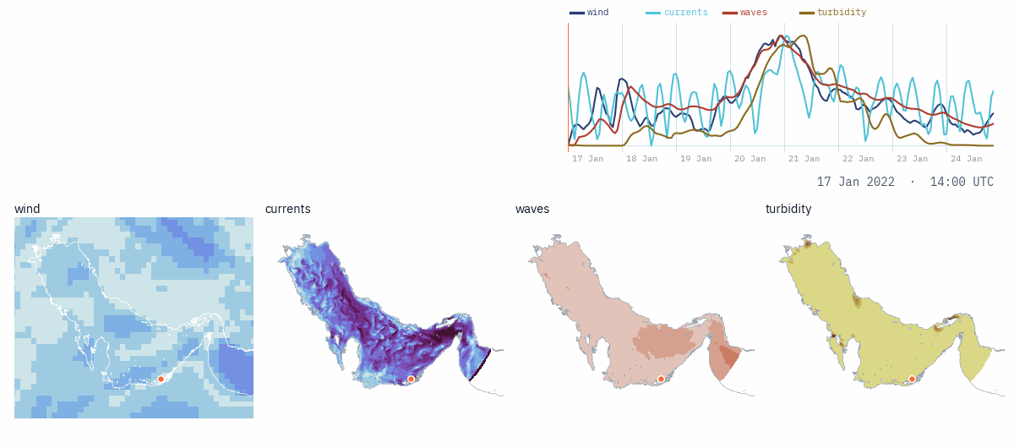
ATMOSPHERE
BOUNDARIES
GRID
CIRCULATION
WAVES
TURBIDITY
One storm, all
the way through.
Wind first, then waves within the hour, then the bed,
then the plume at the surface — twelve hours from the
shamal peaking to the water going brown.
the traces are the marked site: wind at midday, waves within the hour, the plume at the surface by eleven

Slide 17
SECTION 03
What we'd
build for you.

Slide 18
SECTION 03
Three ways in, in the order
they usually happen.
FIRST
THEN
LATER
Site characterisation
A daily forecast
Climate outlook
A hindcast study at your intake. What the water has actually done — turbidity, temperature, salinity, currents — over ten years, with every event resolved hour by hour.
The same models, run every morning without anyone touching them, through a dashboard designed around your intake depth and your own thresholds. Seven days ahead.
The same chain, forced by climate projections instead of reanalysis, to ask what the intake looks like in the 2050s. The one thing here we have not yet delivered.
a sequence, not a menu — each step is built out of what the one before it produced, which is why the second is cheap once the first exists

Slide 19
OFFERING 01
Start with what the water
has already done.
WHAT A STUDY COVERS
PERIOD 2015 → present
OUTPUT hourly · all 15 levels
VARIABLES T, S, u, v, Hs, Tp, NTU
RESOLUTION 3.5 km, nested to ~1 km
DELIVERABLE technical report + the data
extraction at your own
intake coordinates and depth
— Ten years of hourly conditions at your intake, from the chain you have just seen — not a nearby buoy, not a regional average.
— Every shamal since 2015 resolved: how fast turbidity climbed, how high, how long it held, at the depth you actually draw from.
— The numbers a design or an operating procedure needs: exceedance statistics, event durations, seasonal envelopes.
— Brine recirculation, where that is the question: whether your outfall, or your neighbour's, reaches your own intake.
SCOPE, STATED UP FRONT
Turbidity here is sediment-driven — shamal-stirred plumes and wadi input. Algal blooms and biological fouling are not modelled, and we would rather say so than be asked.
the study stands on its own — it is not a sales doorbell for the subscription, and it is scoped to a question you already have

Slide 20
OFFERING 02
These models already run
every morning.
Daily
7 days
75 min
ONE FULL CYCLE, 00Z,
FIRED AT 06:00 UTC
FORECAST HORIZON,
HOURLY THROUGHOUT
FROM RAW GLOBAL DATA
TO A PUBLISHED FORECAST
WHAT WE WILL NOT CLAIM
Today this is best-effort: automated, monitored, and delivered every morning — but without a contractual uptime guarantee, because one person cannot honour a 24/7 SLA. We price it as what it is. Early users are supplementing what they already have, not betting the plant.

Slide 21
OFFERING 02
Built with you, not
handed to you.
— Your intake, at your depth — not the nearest grid point at the surface.
— Your thresholds and your alarm levels, in the units your operators already use.
— Turbidity shown as all five ensemble members, so you see the spread rather than a single number pretending to certainty.
— Water level, waves, temperature, salinity and currents alongside it, because they cost nothing once the model runs.
[ REPLACE WITH DASHBOARD SCREENSHOT ]
the same public site that runs the Gulf today — a client view is a point extraction, a threshold config and a login

Slide 22
OFFERING 03 · IN DEVELOPMENT
And what the intake
looks like in 2050.
HOW IT WOULD WORK
METHOD dynamical downscaling
FORCING CMIP6, two scenarios
HORIZON 2050s and 2080s slices
ANSWERS T, S and NTU at the intake
BUILT ON the identical CROCO, WW3
and sediment configuration
STATUS capability, not yet a product
— A plant commissioned today will still be drawing water in the 2050s. It is being designed against the last ten years.
— The Gulf is warming, and its salinity is rising — in part under the cumulative brine load of the region's own plants.
— Both move the numbers a train is sized against: feed temperature sets flux, energy and boron passage; feed salinity sets recovery.
— The chain does not care what forces it — swap reanalysis for downscaled projections and it answers 2050, not tomorrow.
WHERE THIS ACTUALLY IS
The model chain exists and has been assessed. The climate forcing and the downscaling protocol have not been built. We would rather name that than imply a track record we do not have.
this is the piece a first client part-funds — and the reason to have the conversation before the design is frozen

Slide 23
The people who have to know
what the sea is doing shouldn't
be guessing.

Slide 24
Ocean Motion ANALYTICS
Tell us what you're
working on.
The next step we would propose is a scoped characterisation study at one intake — yours. Thirty minutes first, to work out whether it maps to a problem you actually have.
Giles Fearon
giles@oceanmotionanalytics.com
oceanmotionanalytics.com

