Slide 1


Ocean Motion ANALYTICS
Water quality for your plants:
past, present and future
PITCH DECK
Prepared for Engie · September 2026

Slide 2
CONTENTS
What we'll cover.
01 How the model works
02 Characterising your site
03 A forecast that runs every day
04 The next thirty years and beyond

Slide 3
SECTION 01
How the model works

Slide 4
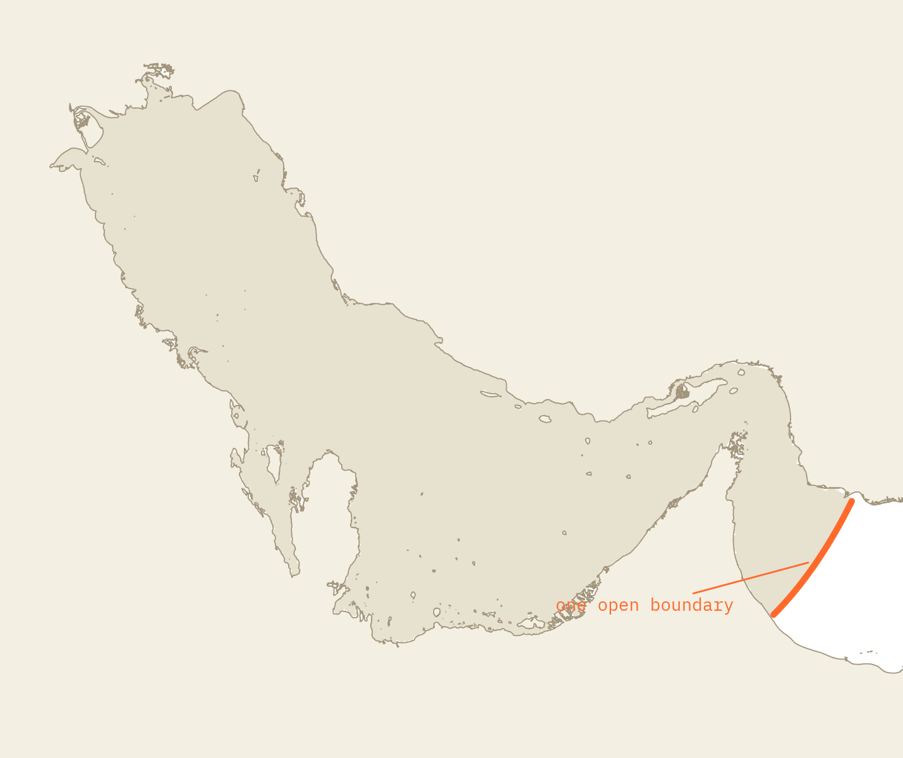
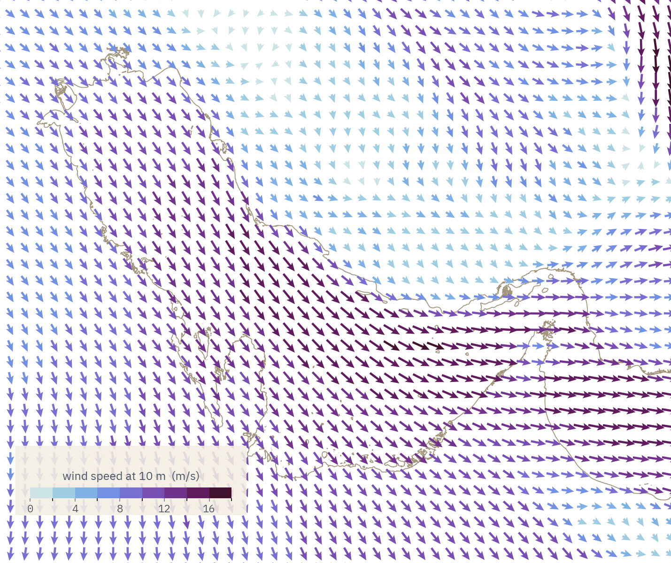
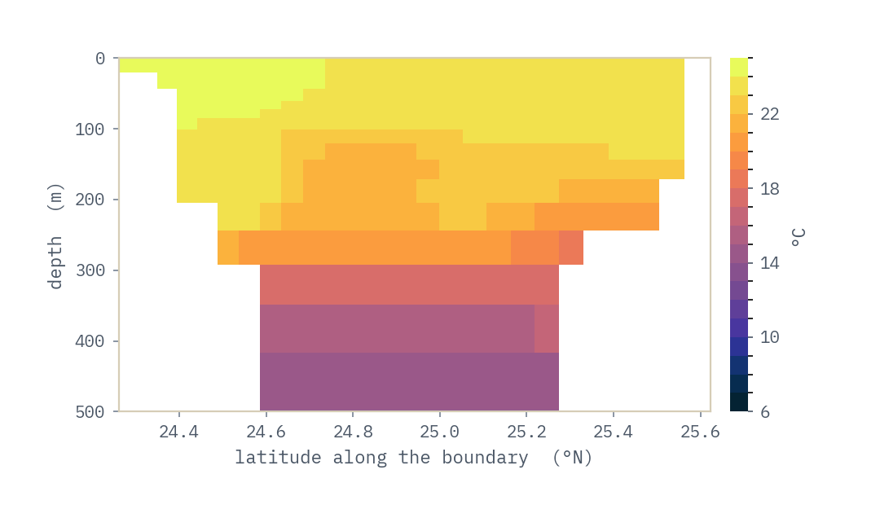
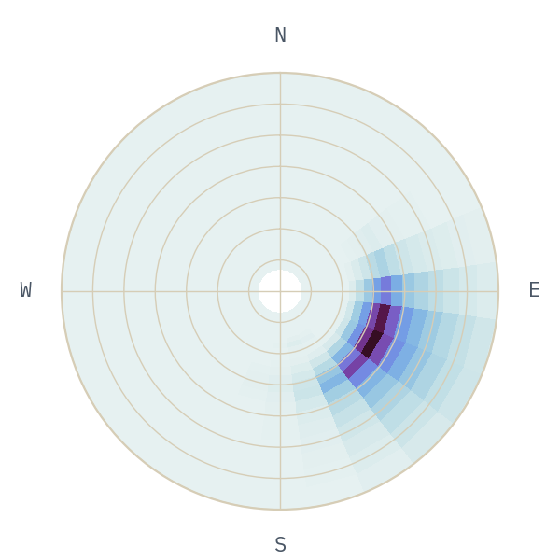
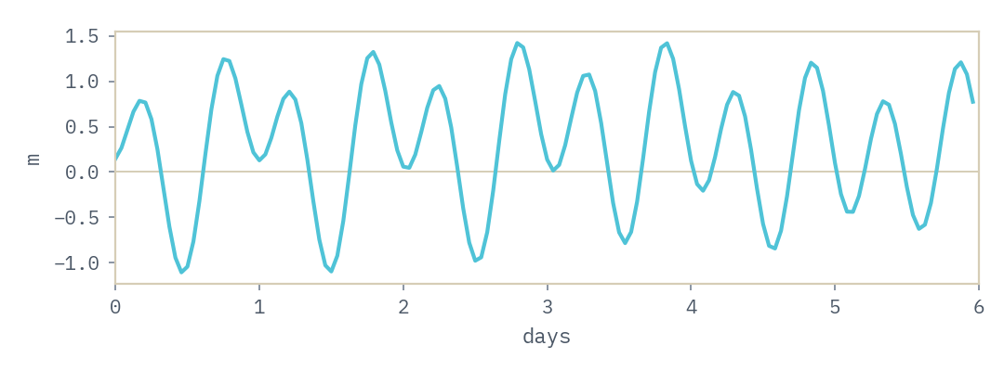
INPUTS
GRID
CIRCULATION
WAVES
TURBIDITY
Upstream data providers.
GLOBAL MODELS
ATMOSPHERICS
ERA5 / GFS
0.25 deg · 1-3 hourly
OCEAN CIRCULATION
MERCATOR / HYCOM
1/12 deg · daily
TIDES
TPXO10
10 tidal constituents
WAVES
METEO FRANCE / GFS
0.1-0.25 deg · 3 hourly

Slide 5
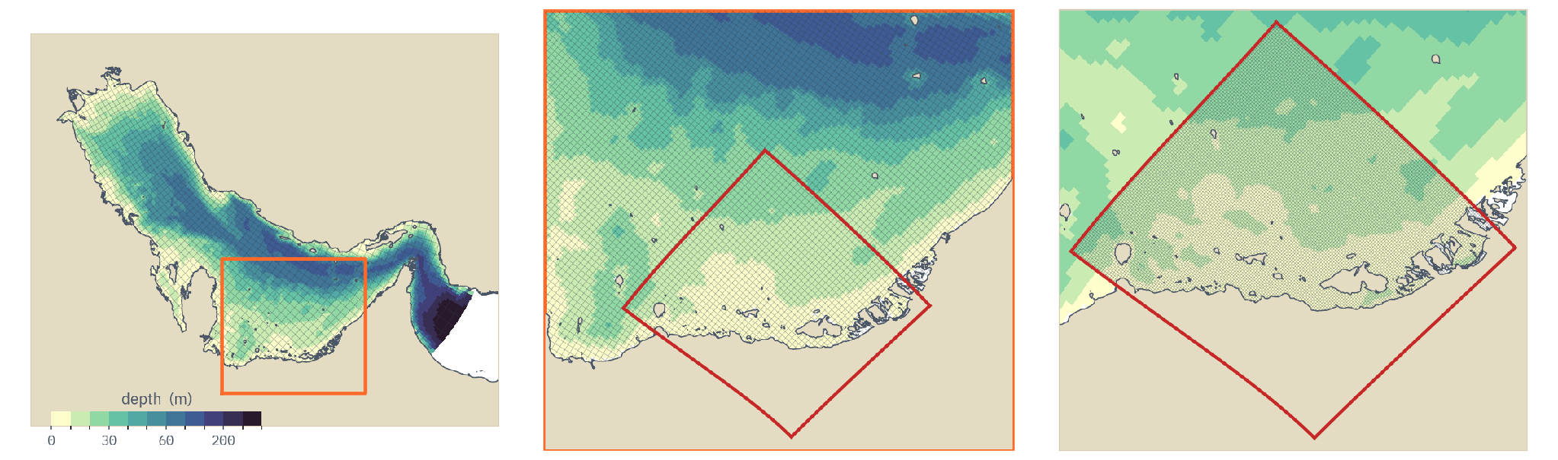
INPUTS
GRID
CIRCULATION
WAVES
TURBIDITY
Model grid is refined until the site is resolved.
MODEL GRID
PARENT ~ 3 km · 15 levels
NEST ~ 1 km · 3x refinement
option for further refinement as required
the whole Gulf
southern shelf zoom
example of a nested grid
~3 km · every 4th line
~3 km · every cell
~1 km · every cell

Slide 6
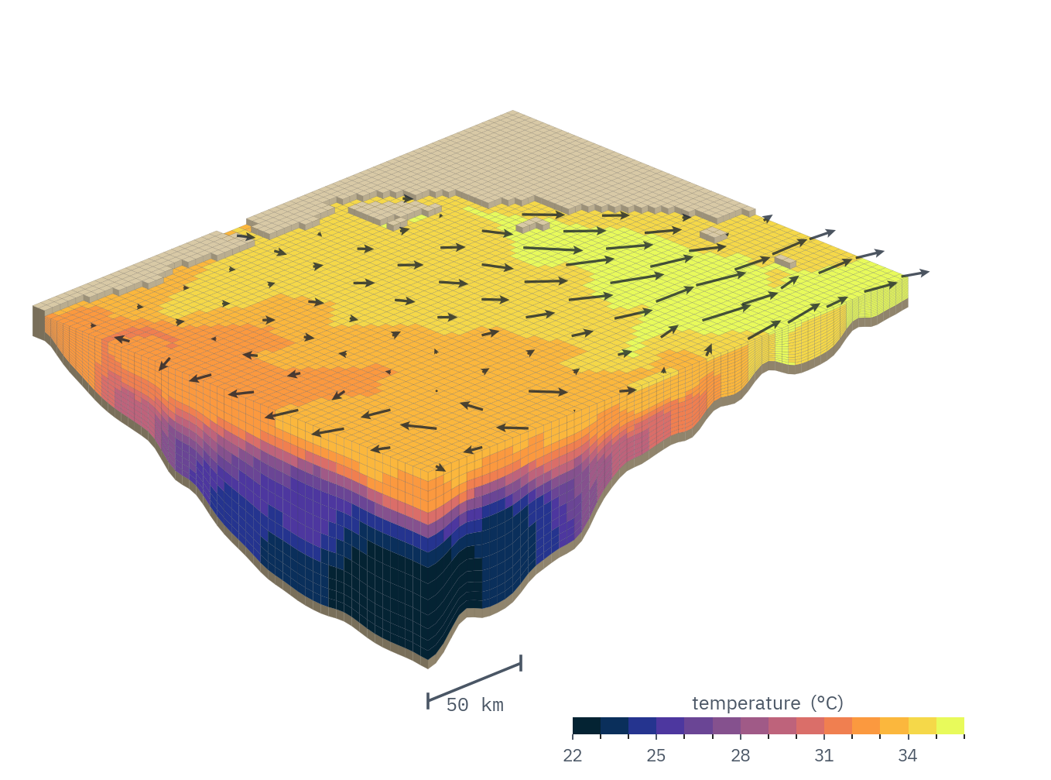
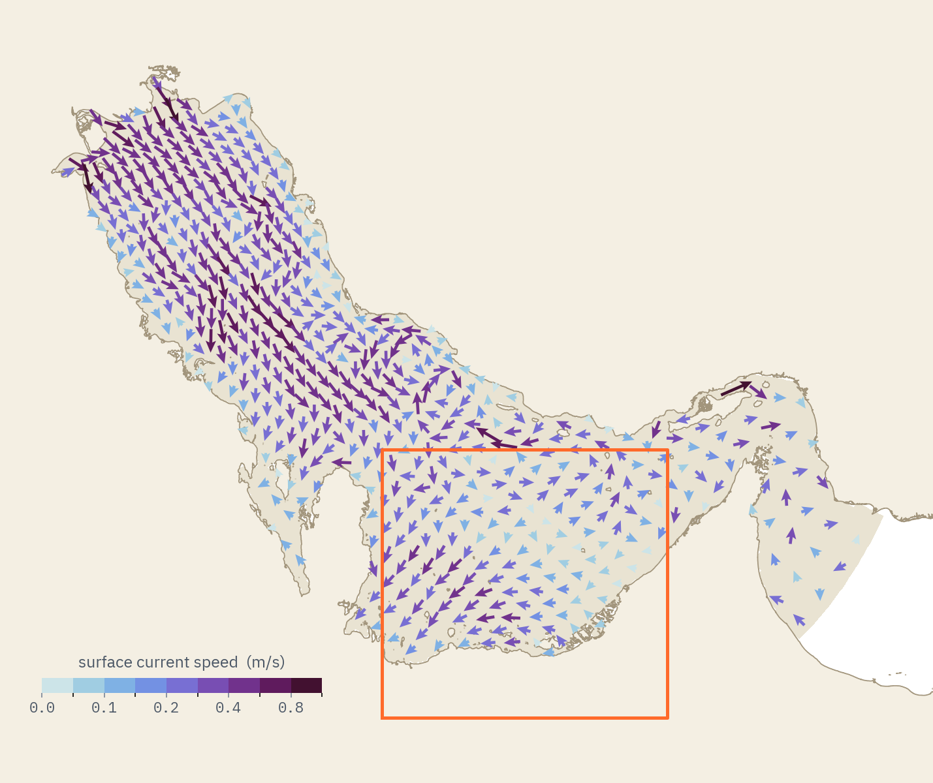
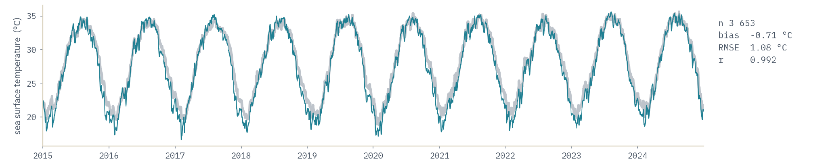
INPUTS
GRID
CIRCULATION
WAVES
TURBIDITY
How the circulation changes over time.
CIRCULATION MODEL
MODEL CROCO v1.3.1
SOLVES temperature, salinity,
currents, water level
LEVELS 15 levels
OUTPUT hourly, every level

Slide 7
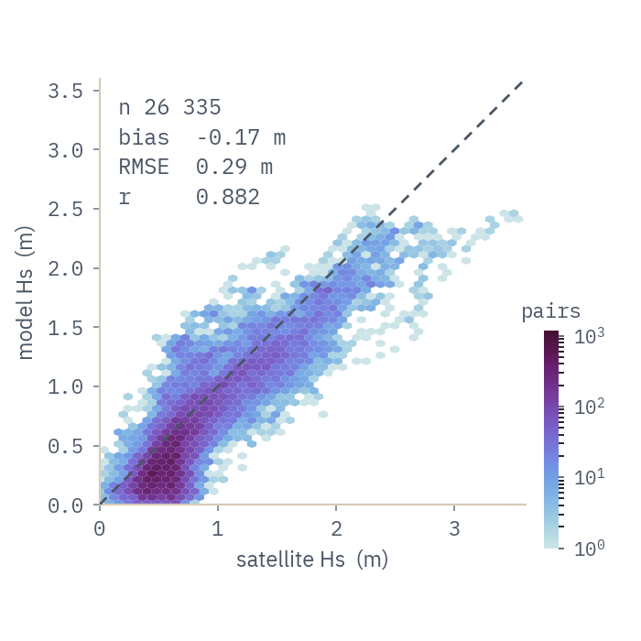
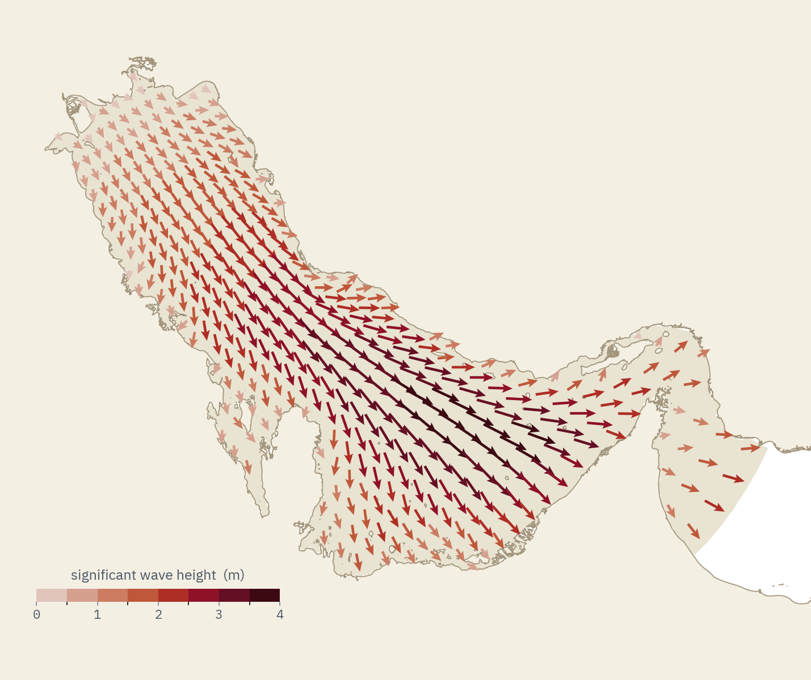
INPUTS
GRID
CIRCULATION
WAVES
TURBIDITY
How the waves change over time.
WAVE MODEL
MODEL WAVEWATCH III v6.07.1
SPECTRUM 32 frequencies x 24 dir
FORCED BY Global winds + CROCO currents

Slide 8
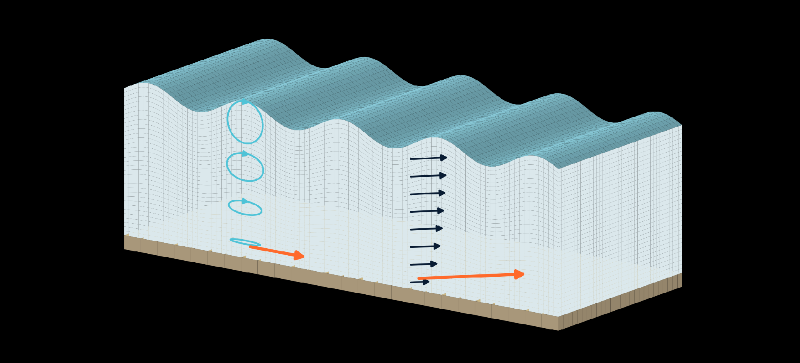
INPUTS
GRID
CIRCULATION
WAVES
TURBIDITY
Turbidity - driven by a combination of wave- and current-driven bed stress.
wave-driven
orbital velocities
currents
wave-driven
bed stress
current-driven
bed stress

Slide 9
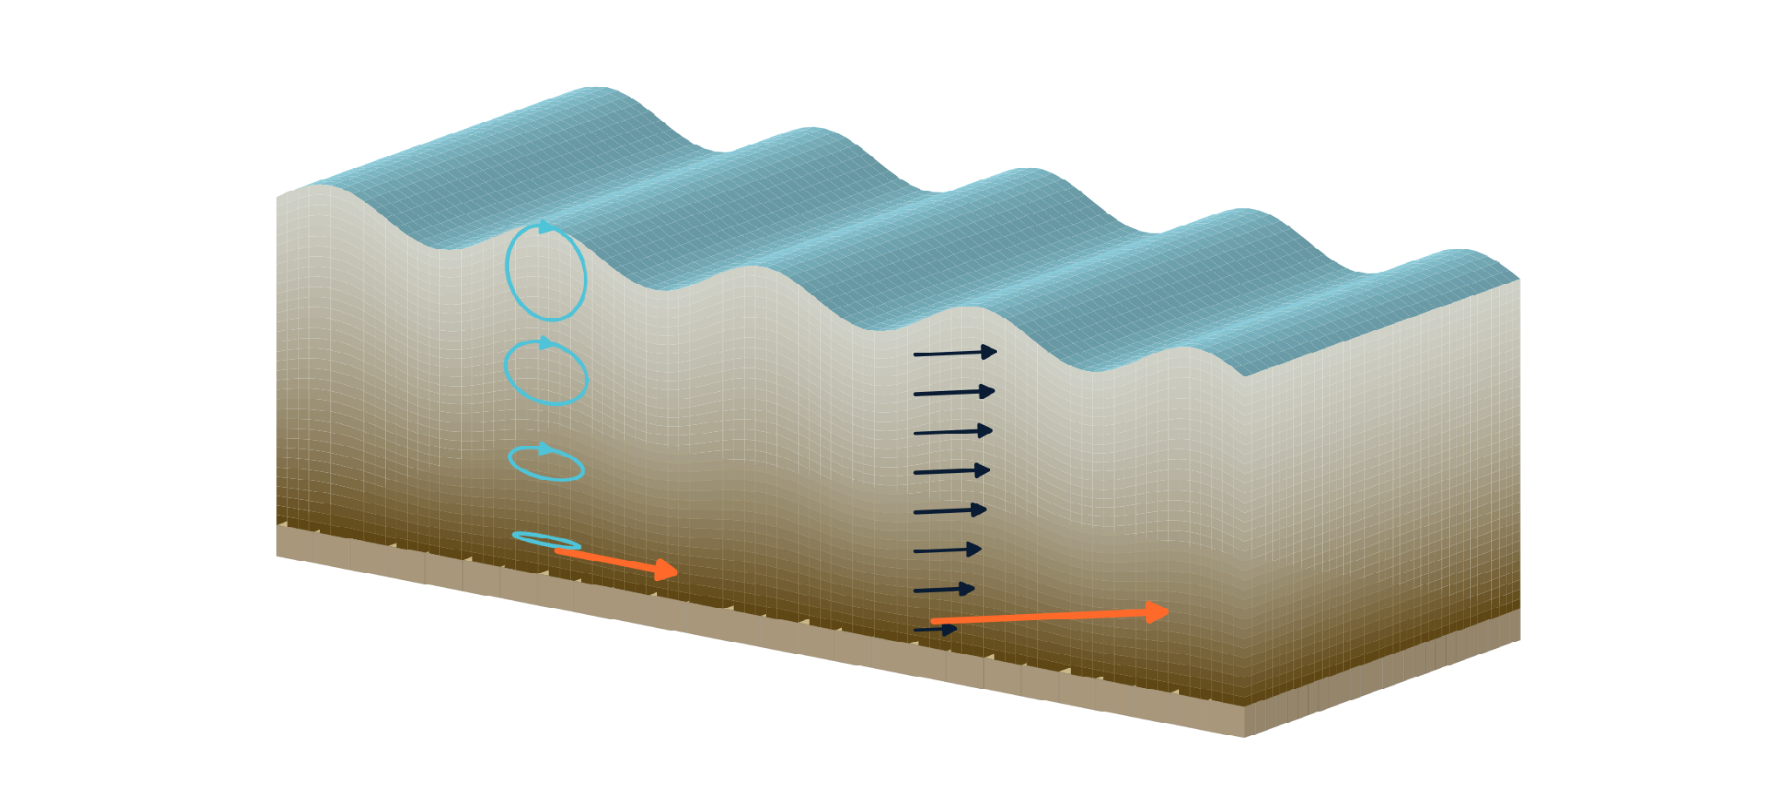
INPUTS
GRID
CIRCULATION
WAVES
TURBIDITY
CALIBRATION PARAMETERS
Past a critical bed stress threshold, the bed lets go.
CLASSES two, solved together
fine ≈ 22 µm · coarse ≈ 64 µm
CRITICAL STRESS 0.10 / 0.25 N/m²
SETTLING 2e-4 / 2e-3 m/s
EROSION RATE 3e-4 / 3e-3 NTU·m/s
BACKGROUND 3 NTU
wave-driven
orbital velocities
suspended sediment —
most of it near the bed
currents
wave-driven
bed stress
current-driven
bed stress

Slide 10
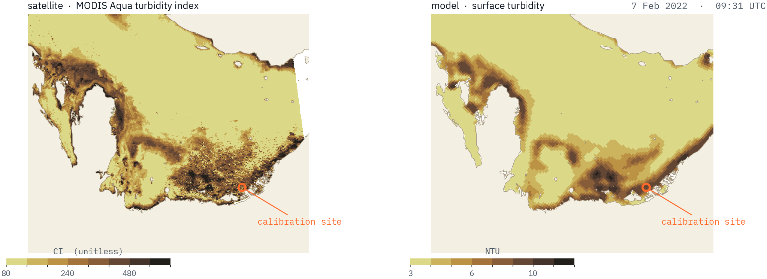
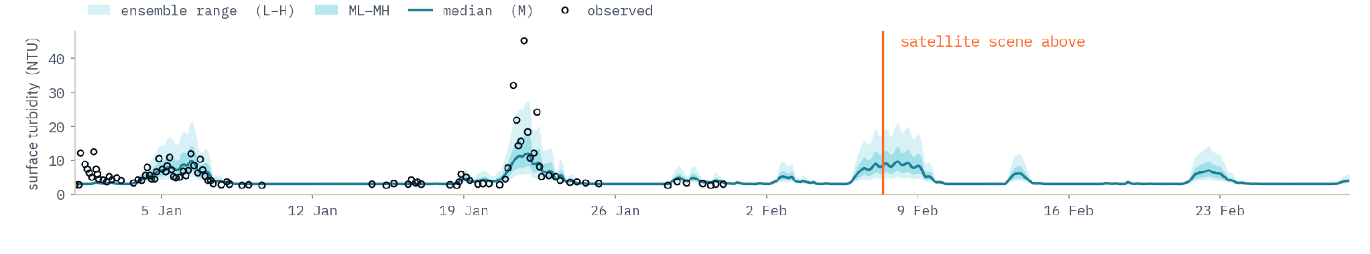
INPUTS
GRID
CIRCULATION
WAVES
TURBIDITY
Turbidity, tuned to observations.
TURBIDITY MODEL
ENSEMBLE 5 runs corresponding to different
erosion rates x0.5 to x2
TUNED TO in-situ NTU, 6 m depth
CHECKED MODIS Aqua, qualitative

Slide 11
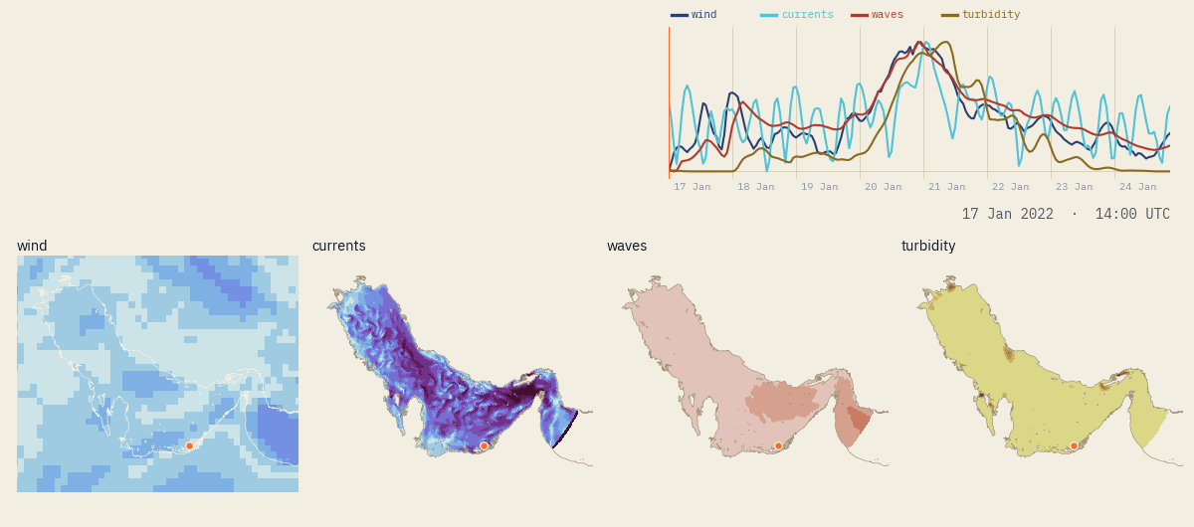
INPUTS
GRID
CIRCULATION
WAVES
TURBIDITY
One example storm, all
the way through.
winds -> circulation -> waves -> turbidity

Slide 12
SECTION 02
What we’d build for you

Slide 13
SECTION 02
Three offerings, looking at three time windows.
THE PAST
THE PRESENT
THE FUTURE
Site characterisation
A daily forecast
Future climate outlook
A hindcast study at your intake. What the water has actually done — turbidity, temperature, salinity, currents — over ten years, with every event resolved hour by hour.
The same models, run every morning, through a dashboard designed around your intake and your own thresholds. Seven days ahead.
The same chain, forced by climate projections, to ask what the intake looks like in the 2050s.

Slide 14
OFFERING 01
Site characterisation.
WHAT A STUDY COVERS
PERIOD 2015 → present
OUTPUT hourly · all 15 levels
VARIABLES T, S, u, v, WL, Hs, Tp, NTU
DELIVERABLE technical report + the data
extraction at your own intake coordinates and depth
— Ten years of hourly conditions at your intake location and depth, from the modelling chain you have just seen.
— Summary statistics required for operations planning e.g. exceedance statistics, event durations, seasonal envelopes.
— Brine dispersion and recirculation i.e. the spatial extent of the plume from your outfall, and whether it reaches your intake.
LIMITATIONS
Turbidity here is sediment-driven — shamal-stirred plumes. Algal blooms and biological fouling are not modelled yet

Slide 15
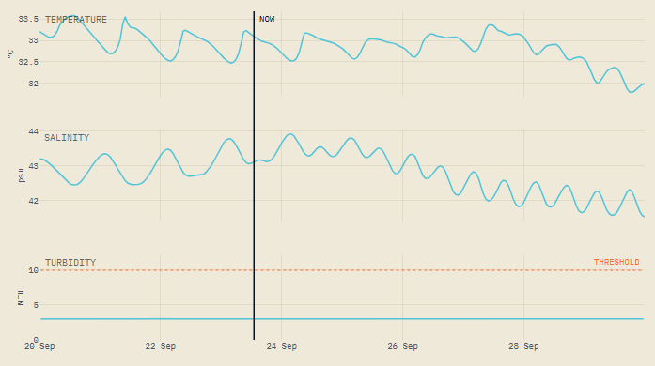
OFFERING 02
A daily forecast viewed on a private dashboard, co-designed with you.
— Your intake, at your depth
— Turbidity, waves, temperature, salinity and currents
— Your thresholds and your alarm levels, in the units used by your operators.
— Automated warnings (e.g. email) for upcoming events
EXISTING PUBLIC VIEW -
ILLUSTRATIVE PURPOSES ONLY

Slide 16
OFFERING 02 · WITH YOUR DATA
The forecast gets sharper
the longer it runs.
WHAT IT NEEDS
VARIABLE turbidity (NTU), or T and S
DEPTH sensor depth, as installed
RECORD 1 year minimum · 2+ preferred
SAMPLING hourly or better · gaps fine
METHOD learned residual correction, re-fit as data arrives
YOUR DATA stays yours, never pooled
— The model forecasts your intake from day one, with nothing required from you. What follows is an improvement, not a condition.
— If you hold sensor records at the intake, we train a correction on the gap between what the model said and what you measured.
— It learns your site's own systematic offsets — your depth, your local bathymetry, your instrument.
— And it compounds — every month of operation is more training data. The forecast in year two is not the one you started with.

Slide 17
OFFERING 03
Future climate outlook - what the intake
might look like in 2050 and beyond.
HOW IT WOULD WORK
METHOD dynamical downscaling
FORCING CMIP6, multiple scenarios
HORIZON 2050s and 2080s slices (and others as needed)
ANSWERS T, S and NTU at the intake
BUILT ON the identical CROCO, WW3
and turbidity models used for previous offerings
— The Gulf is warming, and its salinity is rising.
— A plant commissioned today will see temperature, salinity and turbidity which is different to the last ten years.
— The same model workflow can be used to model the future climate scenario. The model forcing is adjusted to the future climate scenario being modelled.

Slide 18
Ocean Motion ANALYTICS
Tell us what you're
working on.
Giles Fearon
giles@oceanmotionanalytics.com
oceanmotionanalytics.com

