Slide 1


Slide 2
Artbud – A home for art lovers
Dominik Bladek – 2144751b – HTML/CSS
Giles Munn – 2227780m – Django/Python
Charlie Parker – 2144176p – Design Spec
Andreas Klitis – 2141487k – Design spec

Slide 3
What is our app?
Artbud is a place for people to sign up and then upload their artwork, be it sculptures, photographs, paintings, etc.
The artist can write a description for their artwork and set a suggested price.
Others can then view art, if they too are logged in, and can contact the artist using the email address the artist used on signing up which is automatically displayed on their profile page if they wish to purchase it.

Slide 5
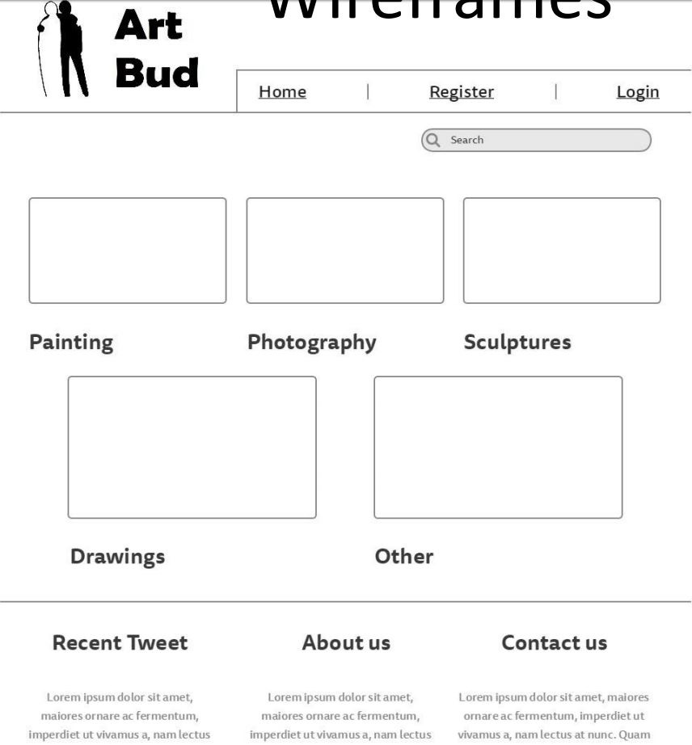
Wireframe from Design Spec
Artbud logo
Navigation bar
Artwork
categories
Footer with tweets, about section, and contact

Slide 6
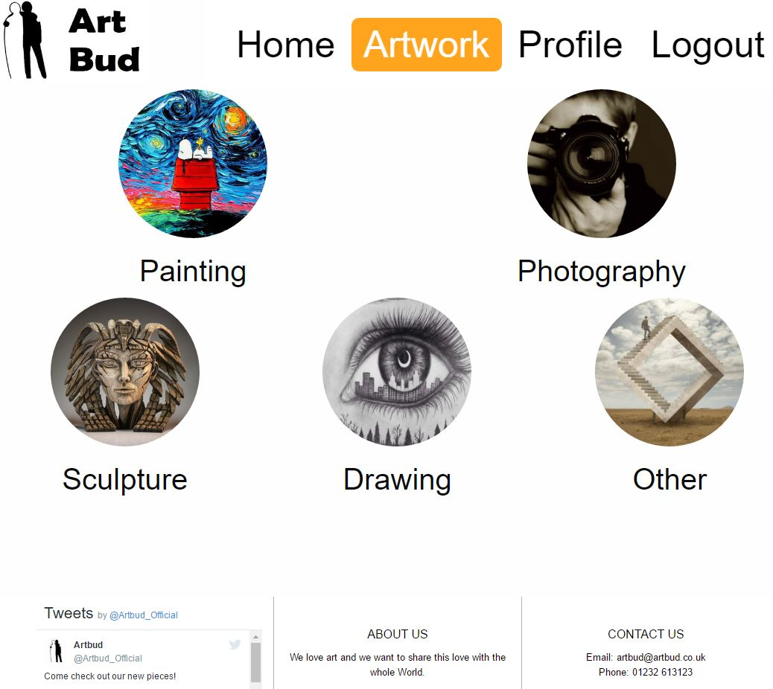


Category page from app
Artbud logo
Navigation bar
Artwork
categories
Footer with tweets, about section, and contact

Slide 7
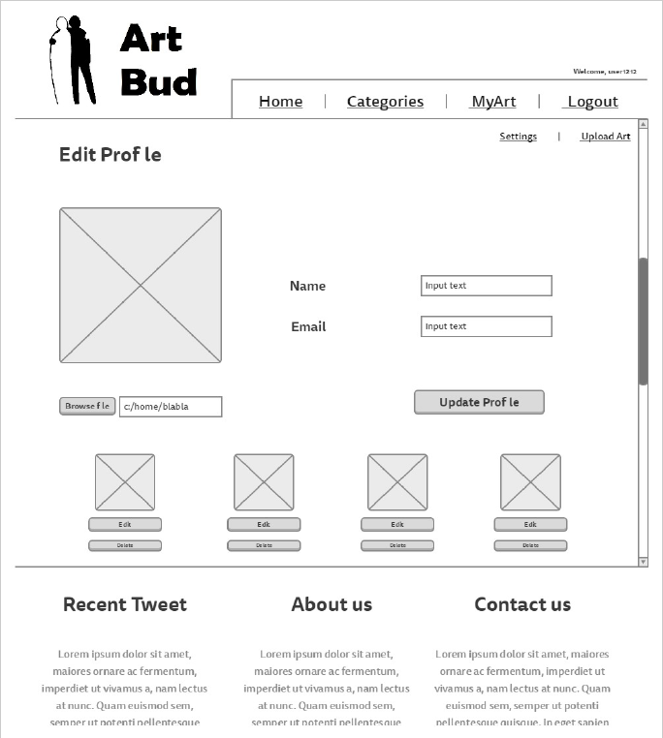
Wireframe from Design Spec
Artbud logo
Navigation bar
Profile Picture
Profile information
All users art
Footer with tweets, about section, and contact

Slide 8
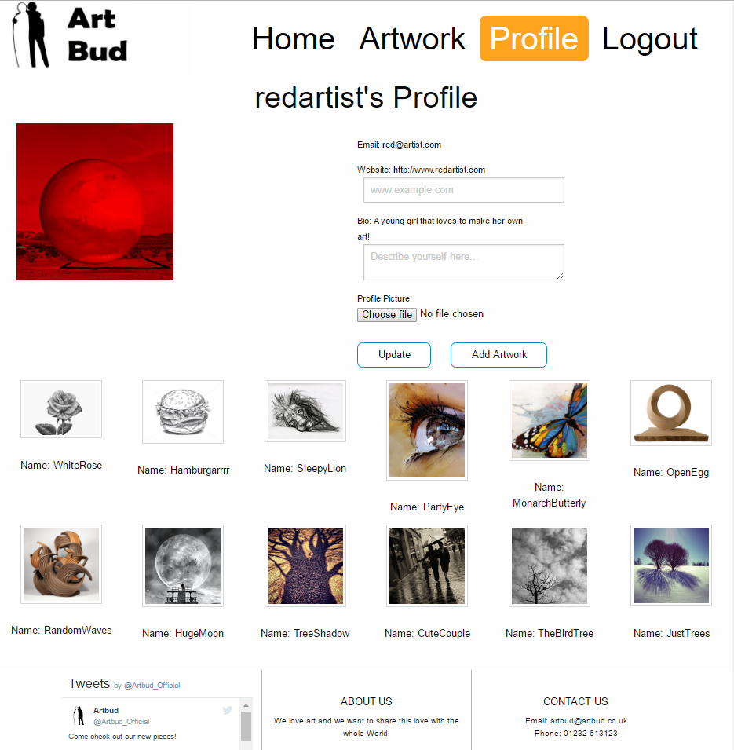
Profile page from app
Artbud logo
Navigation bar
Profile Picture
Profile information
All users art
Footer with tweets, about section, and contact

Slide 9
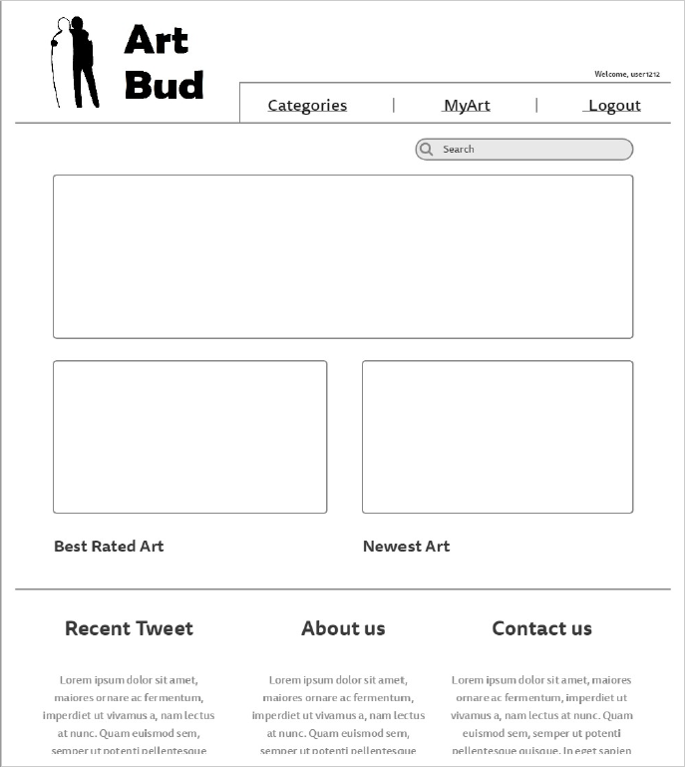
Wireframe from Design Spec
Artbud logo
Navigation bar
Search bar
Main Page Picture
Best and New Art
Footer with tweets, about section, and contact

Slide 10
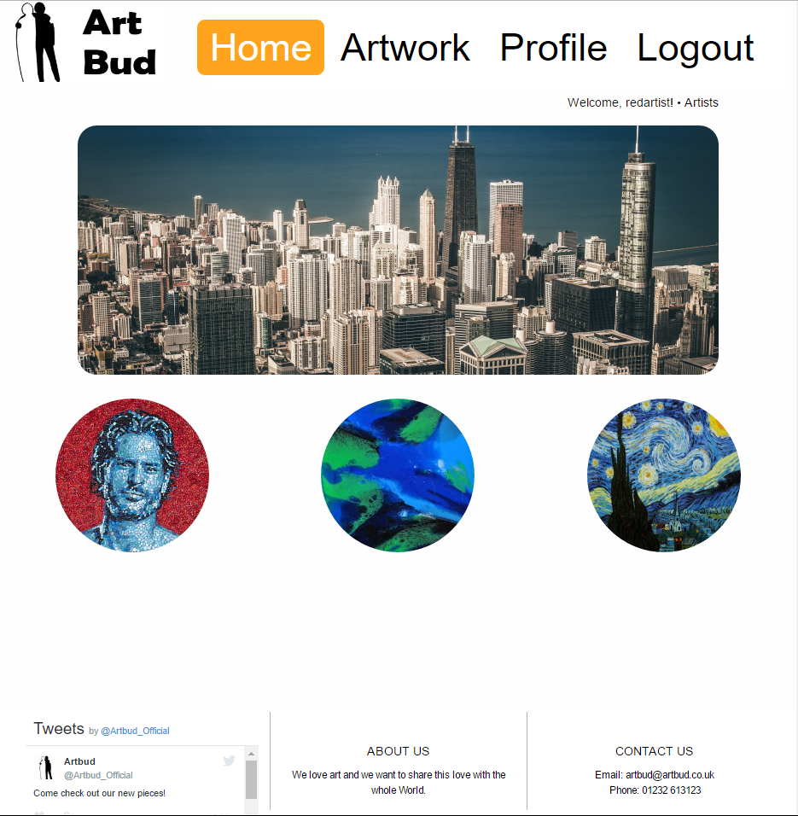
Home page from app
Artbud logo
Navigation bar
Main Page Picture
To be implemented
Best and New Art
Footer with tweets, about section, and contact

Slide 11
Issues we faced
Getting artwork to display in correct categories.
Being able to delete other peoples’ artwork.
Getting users to display properly in a list.

Slide 12
http://artbud.pythonanywhere.com/artbud/
Thank you for listening – go check it out!

