Slide 1
Configurational Coupled Cluster

Slide 2
Table of contents:
Introduction.
Exact diagonalization methods.
Configurational CC methods.
Optimization steps.
Future work.

Slide 3
Introduction.

Slide 4
Notation
x, y, z, w : site labels.
p, q, r, s : generic many body states associated with a site.
i, j, k, l : low-lying state(s) associated with a site. The theory is simplest if there is only one low-lying state.
a, b, c, d : high-lying states associated with a site. Typically, there are a small number of these (around 10-20).

Slide 5
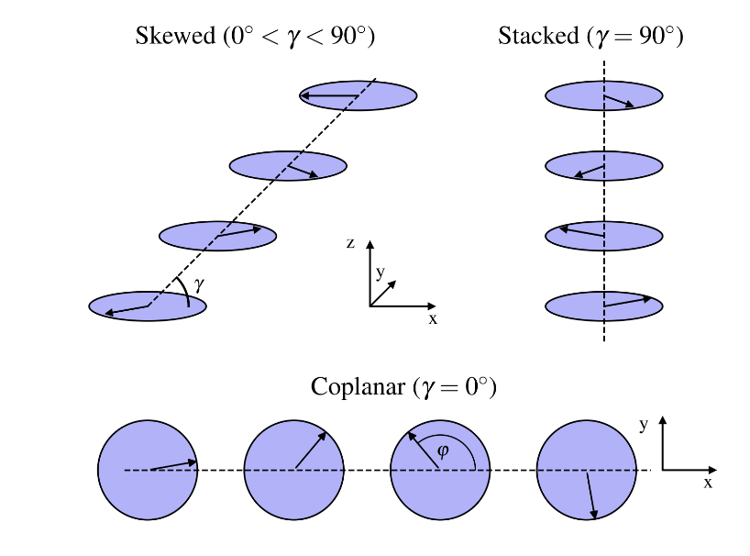


Introduction
In our systems, we are only considering the nearest neighbour interactions:
$\hat{K}$ : kinetic (one-body)
$\hat{V}$ : potential (two-body)
g : coupling constant
So far we are working with 1-D systems but we will the system can be generalized to 2-D and 3-D. (which we are working on.
Planar rotor systems:
Notes:
Remove Angleed

Slide 6
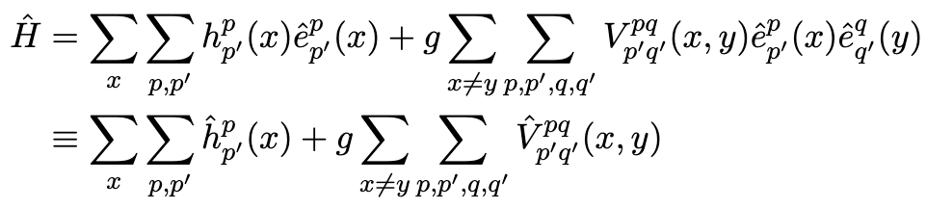





Introduction
Our Hamiltonian is defined like this:
where $\hat{e}$ are one-site excitation operators:
If we instead define $\hat{e}$ as:
We can construct a Hamiltonian that considers the planar rotors’ angle.
Similarly, the Hamiltonian accounting for the planar rotor's angle:
Regardless of the definition of the excitation operator, we can think in terms of matrix elements:
Non-zero elements satisfy:
Serwatka, Tobias & Roy, Pierre-Nicholas. “Quantum criticality in chains of planar rotors with dipolar interactions.” arXiv:2401.02887, 2024.
Notes:
Remove Angleed

Slide 7
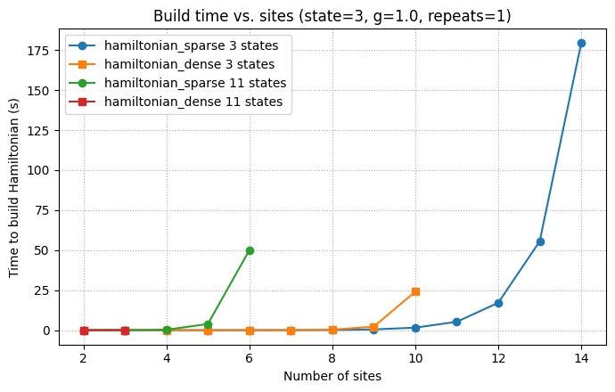


Scaling problem (Time Comparison)
Hamiltonian dimension:
Naturally, for the Exact Diagonalization solution, the scaling problem becomes even more severe.
Approx. 20 times faster.
It’s hard to run a comparison because the dense Hamiltonian crashes the kernel due to insufficient memory.
Notes:
I am not sure whether to have the slides for the indexing first or for hamiltonians.

Slide 8
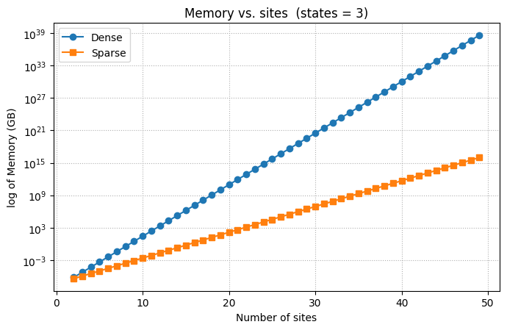


Scaling problem (Memory Comparison)
Dense memory:
Sparse memory:
We can clearly see that the sparse matrices consistently require less storage.
Notes:
I am not sure whether to have the slides for the indexing first or for hamiltonians.

Slide 9
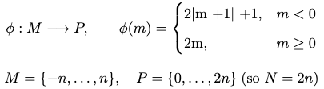
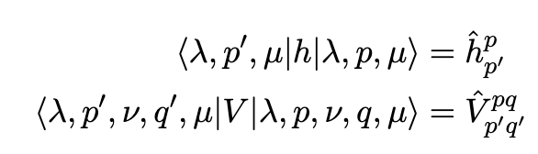






Indexing of the Hamiltonian
First, bringing the Hamiltonian elements into the “m” basis by integrating.
Second, converting from “m” basis to “p” basis:
Constructing the Hamiltonian in a full product basis:
$λ$ : group of sites before operant site
$μ$ : group of sites after operant site
$ν$ : group of sites in-between operant sites
This allows us to only iterate through non-zero elements during Hamiltonian construction.
Diagram one site operator:
Diagram two-site operator:
operant site x
$$λ$$
$$μ$$
operant site x
operant site y
$$λ$$
$$ν$$
$$μ$$
Notes:
I am not sure whether to have the slides for the indexing first or for hamiltonians.

Slide 10
Introduction
Periodic:
Whether the function is periodic or not is determined by the range of summation over sites (x, y).
Non-Periodic:
The change in summation is -1 because we are looking at the nearest neighbours system.
x = 0
y = 1
x = 1
y = 2
x = 2
y = 3
x = 3
y = 4
x = 4
y = 5
x = 5
y = 6
x = 0
y = 1
x = 1
y = 2
x = 2
y = 3
x = 3
y = 4
x = 4
y = 5
x = 6
y = 0
Notes:
Remove Angleed

Slide 11
Reduced Density matrix approach (Natural Orbitals).

Slide 12


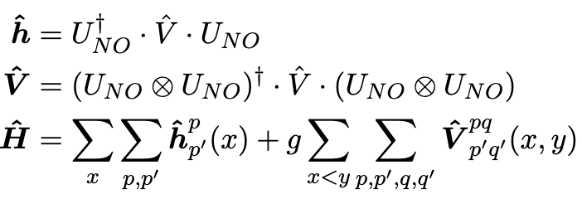

Natural Orbitals
Produce a change of basis matrix:
n : is the new number of states.
Now we apply the change of basis and construct the Hamiltonian through normal means.
First, we devise one body density matrix through a familiar indexing scheme:
C: eigenstate (for our purpose, it will be a normalized ground state)
Next, diagonalize the density matrix:
Producing a Natural Orbital basis allows us to reduce the size of the system, in comparison to ED procedures.

Slide 13
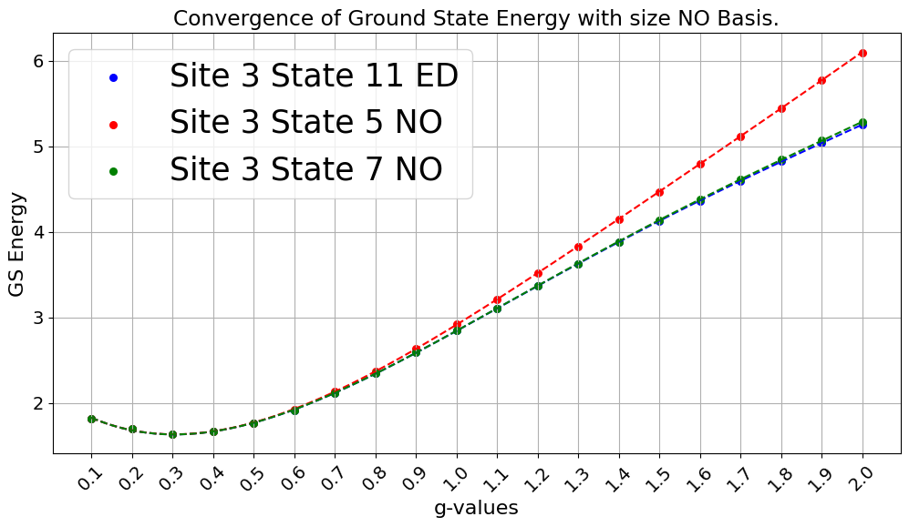

Slide 14
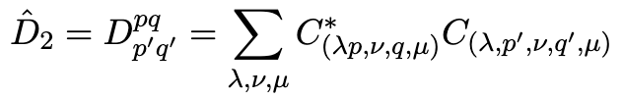
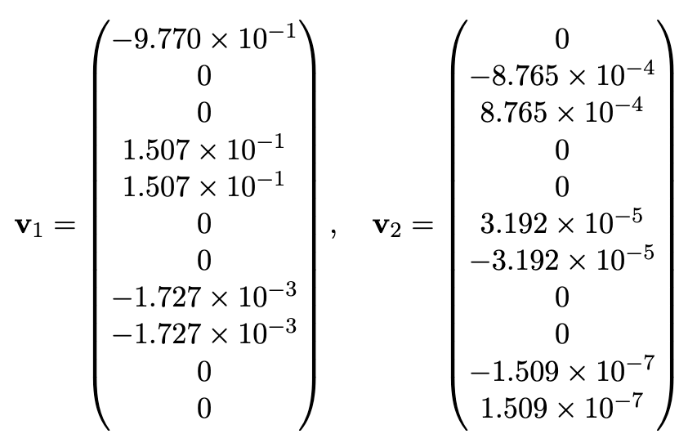


Analysis
In this case, we can schematically show that for the rotor system to be a superposition of the two orientations:
However, we see a pulsing result (system of 11 states, 4 sites, g = 1):
We can also use two body density matrices:
For large g, both ${\hat{D}}_{1}$ and ${\hat{D}}_{2}$ show two highly occupied states and negligible population in others:

Slide 15
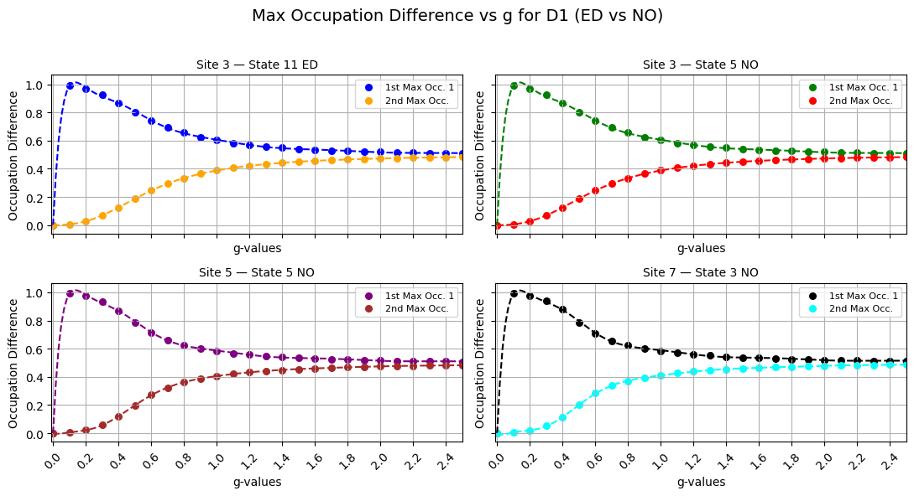

Slide 16
Configurational Coupled Cluster (CCC)

Slide 17


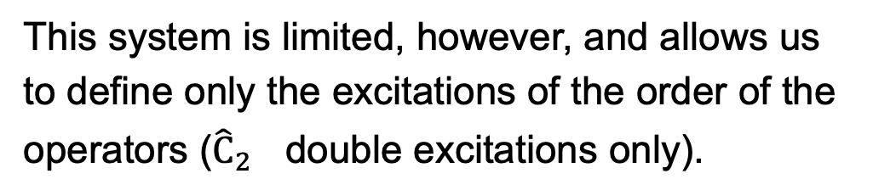
Truncated Configuration Interaction (CI)
One two-site excitation can be shown like this:
Important property to note about these excitation operators is that they can excite the virtual orbitals only two sites at a time, max.
a₅
a₆
a₅
a₆
a₃
a₄
a₃
a₄
The idea of the method is the use of the excitation operators:
which can be generalized to any higher excitations:
Though some manipulation, we can bring it to an eigenvalue problem.
a₁
a₂
a₁
a₂
i
i
x
y
This system is limited, however, and allows us to define only the excitations of the order of the operators (${\hat{C}}_{2}$ double excitations only).
Notes:
I am not sure whether to have the slides for the indexing first or for hamiltonians.

Slide 18






Single Reference CCC (1)
One two-site excitation can be shown like this:
Important property to note: these excitations are not unique in all permutations of s, t, x, y.
But the coefficient of the overall excitation is unique. Additionally, this method has size-consistent energies.
$$t_{ij}^{ab}(s, y)$$
Similarly, we define excitation operators:
The same way can be generalized to higher excitations. But an important distinction is the ansatz:
The property of the ansatz that we are interested in is:
$$t_{ij}^{ab}(x, t)$$
x
s
t
y
The property that makes CCC so much more effective is that, even with a truncated T, due to the ansatz, we get all higher excitations automatically.
Notes:
I am not sure whether to have the slides for the indexing first or for hamiltonians.

Slide 19

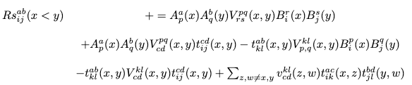

Single Reference CCC (2)
We arrive at the following set of equations:

Slide 20

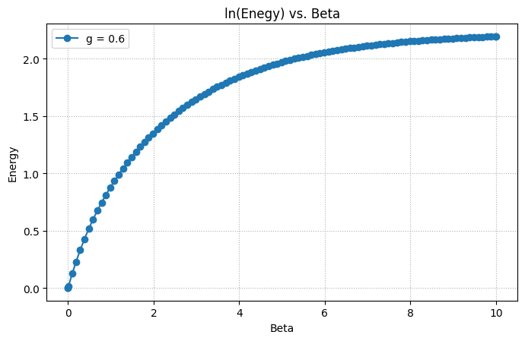


Time-dependent CCC approach with imaginary time
Through some derivation, we can arrive at this expression, which we can solve to get residuals:
We can see that Time-Dep. CCC produces a very stable result:
We start with the time-dependent Schrodinger equation:
By taking the ansatz of CCC:
Notes:
I am not sure whether to have the slides for the indexing first or for hamiltonians.

Slide 21
Optimization Steps.

Slide 22


Periodic boundary conditions
This allows for to reduction in the size of R1 and R2 tensors.
Instead of computing both non-symmetric interactions, just scale one of them by a factor of 2:
Allows us to pre-calculate one and two-body operators much faster, since there are only half of them left.
Finally, it allows us to make some minor summation simplifications.
This can be well summed up by:
These properties can be used to optimize CCC equations.
Notes:
I am not sure whether to have the slides for the indexing first or for hamiltonians.

Slide 23


Sparse optimization steps
Additionally, though we can also make use of the BLAS through NumPy in dense format.
This gives us two different tools to work with different types of systems:
The use case can be determined by constructing a function of Time vs. Memory and sites vs. states:
The function of the dominance ratio between sites and states.
The main consideration is sparse optimization is that the sparse type is stored as a matrix.
So we group the terms in CCC equation as follows:
Sparse
Dense
Minimizes storage
Minimizes time for large systems
Minimizes time
Notes:
I am not sure whether to have the slides for the indexing first or for hamiltonians.

Slide 24
Example of Terms Grouping:
We want to see the difference in one term:
i, j, k, l : low-lying state(s) = 1
a, b, c, d : high-lying states = #states – 1
Dense Intermediate Sparse
Dots represent collapsed low-lying state terms. We can do that since having every element as a one-dimensional vector is redundant.

Slide 25
Sparse Fast CCC
Dense Fast CCC
System states – 11; g – 0.1:
System sites – 3; g – 0.1:
System states – 11; g – 0.1:
System sites – 3; g – 0.1:
# Sites | Time taken to produce (s)
100 | 2 min. 2.1 sec
1000 | > 20 min
# Sites | Time taken to produce (s)
100 | 4.5 sec
1000 | 6 min. 57.1 sec
# states | Time taken to produce (s)
150 | 3 min. 2.1 sec
500 | -
# states | Time taken to produce (s)
150 | 23 min 58 sec
500 | crashes
Notes:
Remove Angleed

Slide 26
Future work

Slide 27
Thermal properties
Better understanding of the large g limit
Through time propagation, pressure of the standard CCC by bringing the Hamiltonian into the Thermal Field basis, we can calculate thermal properties of the system. This would square the dimension of the Hamiltonians. (We already have results)
Density matrices and antisymmetry.
Merge two sites into one Hamiltonian
Notes:
Remove Angleed

