Slide 1
Machine Learning for Networking
Nick Feamster University of Chicago Lecture 5: Clustering

Slide 2
Unsupervised Learning
No outcome/target/dependent variable is present
Goal: exploration, understanding data, finding patterns and/or groups in the data
Examples
Clustering: Find similarity and structure among groups of data points
Principal Components Analysis: Dimensionality reduction (and clustering)
Association Rules: Association between groups

Slide 3
























Slide 4
K-means Clustering
Randomly choose k data points (seeds) to be the initial centroids (cluster centers).
Assign each data point to the closest centroid.
Re-compute the centroids using the current cluster memberships.
If a convergence criterion is not met, go to Step 2.

Slide 5
k-means: Step 1
Pick k initial cluster centers (randomly)
k₁
Y
k₂
k₃
X

Slide 6
k-means: Step 2
Assign each point to the closest cluster center.
k₁
Y
k₂
k₃
X

Slide 7
k-means: Step 3
Move each cluster center to the mean of each cluster.
k₁
k₁
Y
k₂
k₃
k₂
k₃
X

Slide 8
k-means: Step 4
Reassign points
closest to a different new cluster center.
k₁
Y
k₃
k₂
X

Slide 9
k-means: Step 4
k₁
Y
Reassign
points
k₃
k₂
X

Slide 10
k-means: Step 4b
Re-compute cluster means
k₁
Y
k₃
k₂
X

Slide 11
k-means: Step 5
Move cluster centers to cluster means.
k₁
Y
k₂
k₃
X

Slide 12
Stopping/Convergence Criterion
no (or minimum) re-assignments of data points to different clusters,
no (or minimum) change of centroids, or
minimum decrease in the sum of squared error (SSE),
C_{i} is the jth cluster, m_{j} is the centroid of cluster C_{j} (the mean vector of all the data points in C_{j}), and dist(x, m_{j}) is the distance between data point x and centroid m_{j}.

Slide 13

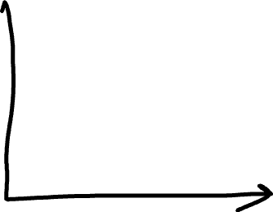
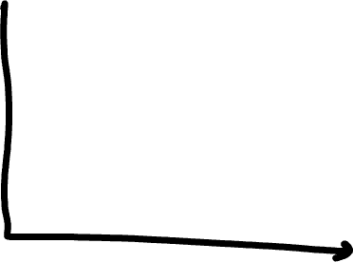
K-Means Failure Scenarios

Slide 14
Pros and Cons
Advatanges
Disadvantages
Simple
Efficient
Have to select k
Stuck in Local minima
Sensitive to outliers
Continuous features
Can only group points close in feature space
Notes:
Have to select k
Stuck in Local minima
Sensitive to outliers
Continuous features
Can only group points close in feature space

Slide 15
Probabilistic k-Means: Expectation Maximization
Iterative method for learning probabilistic clustering model from unsupervised data.
Initially assume random assignment of examples to categories.
Learn an initial probabilistic model by estimating model parameters θ from this randomly labeled data.
Iterate following two steps until convergence:
Expectation (E-step): Compute P(c_{i} | E) for each example given the current model, and probabilistically re-label the examples based on these posterior probability estimates.
Maximization (M-step): Re-estimate the model parameters, θ, from the probabilistically re-labeled data.

Slide 16
Hierarchical Clustering
Dendrogram
No need to know number of clusters k in advance
Needs a termination condition
Agglomerative (bottom-up):
Start with each data point being a single cluster.
Merge closest cluster pairs
Eventually all data points belong to the same cluster.
Divisive (top-down):
Start with all data points belong to the same cluster.
Eventually each node forms a cluster on its own.

Slide 17
Hierarchical Clustering
Clusters that result from cutting the dendrogram at any given height are nested within the clusters obtained by cutting at greater height.
Not all clustering is necessarily hierarchical
Consider a group of people (male and female), with three nationalities
If k = 2, best clusters may be on gender
If k = 3, best clusters my be on nationality
Based on linkage, the dissimilarity between two groups of observations

Slide 18
Linkage: Measure of Dissimilarity between Clusters
Complete: Maximum of pairwise dissimilarities between two clusters
Single: Minimum of pairwise dissimilarities between two clusters.
Average: Average of pairwise dissimiliarities between clusters.
Centroid: Dissimilarity between centroids of each cluster. (Less common, sometimes used in genomics.)

Slide 19
Clustering: Evaluation
Two types of evaluation
Internal evaluation
External evaluation
A good clustering method will produce clusters with
High intra-cluster similarity
Low inter-cluster similarity

Slide 20
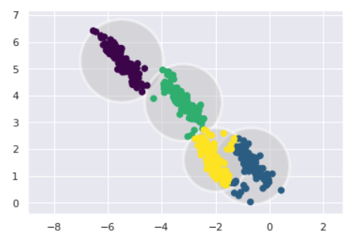
Disadvantages to k-Means Clustering
Need to know the number of clusters k prior to training
Outcome depends on initial values
Difficulty when clusters are of different shapes, sizes, and density
Sensitive to outliers
Lack of scalability in high dimensions.

Slide 21






Other Types of Clustering
Distribution-Based
Density-Based
Kernel Density Estimation
Gaussian Mixture Models
DBSCAN
Mean-shift

Slide 22
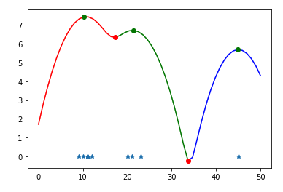
Kernel Density Estimation
Goal: Estimate the probability density function of a random variable.
Data smoothing parameter controls smoothing of data points.
Curve represents density estimate.
Local mimima are where numbers split.
Smoothing can be controlled with size of window.

Slide 23
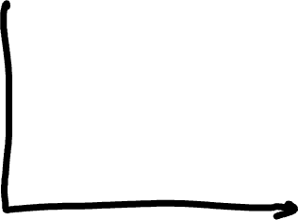
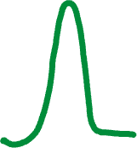



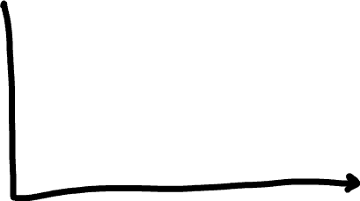
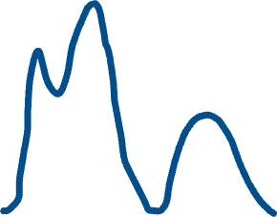
Distribution-Based Clustering: GMM
Gaussian Mixture Model (GMM)
Idea: Consider that data is generated by a combination of several Gaussian distributions (generative model).

Slide 24




Expectation Maximization with Mixtures: Assigning Points to Distributions (Specific GMM)
If we know the source of each observation: Easy
If we don’t know the source, but we know the parameters of the Gaussians: we can guess the source (Bayes rule, expectation maximization)
Expectation Maximization
E: Start with randomly placed Gaussians
M: Assign each point to the corresponding Gaussian with a probability (“soft” clustering)
Adjust means and variances accordingly

Slide 25



Density-Based Clustering
Examples: DBSCAN, Mean-shift
Concept: A region with high density is considered to belong to the same cluster.

Slide 26


DBSCAN
Group together points that have many nearby neighbors. (Density Estimation)
Points in low-density regions are outliers.
Steps:
Select random point
Consider the point part of a cluster if it has a minimum number of neighbors.
Repeat recursively for all of the point’s neighbors.
Pick a new random point.
Parameters: minimum distance, number of neighbors, distance metric

Slide 27
DBSCAN: Advantages and Disadvantages
Advantages
Disadvantages
No need to specify number of clusters
Can find clusters of arbitrary shapes
Robust to outliers
Non-deterministic: clusters depend on choice of points
Cluster quality depends on distance metrics.
Does not work well when different clusters have different densities. (Addressed in OPTICS)

Slide 28




Mean-Shift
Seeks modes (local maxima of density) in the feature space.
Steps:
Identify each point as a cluster center.
Each data point has a radius (bandwidth).
Take mean of data points within each radius to determine cluster center.
Adjust radius around new cluster center.
Repeat until cluster center does not move.
Multiple points converge to smaller group of cluster centers.

Slide 29
Summary
K-Means Clustering has limitations (needing to know k, varying density, sensitivity to outliers)
Density and distribution-based clustering avoid some of these limitations
Distribution-Based: KDE, Mixture Models/EM
Density-Based: DBSCAN, Mean-shift
Density-based methods can detect clusters of different shapes, but are more complex, and require differences in densities
Distribution-based methods require some assumptions about the shape and number of distributions.

