Slide 1
Machine Learning for Computer Networking
Nick Feamster University of Chicago Lecture 5: Naïve Bayes Classification

Slide 2







Kernel Density Classification
Classification based on density estimation
Optimal Bayes Classifier: If you knew that the data had an underlying probability distribution, you could form an optimal classifier as follows:
Unfortunately, that distribution is not known
Select a family of parametric distributions
Estimate the parameters

Slide 3



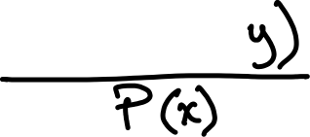








Bayes’ Rule

Slide 4
Naïve Bayes Classifier
Compare an observation’s posterior probabilities for each possible class.
The marginal probability for the observation is the same across all classes
Therefore, can just compare the numerator.
The class with the largest posterior numerator is the predicted class.
Probabilistic classifier: Can predict the likelihood across a set of classes (logistic regression is also a probabilistic classifier)

Slide 5


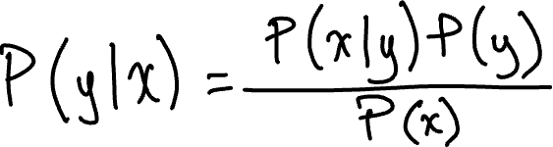





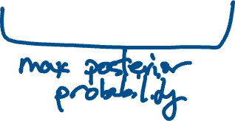
Naïve Bayes Classifier

Slide 6
Popularity of the Naïve Bayes Classifier
Intuitive
Works on small datasets
Computationally efficient for both training and prediction
Works well in a variety of settings
Makes very strong assumptions (independence of features), which do not hold in practice, but works well anyway…

Slide 7
Important Assumptions (“Naïve”)
Each feature and its corresponding likelihood is independent.
For each feature, we must assume some statistical distribution. (Kernel density estimates.)
Gaussian: Numerical Features
Bernoulli: Categorical Features
Multinomial: Discrete or Count Features

Slide 8















Naïve Bayes: Statistical Distribution Assumptions

Slide 9








Naïve Bayes: Independence Assumptions
Conditional Independence: Assume the feature probabilities P(x_{i}|y) are independent given the class y.

Slide 10










Naïve Bayes Classifier

Slide 11
Bayes Classifier: Advantages and Disadvantages
Advantages
Disadvantages
Efficient and scalable
Simple algorithm (counting)
Works on small datasets
Interpretable
Each distribution estimated as a 1D distribution (avoids “curse of dimensionality)
Often bad estimates for probabilities, but thresholds are good enough
Cannot learn relationships between features (independence assumption)

Slide 12
Summary
Naïve Bayes classifier is an efficient probabilistic classifier that works well, even with small datasets (independence assumption helps)
Two assumptions:
Independence of feature set
Features follow some statistical distribution
Often independence assumption does not hold in practice, but the technique works very well in many settings!

