Slide 1
Machine Learning for Computer Networking
Nick Feamster University of Chicago Lecture 2: What is Machine Learning?

Slide 2

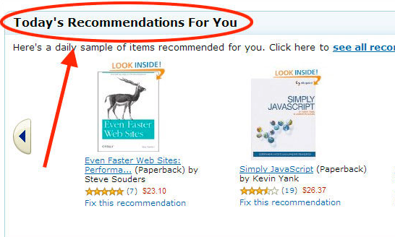
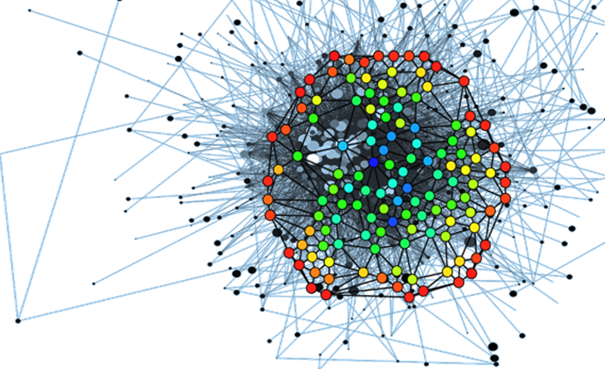
What is Machine Learning?
Automatic discovery of rules from history.
Deriving knowledge from past experience.
Extracting patterns from examples.

Slide 3
Definitions of Machine Learning
“Machines that can perform tasks that are characteristic of human intelligence.” (John McCarthy, 1956)
“The ability to learn without being explicitly programmed.” (Arthur Samuel, 1952)
“A computer program is said to learn from experience E with respect to some task T and some performance measure P, if its performance on T, as measured by P, improves with experience E.” (Tom Mitchell, 1997)

Slide 4
Supervised Learning: Overview
Learning rules from training data.
Two types of supervised learning
Regression: From data points, predict continuous valued outputs.
Classification: From data points, predict classes.

Slide 5
Supervised Learning
y
= f( )
X
output
“Learned”
function
Features/variables/ inputs/predictors/ independent variables/covariates
Training: Given a training set of labeled examples {(x₁,y₁), …, (x_{N},y_{N})}, estimate the prediction function f that minimizes future generalization (out of sample) error
Scoring/Testing: apply f to a new example x and output the predicted value y = f(x)

Slide 6
Statistical Learning Framework (Supervised Learning)
Data
Domain set (data points)
Label set (labels on each data point)
Model
A prediction function that maps from the input set to the label set
Generate a label for a given data point
Evaluation/Measure of Success
Loss function: Takes a pair of output labels for a given dataset and outputs a real value

Slide 7
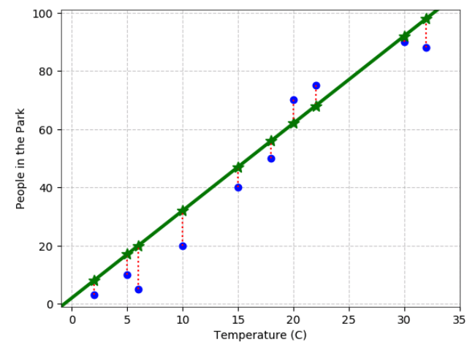
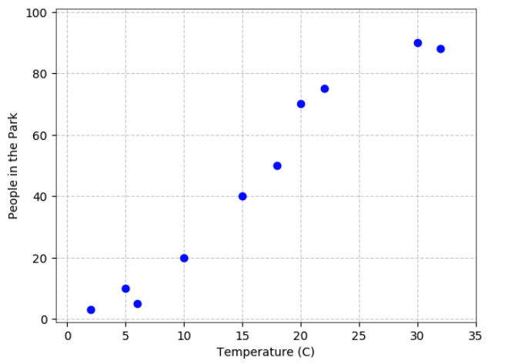
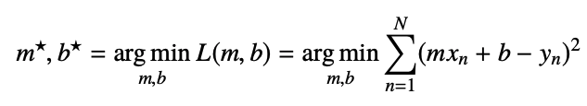
Least Squares Linear Regression, Single Input

Slide 8
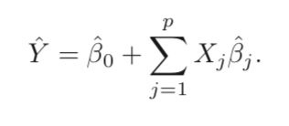
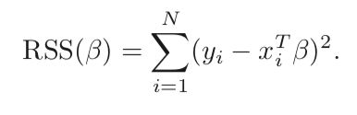




Least Squares with Multiple Inputs
Goal: Find beta that minimize loss.
One example loss function: Residual sum of squares.
Take derivative, set to zero.
Notes:
Mainstay of statistics for 30 years.

Slide 9
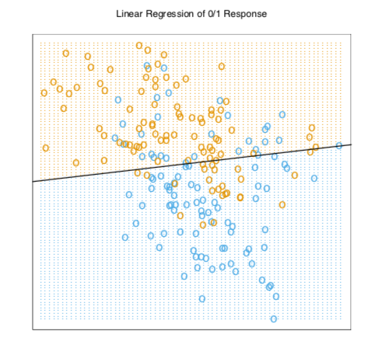

Slide 10
Nearest Neighbor Classification
x
x
x
o
x
x
x
o
x
o
x
o
o
o
New data point
o
f(x) = label of the training example nearest to x
All we need is a distance function for our inputs
No training required!
Slide credit: L. Lazebnik

Slide 11
K-Nearest Neighbor
x
x
x
o
x
x
x
+
o
o
x
x
o
o
+
o
o
x2
x1

Slide 12
3-Nearest Neighbor
x
x
x
o
x
x
x
+
o
o
x
x
o
o
+
o
o
x2
x1

Slide 13
5-Nearest Neighbor
x
x
x
o
x
x
x
+
o
o
x
x
o
o
+
o
o
x2
x1

Slide 14
