Slide 1
Machine Learning for Computer Networking
Nick Feamster University of Chicago Lecture 3: Linear and Logistic Regression

Slide 2
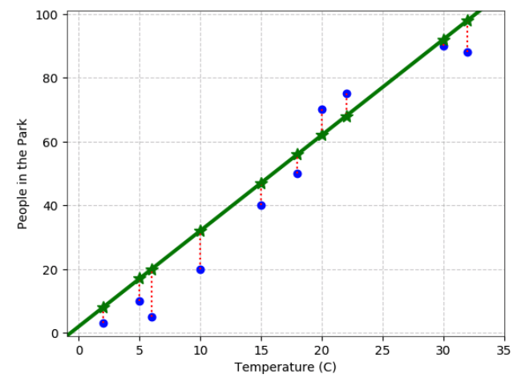
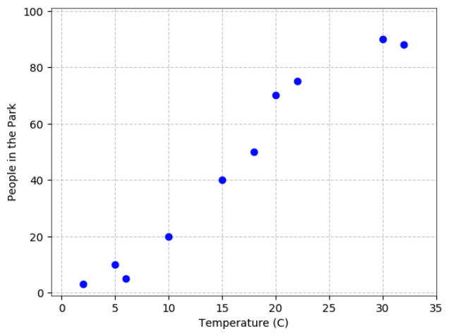
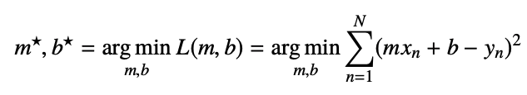
Least Squares Linear Regression, Single Input

Slide 3
Problem Framing
Given: Vector of inputs
Predict: Real-valued output
Inputs can come from different sources
Quantitative inputs
Transformations of quantitative inputs (log, square root, square)
Basis expansions (square, cube, etc.)
Numeric coding of qualitative inputs
Interactions between variables

Slide 4
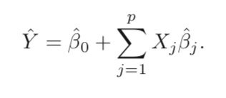
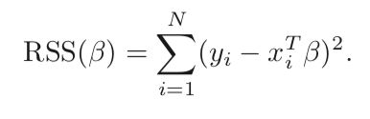




Least Squares with Multiple Inputs
One example loss function: Residual sum of squares.
Goal: Find beta that minimize loss.
Take derivative, set to zero.
Notes:
Mainstay of statistics for 30 years.

Slide 5
Assumptions About Underlying Data
Independence of inputs
Training observations independent random draws from the population
Conditionally independent given the inputs
Matrix should be full rank
If not, then it does not have an inverse
However, can be non-full rank in practice (redundant encodings)
Regression packages typically detect and remove redundancies
Regularization is another approach (will be discussed later)

Slide 6
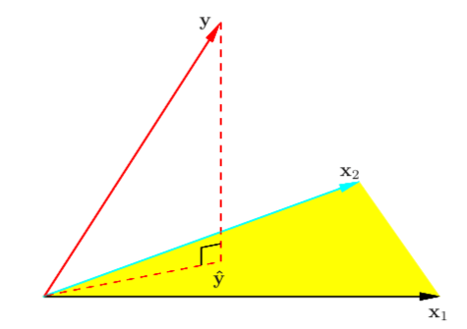
Representing the Estimation Graphically
The estimation is the orthogonal projection of y into the column space of X.
This is true even if the inputs are not linearly independent.
Ideally, we would eliminate variables that are not linearly independent/not significant.

Slide 7


Quality of the Estimation/Variable Significance
Assume that the linear model is the correct model for the mean that the conditional mean of Y is linear in the observations, X.
Test hypothesis that a particular coefficient is 0. Relevant statistics:
Z-Score (for a single coefficient; coefficient divided by its standard error)
F Statistic/F tests (for multiple coefficients)
We will look at how to compute these in the next part of the lecture
Notes:
Good video on F tests: https://www.youtube.com/watch?v=ie-MYQp1Nic

Slide 8
Regression vs. Classification
Regression: Estimation of a real value (e.g., integer, floating point).
Classification: Estimation of a binary outcome, class, etc.
Despite its name, logistic regression is about classification, from features to binary outcomes.

Slide 9
Maximum Likelihood
Linear Regression: One view of linear regression is probabilistic.
Given a set of i.i.d. observations and a parameterized model, determine the value of the parameter that best matches the observations.
For example, assuming Gaussian noise added to a linear model, goal is to estimate mean of the noise that would have produced those observations.
Logistic Regression: The target prediction is binary, which creates two problems:
Modeling a Gaussian distribution does not make sense: Need values between [0,1].
Coefficients times input features must map between [0,1].

Slide 10




Modeling Probabilities of (0,1) Observations: Bernoulli Distribution
Bernoulli Distribution: Biased coin flips, mean
Probability mass function:
We will say that the parameter is a function of the input x.
Need to map x into a 0-1 space.

Slide 11



Mapping Inputs to [0,1] Space: Logistic Function

Slide 12
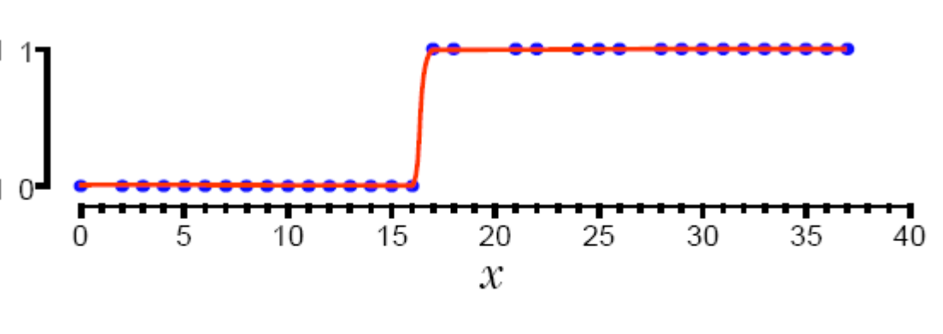
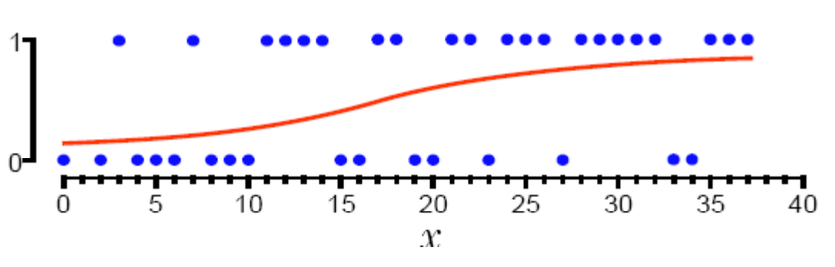



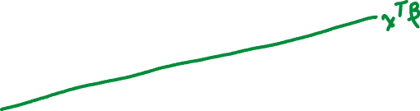


Decision Boundaries

Slide 13


















Relationship to Linear Regression

Slide 14
















Expressing as Log Likelihood

Slide 15
Solving Logistic Regression: Maximizing Log Likelihood
Gradient Descent
Negative gradient points in the direction of steepest descent
Option 1: Empirically determine by stepwise adjustments
Option 2: Newton’s method: Taylor expansion of function around current weights, take the gradient, set to zero.
Stochastic Gradient Descent
Only have access to a noisy version of the gradient
Gradient computed over a smaller subset of all of the data.

Slide 16
Summary
Logistic regression is an extension of linear regression models to predict K classes/values.
Common scenario is K=2 (binary), but can extend the approach to multinomial estimation.
Solution can be expressed as maximization of (log) likelihood, solved using gradient descent.

