Slide 1

Seizure Onset as a Dynamical Transition
Wilson–Cowan stability analysis with CHB-MIT ictal detection
and explanation reliability checks
AMATH 383 Final Project • June 2026
Yuming Chen, Linfeng Nie, Maria Felix
Notes:
Hi everyone. Today we are presenting our AMATH 383 final project, Seizure Onset as a Dynamical Transition. The central idea is to view a seizure not only as a label in EEG data, but also as a change in the stability of a dynamical system. We use a Wilson-Cowan excitatory-inhibitory ODE model to study the mathematical mechanism, then compare that mechanism with features extracted from a scoped CHB-MIT EEG subset. The goal is not to build a clinical prediction device. The goal is to connect seizure onset with dynamical-systems reasoning and to check how reliable the empirical feature explanations are.

Slide 2
Main Question
Problem
Can seizure onset be understood as a dynamical transition?
Normal regime
locally stable equilibrium
Parameter change
excitatory drive P
Ictal regime
seizure-like oscillations
Key idea: a brain system may remain near a background state until a change in excitation/inhibition pushes the equilibrium through a stability boundary.
AMATH 383 Final Project
02
Notes:
The main question is whether seizure onset can be understood as a dynamical transition. In this framing, normal brain activity is represented as a locally stable equilibrium. As an excitability parameter changes, the system can cross a stability boundary. After that crossing, the activity may become oscillatory and seizure-like. This gives us a simple storyline: a normal regime, a parameter change, and an ictal regime. The key mathematical object is not only the EEG signal itself, but the stability of the equilibrium under changing excitatory drive.

Slide 3
Concepts: Epilepsy and Seizures
Background
Epilepsy
Seizures
Epilepsy is a neurological disorder associated with recurrent seizures.
A seizure is a temporary episode of abnormal electrical activity in the brain, which may affect movement, awareness, sensation, or behavior.
How they differ from normal brain activity
Normal brain activity also involves electrical signaling among neurons. The difference is not that normal brains are electrically inactive. Instead, normal activity is regulated: excitation and inhibition remain sufficiently balanced so that the brain can process information without losing control of its dynamics. During a seizure, this regulation temporarily breaks down, and abnormal neural activity disrupts normal function.
AMATH 383 Final Project
20
Notes:
Before getting into the equations, we should define the biological terms carefully. Epilepsy is a disorder associated with recurrent seizures. A seizure is a temporary episode of abnormal electrical activity in the brain. Normal brain activity is also electrical, so the difference is not that one has electricity and the other does not. The difference is regulation. In normal activity, excitation and inhibition remain balanced enough that the brain can process information. During a seizure, that regulation temporarily breaks down and abnormal activity disrupts normal function. This is why a stability-based model is useful.

Slide 4
Why model seizure onset?
Motivation
TWO COMPLEMENTARY TASKS
EEG classifier
Detects which windows look ictal
ODE model
Explains how a transition can occur
• A classifier can identify seizure-overlapping EEG windows.
• It may not explain why neural activity changes suddenly.
• Performance can be high while interpretation remains unstable.
• A mechanistic model studies excitation, inhibition, and stability.
• Equilibria and eigenvalues reveal local stability changes.
• The model gives a qualitative seizure-transition mechanism.
AMATH 383 Final Project
03
Notes:
This project uses both a classifier and a mechanistic model because they answer different questions. An EEG classifier can detect which windows look ictal, which is useful for identifying seizure-overlapping data. However, a classifier alone may not explain why neural activity changes suddenly. A mechanistic ODE model asks a different question: what change in excitation, inhibition, or drive could make a normal equilibrium lose stability? This is also a direct connection to our course: state variables, governing equations, equilibria, Jacobians, eigenvalues, and qualitative interpretation.
Possible audience question: The ODE model does not seem very close to the machine-learning part. Is that a problem? Answer: It is a limitation, but not a problem if we present the two parts honestly. The ODE is a mechanism model. It asks how a neural system could move from stable background activity to seizure-like oscillation. The machine-learning part is an empirical detection pipeline. It asks whether real EEG windows that overlap seizures are separable from non-ictal windows. The connection is conceptual, through the idea of transition and ictal separability, not through direct parameter fitting.

Slide 5
Project Roadmap
Overview
1
Wilson–Cowan
ODE model
2
Stability
analysis
3
CHB-MIT EEG
features
4
CI reliability
checks
The talk moves from mechanism to evidence, then ends with a cautious interpretation.
• Mechanism: equilibrium loses stability under changing excitatory drive.
• Evidence: ictal windows are separable by amplitude, power, and Hjorth features.
• Caution: explanation rankings and preictal evidence are not fully stable.
AMATH 383 Final Project
04
Notes:
Here is the roadmap for the presentation. First, we introduce the Wilson-Cowan ODE model and explain how it represents excitation, inhibition, and the drive parameter P. Second, we use linear stability analysis to study equilibria as P changes. Third, we move to the CHB-MIT EEG subset and explain the feature pipeline for ictal-window detection. Fourth, we use the Consistency Index to ask whether feature-importance explanations agree across methods. We end with a cautious discussion, because the ODE and EEG analyses support related but not identical claims.

Slide 6
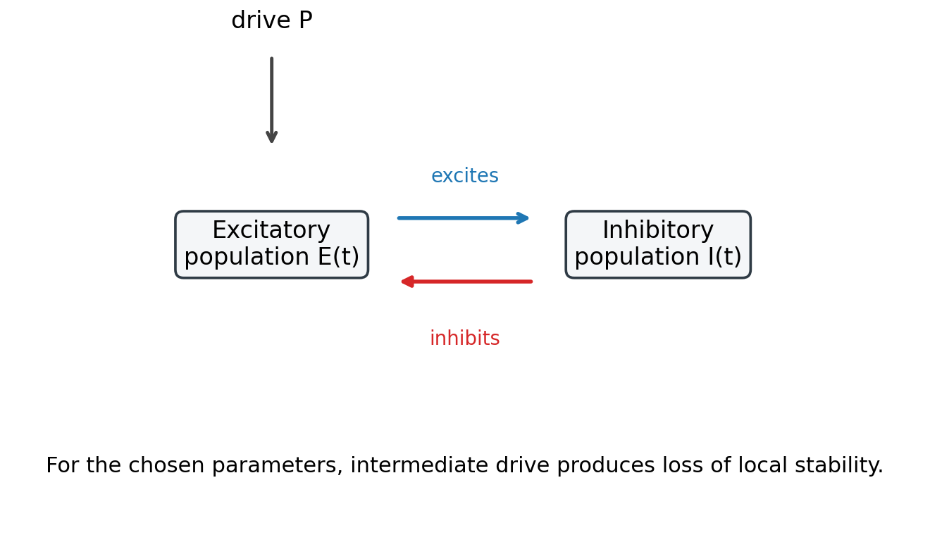
Wilson–Cowan model intuition
ODE Model
State variables
E(t): normalized excitatory population activity
I(t): normalized inhibitory population activity
P: excitatory drive / excitability control parameter
Model structure
Excitation pushes inhibition upward
Inhibition suppresses excitation
Increasing P can push the system toward instability
Interpretation: P summarizes many biological mechanisms; it is not estimated directly from EEG.
AMATH 383 Final Project
05
Notes:
The Wilson-Cowan model has two state variables. E(t) represents normalized excitatory population activity, and I(t) represents normalized inhibitory population activity. The model captures a feedback loop: excitation pushes inhibition upward, and inhibition suppresses excitation. The parameter P enters the excitatory equation and represents excitatory drive or excitability. In this project, increasing P is a simplified way to push the system toward seizure-like activity. Importantly, P is not estimated directly from EEG. It is a control parameter used to study how local stability changes.
To figure out the ODE model, we started from the smallest meaningful brain feedback loop: excitation and inhibition. Instead of modeling every neuron, we model the average activity of two interacting populations. That gives two state variables, E(t) and I(t). Then we write one rate equation for each variable. Each rate equation has a decay part, a nonlinear activation part, and coupling from the other population.

Slide 7
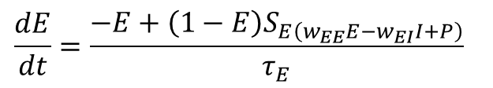
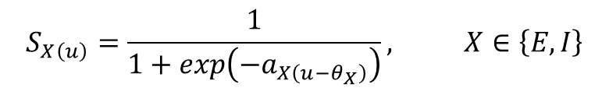
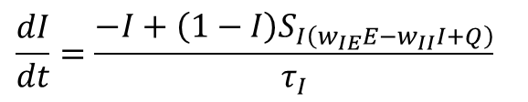
Governing equations
ODE Model
$$\frac{dE}{dt}=\frac{−E+\left(1−E\right)S_{E\left(w_{EE}E−w_{EI}I+P\right)}}{τ_{E}}$$
$$\frac{dI}{dt}=\frac{−I+\left(1−I\right)S_{I\left(w_{IE}E−w_{II}I+Q\right)}}{τ_{I}}$$
$$S_{X\left(u\right)}=\frac{1}{1+exp\left(−a_{X\left(u−θ_{X}\right)}\right)}, X∈\left\{E,I\right\}$$
Sigmoid response function
• The −E and −I terms pull activity downward.
• The sigmoid terms describe nonlinear population activation.
• The factor (1−E) or (1−I) keeps normalized activity bounded.
AMATH 383 Final Project
06
Notes:
These are the governing equations. The first equation describes the excitatory population, and the second describes the inhibitory population. Each equation has a decay term, such as negative E or negative I, plus a nonlinear activation term. The sigmoid function converts weighted input into bounded population activity. The factors one minus E and one minus I also help keep the normalized activities bounded. The important point is that this is a nonlinear two-dimensional ODE system. Because it is nonlinear, the local behavior depends on equilibria and their Jacobian eigenvalues.
Model-building logic: first choose the state variables E and I. Second, write rate of change equals decay plus activation. Third, make activation nonlinear using a sigmoid so that population activity has a threshold and saturation. Fourth, define the inputs. The excitatory input is w_EE E minus w_EI I plus P, so excitation is increased by itself, suppressed by inhibition, and pushed by the drive P. The inhibitory input is w_IE E minus w_II I plus Q, so excitation activates inhibition, while inhibitory self-coupling and the background drive shape the inhibitory response.

Slide 8
Parameter choices and sweep
ODE Model
Parameter
Meaning
Value
ONLY P IS VARIED
τE
excitatory time scale
1.0
P ∈ [0, 8]
201 grid points
τI
inhibitory time scale
2.0
wEE, wIE
excitatory couplings
10.0, 10.0
• Fixed qualitative values keep the model interpretable; not patient-fitted.
• The parameter sweep asks how local stability changes as excitatory drive changes.
• Focus on equilibria, Jacobians, and eigenvalues.
wEI, wII
inhibitory couplings
9.0, 2.0
Q
inhibitory drive
0.5
aE, aI
sigmoid slopes
1.5
θE, θI
sigmoid thresholds
3.5
AMATH 383 Final Project
07
Notes:
Most parameters are fixed so that the analysis stays interpretable. These values are not patient-specific fitted constants. They are a qualitative Wilson-Cowan demonstration set chosen to keep excitation, inhibition, nonlinear saturation, and feedback all present while only P is varied.
The excitatory time scale tau_E equals 1, which defines the basic time unit. The inhibitory time scale tau_I equals 2, so inhibition responds more slowly than excitation. That slower inhibitory response helps create delayed negative feedback, which can support oscillatory behavior. The excitatory couplings w_EE and w_IE are both 10, so excitation both reinforces itself and activates inhibition. The inhibitory couplings w_EI equals 9 and w_II equals 2, so inhibition strongly suppresses excitation but has weaker self-coupling. Q equals 0.5 and gives a small background inhibitory drive. The sigmoid slopes are 1.5, which gives a smooth nonlinear response rather than an almost linear or almost step-like response. The sigmoid thresholds are 3.5, so input has to become large enough before population activity rises strongly.
For the reason we choose these parameter values, we chose them as a controlled qualitative parameter set, not as measured biological constants. Fixing them lets us isolate the main mathematical question: as the excitatory drive P changes, does the tracked equilibrium stay stable or lose stability? Different parameter choices could produce different diagrams, so our claim is about this interpretable Wilson-Cowan setting, not exact patient-specific physiology. P ranges from 0 to 8 because that range includes the low-drive stable regime, the intermediate unstable interval, and the restabilized high-drive regime.

Slide 9
Stability analysis method
ODE Model
Equilibrium
F(E*, I*) = 0
G(E*, I*) = 0
Jacobian
J(E*, I*)
Eigenvalues
λ1, λ2
Stability
max Re(λ)
Decision rule
max Re(λ) < 0 → locally stable
max Re(λ) > 0 → locally unstable
AMATH 383 Final Project
08
Notes:
This slide summarizes the stability method. For each value of P, we solve for an equilibrium, meaning a point where both derivatives are zero. Then we evaluate the Jacobian matrix at that equilibrium. The Jacobian gives the local linear approximation to the nonlinear system. Next, we compute the eigenvalues. If the largest real part of the eigenvalues is negative, perturbations decay and the equilibrium is locally stable. If the largest real part is positive, perturbations grow and the equilibrium is locally unstable. This is the main numerical diagnostic used in the ODE analysis.

Slide 10
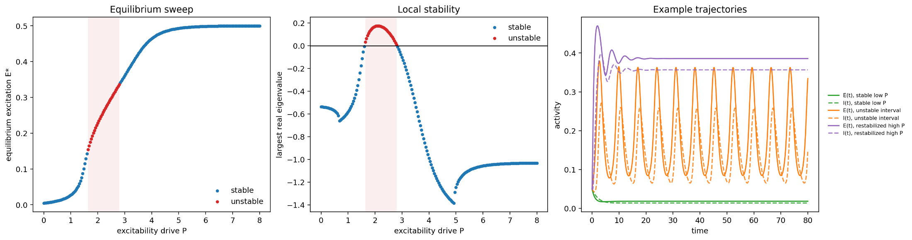
ODE result: stability transition
Results
• The sweep found one tracked equilibrium for each of 201 tested values of P.
• 171 grid points were locally stable; 30 were unstable.
• The unstable interval is approximately P = 1.64 to P = 2.80.
• Low drive is stable, intermediate drive is unstable, and high drive restabilizes.
Main interpretation:
intermediate excitatory drive produces loss of local stability.
AMATH 383 Final Project
09
Notes:
This figure shows the main ODE result. The sweep tracks one equilibrium for each tested value of P. Out of 201 grid points, 171 are locally stable and 30 are unstable. The unstable interval is approximately P equals 1.64 to 2.80. In words, low drive gives a stable equilibrium, intermediate drive produces loss of local stability, and high drive restabilizes the equilibrium. The middle panel is especially important because it shows the largest real eigenvalue crossing zero. That crossing is the mathematical signal that local stability changes.

Slide 11
Hopf-like interpretation
Results
P
E*
I*
max Re(λ)
Stability
Because the eigenvalues near both crossings are complex conjugate pairs, the result is best described as a Hopf-like loss of local stability.
1.60
0.142
0.067
−0.007
stable
1.64
0.154
0.076
0.032
unstable
2.80
0.336
0.294
0.008
unstable
2.84
0.341
0.300
−0.011
stable
What the result is NOT saying
• Not a saddle-node transition
• Not a hysteresis result
• Not the emergence of a separate stable seizure equilibrium
• Not a patient-specific clinical fit
AMATH 383 Final Project
10
Notes:
This table explains how to interpret the stability change. Near both stability crossings, the eigenvalues are complex conjugate pairs. Therefore, the result is best described as a Hopf-like loss of local stability. A Hopf-like transition means the system does not just move away in a straight line. It tends to start rotating or oscillating around the equilibrium. That matches the idea of rhythmic seizure-like activity. We are not claiming a fully validated Hopf bifurcation from a complete bifurcation analysis. We are also not claiming a saddle-node transition, hysteresis, or the appearance of a separate stable seizure equilibrium. The safe conclusion is that changing P can make the equilibrium lose local stability in a way associated with oscillatory behavior.

Slide 12
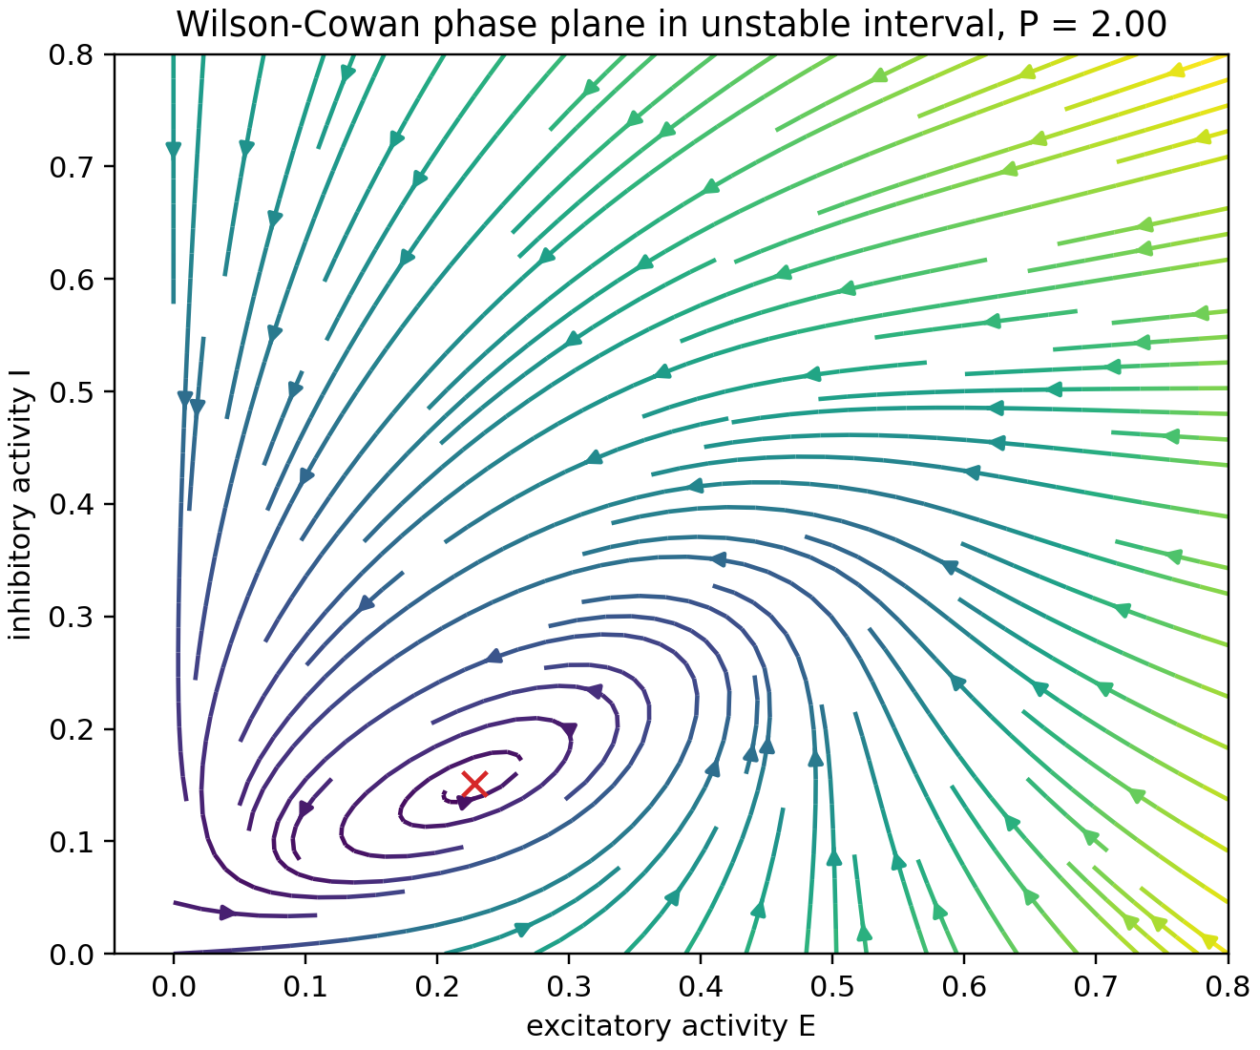
Phase plane at P = 2.0
Results
INSIDE THE UNSTABLE INTERVAL
• P = 2.0 lies within the unstable interval.
• The red marker is the unstable equilibrium.
• The vector field has rotational structure around the equilibrium.
• This visual pattern supports the oscillatory-instability interpretation.
Mathematically: complex eigenvalues.
Visually: rotational flow.
AMATH 383 Final Project
11
Notes:
The phase plane gives a visual interpretation of the same result. Here P equals 2.0, which lies inside the unstable interval. The red marker is the unstable equilibrium. The vector field around it has rotational structure, meaning nearby trajectories do not simply move straight back to the equilibrium. This visual pattern matches the complex-eigenvalue result. It supports the interpretation that the instability is oscillatory. Again, this is a qualitative dynamical mechanism, not a direct simulation of a patient-specific seizure.

Slide 13
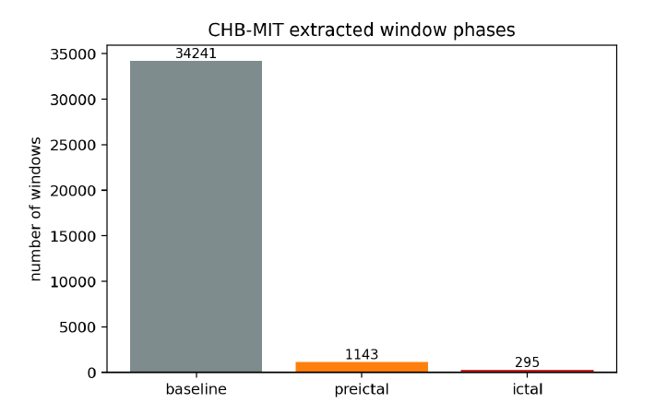
CHB-MIT EEG dataset
Data Pipeline
SCOPED SUBSET
• Subjects: chb01, chb03, and chb05
• Records: 51 EDF files
• Windows: 35,679 non-overlapping 5-second windows
• Task: ictal-window detection
Phase
Windows
Baseline
34,241
The data are highly imbalanced: ictal windows are less than 1% of the extracted windows.
Preictal
1,143
Ictal
295
AMATH 383 Final Project
12
Notes:
Now we move from the ODE model to the EEG data. The empirical component uses a scoped CHB-MIT subset with subjects chb01, chb03, and chb05. The subset contains 51 EDF records and 35,679 non-overlapping five-second windows. The class balance is highly uneven: there are 34,241 baseline windows, 1,143 preictal windows, and only 295 ictal windows. Ictal windows are less than one percent of the dataset. This imbalance matters because accuracy alone can be misleading, and false positives become important when there are many non-ictal windows.

Slide 14
Label design: detection, not prediction
Data Pipeline
y = 1 if a window overlaps an annotated ictal interval
y = 0 for baseline and preictal windows
Important framing
• The classifier detects seizure-overlapping windows.
• Preictal windows are included for descriptive context.
• Preictal windows are treated as negative examples during training.
• Therefore, this is not a validated seizure early-warning system.
“ictal-window detection” rather than “seizure prediction.”
AMATH 383 Final Project
13
Notes:
The label design is very important. A window is labeled one only if it overlaps an annotated ictal interval. Baseline and preictal windows are labeled zero during classifier training. Therefore, the task is ictal-window detection. It is not seizure prediction, and it is not a validated early-warning system. Preictal windows are included to provide descriptive context, but they are not treated as positive examples. Throughout the presentation, the safest wording is ictal-window detection rather than seizure prediction.

Slide 15
Feature extraction
Data Pipeline
INPUT
8 bipolar EEG channels
5-second non-overlapping windows
Total feature set:
25 base features × 2 channel summaries = 50 features
FEATURE FAMILIES
Family
Examples
• The EEG features are empirical observables.
• They are not direct measurements of the ODE variables E and I.
• The comparison with the ODE is qualitative, not a direct model fit.
Amplitude
RMS, line length
Spectral power
delta, theta, alpha, beta power
Complexity
entropy, Hjorth mobility/complexity
Channel summaries
mean and maximum across channels
AMATH 383 Final Project
14
Notes:
The EEG signal is a time series, so each five-second window has many raw voltage values. Instead of feeding all raw values directly into the models, we summarize each window with features. For each five-second EEG window, features are computed from eight bipolar EEG channels when available. The feature families include amplitude features such as RMS and line length, spectral power features such as delta, theta, alpha, and beta power, and complexity features such as entropy and Hjorth measures. Channel-level features are summarized by the mean across channels and the maximum across channels. This gives 50 total features: 25 base features times two channel summaries. These features are empirical observables. They are not direct measurements of the ODE variables E and I.

Slide 16
Feature behavior by phase
Results
Phase
Mean RMS
Mean theta power
Mean Hjorth activity
Mean total power
Baseline
38.93
93.58
1,733
696.9
Preictal
39.57
85.80
1,790
686.9
Ictal
119.50
1,057.88
15,469
6,918.0
• Ictal windows show much larger amplitude and power summaries.
• Baseline and preictal medians are much closer to each other.
• This supports ictal separability more strongly than gradual preictal separation.
Main separation: ictal vs. non-ictal
AMATH 383 Final Project
15
Notes:
This table summarizes how selected features behave by phase. The main separation is between ictal and non-ictal windows. For example, mean RMS is about 39 for baseline and about 40 for preictal, but it rises to about 120 for ictal windows. Mean theta power rises from about 94 at baseline to over 1,000 during ictal windows. Mean Hjorth activity rises from about 1,733 to more than 15,000. In contrast, baseline and preictal medians are much closer to each other. This supports ictal separability more strongly than gradual preictal separation.

Slide 17
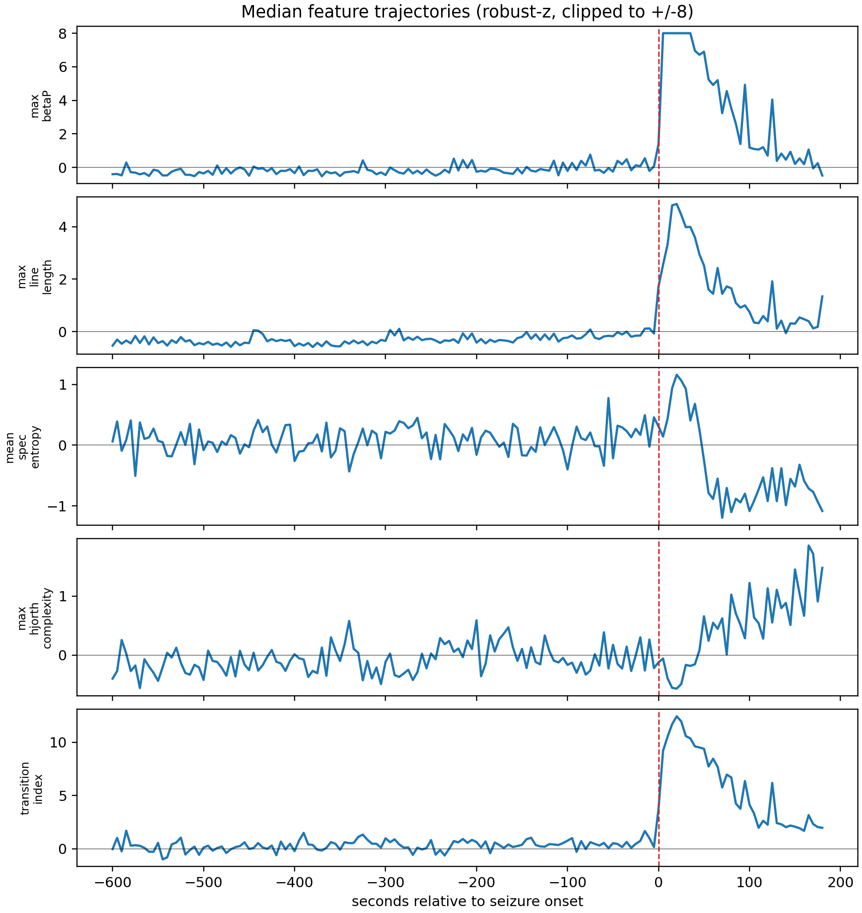
Feature trajectories around seizure onset
Results
Median feature pattern
•
RMS, theta power, line length, and transition index rise near onset.
•
Spectral entropy and Hjorth complexity change in a different direction after onset.
•
The strongest visual evidence is ictal separability, not gradual preictal warning.
Phase
RMS
θ power
Hjorth activity
Baseline
38.93
93.58
1,733
Preictal
39.57
85.80
1,790
Ictal
119.50
1,057.88
15,469
Visualization only: Features are robust-z scaled and clipped to [−8, 8]. The transition index is a heuristic visualization, not a clinical score.
Preictal medians stay close to baseline, while ictal medians are much larger.
AMATH 383 Final Project
16
Notes:
This figure plots median feature trajectories relative to seizure onset. The dashed red line marks onset. Several features change sharply at or right after onset. For example, beta power, line length, and the transition index rise strongly. This is consistent with ictal windows being very different from baseline. The trajectories are robust-z scaled and clipped for visualization, so the figure should be read as a pattern summary rather than raw physical magnitude. Preictal medians are close to baseline, so this supports ictal separability more than reliable preictal prediction.

Slide 18
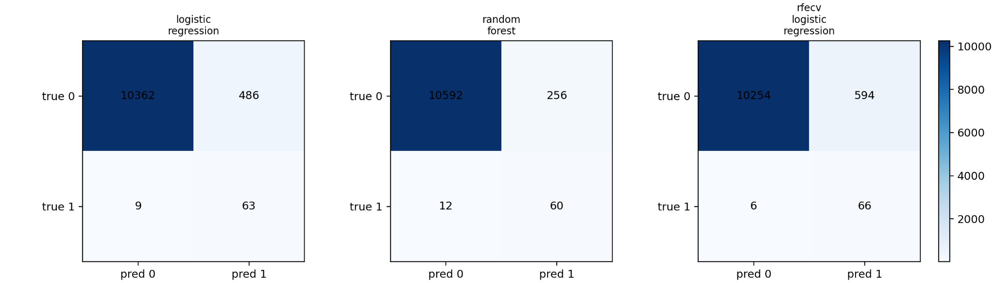
Classifier performance
Results
Model
Balanced acc.
Recall
Precision
FP win/hr
Logistic regression
0.915
0.875
0.115
32.26
Random forest
0.905
0.833
0.190
16.99
RFECV logistic
0.931
0.917
0.100
39.42
Test-set design
Record-held-out split: 10,920 test windows, 72 ictal;
no windows from the same EDF record appear in both train and test.
Best depends on objective: RFECV maximizes sensitivity;
random forest reduces false positives and improves precision.
AMATH 383 Final Project
17
Notes:
Logistic regression is a relatively simple model that combines features with weights and outputs a probability of an ictal window. Random forest is a collection of decision trees. Each tree makes simple split decisions, and the forest combines them. RFECV (Recursive Feature Elimination with Cross-Validation) logistic regression means recursive feature elimination with cross-validation. It starts with many features and repeatedly removes weaker ones while checking performance.
This slide compares the classifier results. All three models achieve high balanced accuracy because they detect many ictal windows. RFECV logistic regression has the highest balanced accuracy and recall, so it is the most sensitive model in this run. However, it also has the lowest precision and the highest false-positive-window rate. Random forest has lower recall, but better precision and fewer false positives. Therefore, RFECV is not simply the best model overall. The best model depends on whether the priority is sensitivity, precision, or reducing false-positive burden.

Slide 19
Preictal positive-call rates
Results
Model
Baseline
Preictal
Ictal
Observation: preictal windows are called positive more often than baseline windows.
Logistic regression
0.0425
0.1458
0.8750
Random forest
0.0222
0.0875
0.8333
RFECV logistic regression
0.0519
0.1792
0.9167
Interpretation
• This may reflect onset-near feature changes.
• However, preictal windows were negative examples during training.
• The result does not validate a reliable seizure-prediction system.
• It should be treated as qualitative context only.
AMATH 383 Final Project
18
Notes:
This slide focuses on preictal positive-call rates. Although preictal windows were labeled negative during training, the models call them positive more often than baseline windows. For example, RFECV logistic regression calls about 5.2 percent of baseline windows positive, but about 17.9 percent of preictal windows positive. This is suggestive because it may reflect onset-near feature changes. However, it does not validate seizure prediction. The implementation does not assign time-to-next-seizure labels across neighboring EDF files, so this result should be treated only as qualitative context.

Slide 20
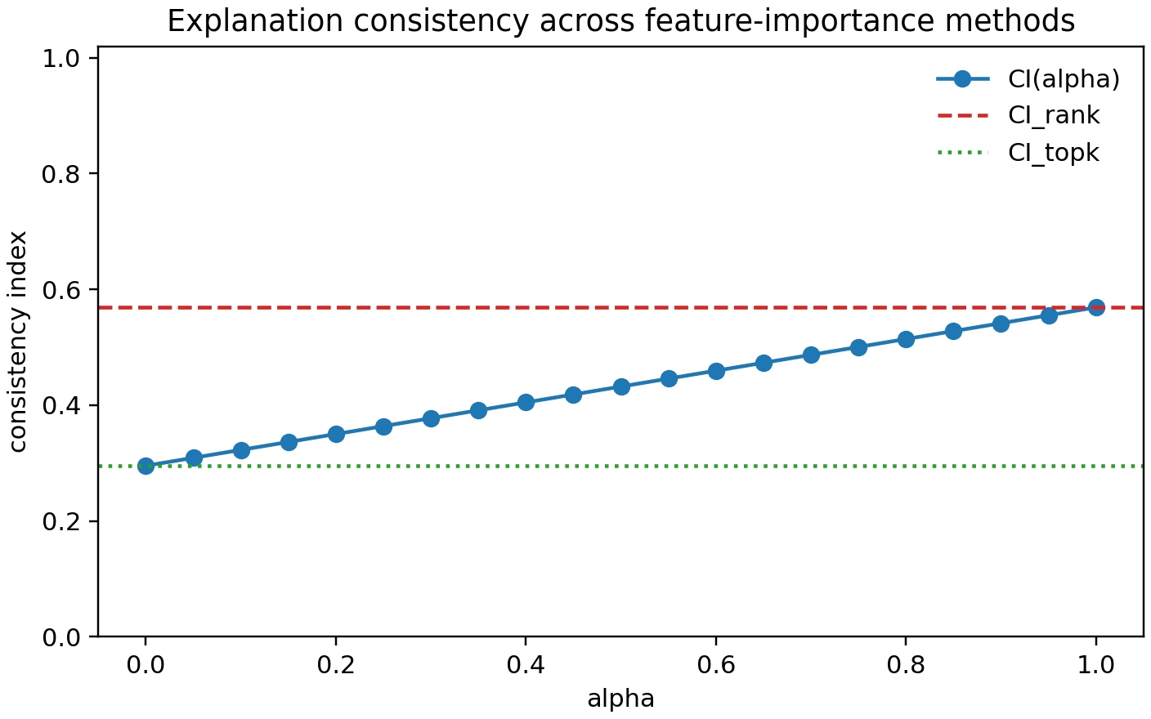
Explanation reliability: full-feature CI
CI / RFECV
What CI compares
Three importance rankings:
• logistic coefficient magnitude
• random-forest impurity importance
• random-forest permutation importance
Formula
CI(α) = α·CI_rank + (1−α)·CI_topk
α controls how much weight goes to rank agreement.
0.569
CIrank
global rank
0.295
CItopk
top-8 overlap
0.432
CI at α=0.5
combined
full-feature CI alpha sensitivity
Key read: moderate rank agreement, weak top-k overlap; exact top features depend on the explanation method.
AMATH 383 Final Project
19
Notes:
This slide slows down the Consistency Index. We compare three feature-importance rankings: logistic-regression coefficient magnitude, random-forest impurity importance, and random-forest permutation importance. CI_rank measures global rank agreement across all features. CI_topk measures overlap among the top eight features. Alpha weights these two components. The red dashed line is CI_rank, the green dotted line is CI_topk, and the blue curve is the combined CI(alpha). At alpha equals 0.5, the full-feature CI is 0.432. The main interpretation is that the methods have moderate rank agreement but weak agreement on the exact top features.

Slide 21
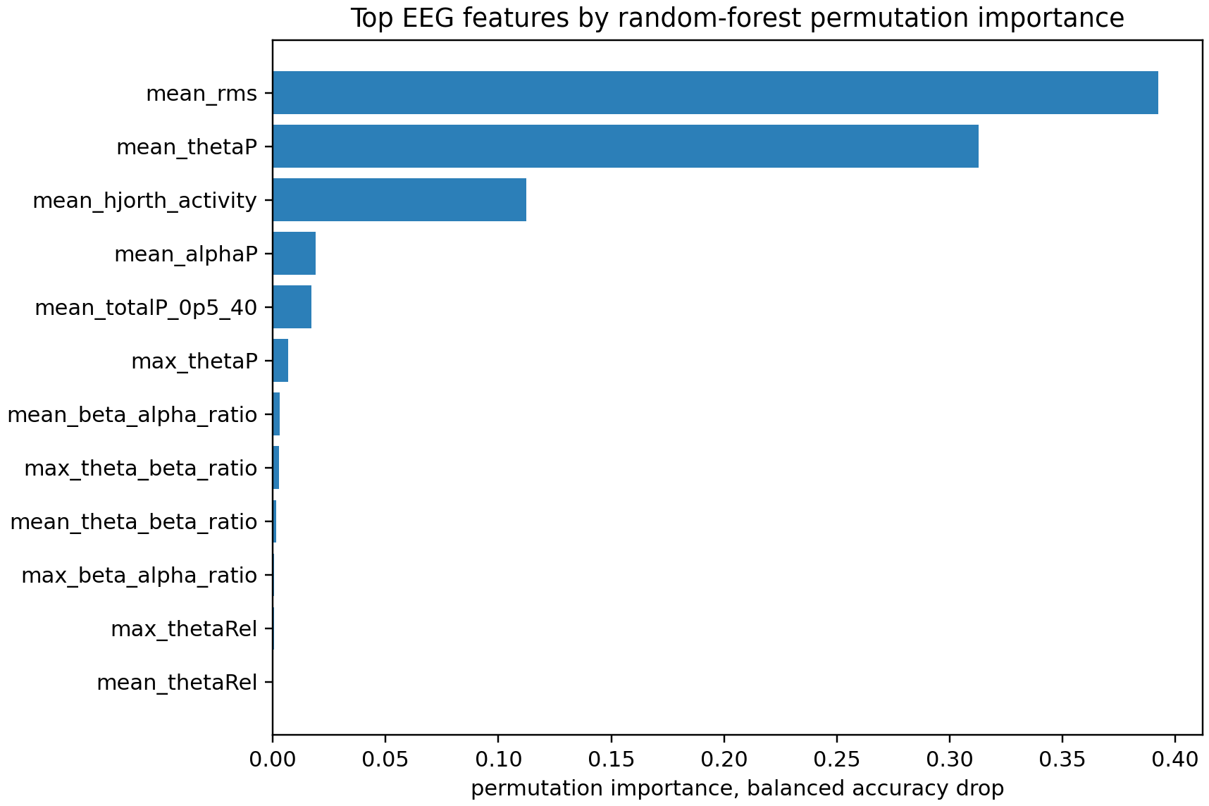
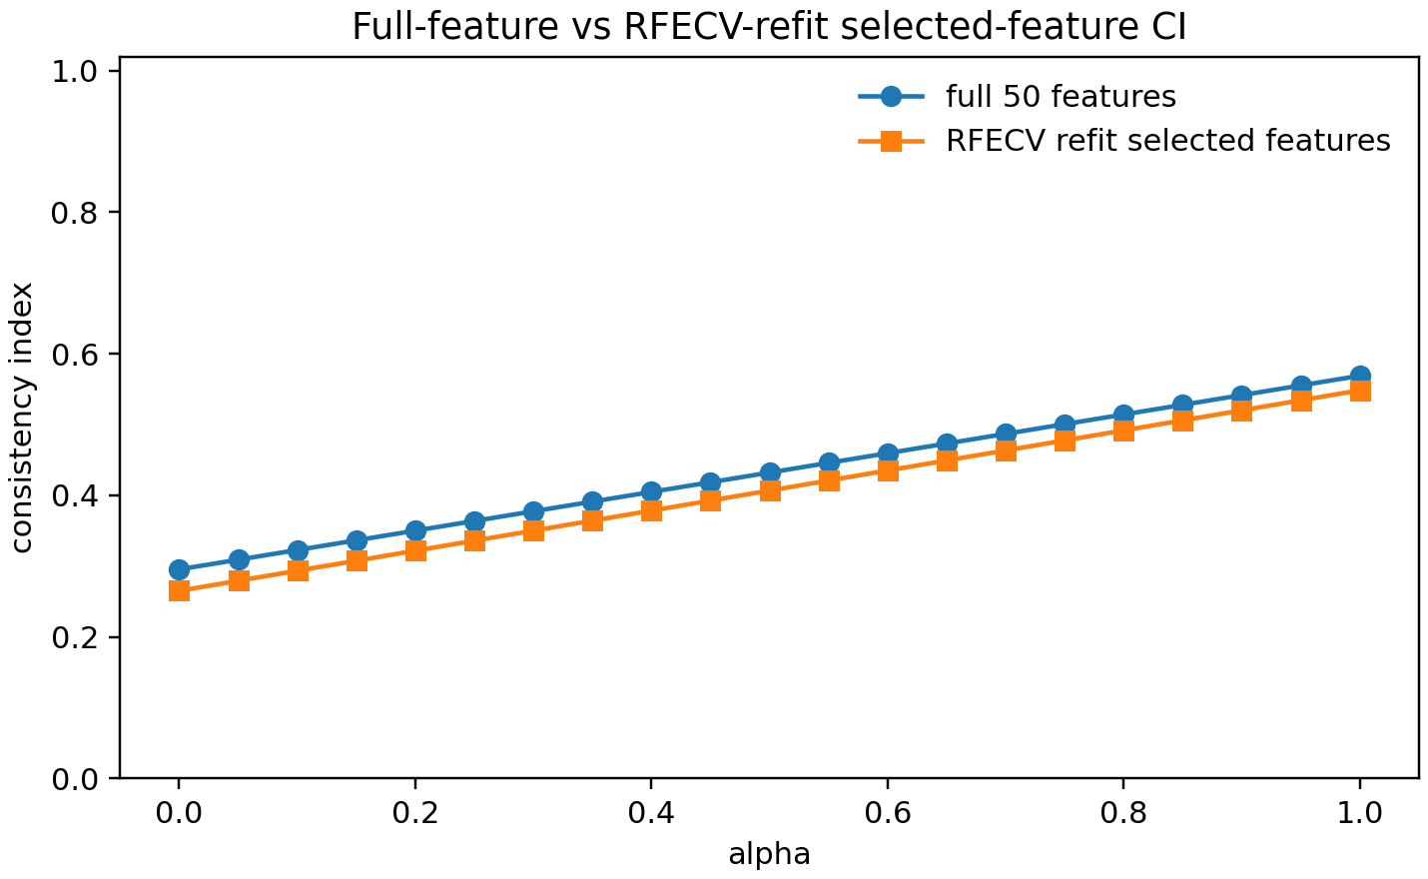
Explanation reliability: RFECV refit check
CI / RFECV
• Top drivers: mean RMS, mean theta power, mean Hjorth activity.
• RFECV selected 22 of 50 features, then models were refit.
• Full-feature CI at α=0.5: 0.432.
• RFECV-refit selected-feature CI at α=0.5: 0.407.
Key result: RFECV improved recall, but CI decreased after refitting.
AMATH 383 Final Project
20
Notes:
This slide connects RFECV to explanation reliability. RFECV selected 22 of the 50 features. After that, logistic-regression and random-forest models were refit on the selected subset and CI was recomputed. This asks whether feature selection makes the explanations more stable. In this run, it did not. The selected-feature CI at alpha equals 0.5 decreased to 0.407, compared with 0.432 for the full feature set. So RFECV improved recall and balanced accuracy, but it did not improve explanation consistency.

Slide 22
Discussion: connecting model and data
Closing
What the ODE shows
What the EEG shows
• Changing P moves the equilibrium into a locally unstable interval.
• Complex eigenvalues support oscillatory local behavior.
• This gives a mechanism for seizure-like transition.
• Ictal windows are separable in the scoped subset.
• Main drivers are amplitude, spectral power, and Hjorth activity.
• Preictal separation is weaker and should be treated cautiously.
How to interpret them together
Complementary claims, not a direct patient-specific fit.
The safest claim is qualitative compatibility.
Mechanism + qualitative EEG support, not a validated clinical prediction system.
Mechanism + qualitative EEG support, not a validated clinical prediction system.
AMATH 383 Final Project
21
Notes:
This discussion slide separates the two main claims of the project. The Wilson-Cowan ODE gives a mathematical mechanism: changing the excitatory drive P can move the equilibrium into a locally unstable interval, and the complex eigenvalues support oscillatory local behavior. The EEG analysis gives qualitative empirical support: ictal windows in the scoped CHB-MIT subset are separable from non-ictal windows mainly through amplitude, spectral-power, and Hjorth-activity features.
Possible audience question: The ODE model does not seem very close to the machine-learning part. Is that a problem? Answer: It is a real limitation, but it is acceptable because we are not claiming a direct fit. The ODE variables E and I are abstract population activities, while the machine-learning features are empirical EEG summaries such as RMS, power, entropy, and Hjorth activity. The connection is that a stability loss in the ODE can produce oscillatory seizure-like behavior, and the EEG data show that ictal windows have strong amplitude and power changes. These two claims are qualitatively compatible, but they are not the same. A stronger future project would estimate a latent excitability parameter P(t) from EEG, fit a patient-specific neural mass model, or use ODE-derived features inside the classifier.

Slide 23
Limitations and careful interpretation
Closing
Model simplification
Drive parameter P
• Two variables cannot represent spatial spread, anatomy, medication state, or seizure subtypes.
• P is an abstract control parameter, not a value estimated directly from EEG.
Dataset scope
Prediction wording
• Only 3 subjects and 51 EDF records were used; the split is record-held-out, not subject-held-out.
• The task is ictal-window detection, not seizure prediction, early warning, or a clinical alarm system.
Additional caution
• Precision remains low because the dataset is highly imbalanced.
• False-positive metrics are project-level diagnostics, not clinical alarm measures.
ictal-window detection and qualitative empirical support, not clinical prediction.
AMATH 383 Final Project
22
Notes:
The limitations are central to the project. Mathematically, the Wilson-Cowan model is intentionally simple. Two variables cannot represent spatial seizure propagation, detailed anatomy, medication effects, or multiple seizure types. The parameter P is also abstract: it summarizes changes in excitatory drive or effective inhibition, but it is not estimated from EEG. Empirically, the dataset is scoped to three subjects and 51 EDF records, so the results should not be presented as a full CHB-MIT benchmark or as unseen-patient generalization. The classifier target is ictal-window detection, so it should not be described as seizure prediction or a clinical alarm system. Finally, the explanation rankings are only partly stable, so interpretation should remain cautious.

Slide 24
References
Sources
[1] Wilson, H. R., & Cowan, J. D. (1972). Excitatory and inhibitory interactions in localized populations of model neurons. Biophysical Journal, 12(1), 1–24.
[2] Jirsa, V. K., Stacey, W. C., Quilichini, P. P., Ivanov, A. I., & Bernard, C. (2014). On the nature of seizure dynamics. Brain, 137(8), 2210–2230.
[3] Guttag, J. (2010). CHB-MIT Scalp EEG Database, version 1.0.0. PhysioNet. https://doi.org/10.13026/C2K01R
[4] Shoeb, A. H. (2009). Application of machine learning to epileptic seizure onset detection and treatment. PhD thesis, Massachusetts Institute of Technology.
[5] Chang, C.-C., Chen, Y., & Chen, C.-Y. (2026). Towards decision-ready explainable machine learning for water quality management using a consistency index and cross-validated feature-selection framework. Environmental Research, 297, 124207.
[6] Pedregosa, F., Varoquaux, G., Gramfort, A., et al. (2011). Scikit-learn: Machine learning in Python. Journal of Machine Learning Research, 12, 2825–2830.
AMATH 383 Final Project
23
Notes:
This references slide lists the main sources used for the presentation. The most important sources are the Wilson-Cowan neural population model, the CHB-MIT dataset, the PhysioNet database paper, the Epileptor transition paper, and the CI/RFECV explanation-consistency paper. Use this slide only if the audience asks about sources or if there is extra time at the end.

Slide 25
Contributions
During this project,
Yuming has done: Connected seizure onset to dynamical-systems stability. Developed a reproducible CHB-MIT EEG feature pipeline. Correctly framed the machine-learning task as ictal-window detection. Showed that ictal EEG windows are separable mainly through interpretable feature families. Compared model performance using metrics suitable for imbalanced data.
Maria has done: Built and analyzed a Wilson-Cowan excitatory-inhibitory ODE model. Clarified the correct mathematical interpretation of the ODE result. Added explanation-reliability analysis using CI and RFECV. Made the model-data relationship explicit and cautious. Identified clear limitations and next steps.
Linfeng has done: Creating the slides.
AMATH 383 Final Project
24

Slide 26
Thanks
AMATH 383 Final Project
Questions?
Notes:
Thank you for listening. We are happy to take questions. The main message is that seizure onset can be studied as a stability transition in a nonlinear ODE model, while the EEG analysis supports ictal separability in a scoped dataset. The careful interpretation is mechanism plus qualitative EEG support, not a validated clinical prediction system.

