Slide 1






.yml

Slide 2

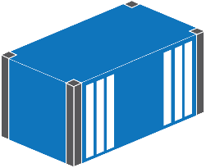
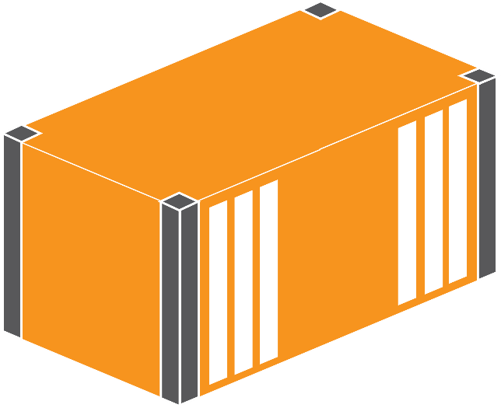
.yml

Slide 3



Dockerfile: deployment script
Image: packaged application
Container: running application

Slide 4

Image: packaged application
Registry: image store

