Slide 1



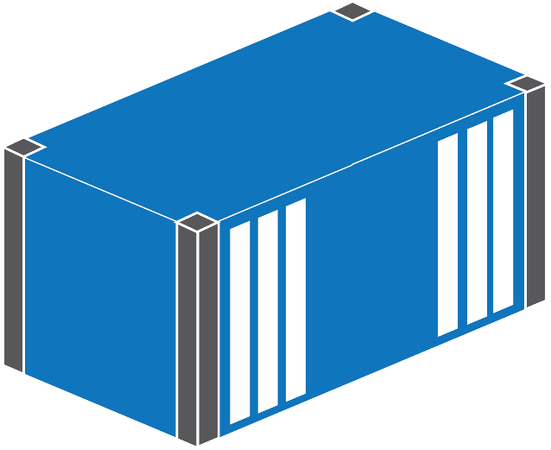
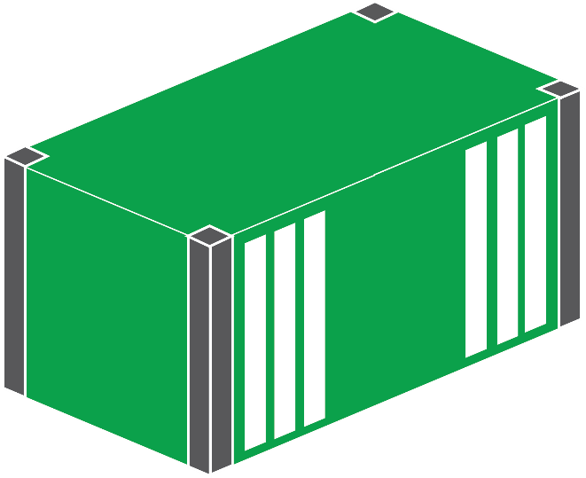



w3wp.exe
console.exe
sqlservr.exe

Slide 2
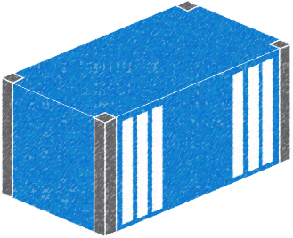

> docker image build
Web App
ASP.NET
.NET Fx
IIS
Server Core

Slide 3
FROM mcr.microsoft.com/dotnet/framework/aspnet:4.8
COPY MyApp.msi /
RUN msiexec /i MyApp.msi /qn

Slide 4
FROM mcr.microsoft.com/dotnet/core/sdk:3.1.300 AS builder
WORKDIR /src
COPY src/ .
RUN dotnet publish -c Release -o /out ToDoList.csproj
# app image
FROM mcr.microsoft.com/dotnet/core/aspnet:3.1.4
WORKDIR /app
ENTRYPOINT ["dotnet", "ToDoList.dll"]
COPY --from=builder /out/ .

Slide 5
FROM mcr.microsoft.com/dotnet/core/sdk:3.1.300 AS builder
WORKDIR /src
COPY src/ .
RUN dotnet publish -c Release -o /out ToDoList.csproj
# app image
FROM mcr.microsoft.com/dotnet/core/aspnet:3.1.4
WORKDIR /app
ENTRYPOINT ["dotnet", "ToDoList.dll"]
COPY --from=builder /out/ .

Slide 6
FROM mcr.microsoft.com/dotnet/core/sdk:3.1.300 AS builder
WORKDIR /src
COPY src/ .
RUN dotnet publish -c Release -o /out ToDoList.csproj
# app image
FROM mcr.microsoft.com/dotnet/core/aspnet:3.1.4
WORKDIR /app
ENTRYPOINT ["dotnet", "ToDoList.dll"]
COPY --from=builder /out/ .

Slide 7

> docker image push
hub.docker.com

Slide 8
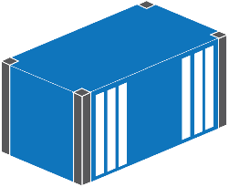
> docker container run
Web App
ASP.NET
.NET Fx
w3wp.exe
IIS
Server Core

Slide 9



Slide 10
> docker container run
Web App
ASP.NET Core
dotnet
.NET Core
Debian

Slide 11




Dockerfile: deployment script
Image: packaged application
Registry: image store
Container: running application

