Slide 1
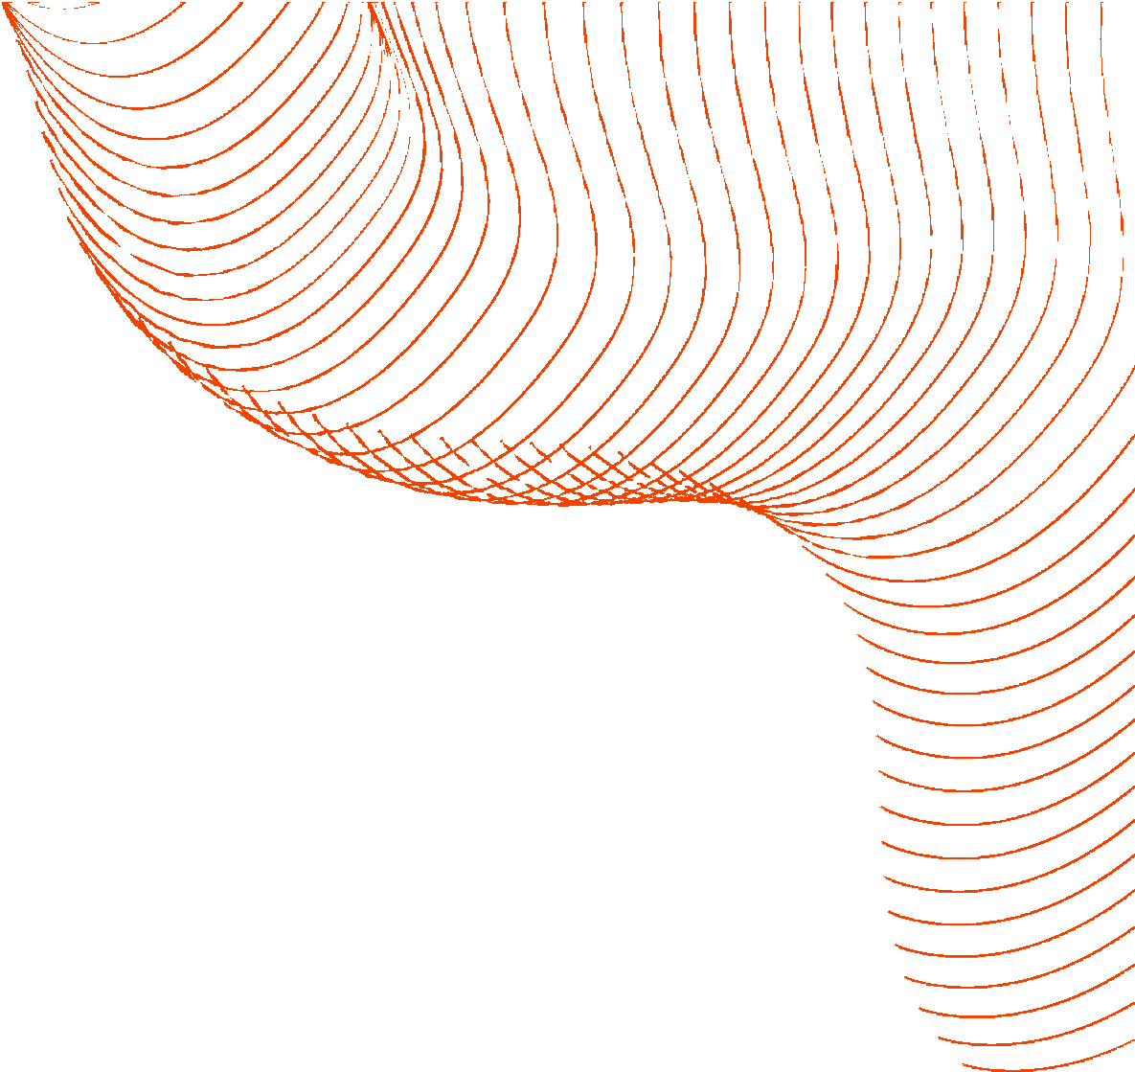
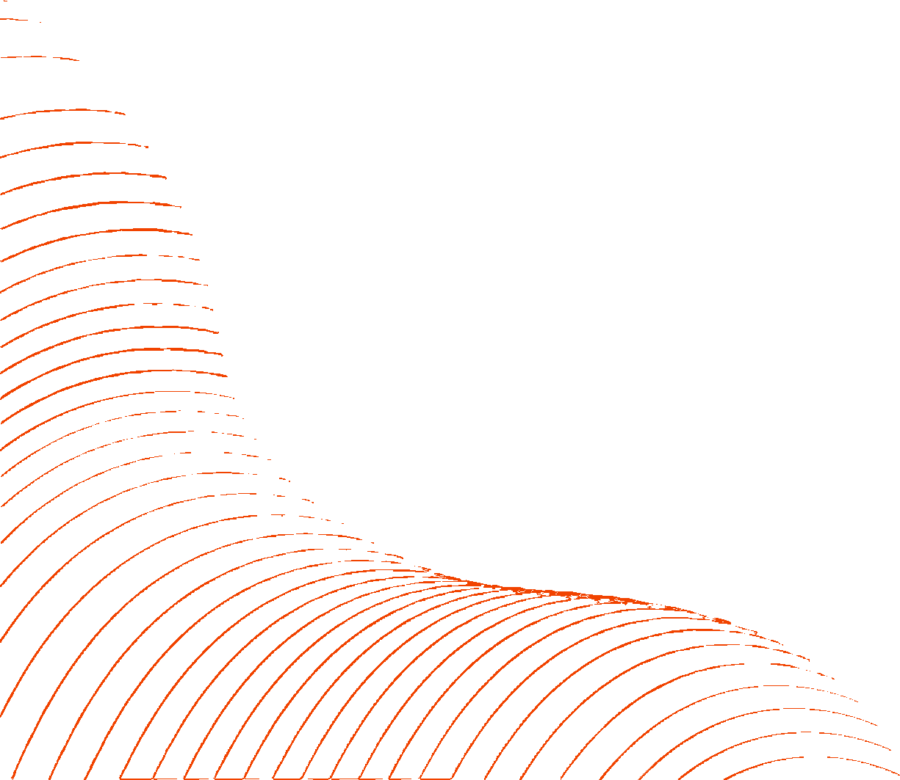
Malaria Spread Analysis

Slide 2


Introduction
To analyze the spread of malaria disease in a region.
We would find the hotspots, trends and patterns in the disease spread.
We would digitize the region and perform certain analyses to find the patterns in the spread.
CK TO AGENDA

Slide 3
Objective
The objective of this study is to analyze the spatial distribution and temporal trends of malaria incidence in a specific region using GIS software.
By mapping the incidence of malaria and identifying areas with high disease burden, we can gain insights into the factors driving the spread of the disease and develop effective strategies for malaria control and prevention.

Slide 4


Layers Used
Raster Layers used: Reference map
Vector layers Used: School Layer Hospital Layer Road Layer
Water Bodies layer Houses layer Governement Bodies layer Malaria spread data Boundary layer

Slide 5
Methodology
We have digitized the vector layers from the Google earth and then have used QGIS to perform analyses and have deployed on web

Slide 6



Analyses performed
Interpolating the road layer
Centroids of house, water bodies layer and schools layer Buffer regions for water bodies and malaria spread data Shortest path distance between houses and government bodies , between hospitals and schools
Conversion of road layer to point layer with a specific distance

Slide 7
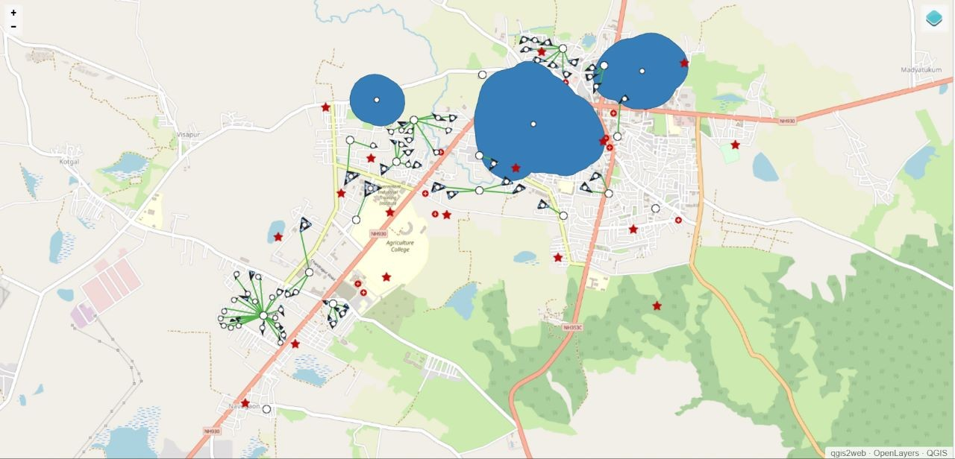
Results hosted on web

Slide 8
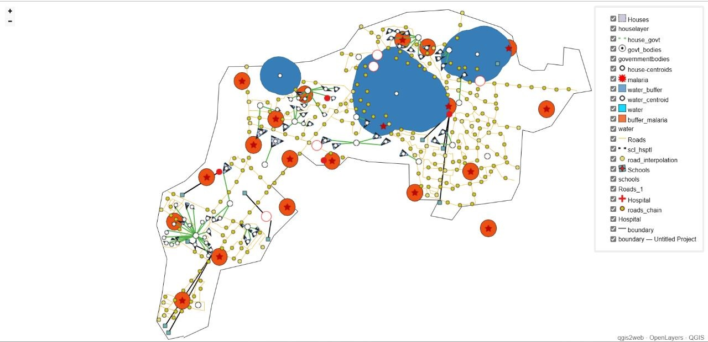
Results when hosted on web

Slide 9
My Contributions
For the layers I have digitized water bodies using google earth
I have generated the dummy data for malaria shape file
Used qgis to display the vector layers
For the analysis, I have found the shortest path between layers and assigned to those nearest layers.
For example, in our project we assigned the houses to nearest government bodies.Similarly,the schools are mapped to nearest hospitals.

Slide 10
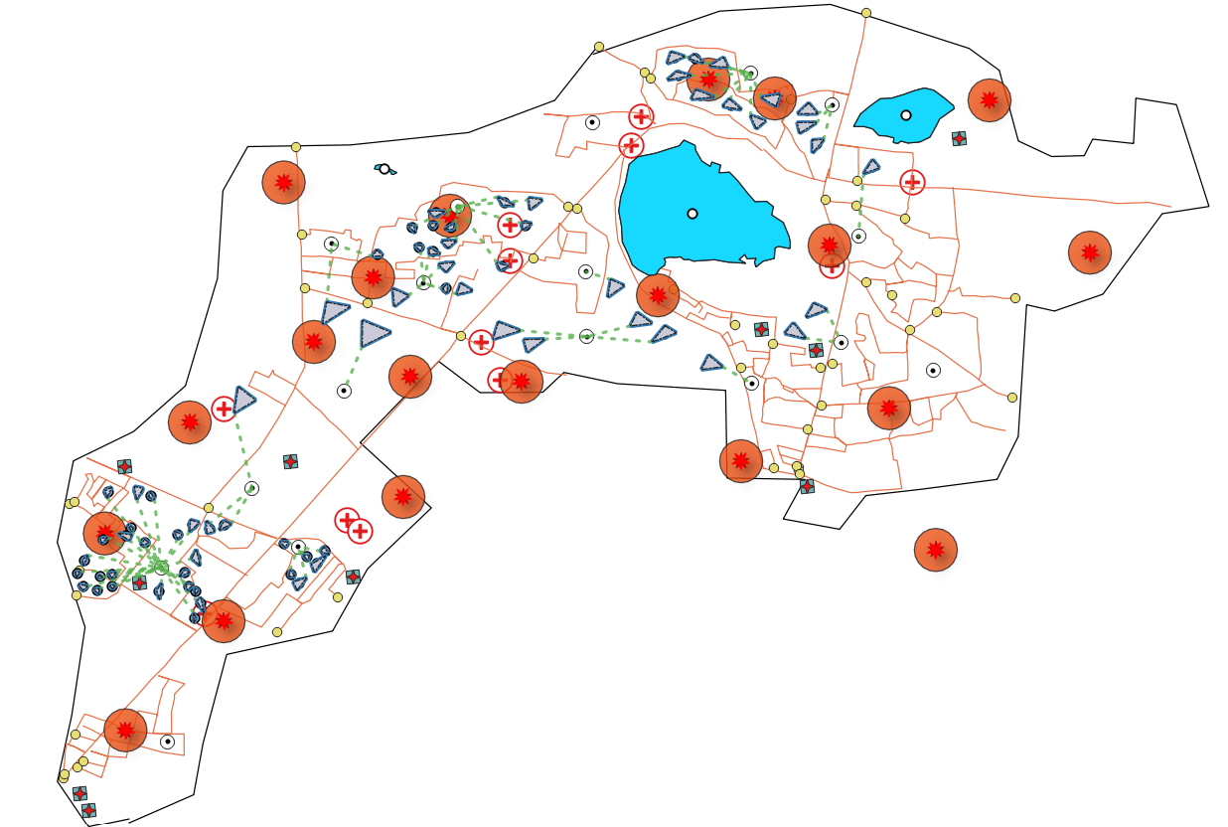
Results when hosted on web
Layers: star symbol represents malaria data points and blue polygon represents waterbodies

Slide 11
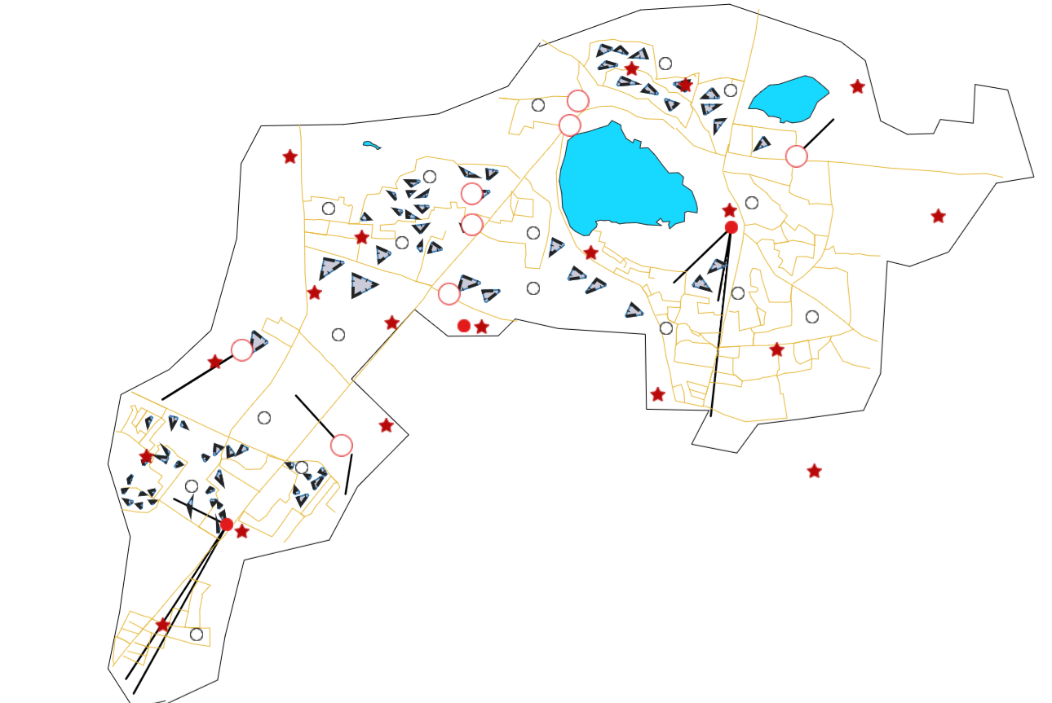
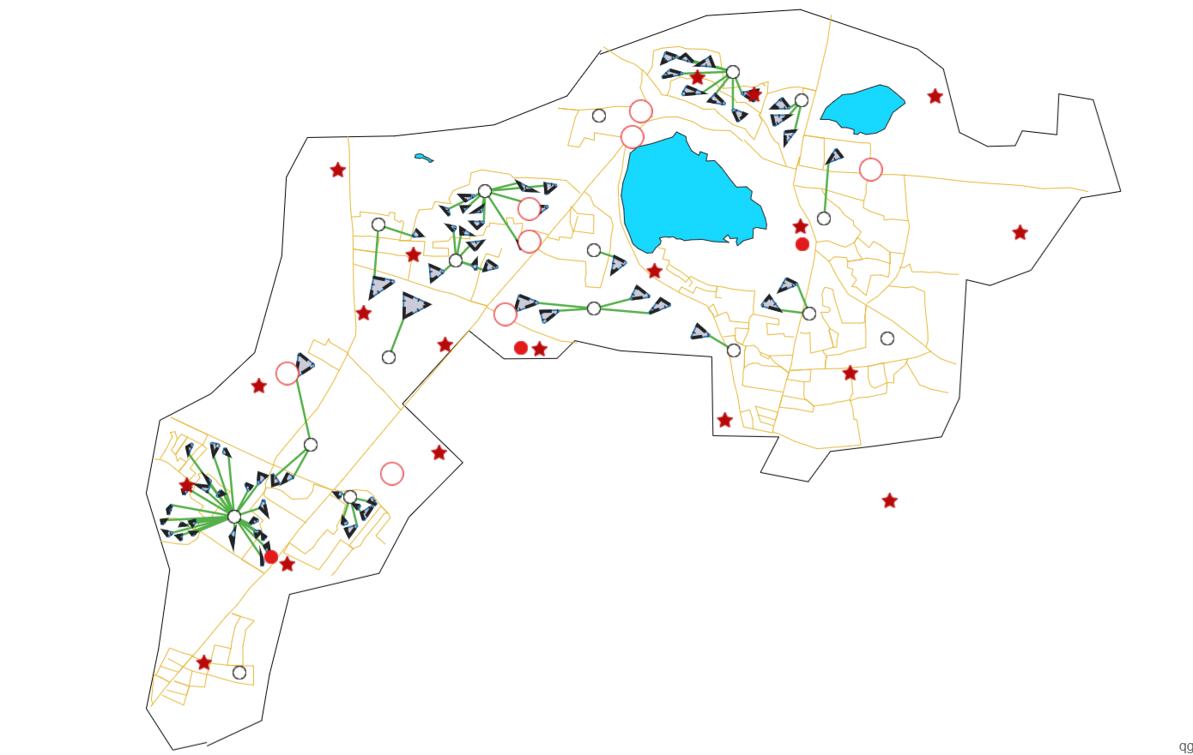
Results when hosted on web
Analysis:

Slide 12

Thank You

