Slide 1
Signaalverwerking en modellering: labosessie [ JLI2AB ]
Emanuele Peschiera, Fan Wu 07/03/2024

Slide 2
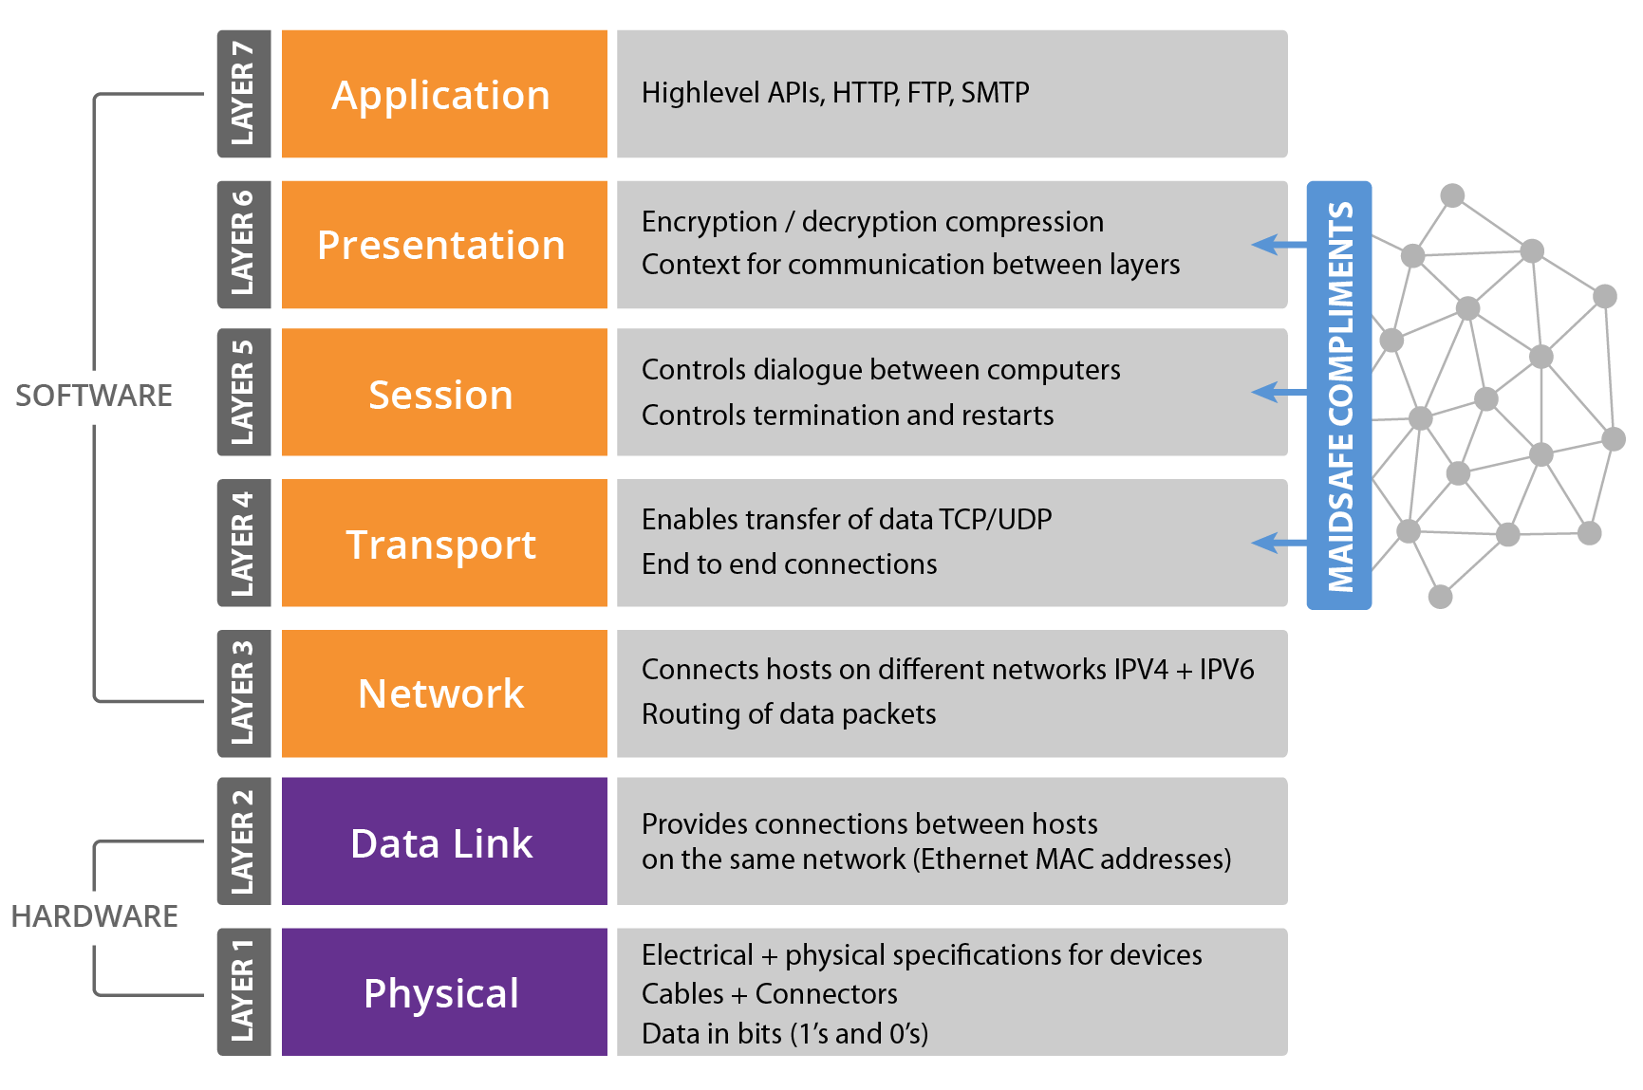
Data communication in the OSI model
Type of communication
E-mail
Encryption and data conversion
Binary representation
Starting/stopping of a session
Ensure receiving a message
Data routing
Packet transmission between neighbouring nodes
Electrical Signals

Slide 3
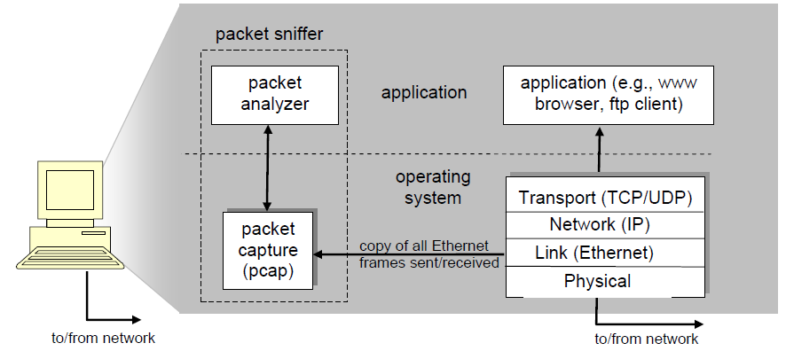
What is Wireshark?

Slide 4
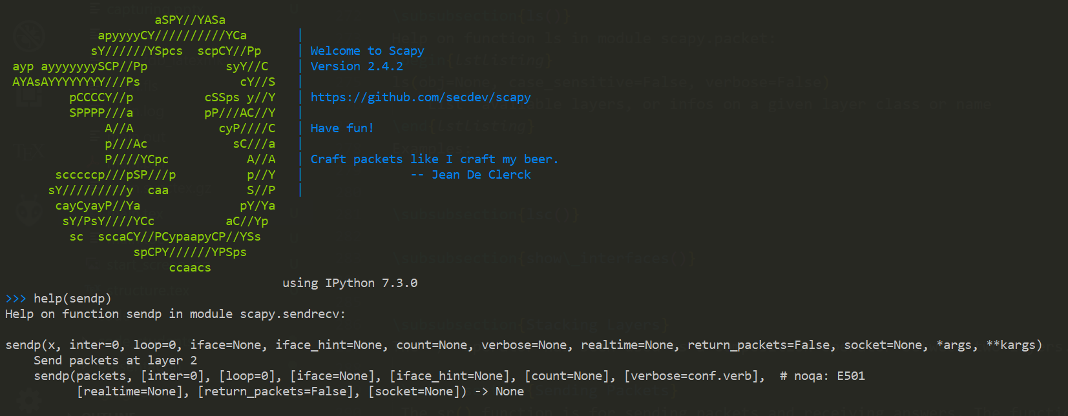

Slide 5
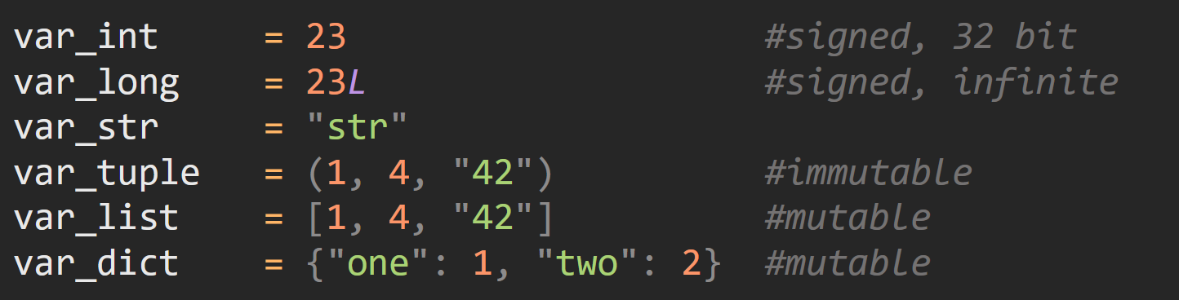

Slide 6
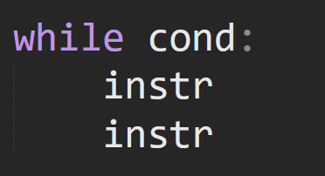
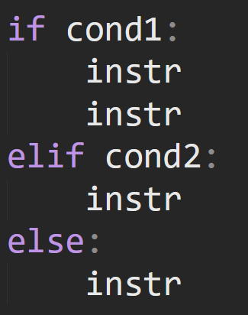
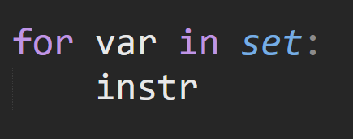
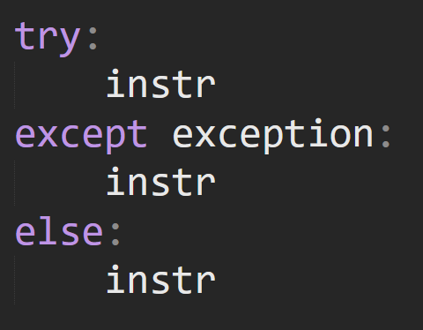
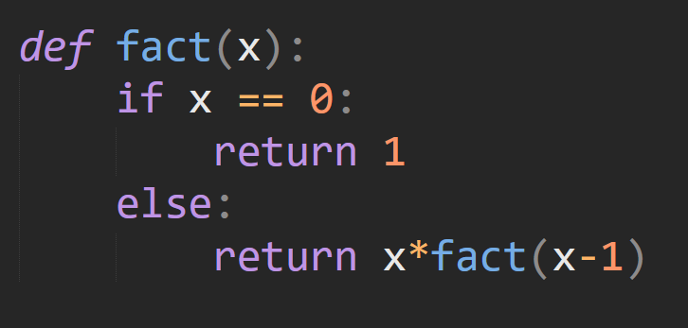

Slide 7
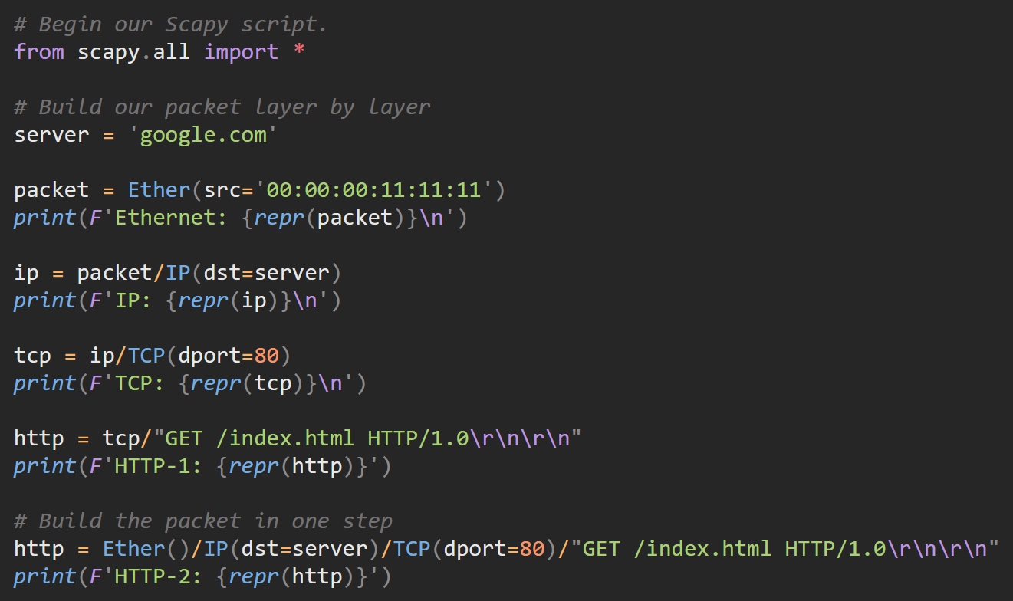

Slide 8
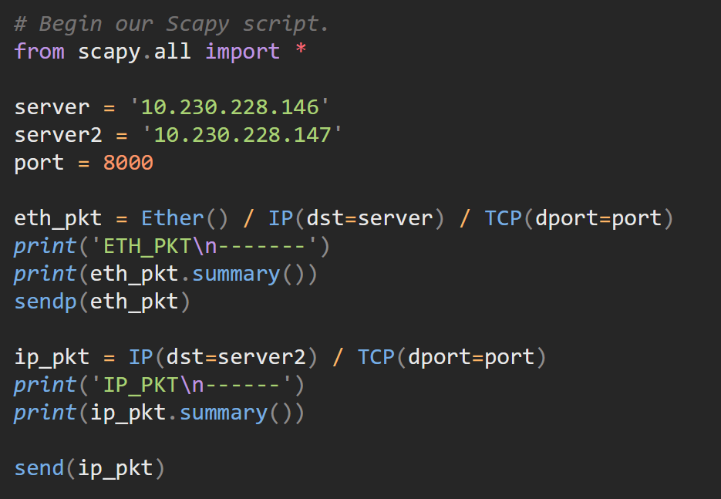
send - Send a layer 3 packet or packet set. Do not wait for an answer.
sendp - Send a layer 2 packet or packet set. Do not wait for an answer

Slide 9
Layer 2 versus layer 3
Type of communication
E-mail
Encryption and data conversion
Binary representation
Starting/stopping of a session
Ensure receiving a message
Data routing
Packet transmission between neighbouring nodes
Electrical Signals

Slide 10
Layer 2 versus layer 3
Type of communication
E-mail
Encryption and data conversion
Binary representation
Starting/stopping of a session
Ensure receiving a message
Data routing
Packet transmission between neighbouring nodes
Electrical Signals

Slide 11
Layer 2 versus layer 3
Type of communication
E-mail
Encryption and data conversion
Binary representation
Starting/stopping of a session
Ensure receiving a message
Data routing
Packet transmission between neighbouring nodes
Electrical Signals

Slide 12
Layer 2 versus layer 3
Type of communication
E-mail
Encryption and data conversion
Binary representation
Starting/stopping of a session
Ensure receiving a message
Data routing
Packet transmission between neighbouring nodes
Electrical Signals

Slide 13
Timeline
Test Lab 1 + Section 4, 5 & 6
1
2
3
Section 1, 2 & 3
Test Lab 2 + Q4

