Slide 1
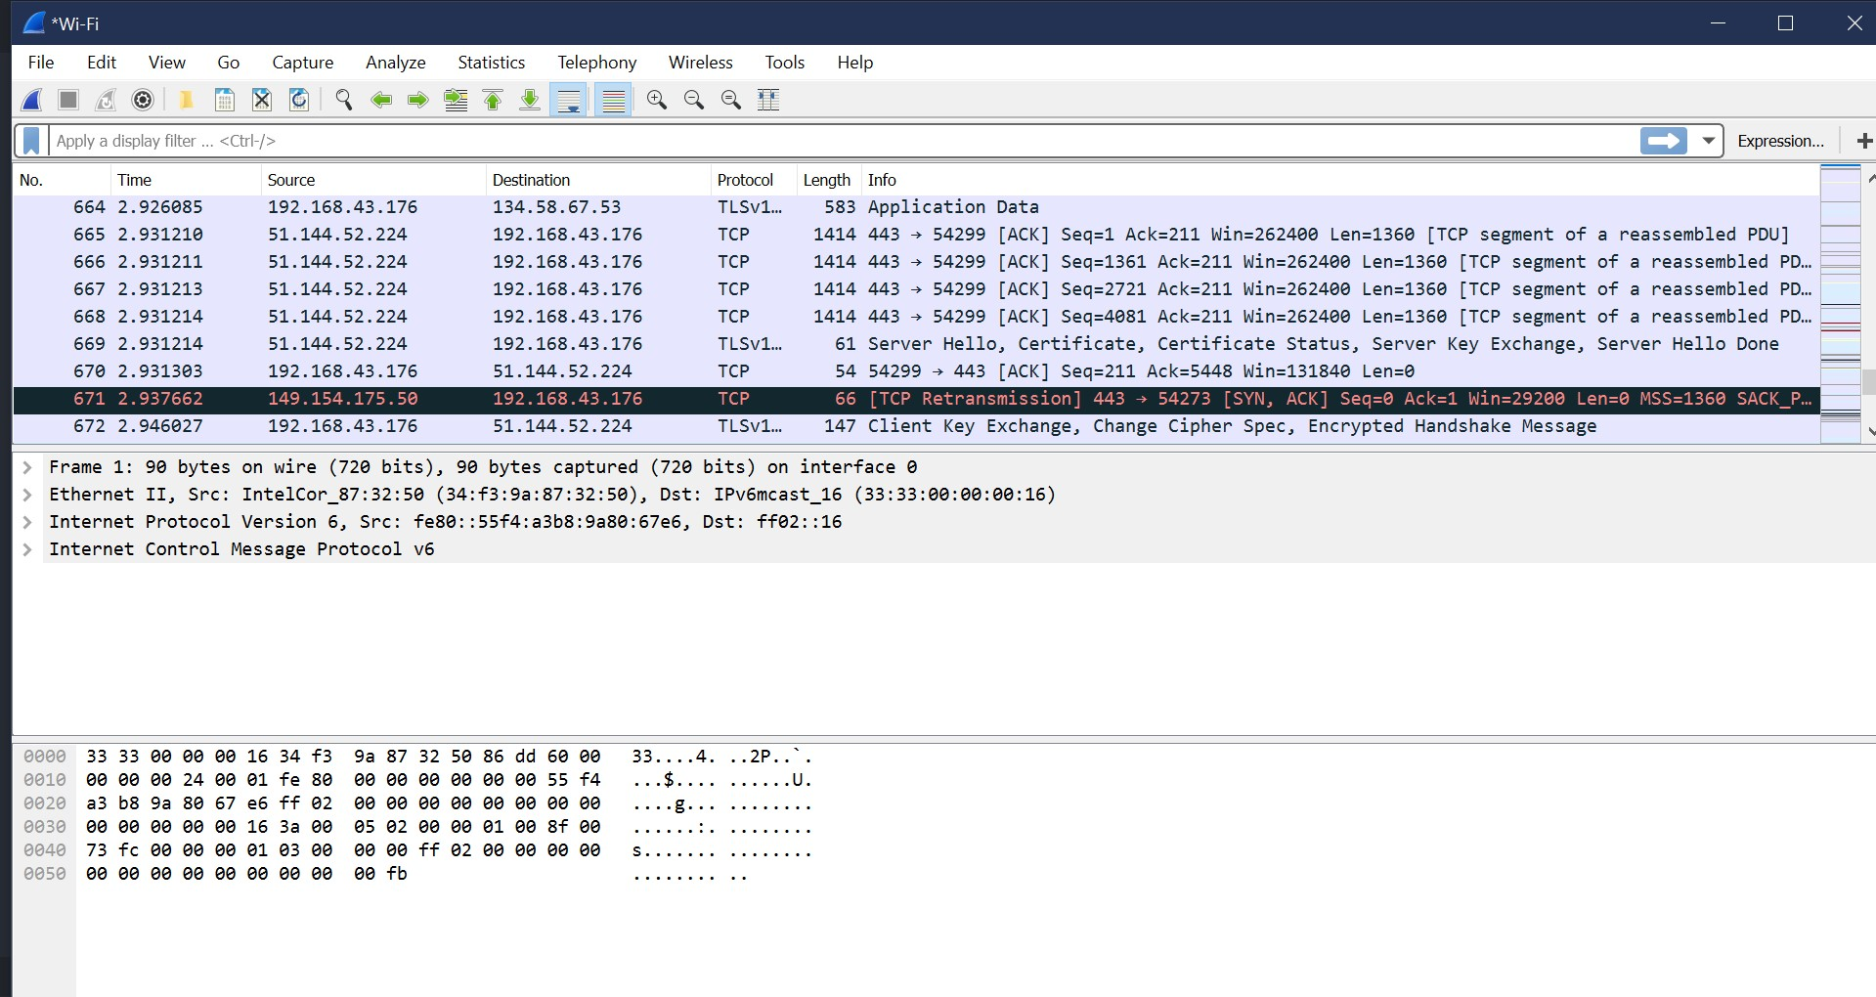
Command
menus
Display filter
specification
Listing of
captured
packets
details of
selected
packet
header
packet content
in hexadecimal
and ASCII

