Slide 1




A small contribution towards understanding genome evolution in Saccharomyces cerevisiae
DUBii 2020
2020/06/24
Gilles FISCHER
----------------------
Sorbonne Université - CNRS
Laboratory of Computational and Quantitative Biology
Etienne Kornobis + Thomas Cokelaer

Slide 2
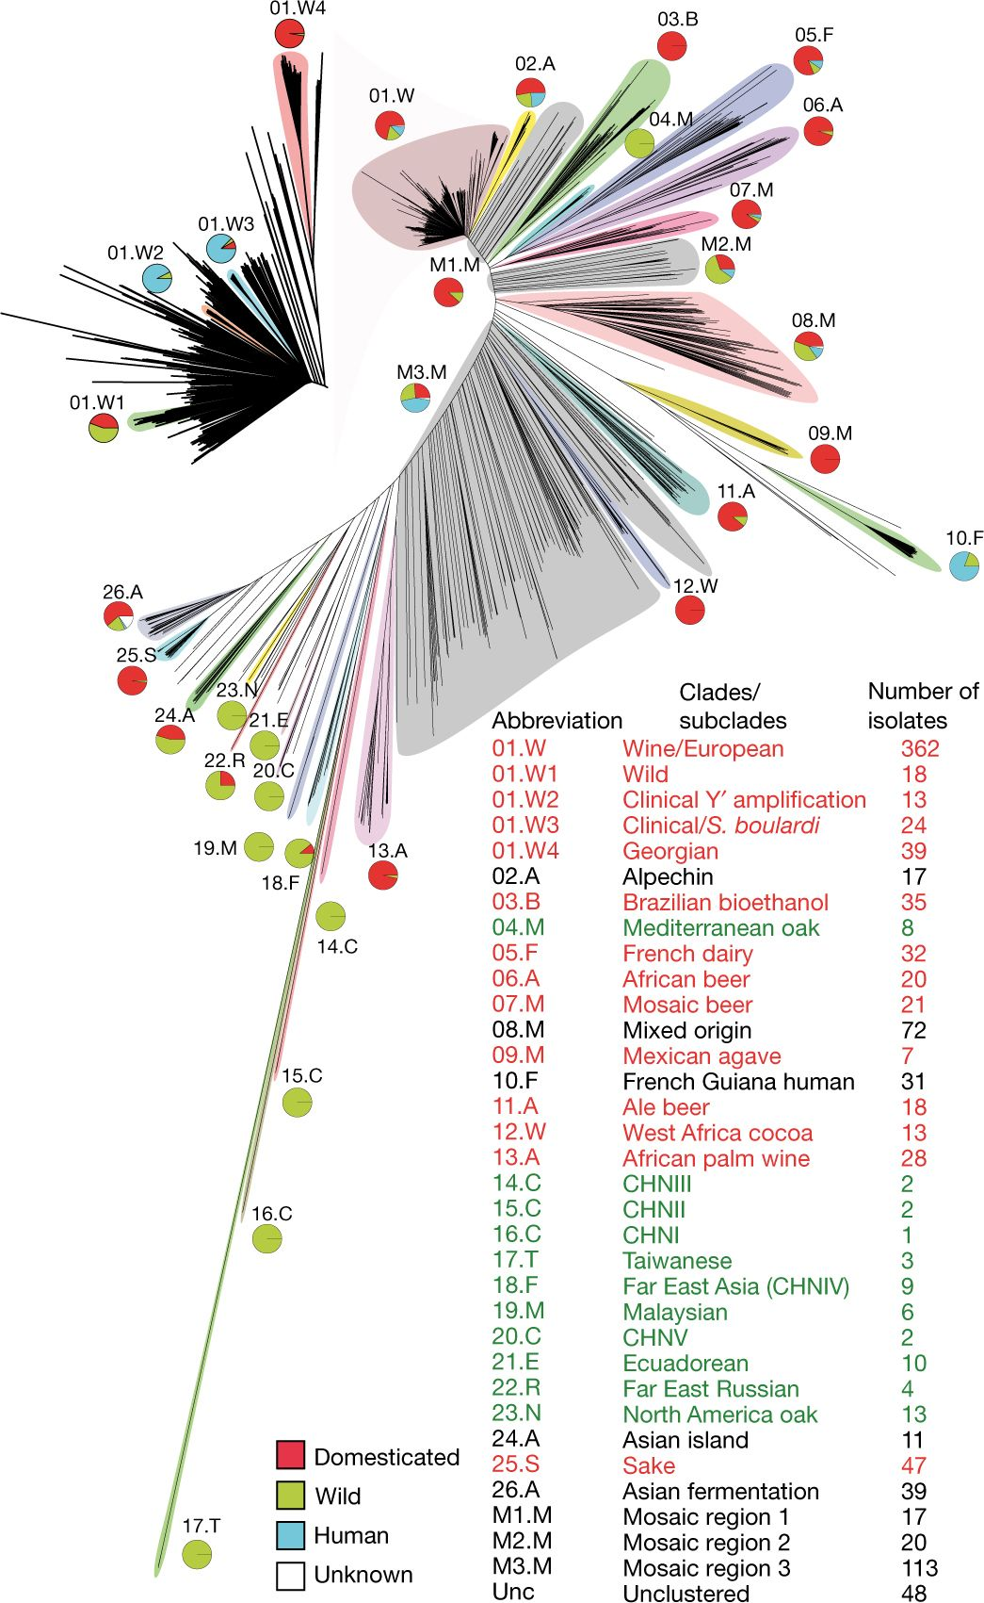

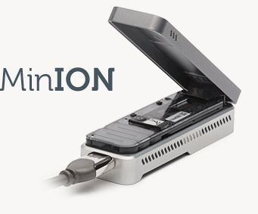
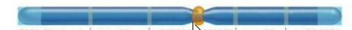

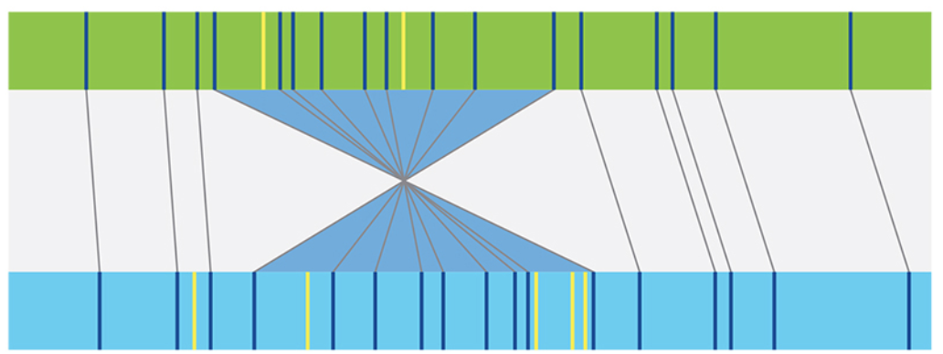
INDIVIDUAL
POPULATION
Saccharomyces cerevisiae
POINT MUTATIONS
12.2 Mb
16 nuclear chromosomes
1 mt DNA
2,323 strains were Illumina sequenced
Combined vcf file (Fanny Pouyet)
=> Comprehensive catalogue 2.8 M SNPs
LARGE-SCALE MUTATIONS
GENETIC DIVERSITY
DMP
INVERSION
PHENOVAR (Fischer, Liti, Schacherer)
Single Nucleotide Polymorphisms: SNPs
Small insertions/deletions: indels
Structural Variations: SVs
99 strains Oxford Nanopore sequencing
TRANSLOCATION
telomere to telomere assemblies
DUPLICATION
MUM&Co (Samuel O’Donnell)
Bioinformatics 2020
=> Comprehensive catalogue of SVs
Evolution of the gene repertoire
DELETION
HGTs, INTROGRESSION, TRANSPOSITION
PHENOTYPIC DIVERSITY
37 available strains => Reference assembly for 136 genomes

Slide 3
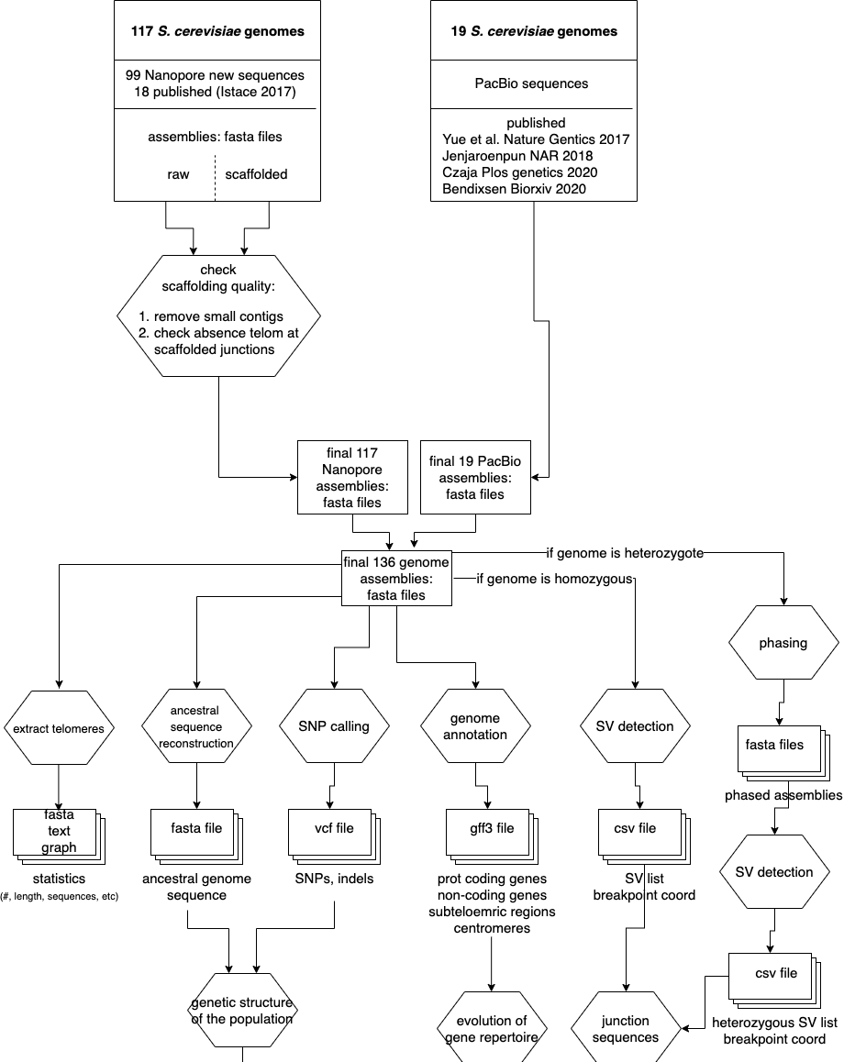
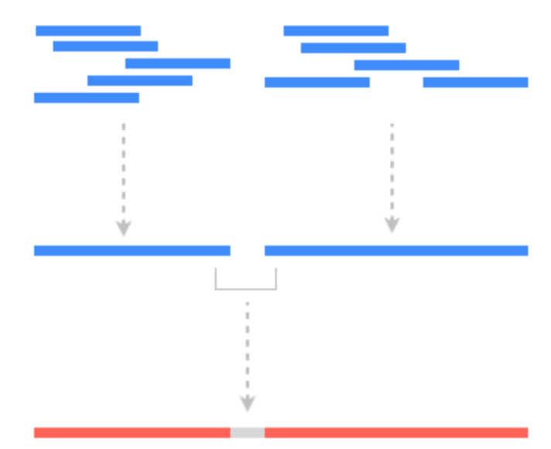
PROJECT
Scaffolding and telomeric sequences
reads
contigs
scaffolds
50 Ns
chromosome
1 – absence of telomere sequence at scaffold junctions:
python script: - input: genome assemblies
- output: a csv file with scaffolding details
- 256 scaffolding events
- 4 cases of scaffolded telomeres in 3 strains
(1 triploid and 2 tetraploids)

Slide 4
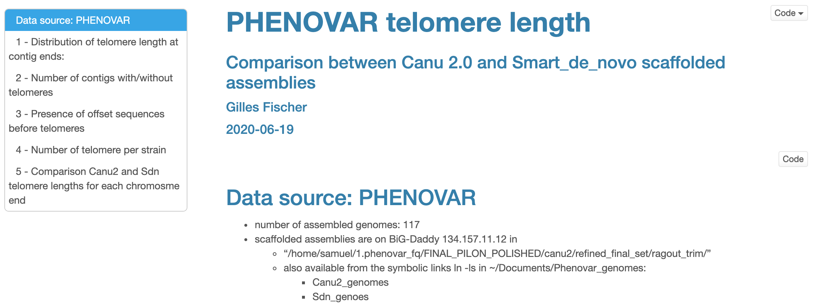
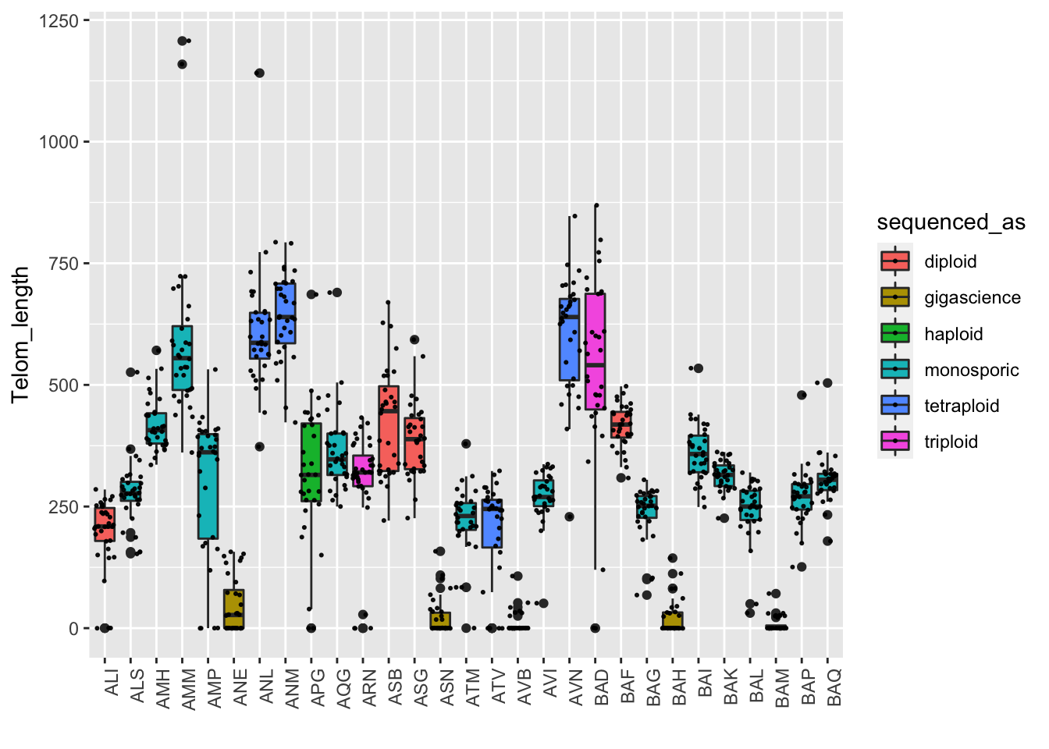
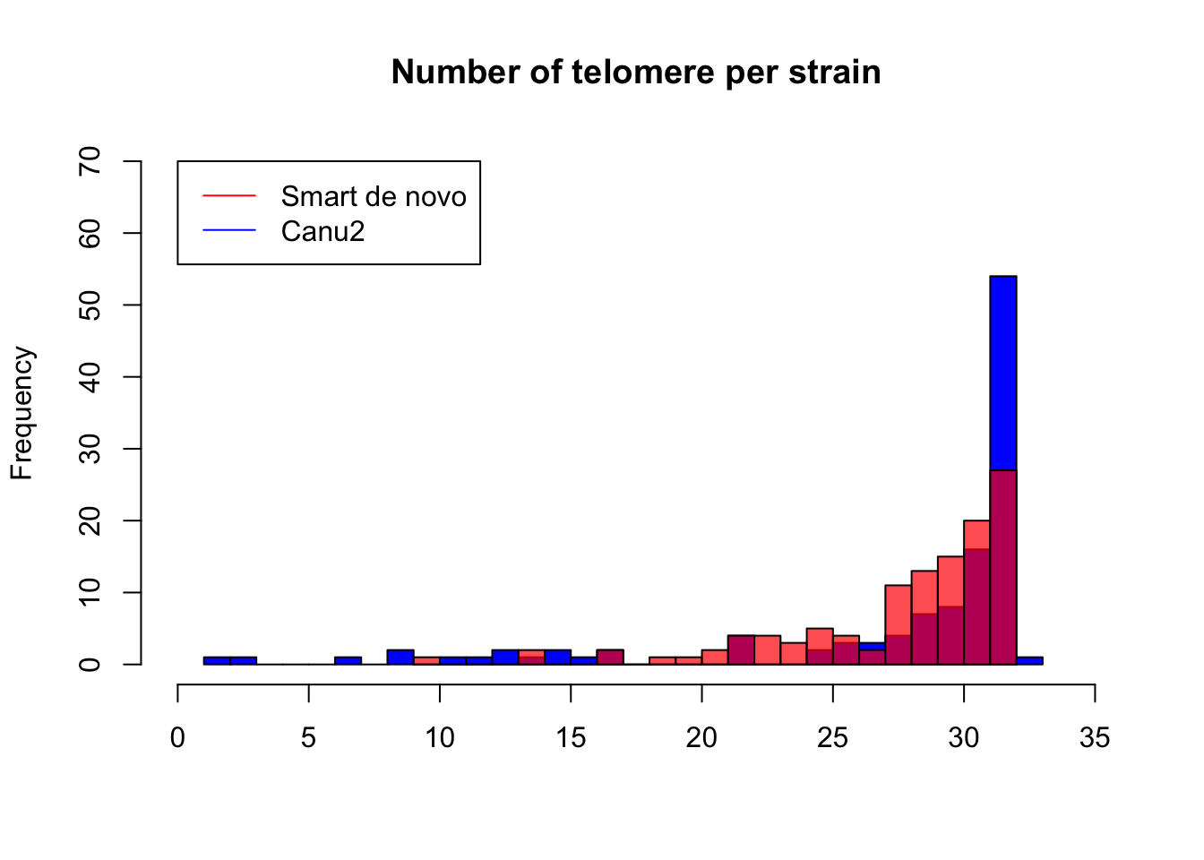
PROJECT
Scaffolding and telomeric sequences
2– presence of telomeres at scaffold ends:
python script + Rmd
Canu 2.0 assemblies are more complete (54 strains with 32 telomere)
Telomere length varies a lot across genomes

Slide 5

PROJECT
Evolution of gene repertoire
3– Complete genome annotation (PanGenome)
4- Compare gene content across strains
5- Reconstruction of gene families evolution
Yue et al.,
Nature Protocols 2018

Slide 6

PROJECT
Evolution of gene repertoire
3– Complete genome annotation (PanGenome)
4- Compare gene content across strains
5- Reconstruction gene families evolution
Evolution of chromosome structure
6– Extract breakpoint sequences
4- Infer mechanisms
5- Impact on gene repertoire evolution
- gene disruption
- novel gene birth
O’Donnell & Fischer
Bioinformatics 2020
Phylogeny of the 136 strains

Slide 7
PROJECT
Scaffolding and telomeric sequences

