Slide 1











SRDD
[$d_{R}$]
$$U_{k}$$
𝑂ₜ
GPD
$$⋯$$
Pauli basis
$$ρ$$
$$θ_{i}$$
$$α_{1}IIIXXI$$
$$θ_{j}$$
𝐻 ≈ ∑ₖ 𝑈ₖ† Λₖ 𝑈ₖ
$$⋯$$
$$H$$
$$α_{2}IXYYIZ$$
$$k∼p_{k}$$
$$α_{3}ZYYXXY$$
$$⋯$$
0
1
2
3
…
$$L$$

Slide 2
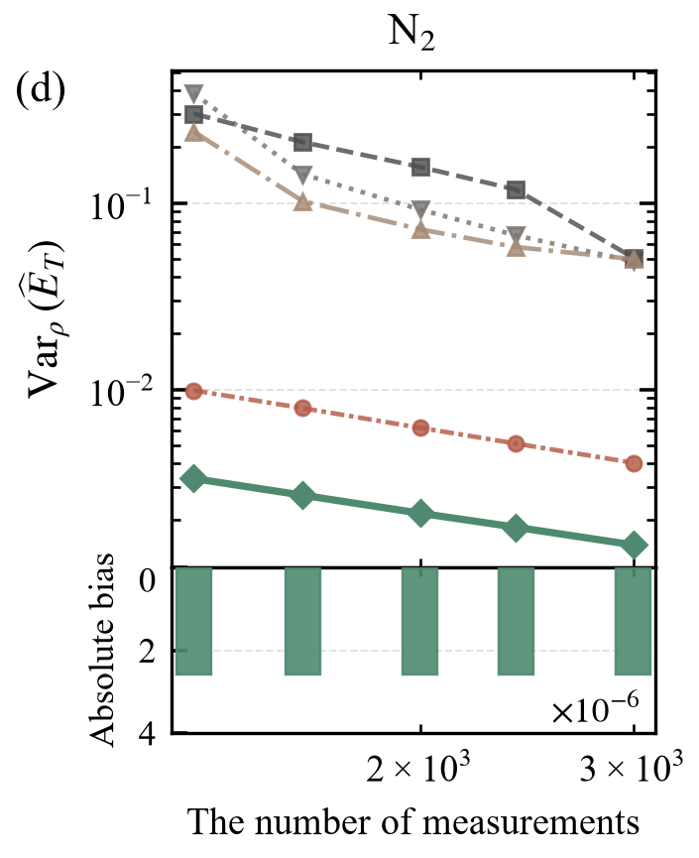
SRDD
[$d_{R}$]
𝑂ₜ
Pauli basis
GPD
$$α_{1}IIIXXI$$
$$H$$
$$α_{2}IXYYIZ$$
$$α_{3}ZYYXXY$$
𝐻 ≈ ∑ₖ 𝑈ₖ† Λₖ 𝑈ₖ

Slide 3






SRDD
$$t=t+1$$
[$d_{R}$]
$$U_{k}$$
$$Z$$
𝑂ₜ
Yes
GPD
$$⋯$$
$$b$$
Pauli basis
$$t=1$$
$$ρ$$
$$θ_{i}$$
$$t<T$$
No
$$α_{1}IIIXXI$$
$$θ_{j}$$
Est
𝐻 ≈ ∑ₖ 𝑈ₖ† Λₖ 𝑈ₖ
$$⋯$$
$$v=MedianOfMeans(v_{1},…, v_{T})$$
$$H$$
$$α_{2}IXYYIZ$$
$$k∼p_{k}$$
$$v_{t}=\frac{Λ_{k}\left(b\right)}{p_{k}}$$
$$α_{3}ZYYXXY$$
$$⋯$$
0
1
2
3
…
$$L$$

