Slide 1
To do list: 1. template for ppt 2. btw graph?? 3.

Slide 2
Intro

Slide 3
Problem setup

Slide 4
Data processing
Raw Data (Nodes : 37699)
If somebody loves reading, then he/she would have a tag. We first filter out those who love reading, and then extract their connections
(p1, p2) → edges
Common Interest: Reading
(Nodes : 9739)

Slide 5
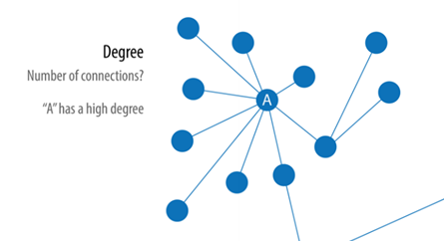
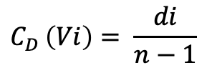
Degree Centrality
The number of a node's links to and from other nodes.
$$C_{D }\left(Vi\right)= \frac{di}{n−1}$$
CD(v) = deg(v) / (n - 1), where "CD(v)" represents the degree centrality of node "v", "deg(v)" is the number of connections (degree) of node "v", and "n”.
High 代表意義？
適用場合

Slide 6
Use deg centrality – output
Table (list top 10)
Heatmap?
選幾個點zoom-in？
Raw Data (Nodes : 37699)
Common Interest: Reading
(Nodes : 9739)
Degree Centrality
(Nodes : 200)

Slide 7
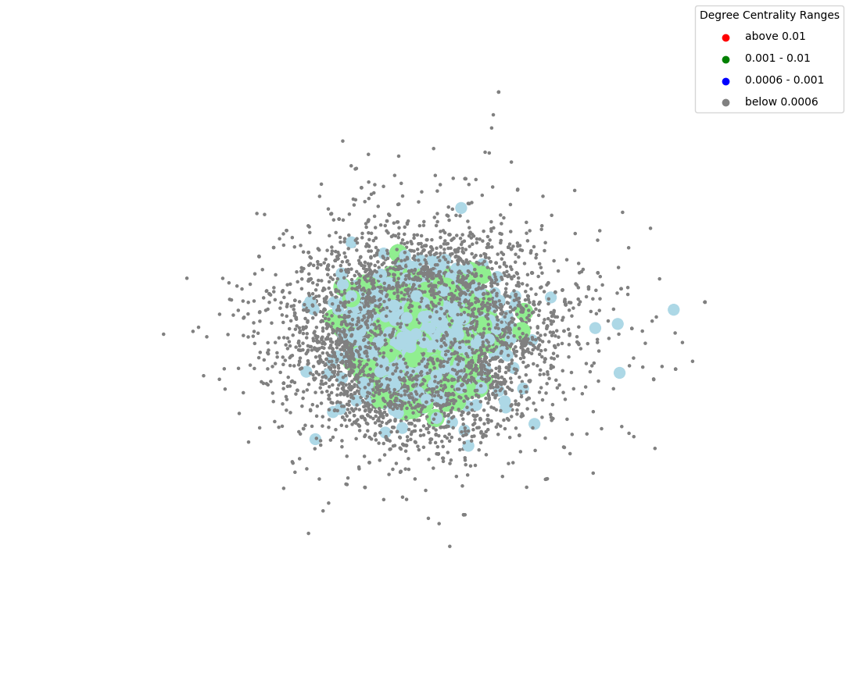
再調整，將紅點放在上面
Or
Only plot top 200 nodes?

Slide 8
Random pick up 10 people to count shortest path
關注者數分佈
Id | Avg shortest path from id
1
2
…
10

Slide 9
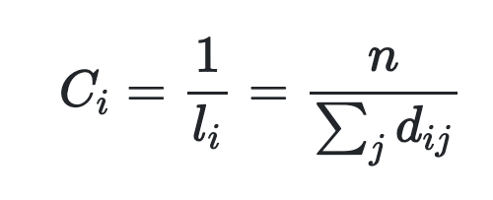
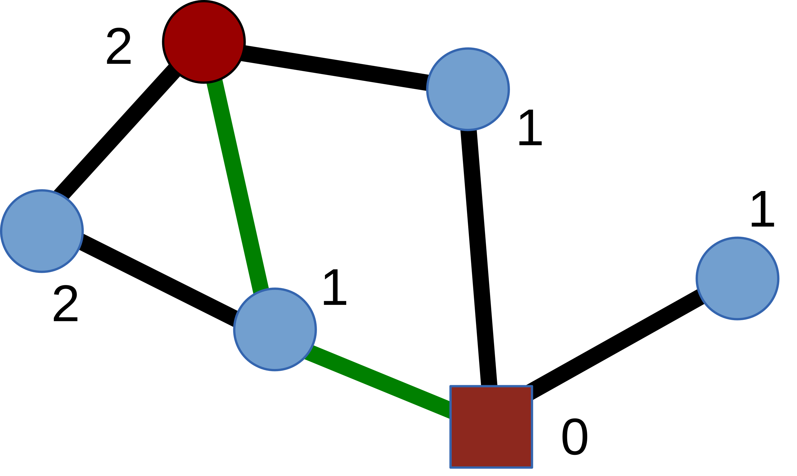
Closeness Centrality
The reciprocal of the sum of the length of the shortest paths between the node and all other nodes in the graph.
Let dij be the length of the shortest path between nodes i and j, the average distance li

Slide 10
 | ID | Closeness Centrality
1 | 29023 | 0.5653409090909091
2 | 16631 | 0.5407608695652174
3 | 20193 | 0.5335120643431636
4 | 6149 | 0.5306666666666666
5 | 14954 | 0.5223097112860893
… | … | …
50

Slide 11
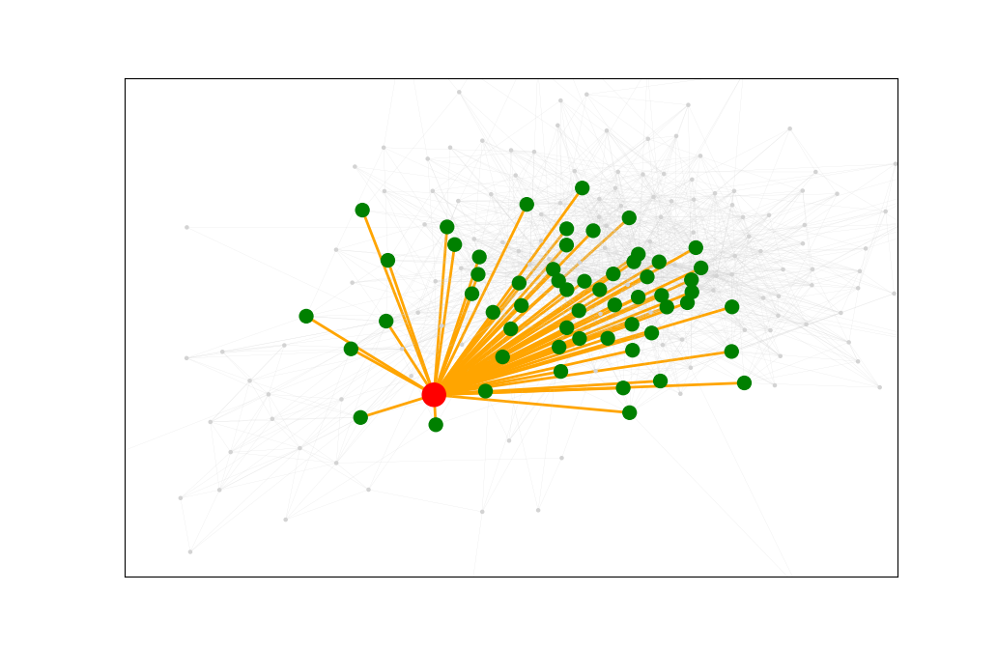
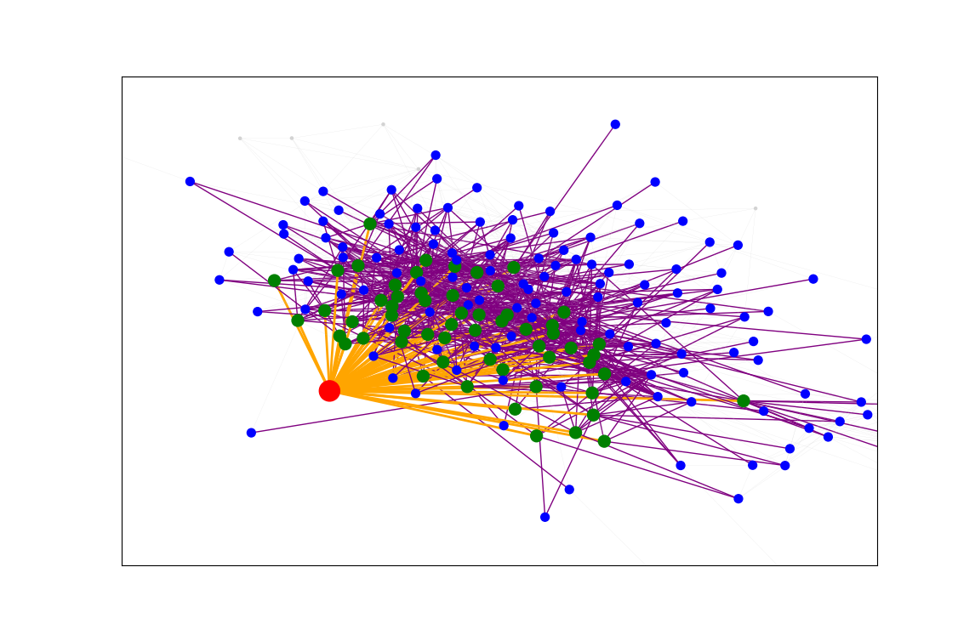
Use closeness centrality – output
Table (list top 10)
Shortest path graph (highest vs a node with low closeness centrality) ?
Choose 3 random ID from 10 people we previosuly chose

Slide 12
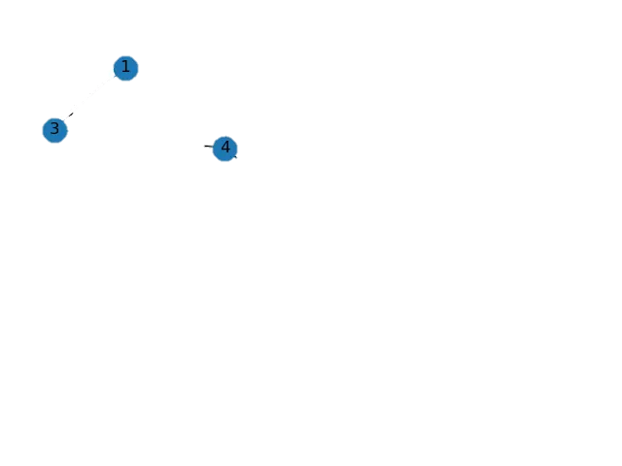
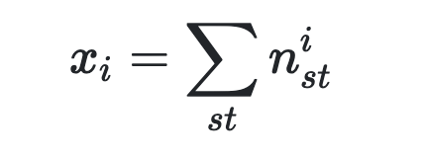
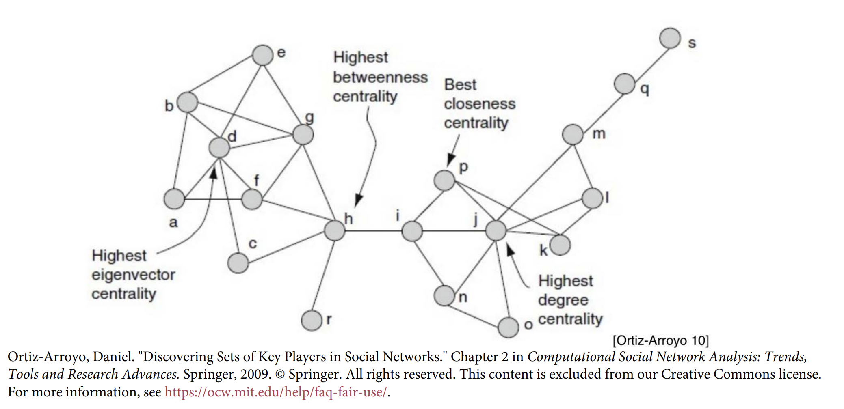
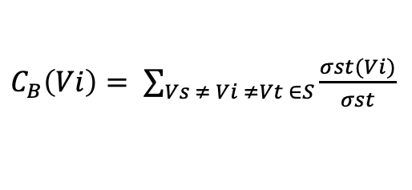
Betweenness Centrality
It is determined as how often the shortest path between two other nodes in the network.
$C_{B}\left(Vi\right)= \sum_{Vs ≠ Vi ≠Vt ∈S}{\frac{σst(Vi)}{σst}}$
For starting node s, destination node t and the input node ii that holds s≠t≠i, let n^{i}_{st} be 1 if node i lies on the shortest path between s and t; and 0 if not.

Slide 13
floyld

Slide 14
Use closeness centrality – output
Table (list top 10)
Graph???
標示出source_node在圖中位置 & 不同clusters，希望表達出 source_node可以連接不同 clusters？

