Slide 1
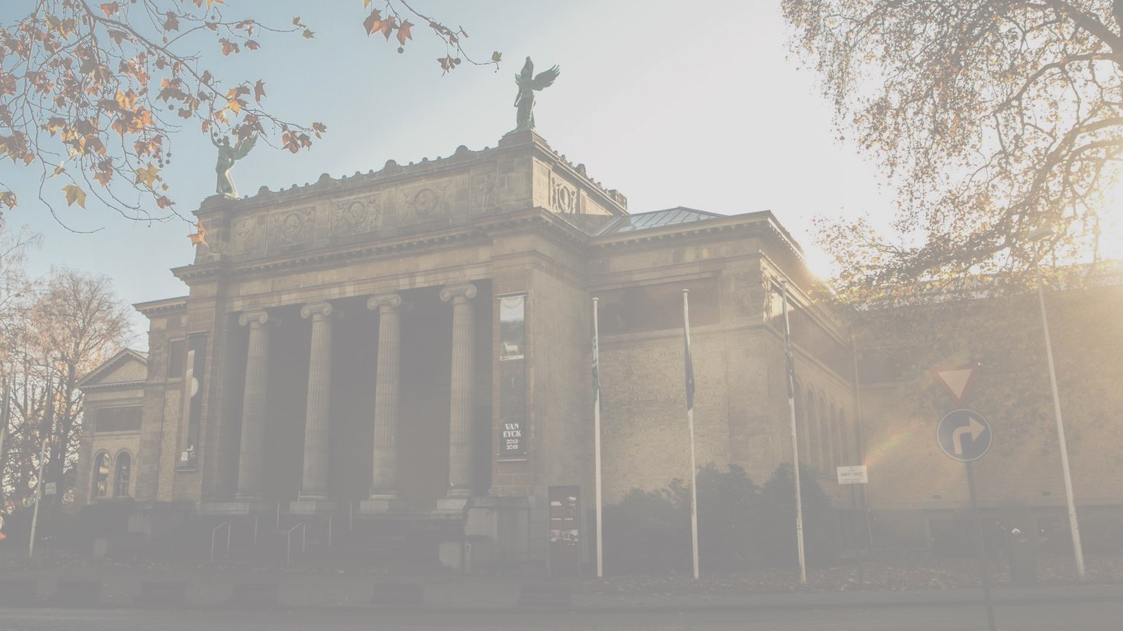
An approach for continuous painting detection and room prediction
Thomas Aelbrecht | Andreas De Witte | Jochen Laroy | Pieter-Jan Philips | Gillis Werrebrouck
Source: https://visit.gent.be/nl/zien-doen/museum-voor-schone-kunsten-msk

Slide 2
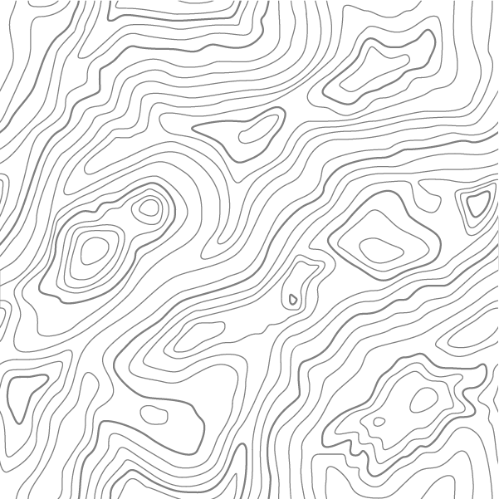
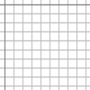


Content
DETECTION
MATCHING
HIDDEN
MARCOV
MODEL
DEMO
02/06/2020

Slide 3
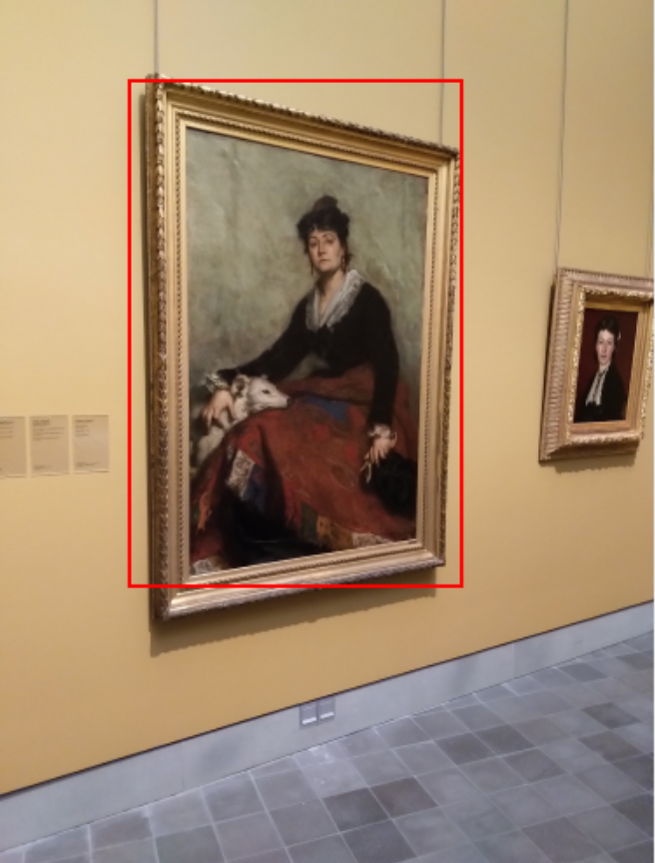
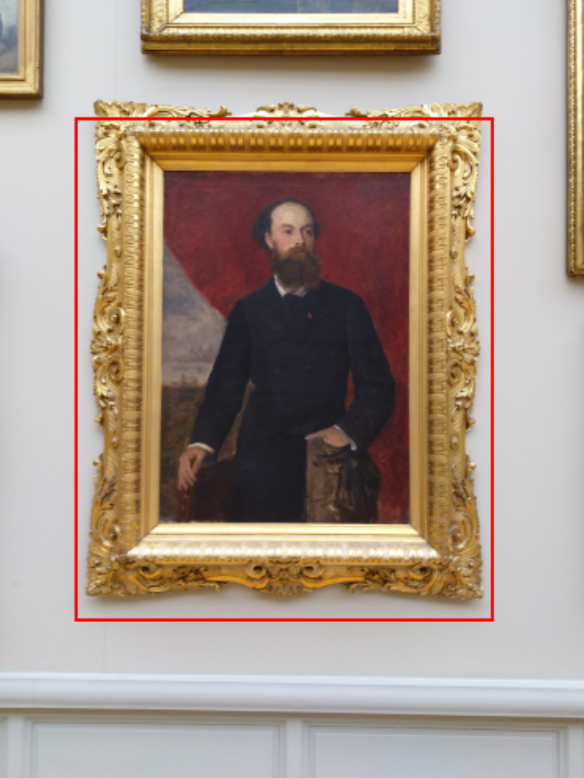
Detection
Semi-supervised algorithm
02/06/2020
Notes:
Algoritme:
verkleinen - vergroten
naar grijswaarden
dilate (kernel 21x21)
erode (kernel 21x21)
median blur
Canny
dilate (kernel 9x9)
contours zoeken
enkel contours met ratio 1:10 overhouden (horizontaal & verticaal)

Slide 4

Detection
Mean shift segmentation filter
Unsupervised algorithm
Flood fill (keep largest mask)
Invert + erode
Median blur
Canny (with Otsu treshold)
Close lines
Find contours
02/06/2020

Slide 5
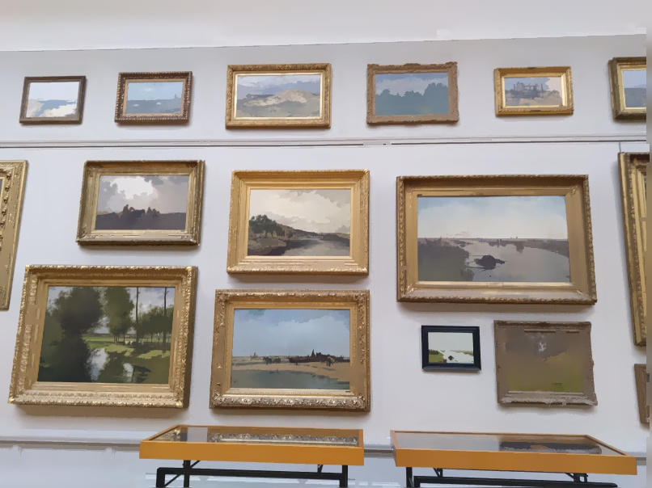
1
mean shift segmentation filtering
02/06/2020

Slide 6
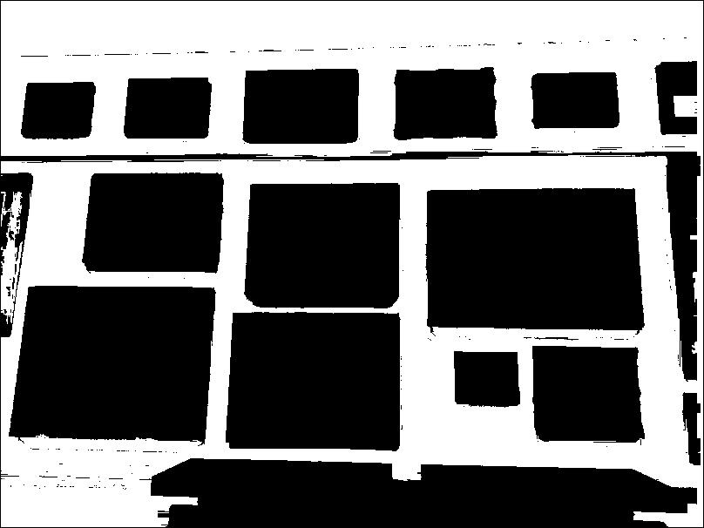
2
flood fill
02/06/2020

Slide 7

3
invert + erode
02/06/2020

Slide 8

4, 5 & 6
median blur, Canny & close lines
02/06/2020

Slide 9
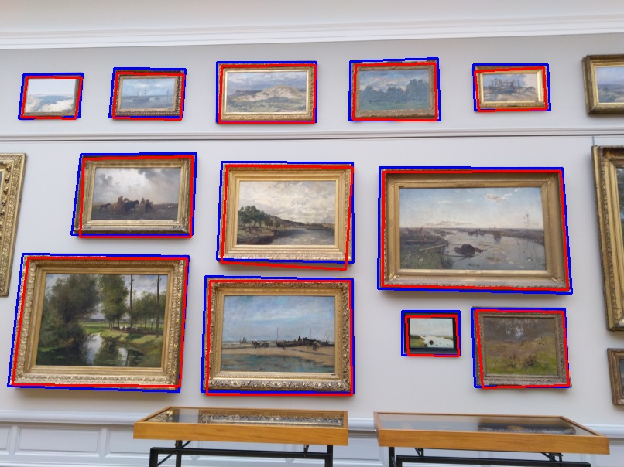
7
find contours
02/06/2020

Slide 10
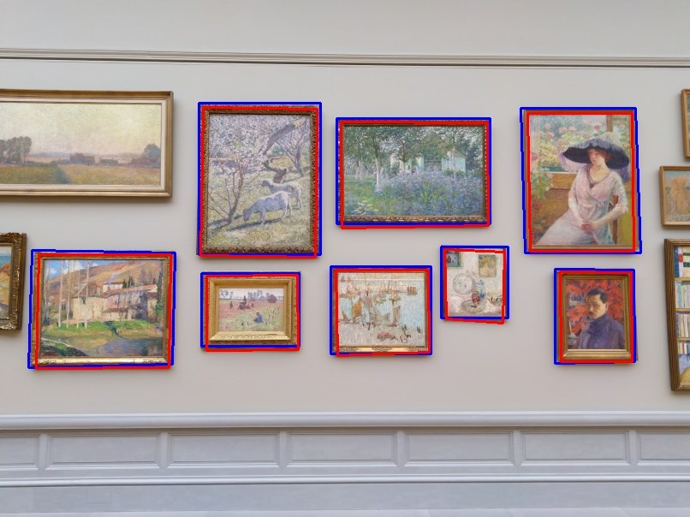
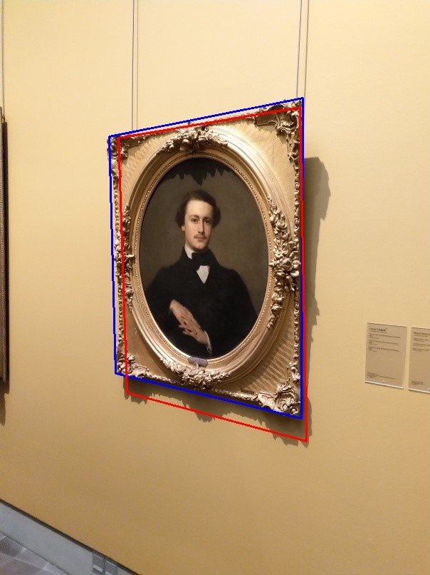
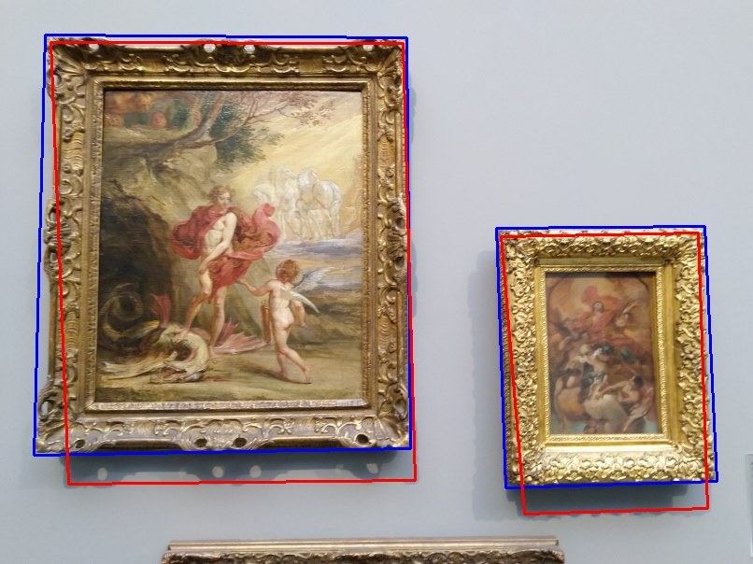
samples
02/06/2020

Slide 11
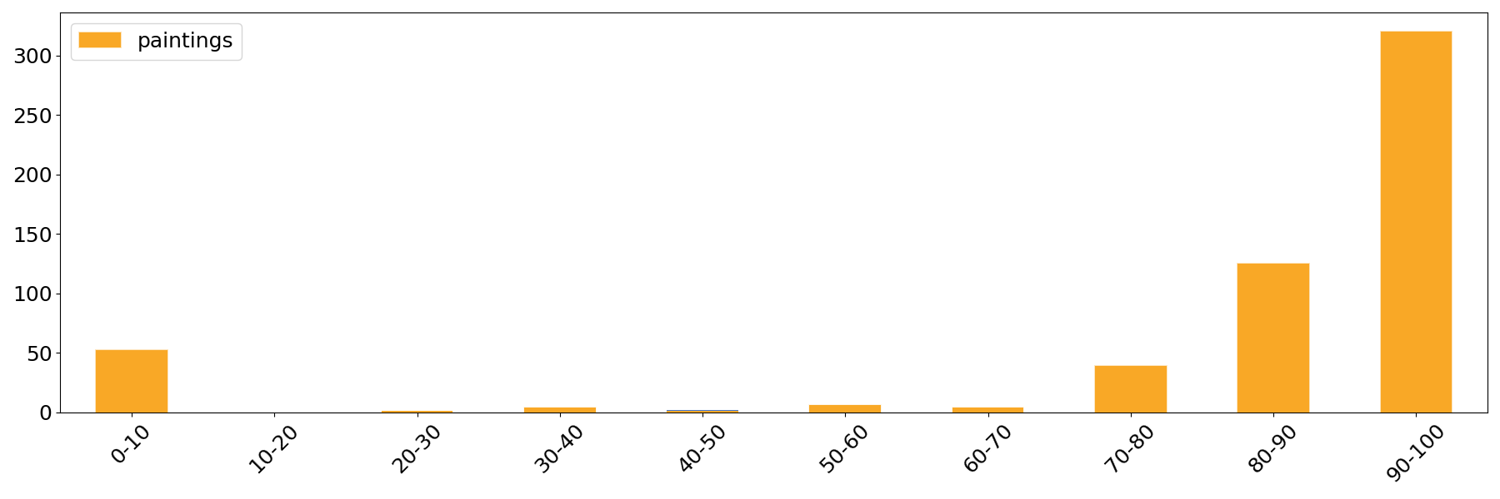
detection
Detection accuracy ranges for the dataset
02/06/2020

Slide 12
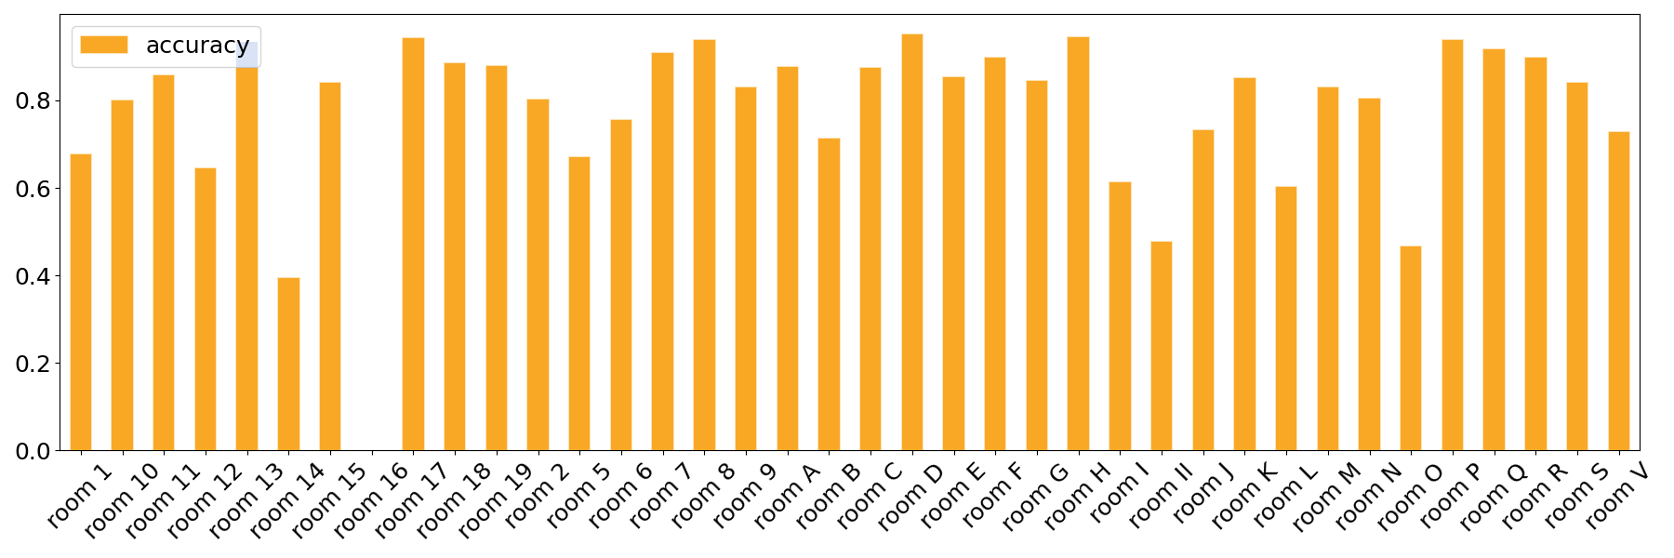
Detection
Average room detection accuracy
02/06/2020

Slide 13
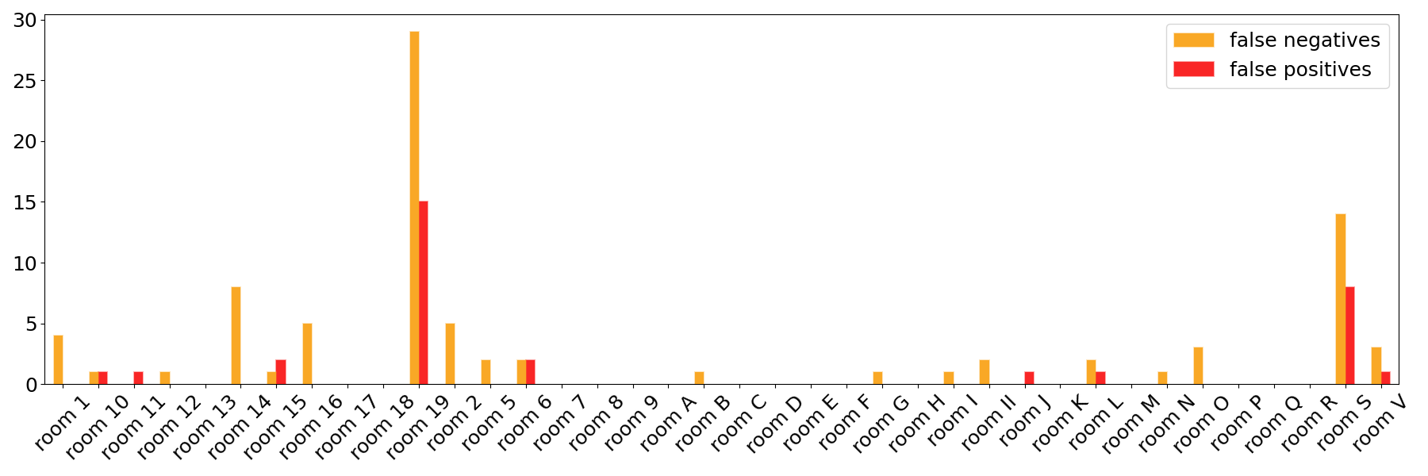
Detection
False negatives and false positives per room
02/06/2020

Slide 14

Matching
ORB
Line segments
Ideas
Histograms
(block & full image)
Local Binary Patterns
02/06/2020

Slide 15
Matching
Final choice
Full image
Image devided in 16 blocks
Image’s LBP
Based on histograms of:
02/06/2020

Slide 16
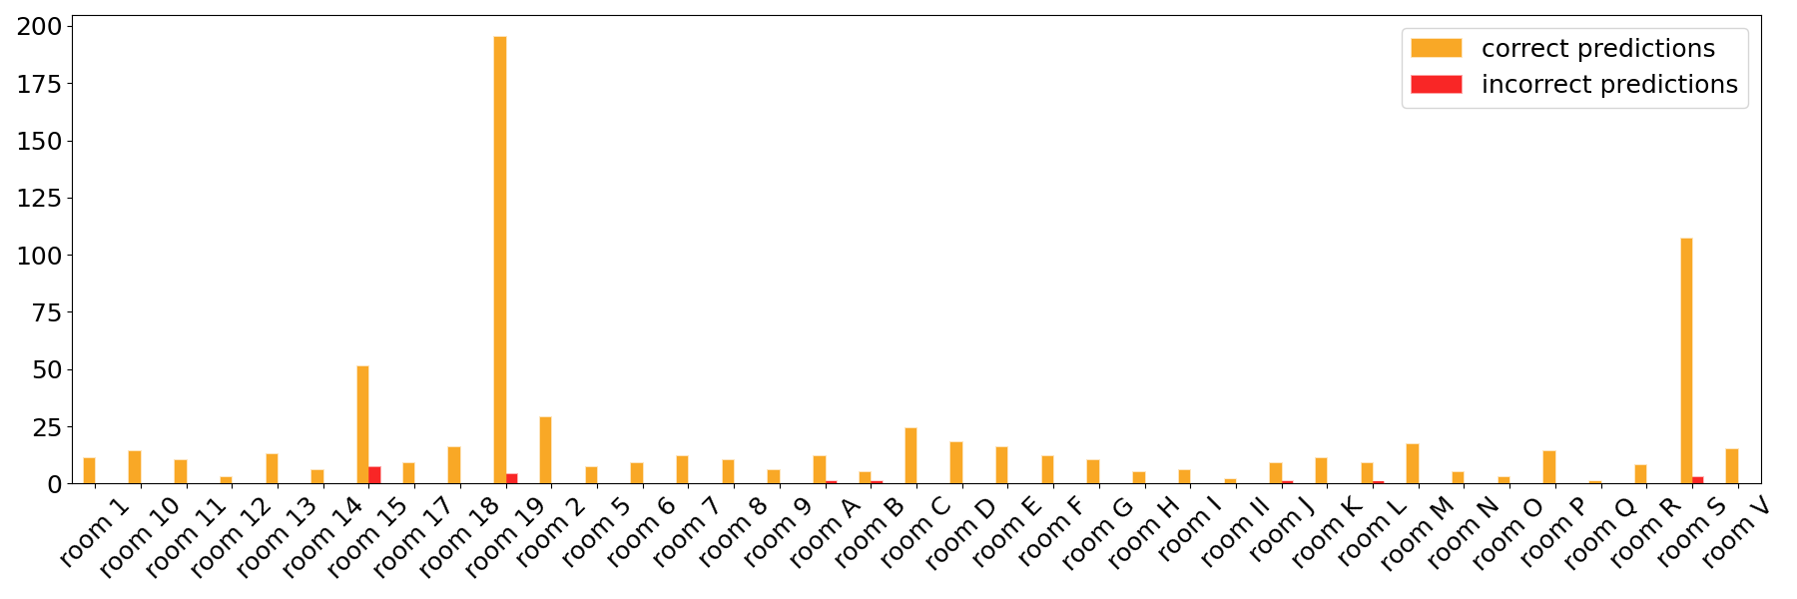
Matching
Correct and incorrect painting predictions per room
02/06/2020

Slide 17


Hidden Markov Model
[ “19” , 0.456 ]
[ “3” , 0.061 ]
[ “19” , 0.320 ]
[ “J” , 0.106 ]
[ ROOM : “19” ]
HIDDEN MARKOV
[ “19” , 0.764 ]
02/06/2020

Slide 18

DEMO
02/06/2020

