Slide 1

HBase Conceptual Architecture
Software-Group

Slide 2
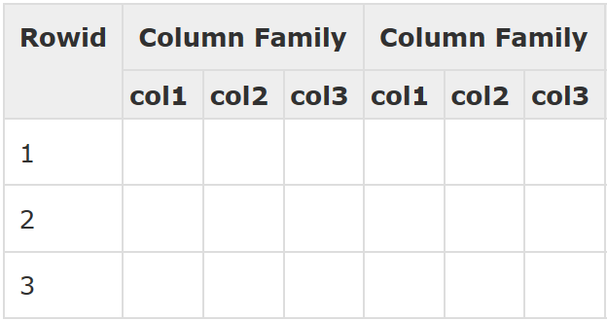
What is HBase
Open source Column-oriented distributed database management system that runs on top of Hadoop Distributed File System (HDFS).
Modelled after Google’s BigTable
NoSQL Database (Semi- Structured)
Data is stored in tables sorted by rows
Row is a collection of column families.
Column family is a collection of columns.
Column is a collection of key value pairs.

Slide 3
Need for HBase
Apache Hadoop has gained popularity in the big data space.
Can’t handle high velocity of random reads and writes
Does not support fast individual record lookups.
Only sequential access of data
HBase is built on top of Hadoop to overcome the drawbacks of HDFS.
Allow fast random read and writes
Provide fast lookups for large tables
Internally use Hash tables and provide random access.

Slide 4
When to use HBase
Automatic failure support
Consistent read and writes
Need to Serve large amount of data
Need to write heavy applications
Need to provide fast random access
Perfect for High-scale, real-time applications
Fault tolerant, fast and usable data management
Adapted by Facebook, Twitter, Yahoo, Pinterest , Adobe etc.
Easy java API for clients
Data replication across clusters.

Slide 5
History of HBase
Year | Event
Feb 2007 | Initial HBase prototype was created as a Hadoop contribution
Oct 2007 | The first usable HBase along with Hadoop 0.15.0 was released.
Jan 2008 | HBase became the sub project of Hadoop.
Oct 2008 | HBase 0.18.1 was released.
Jan 2009 | HBase 0.19.0 was released.
Sept 2009 | HBase 0.20.0 was released.
May 2010 | HBase became Apache top-level project.
https://www.tutorialspoint.com/hbase/hbase_overview.htm

Slide 6
Components and Interactions

Slide 7
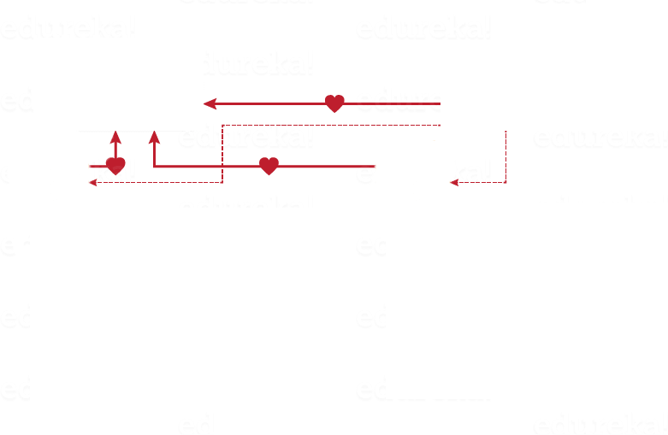


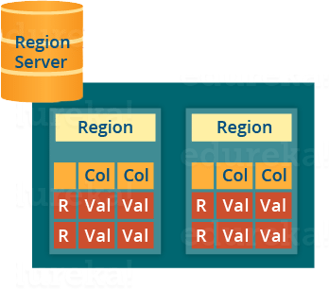
Components

Slide 8
Region Servers
Communicate with the client
Handle, manage, execute data-related operations
Decide the size of the region
Regions tables that are split up
Multiple regions reside
Hbase Cluster can have multiple Region servers

Slide 9
HMaster
Assign Regions on startup for recovery or load balancing
Monitors all Region Server instances
Performs suitable recovery actions
Acts as an interface for creating, deleting and updating tables in HBase.
Hbase cluster has Multiple HMaster
Active and inactive HMaster

Slide 10
Zookeeper
Establishing client communication with region servers.
Tracking server failure and network partitions.
Maintain Configuration Information
Provides ephemeral nodes, which represent different region servers.

Slide 11
Zookeeper
Every Region Server and HMaster Server sends continuous heartbeat at regular interval
Checks which server is alive and available
Provides server failure notifications
Active HMaster sends heartbeats to the Zookeeper while the inactive HMaster listens for the notification
Notify listeners when server fails to send a heartbeat

Slide 12
Architecture Types

Slide 13
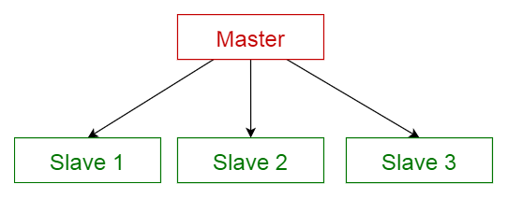
Master-Slave Architectural Style
Hadoop runs on Master slave architecture
HMaster is the master responsible for monitoring, assignment, Region Server failover, etc.
Region Server is the slave. It’s responsibilities include serving and managing the regions

Slide 14
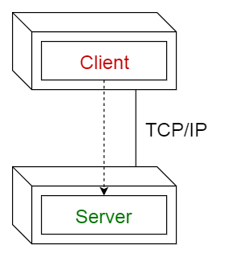
Client-Server Architectural Style
The client in this architecture style is the user communicating with the server. This is a thick client.
The server here is the HBase server
The connector is the network the client and the server communicate through.

Slide 15
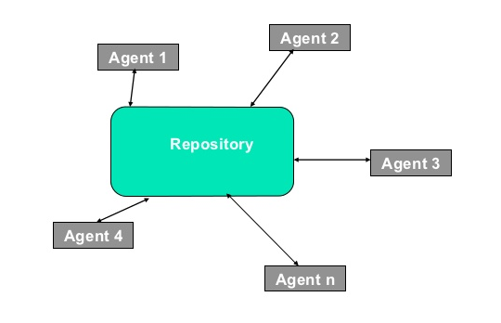
Repository Architectural Style
HMaster is the central body that augments and maintains the complex body of information.
HMaster works mostly with the Region servers.

Slide 16
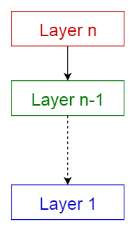
Layered Architectural Style
Allows for abstraction by dividing the program into layers. Layers only communicate downwards and obtain services from lower layers that way.
Client Layer: Easy to use API provided by HBase for the clients HBase Layer: Contains the core logic of the system Hadoop HDFS Layer: The fundamental layer upon which HBase is built.

Slide 17
Region Server Layered Architecture

Slide 18
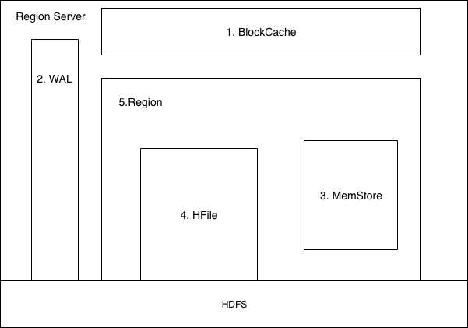
Region Server Layered Architecture

Slide 19
Region Server Layered Architecture
BlockCache
Stores frequently use data in memory.
Implement an LRU(Least recently used) algorithm, When the cache is full it discards the least recently used data.
Increase read speed access of the most frequently use data from the client(it’s faster to read from the cache than the disk).
WAL(Write Ahead Log)
“Store new data that hasn't yet been persisted to permanent storage”(HDFS)
WAL is persisted on HDFS, in case of server failure, it is used to recovered data on a new region server.

Slide 20
Region Server Layered Architecture
MemStore
It is a write buffer cache, it Cached data that will be written to HFile
Keep data sorted using a key Value pair algorithm
When full, data are flush, transfer to Hfile and then persisted to the disk
Hfile
Receive data from MemStore and persist it on HDFS
Contains Multiples Regions
Regions are assigned by Hmaster
Contains multiple Memstores and HFiles

Slide 21
Data Flow

Slide 22
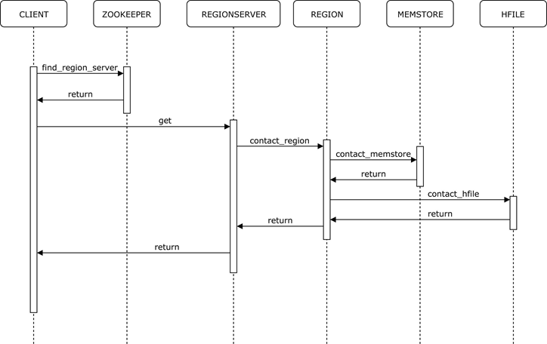

Slide 23
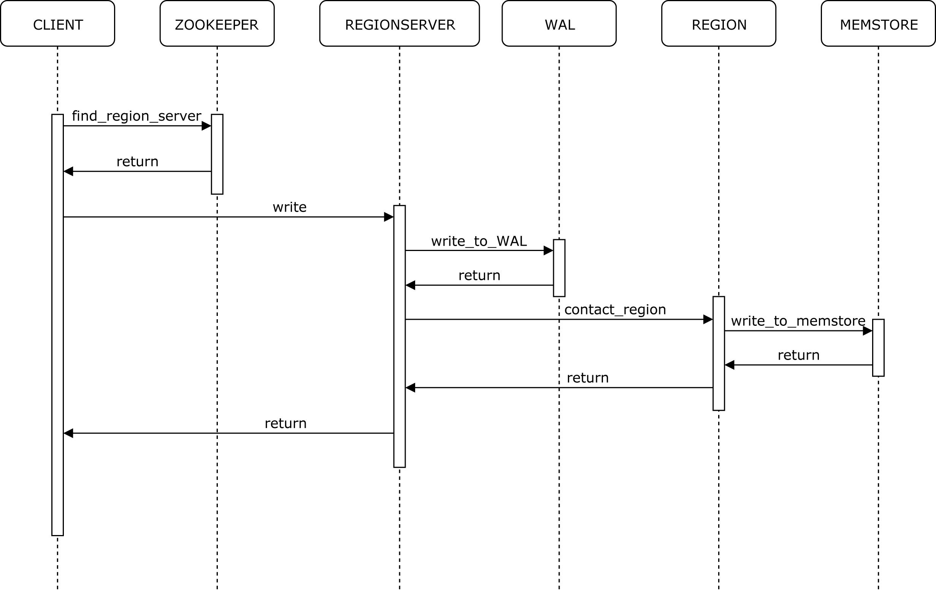

Slide 24
Derivation Process
Documentations, articles, books, and YouTube videos.
Most of the documents contain same information.
Used the information from authentic websites and articles.
Group members had several meetings to discuss and share their research.

Slide 25
Lessons Learned
How to
Research and find the authentic sources of information.
Organize all the gathered information in a sequence that is easy to follow.
Explain all the required information in limited time.

Slide 26
References
https://www.tutorialspoint.com/hbase/hbase_overview.htm
https://www.credera.com/blog/technology-insights/java/apache-hbase-explained-5-minutes-less/
https://www.dezyre.com/article/overview-of-hbase-architecture-and-its-components/295
https://blogs.igalia.com/dpino/2012/10/31/introduction-to-hbase-and-nosql-systems/
https://blog.eduonix.com/bigdata-and-hadoop/use-hbase-nosql-db/

Slide 27
References
10 Common software architectures in a nutshell
Architecture Styles ~ Paolo Ciancarini
HBase Architecture Analysis
An In-Depth Look at the HBase Architecture
HBase Architecture Analysis
https://www.edureka.co/blog/hbase-architecture/
https://www.tutorialspoint.com/hbase/hbase_architecture.htm
https://data-flair.training/blogs/hbase-architecture/

Slide 28
Thank you!
ANY QUESTIONS

