Slide 1
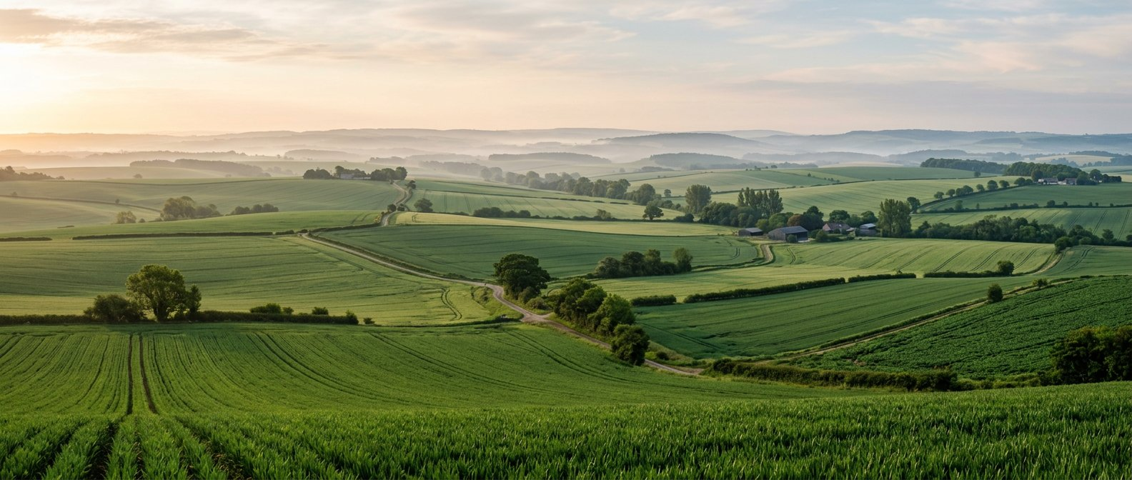
TERRAFIELD / HACK-P302
Better decisions start from the ground up.
Crop planning with transparent screening.
HACK-P302 • Crop Recommendation System
Team, roll numbers and contributions: to be supplied
TERRAFIELD • STUDENT PROTOTYPE • ADVISORY ONLY
01

Slide 2
TERRAFIELD / HACK-P302
The problem
Crop choices depend on field conditions and local context.
Users need a way to compare options and understand the reasons.
A screening tool cannot guarantee yield, profit or suitability.
Field measurements and local expert advice remain essential.
TERRAFIELD • STUDENT PROTOTYPE • ADVISORY ONLY
02

Slide 3
TERRAFIELD / HACK-P302
Our approach
01 FIELD PROFILE
02 SCREEN
03 EXPLORE
Enter soil texture, pH, annual rainfall, growing-season temperature and season.
The backend evaluates 21 crop profiles using documented, inspectable rules.
Review explanations, compare two crops, and save a historical report.
TERRAFIELD • STUDENT PROTOTYPE • ADVISORY ONLY
03

Slide 4
TERRAFIELD / HACK-P302
What works locally
Inline and server validation; clearly labelled synthetic examples.
Rankings, factor explanations, comparison and print-friendly output.
SQLite-backed reports: save, reopen, rename and delete.
Plant reference library and dated soil snapshots; optional online data.
Browser-held workspace key is not an account or production authentication.
TERRAFIELD • STUDENT PROTOTYPE • ADVISORY ONLY
04

Slide 5
TERRAFIELD / HACK-P302
Architecture & stack
FRONTEND
BACKEND
PERSISTENCE
Existing HTML, CSS and vanilla JavaScript
Same-origin API requests
Node 24 HTTP API
Validation and scoring engine
SQLite reports and soil cache
Reference data in versioned files
User → frontend → REST API → validation / scoring → SQLite → response
TERRAFIELD • STUDENT PROTOTYPE • ADVISORY ONLY
05

Slide 6
TERRAFIELD / HACK-P302
The screening index
pH 30 + temperature 25 + annual rainfall 25; texture 10; humidity and season 5 each.
Within optimal range: 100; declines toward absolute boundaries; outside: 0.
Outside an absolute range caps the overall index at 50.
Unknown optional factors are excluded; remaining weights are renormalized.
Humidity / season and weights are prototype heuristics. N, P and K are not scored.
Index ≠ probability. Not the FAO ECOCROP model.
TERRAFIELD • STUDENT PROTOTYPE • ADVISORY ONLY
06

Slide 7
TERRAFIELD / HACK-P302
Database & API
SQLite
Key REST endpoints
reports: owner hash, title, input and result snapshots, timestamps
soil_cache: lookup key, JSON, expiry
Historical results remain understandable after source changes.
GET /api/health, /api/crops
POST /api/recommendations
GET / POST /api/reports
GET / PATCH / DELETE /api/reports/{id}
External soil, weather and location routes
TERRAFIELD • STUDENT PROTOTYPE • ADVISORY ONLY
07

Slide 8
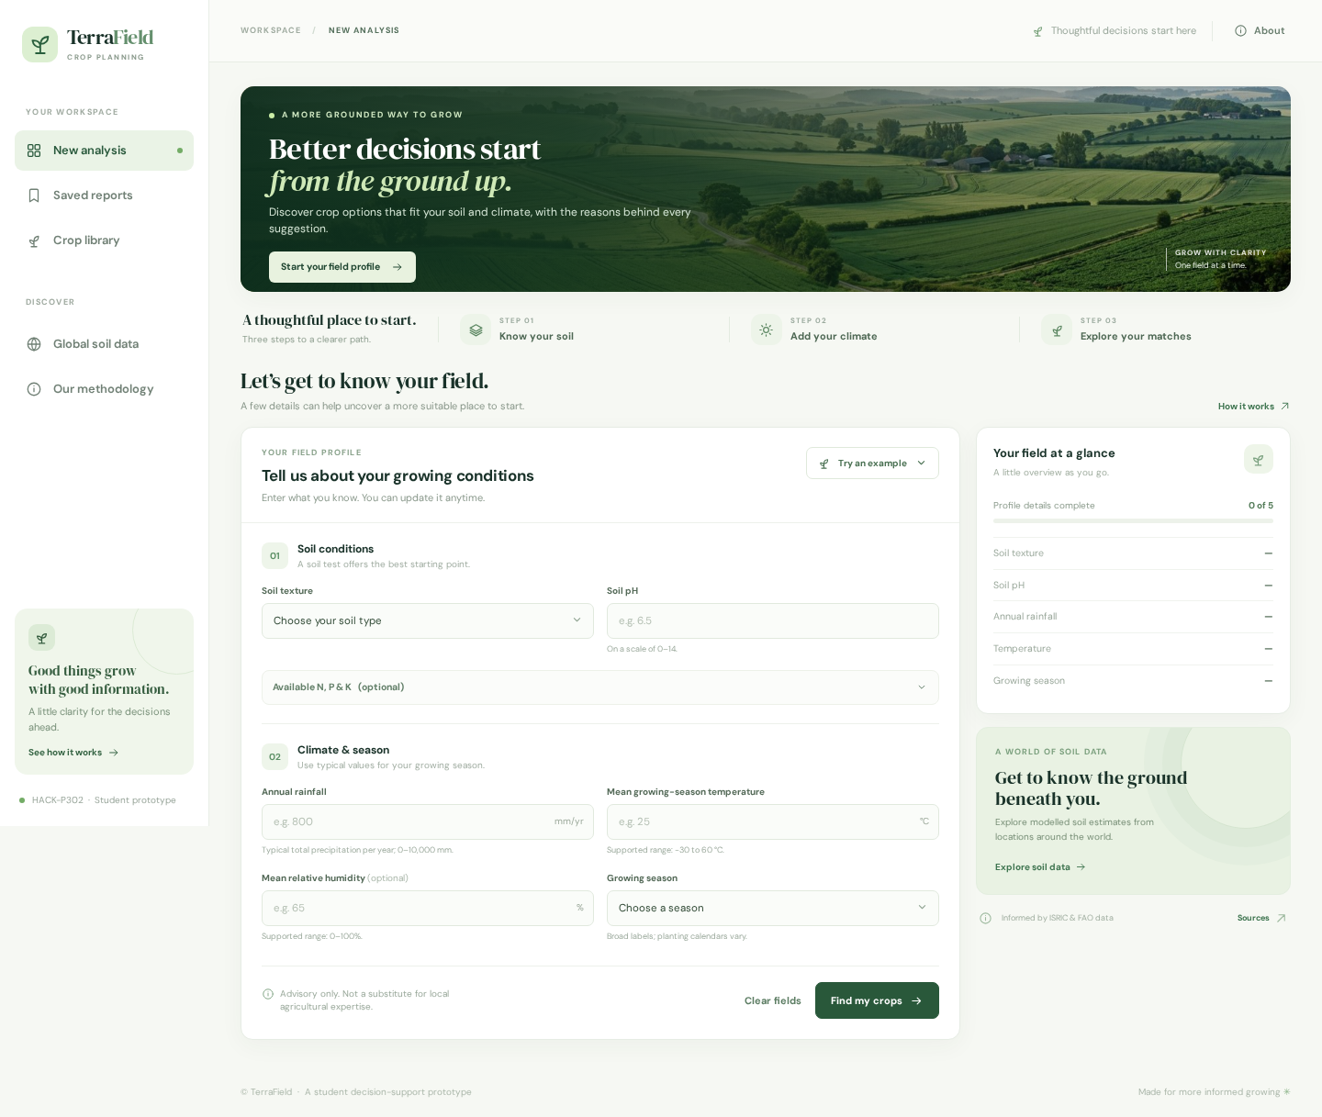
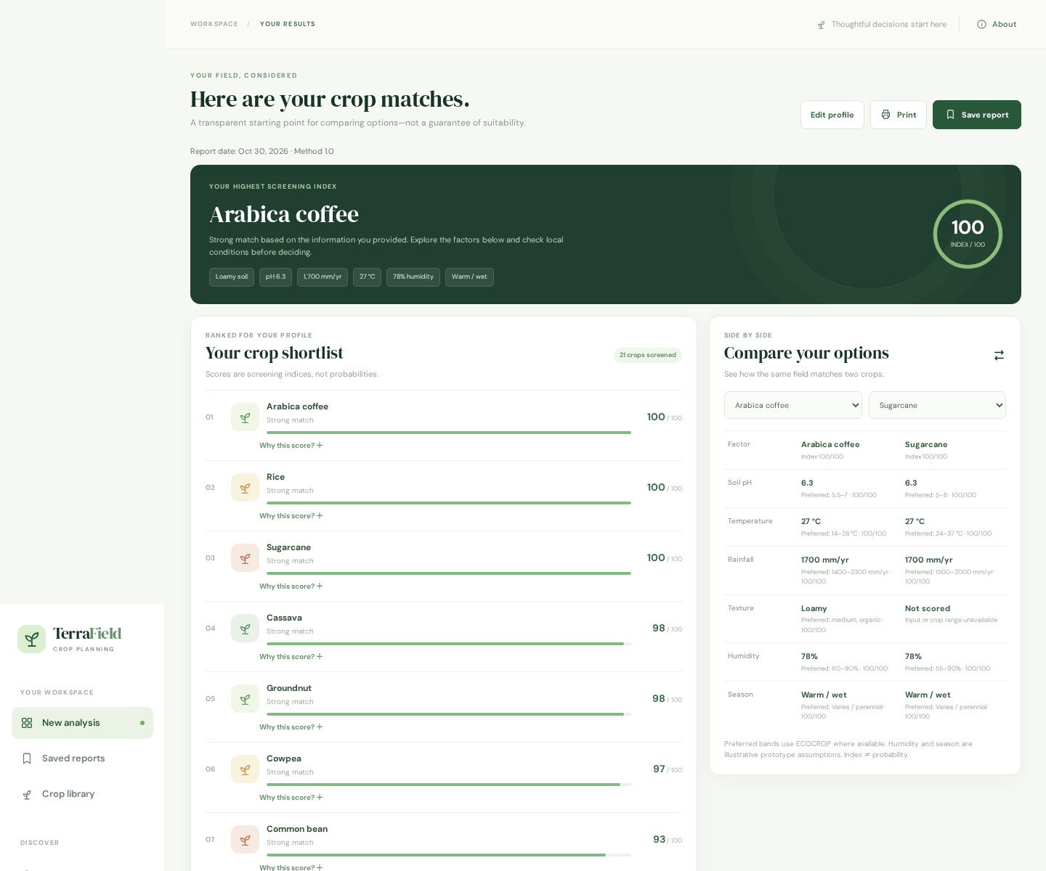
TERRAFIELD / HACK-P302
Application evidence
Captured from the running application. Example inputs are synthetic.
TERRAFIELD • STUDENT PROTOTYPE • ADVISORY ONLY
08

Slide 9
TERRAFIELD / HACK-P302
Testing: actual results
Node 24.22.2: 31 of 32 tests passed; one offline GeoNames index test failed because source files were omitted.
Automated Chromium workflow passed: validation, request failure, calculate, compare, save, refresh, reopen and edit.
Four viewport widths checked; print CSS and PDF checked, not the native print dialog.
SQLite restart persistence, ownership, report CRUD and safe database errors tested.
TERRAFIELD • STUDENT PROTOTYPE • ADVISORY ONLY
09

Slide 10
TERRAFIELD / HACK-P302
Deployment & limitations
No live deployment or public URL has been verified.
Docker packaging prepared but not tested here; a persistent database volume is required.
Offline GeoNames dataset and original LICENSE were not supplied.
External lookups may fail; modelled soil/weather are not field measurements.
Not production authentication; public use needs security review and abuse controls.
TERRAFIELD • STUDENT PROTOTYPE • ADVISORY ONLY
10

Slide 11
TERRAFIELD / HACK-P302
Next steps
Restore the original GeoNames index and confirm project licensing.
Provide team names, roll numbers and actual contributions.
Complete native print and device testing; validate with agricultural experts.
Deploy with HTTPS and persistent storage, then verify the full workflow.
Record a real 3–5 minute demo using docs/DEMO.md.
TERRAFIELD • STUDENT PROTOTYPE • ADVISORY ONLY
11

