Slide 1
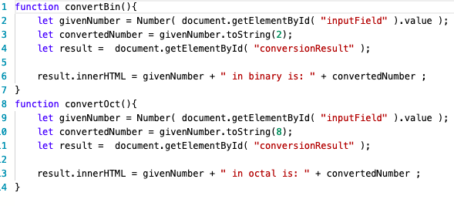
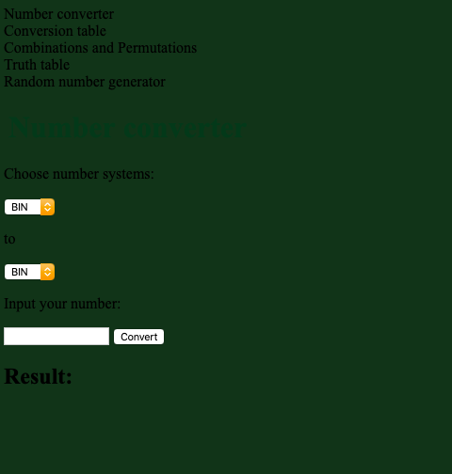
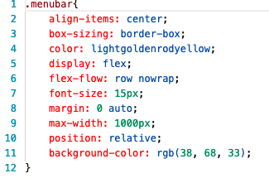
Web Based Mathematics Tool Project
Roope Hautamaki, Ingrid Mikkola, Petri Jahnsson DIN19SP
Information Technology, CSS + HTML Programming
Introduction
The objective of this project was to create a mathematics tool web page using HTML ,CSS, and JavaScript programming techniques and languages while incorperating learned mathematical skills.
Objectives
The main aim of this project was to create a usable web based mathematics tool that includes six functionality requirements. The first requirement was that the tool is able to do number systems conversions between binary, octal, hexidecimal, and decimal numbers. The web page has to also have a tool that displays a number system output, have a tool for combinatorics, create basic truth tables and test random values.
FIGURE 1: Code
Methods
The methods used to create the web based math tool included implementing the math processes by using the programming languages HTML, CSS, and JavaScript. Computing math concepts were integrated into the programs as well to achieve the desired outcome.
Results
The web page worked exactly as designed and planned. The web page loaded on time and displayed the proper outputs. There were some cosmetic and basic modifications made within the code to create the desired user interface of the web page. (See Figure 2 below)
below).
FIGURE 2. The Web Page Interface
Conclusions
In conclusion while testing the web page code and the math tools, there were few small errors that required maintainance. The math tools performed as designed.
See Figure 3 for the mathematics tool code.
FIGURE 3: Math Tools Code
References
W3Schools HTML Source: https://www.w3schools.com/html/
W3Schoolls JavaScript Source:
https://www.w3schools.com/js/
3. W3 Schools CSS Source:
https://www.w3schools.com/w3css/
4:JavaScript Help Source: https://rosettacode.org/wiki/Truth_table#JavaScript
5. Combinatorial Source: https://home.ubalt.edu/ntsbarsh/Business-stat/otherapplets/comcount.htm
6. Calculator Help: https://stackoverflow.com/questions/27111342/simple-calculator-in-html-and-javascript
DevBasicSkills2019 Team 2
ECTS credits: 3
Date of publication: 2019, Autumn
Instructor Lasse Haverinen

