Slide 1
AR Development for Modular Drone’s Assembly
Zhuorui yu
Supervisor: Dr. Slawomir Tadeja
Institute For Manufacturing

Slide 2
Introduction
System Introduction
FAST(Functional Analysis System Technique)
FEMA(Failure Mode and Effect Analysis)
AR system development

Slide 3
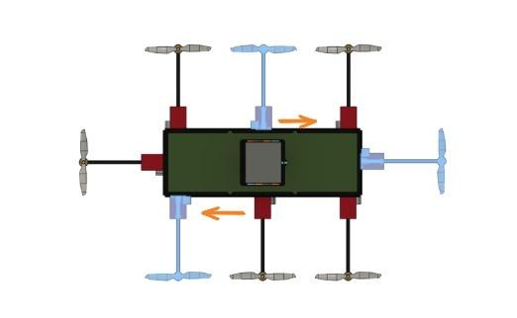
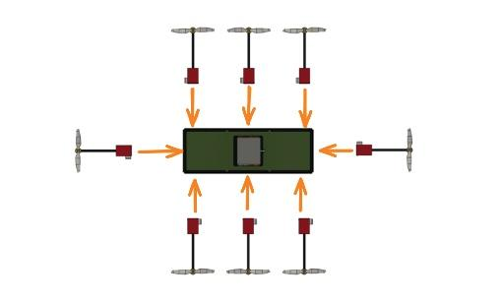
111fdsfasfasdf a
System Introduction
Help guide user to assemble the propellers to their designated position, and apply cable insertion for different configurations.
Provide text, animation, visual cue for training, and provide checking mechanism.

Slide 4
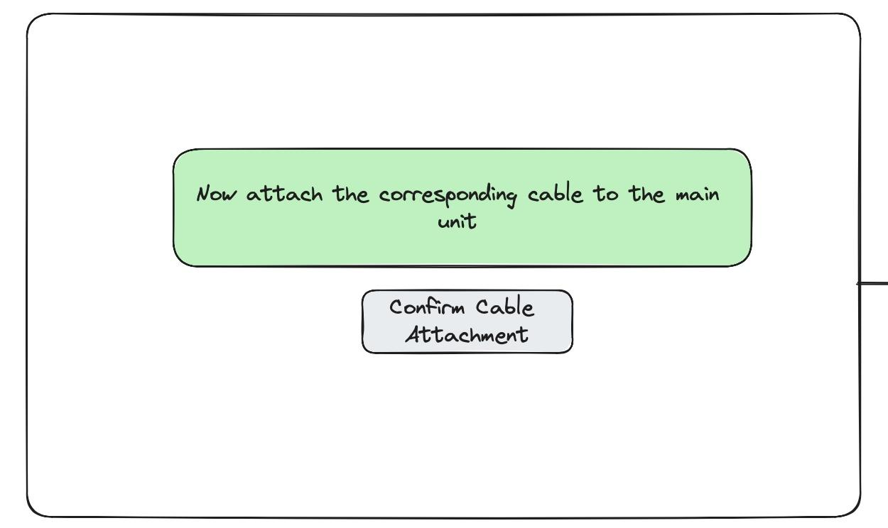
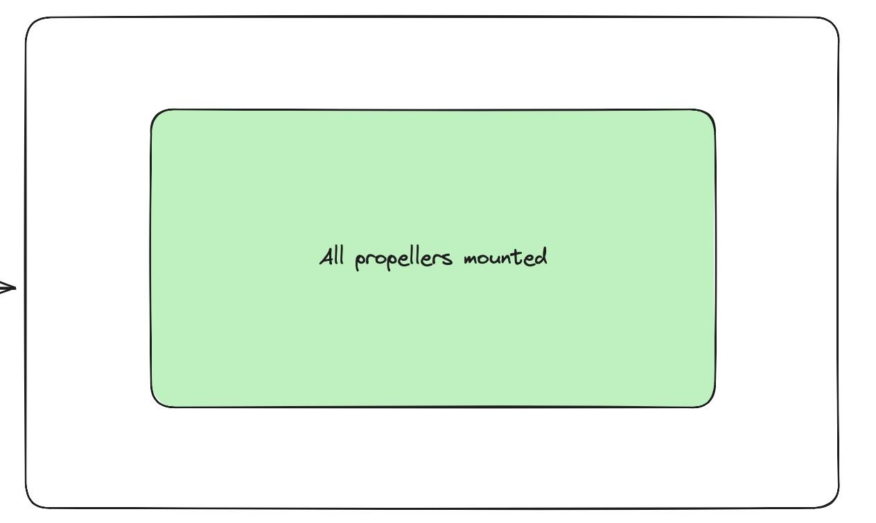
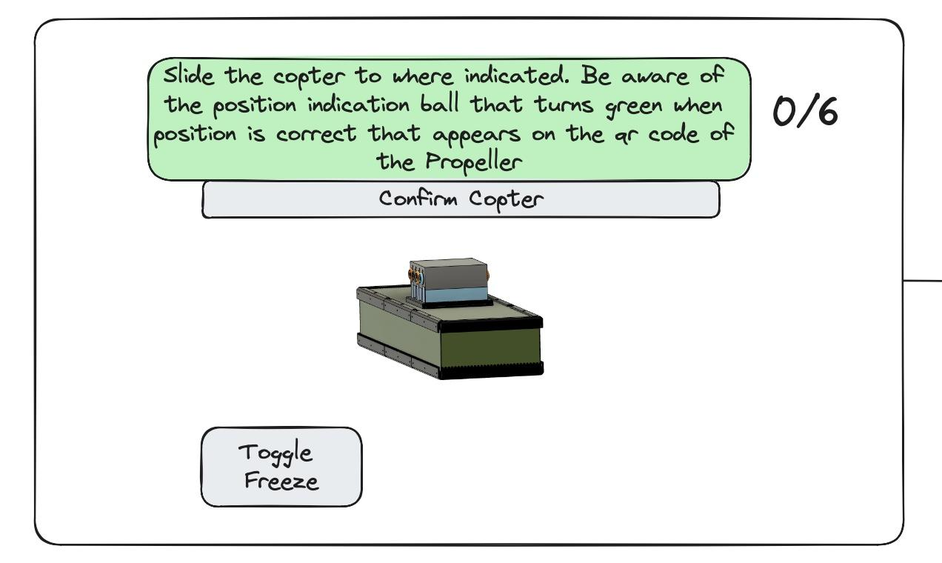
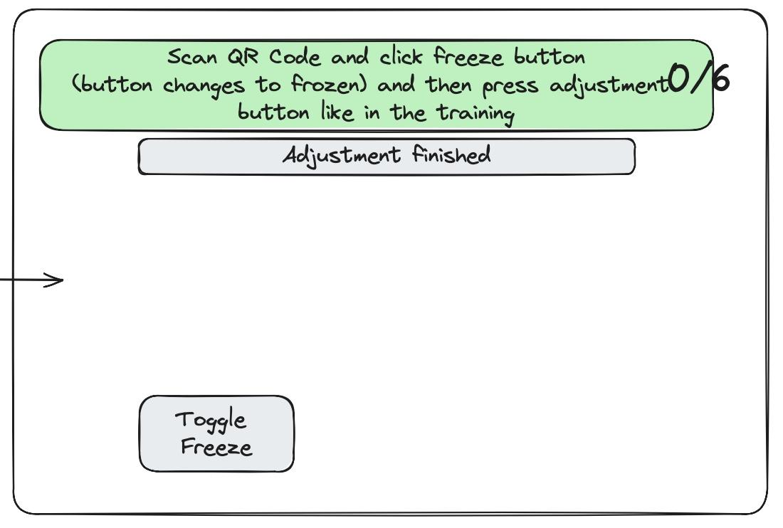
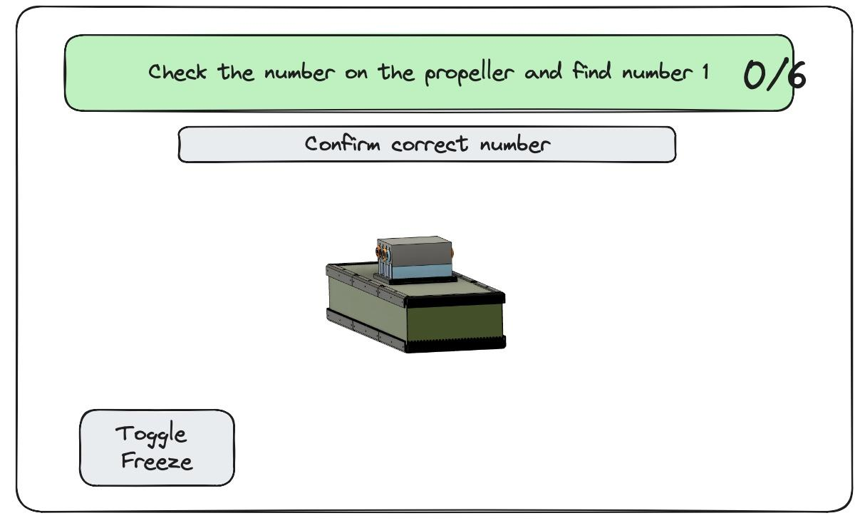
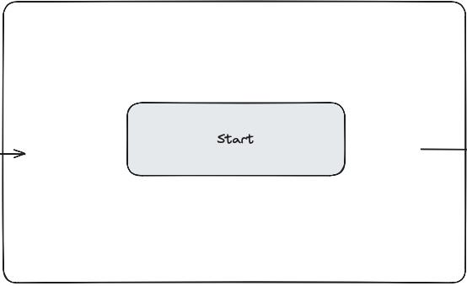
System Overview

Slide 5
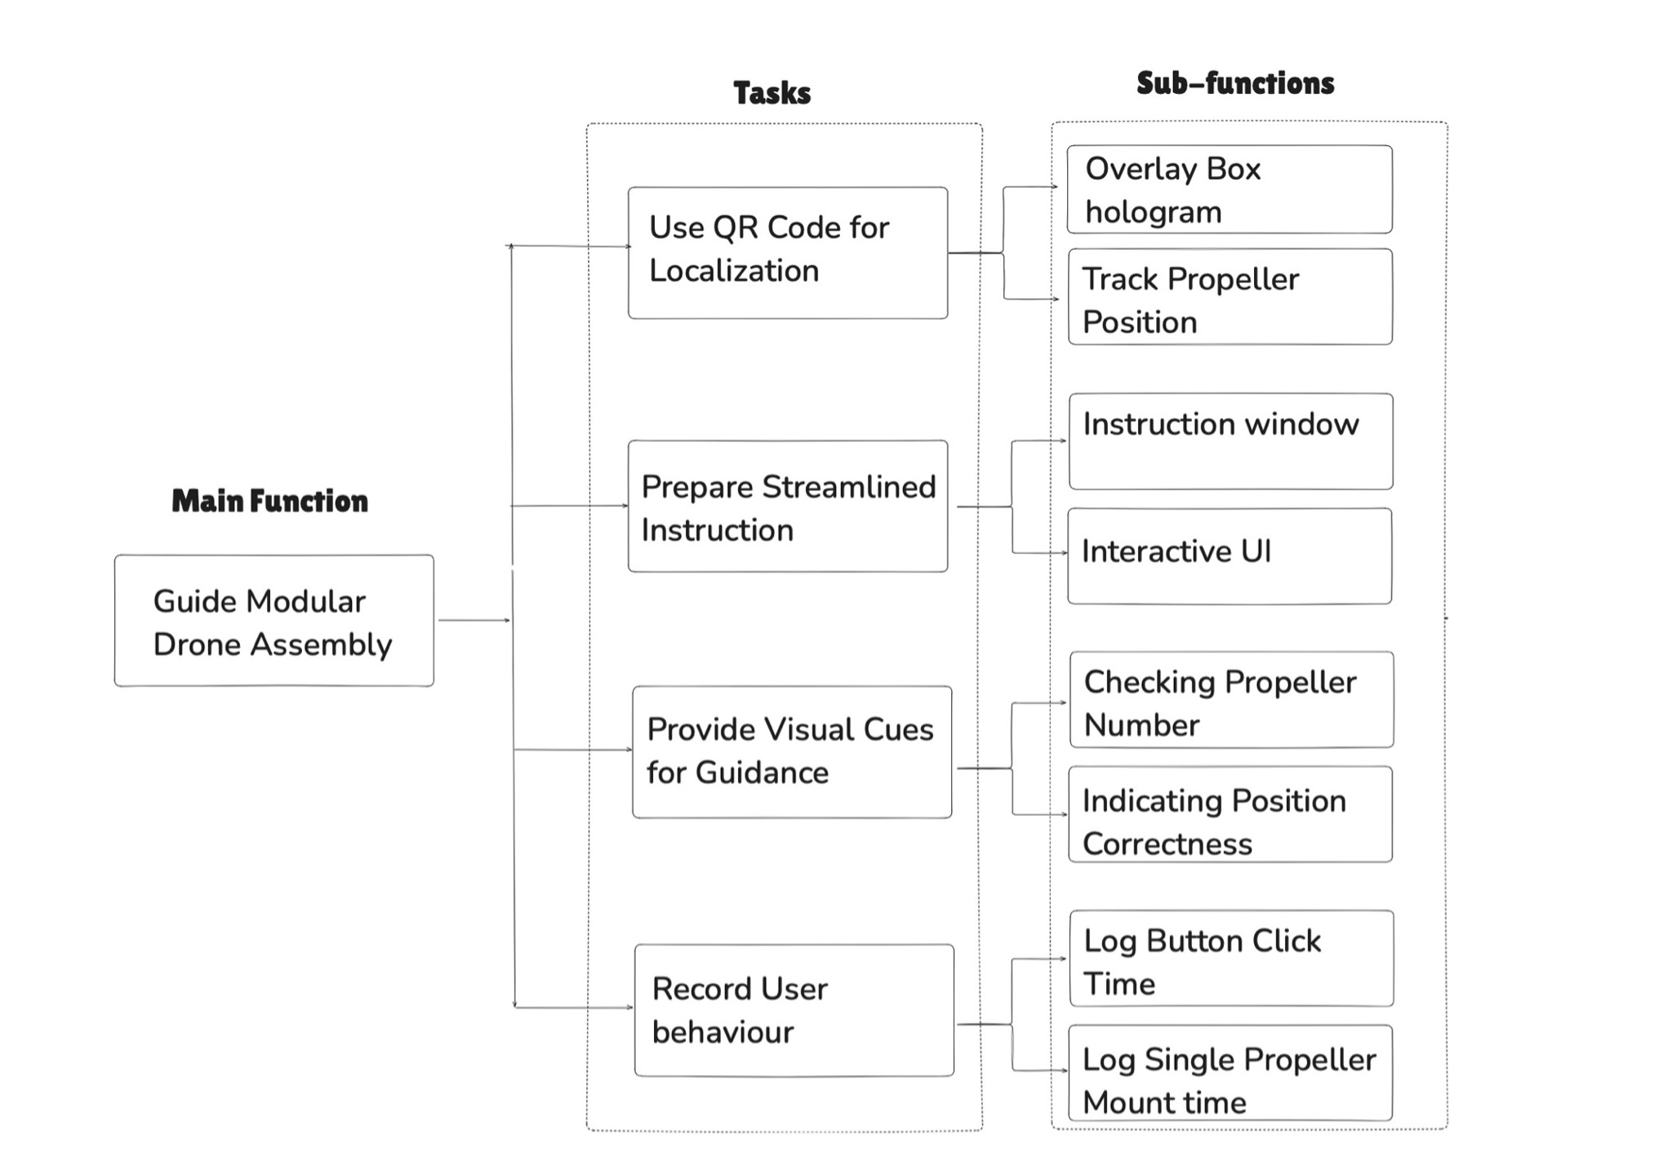
FAST(Functional Analysis System Technique)

Slide 6
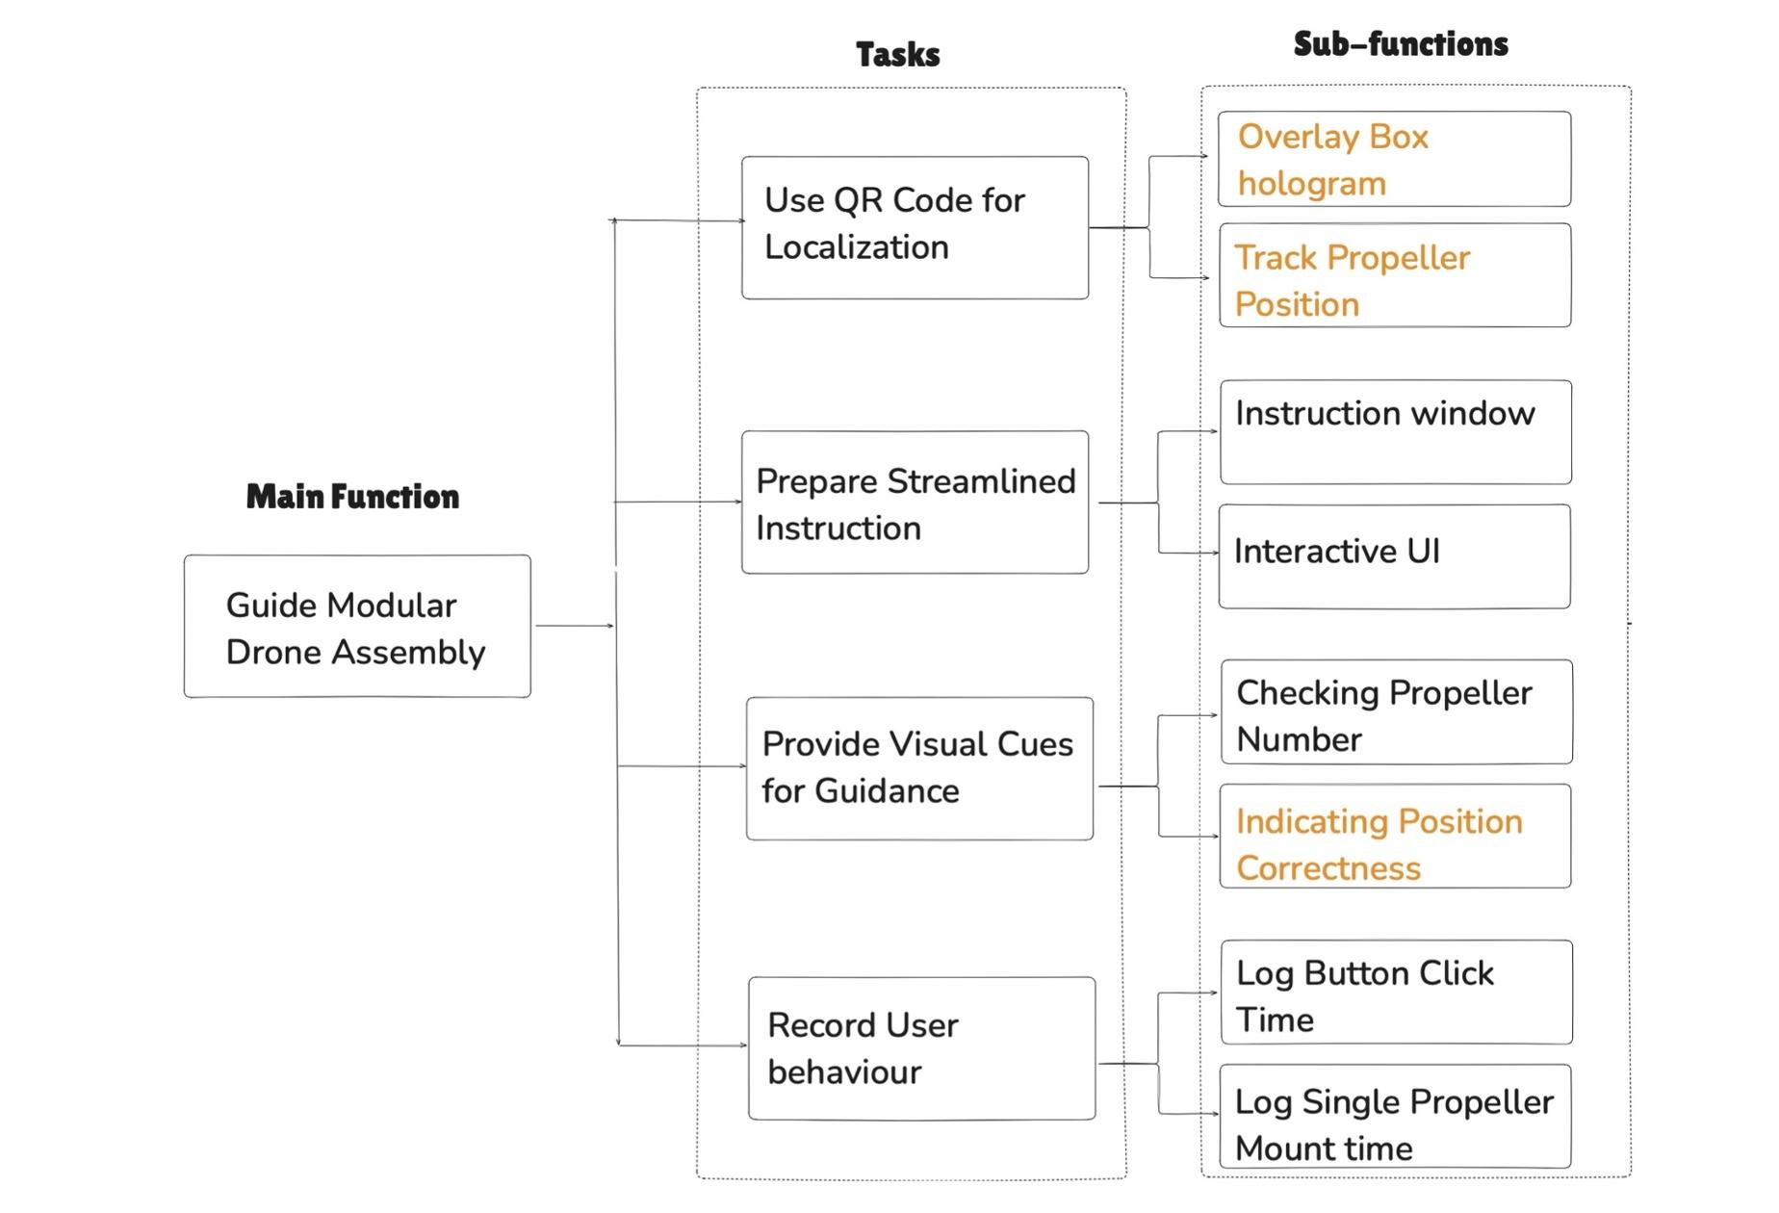
Critical Function Analysis

Slide 7
Critical Function Analysis
Overlay Box Hologram
Track main QR code, apply manual offset adjustment
Vuforia
Freeze Box Hologram
Show propeller hologram
Track propeller Position
Vuforia
Transform to AR camera coordinates
Indicating Mounting correctness
Show image to indicate number index
Show sphere and change color when the propeller at correct position

Slide 8
FEMA(Failure Mode and Effects Analysis)
No. | Task steps | Failure modes | Failure causes | Probability | Failure effects | Actions
1 | During App running | App becomes slow and sudden shutdown occurs | The app is putting too much workloads on CPU | High | Hololesn becomes too hot, app is too slow to work | Not using recording. Prevent using app for too long
2 | During App running | Display got dark | Battery depletion | Low | User cannot see holograms clearly | A restart could help Charge Hololens timely
3 | During App running | User feel sick | Bad synchronization and visual display | Moderate | Reduced training effectiveness. | Put hologram in the scene, avoid having hologram following user’s view
4 | During App running | User cannot view the real world clearly | The hologram being too bright | Moderate | Less accuracy, longer operating time | Flip Hololens glasses Increase the transparency of the hologram

Slide 9
AR Development
Project Setup
Unity Hub
Unity editor
Visual Studio 2022
Windows 10 or 11PC
Mix Reality Feature Tool
MRTK2
Vuforia Engine
Hololens2

Slide 10
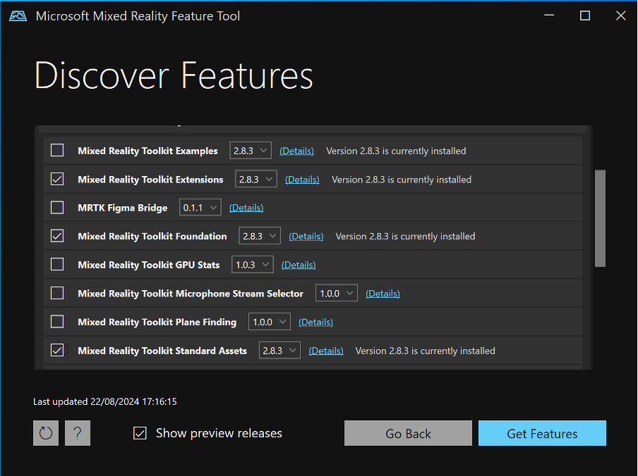
AR Development
Environment Setup
Create new Unity project using Universal 3D template
Use Mix Reality Feature Tool, import MRTK2 to this unity project
In Build Settings, switch to UWP platform, and configure the settings
In Project Settings, configure XR plugin management
Use Microsoft Hand Interaction profile
Tick Open XR

Slide 11
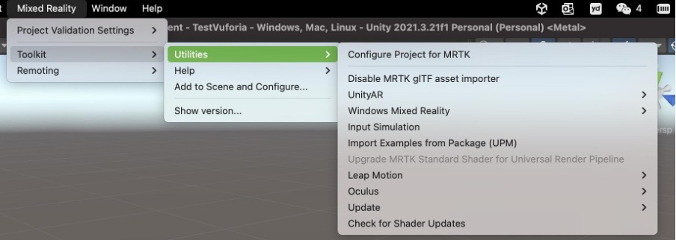
AR Development
MRTK 2
In the top bar, click Mixed Reality
Add to scene and configure
Utilities->Configure Project for MRTK

Slide 12
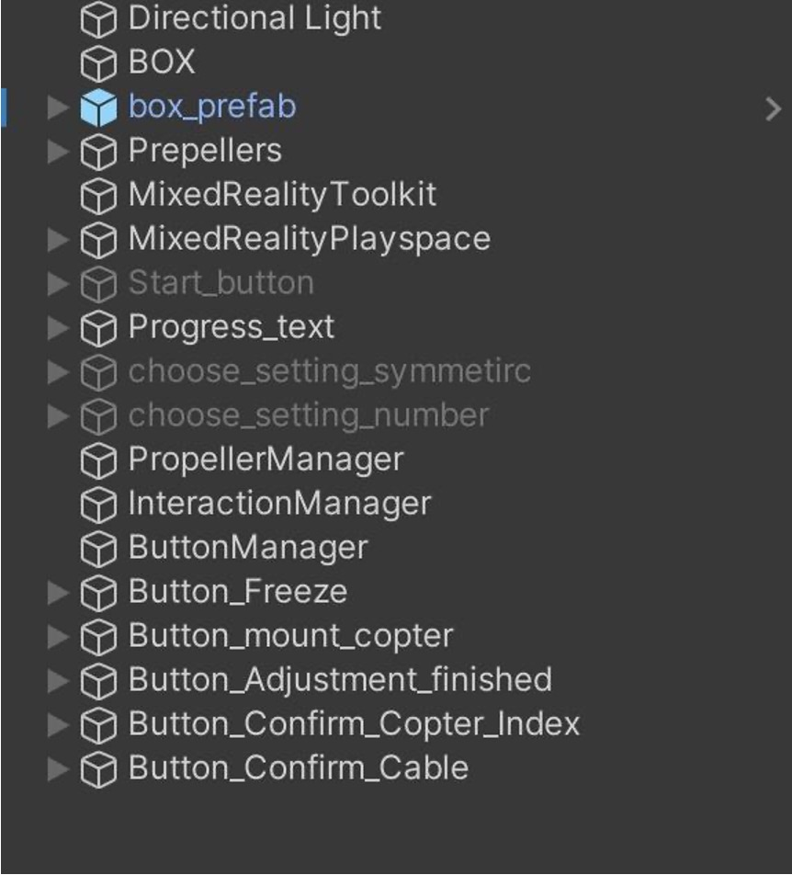
AR Development
Scene Explanation
5 Buttons
Managers are for handling logic and functions
Box is the image target for the main QR code
Prepellers has 6 childrem, each of them has one of 6 small QR code’s image target
Progress_text is a window for showing instructions

Slide 13
AR Development
Vuforia
Import Vuforia from https://developer.vuforia.com
Learn to use Image Target
Add image to database
Apply license
Add AR camera to Mixed Reality playspace
Check Video for detail Instruction

Slide 14
AR Development
Codes preview
MainQR:
Start()
Update()
ToggleFreeze()
UpdateWindowPosition()
ColorChange(bool isBad)
ShowPlug(int copterOrder)
InteractionManager:
Start()
ShowChooseSettingSymmetricDialog()
OnSymmetricSelected()
OnUnsymmetricSelected()
ShowChooseSettingNumberDialog()
OnNumberSelected(int numberOfCopters)
Show_Start_button()
On_start_clicked()
OnAdjustmentConfirmed()
AskGrabCopter()
OnconfirmNumber()
OnMountCopterButtonClicked()
OnCableMounted()
LogTimes(float overallTime)
LogAction(string action)
Propellermanager:
Start()
InitializeConfigurations()
SetConfiguration
GetConfigurationIndex()
InstantiateCylinders()
UpdateCylinderPositions
ActivateNextCopter()
HideCurrentCopter()
FinishMountingStep()
UpdateQRCodeDisplay()
CheckSecondQRCodePosition
UpdateArrowTransform
ChangePlugColor()

Slide 15
AR Development
BOX GameObject in the Scene
MainQR.cs
Tracking main QR code, obtain its coordinates, pass the information to Propeller Manger
Update Box hologram, change color, change plug color, freeze box hologram

Slide 16
AR Development
Propeller_x GameObject in the Scene
SecondQRCodeTransform.cs
Tracking individual small QR code
Show tick or cross according to propeller index
Show sphere when propeller is mounted at correct position

Slide 17
AR Development
PropellerManger in the Scene
PropellerManger.cs
Handling propellers’ hologram
Checking for propeller’s position
Showing arrow as visual cues

Slide 18
AR Development
InteractionManger GameObject in the Scene
InteractionManger.cs
Handling button’s appearance and disappearance
Handling whole system logic

Slide 19
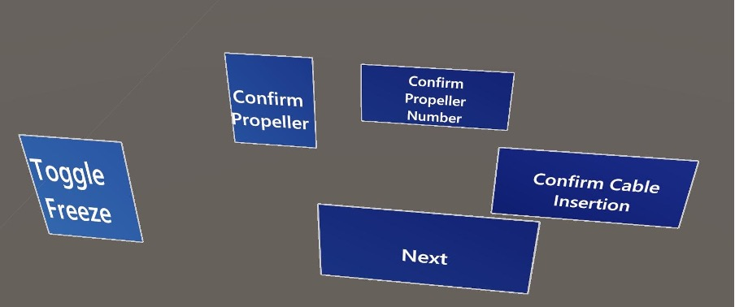
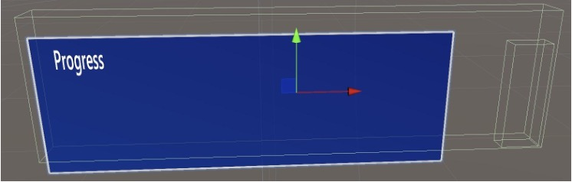
AR Development
UI in the Scene
PressableButtonHololen2 prefab
Window
Fixed above main QR code
Rotating so that always face user

Slide 20
AR Development
Deploying the app
USB
WiFI
Sideload
Right click on the solution in the visual studio
Publish -> to app package
Use certificate -> only tick Arm 64 -> publish
Use Hololens’s device portal to deploy the app

