Slide 1
UIKit

Slide 2
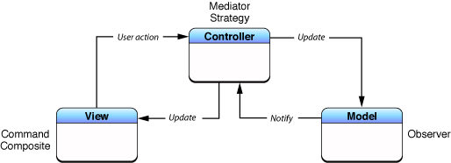
MVC

Slide 3
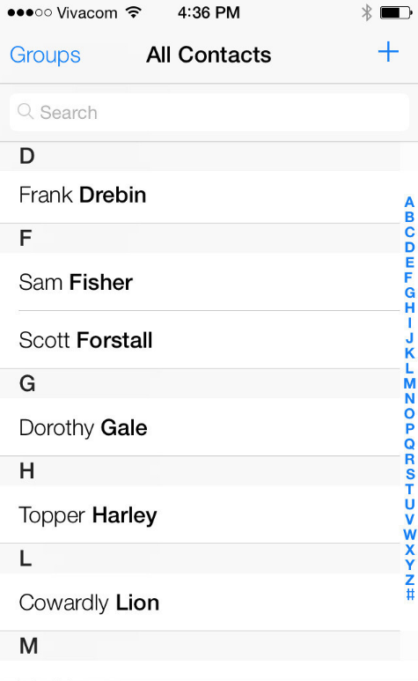
Простой пример

Slide 4
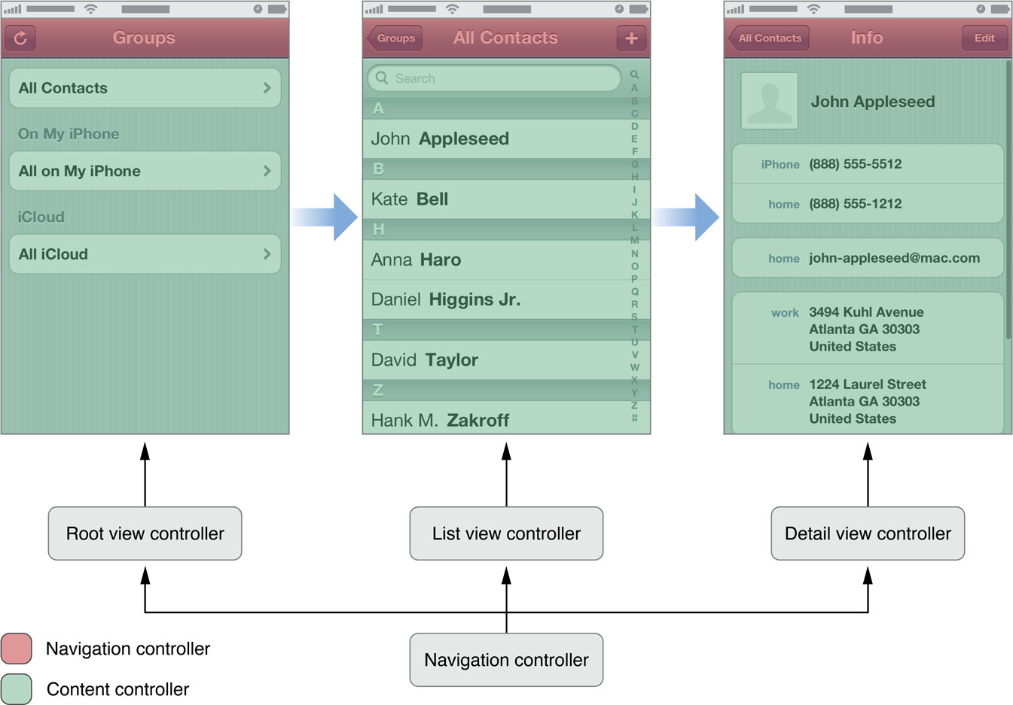
View Controller

Slide 5
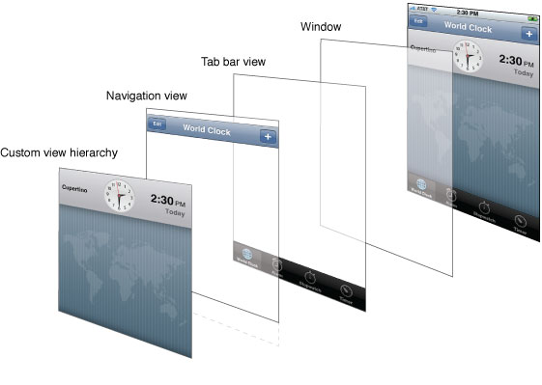
Иерархия view

Slide 6
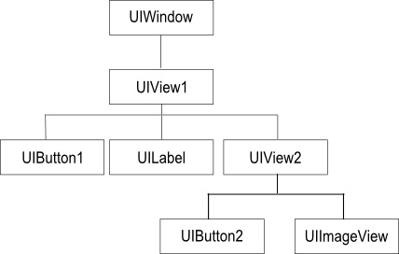
Иерархия view

Slide 7
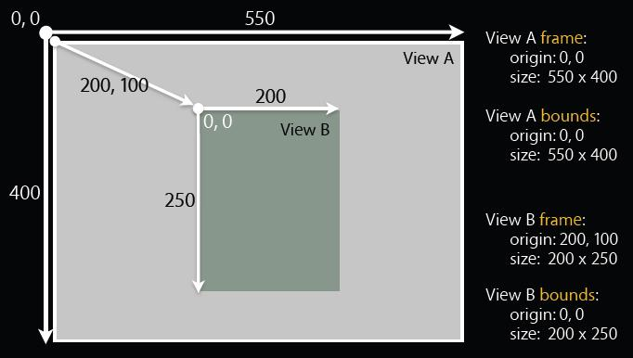
Размеры, координаты

Slide 8
Связь view-view controller

Slide 9
Ссылки
https://developer.apple.com/library/ios/documentation/general/conceptual/CocoaEncyclopedia/Model-View-Controller/Model-View-Controller.html
https://developer.apple.com/library/ios/featuredarticles/ViewControllerPGforiPhoneOS/Introduction/Introduction.html
https://developer.apple.com/library/ios/documentation/windowsviews/conceptual/viewpg_iphoneos/CreatingViews/CreatingViews.html

Slide 10
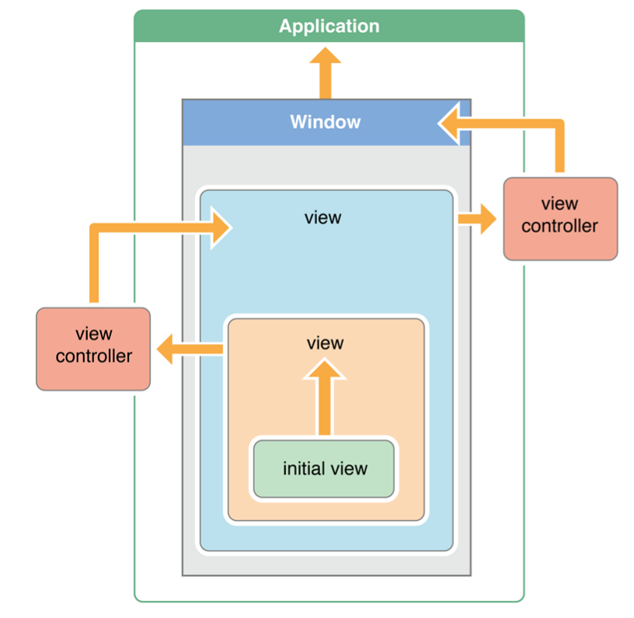
(Later) Responder Chain

