Slide 1



REQUIRE
Array DB_INFO
PDO pdo
__construct()
getHostConnection()
getBaseConnection()
initPdo()
tableExist()
initDatabase()

Slide 2
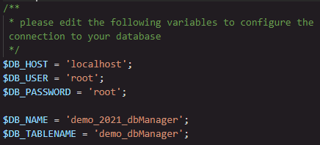
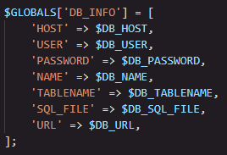
Array DB_INFO
PDO pdo
__construct()
getHostConnection()
getBaseConnection()
initPdo()
tableExist()
initDatabase()

Slide 3

REQUIRE
Array DB_INFO
PDO pdo
__construct()
getHostConnection()
getBaseConnection()
initPdo()
tableExist()
initDatabase()

Slide 4
__construct()
REQUIRE
__construct()
Array DB_INFO
Get attribute DB_INFO from conf file…
PDO pdo
getHostConnection()
getBaseConnection()
…and try to instanciate this PDO
initPdo()
tableExist()
initDatabase()

Slide 5
tableExist()
REQUIRE
__construct()
getHostConnection()
Get a server connection…
getBaseConnection()
initPdo()
…Check if table exist…
tableExist()
initDatabase()

Slide 6
initPdo()
REQUIRE
__construct()
getHostConnection()
getBaseConnection()
Check if table exist…
initPdo()
…If exist, get connection…
tableExist()
initDatabase()
else, import database

Slide 7
initDatabase()
REQUIRE
__construct()
Get a host connection…
getHostConnection()
…get the content of sql file and make queries from it…
getBaseConnection()
initPdo()
tableExist()
initDatabase()

