Slide 1

Detecting High-Risk of Alzheimer’s Disease Using Statistics and Machine Learning
Data Science Project by Chuck Tucker

Slide 2
Alzheimer’s Disease
"Worldwide, 50 million people are living with Alzheimer's and other dementias."
Alzheimer’s disease is terminal unlike other dementias
Source: alz.org

Slide 3
Cost of Care
15 million family members are providing 18.2 billion hours of unpaid care
Economic value of this care is more than $230 billion
Source: alz.org

Slide 4
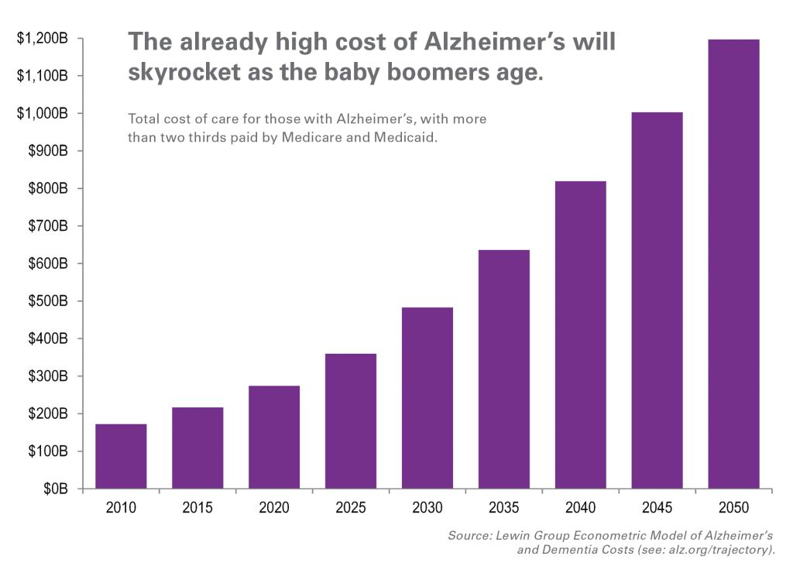

Slide 5
Best Outcomes from Early Treatment
Early Treatment Options
Changes in diet
Taking supplements and/or antioxidants
Avoid smoking and alcohol
Social activities
Exercising
Brain stimulating activities
Symptoms and disease progression are best mitigated with early treatment
Early treatment options are inexpensive compared to medication costs
Source: alzheimers.net

Slide 6
Primary Goal for this Analysis
Create tools that can detect or predict Alzheimer’s disease to identify high-risk patients
These patients can be referred for additional tests or begin early treatment

Slide 7
Target Audience
Medical professionals diagnosing or treating Alzheimer’s disease
Patients or family members of patients suspecting early cognitive impairment

Slide 8
Data Source and Analysis Tools
Data Source: Alzheimer’s Disease Neuroimaging Initiative
Cognitive tests and brain scans
Classical Statistical Methods
Threshold values that indicate high-risk
Machine Learning Algorithms
Predict high-risk patients

Slide 9
Provide Patient Recommendations Based on:
Baseline Biomarkers
Change in Biomarkers
Screening Method
Biomarker measurements at a patient’s first exam
Predict Alzheimer’s risk using only initial measurements
Change in biomarkers over time for a patient
Change between first exam and most recent exam
Detect a progression to Alzheimer’s disease
Use only cognitive tests to create a recommendation system to refer patients for brain scans
Biomarkers = cognitive test results or scan results

Slide 10
Threshold Results

Slide 11
Baseline Biomarkers (first exam)
Biomarker | Threshold | Detection Rate
CDRSB Males | 1.48 | 83 %
CDRSB Females | 1.04 | 85 %
ADAS11 Males | 10.46 | 81 %
ADAS11 Females | 8.78 | 90 %
ADAS13 Males | 16.74 | 86 %
ADAS13 Females | 13.79 | 93 %
MMSE Males | 27.37 | 80 %
MMSE Females | 28.00 | 85 %
RAVLT Immed. Males | 29.36 | 78 %
RAVLT Immed. Females | 37.29 | 91 %
Cognitive Test Thresholds:
Very good detection rates
Different thresholds for males and females
Calculations at 25% false positive rate
* Statistical tests showed males/females had different thresholds for all biomarkers

Slide 12
Recommended Usage
Patients that exceed thresholds for one or more baseline cognitive tests
Refer patient for brain scans
Use the machine learning models (introduced later) to predict if patient is high-risk for Alzheimer’s disease
Recommend patient begin early treatment as recommended by medical practitioner
Suggest continued monitoring of symptoms and regular exams

Slide 13
Baseline Biomarkers (first exam)
Biomarker | Threshold | Detection Rate
Hippocampus Males | 6673.01 | 66 %
Hippocampus Females | 6391.04 | 80 %
Ventricles Males | 50797.64 | 45 %
Ventricles Females | 37943.74 | 40 %
WholeBrain Males | 1025582.00 | 48 %
WholeBrain Females | 928774.86 | 56 %
Entorhinal Males | 3474.42 | 67 %
Entorhinal Females | 3152.40 | 76 %
MidTemp Males | 19179.84 | 57 %
MidTemp Females | 17617.11 | 70 %
Brain Scan Thresholds:
Lower detection rates than cognitive tests
Different thresholds for males and females
Calculations at 25% false positive rate
* Statistical tests showed males/females had different thresholds for all biomarkers

Slide 14
Recommended Usage
Patients that exceed thresholds for one or more baseline brain scans
Use the machine learning models (introduced later) to predict if patient is high-risk for Alzheimer’s disease
Recommend patient begin early treatment as recommended by medical practitioner
Suggest continued monitoring of symptoms and regular exams

Slide 15
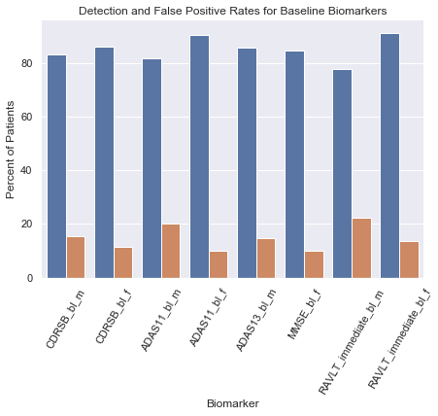
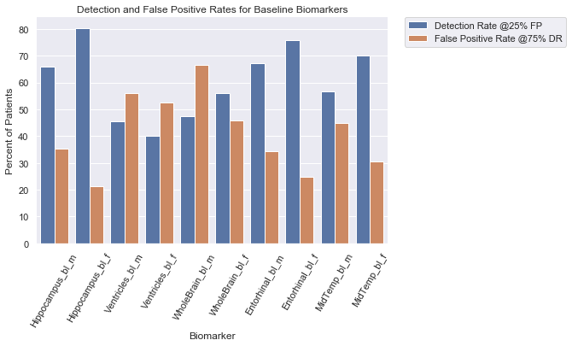
Baseline Thresholds Performance Summary
* Cognitive tests performed better

Slide 16
Change in Biomarkers
Cognitive Test Thresholds: high detection rates & low false positive rates
Biomarker | Threshold | CN to AD Detect Rate | MCI to AD Detect Rate | False Positive Rate
CDRSB | + 2.07 | 100 % | 95 % | 4 %
ADAS11 Males* | + 1.69 | 100 % | 81 % | 15 %
ADAS11 Females* | + 2.41 | 100 % | 85 % | 14 %
ADAS13 Males* | + 2.13 | 100 % | 80 % | 12 %
ADAS13 Females* | + 0.60 | 100 % | 89 % | 19 %
MMSE | - 176.0 | 100 % | 84 % | 15 %
RAVLT Immediate | - 281.7 | 100 % | 74 % | 23 %
* Statistical ADAS tests showed males/females had different thresholds
+ indicates in increase, – indicates a decrease

Slide 17
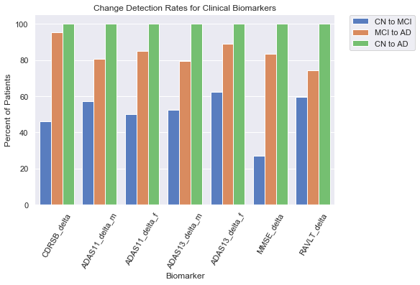
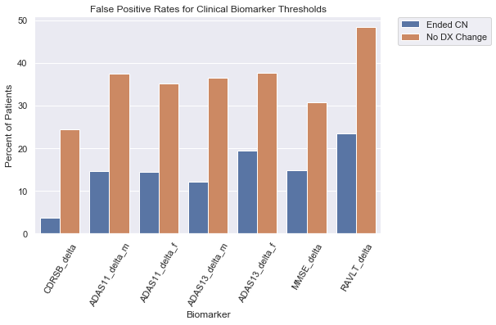
Change in Cognitive Tests Performance of Thresholds
* Good detection rates and acceptable false positive rates for recommended purpose

Slide 18
Recommended Usage
Patients that exceed thresholds for changes in one or more cognitive tests
Refer for brain scans
Use the machine learning models (introduced later) to predict if patient is high-risk for Alzheimer’s disease
Recommend patient begin early treatment as recommended by medical practitioner
Suggest continued monitoring of symptoms and regular exams

Slide 19
Change in Biomarkers
Brain Scan Thresholds: less accurate than cognitive thresholds
Biomarker | Threshold | CN to AD Detect Rate | MCI to AD Detect Rate | False Positive Rate
Hippocampus | - 1.0 | 80 % | 77 % | 26 %
Ventricles Males* | - 772.8 | 100 % | 79 % | 19 %
Ventricles Females* | - 684.1 | 66 % | 84 % | 24 %
WholeBrain | - 1.9 | 40 % | 73 % | 27 %
Entorhinal | + 4684.0 | 40 % | 73 % | 29 %
MidTemp Males* | + 5764.3 | 50 % | 73 % | 22 %
MidTemp Females* | - 21220.4 | 67 % | 82 % | 27 %
* Statistical tests for Ventricles and MidTemp showed males/females had different thresholds
+ indicates an increase, – indicates a decrease

Slide 20
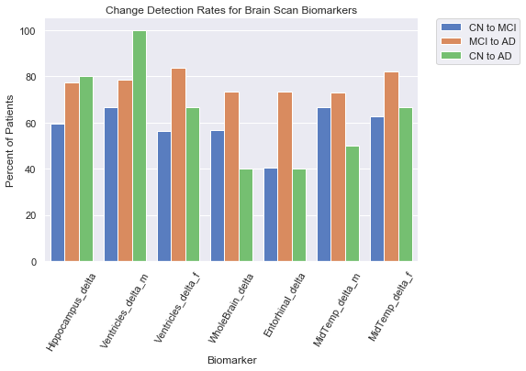
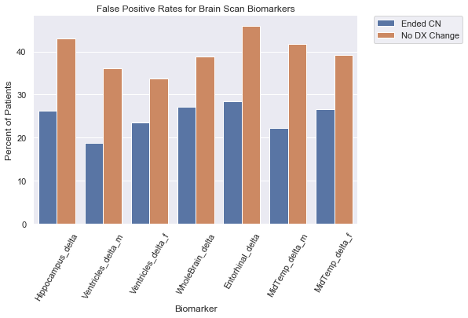
Change in Brain Scans Performance of Thresholds
* Lower detection rates and higher false positive rates than cognitive tests

Slide 21
Recommended Usage
Patients that exceed thresholds for changes in one or more brain scans
Use the machine learning models (introduced later) to predict if patient is high-risk for Alzheimer’s disease
Recommend patient begin early treatment as recommended by medical practitioner
Suggest continued monitoring of symptoms and regular exams

Slide 22
Machine Learning and Predictive Modeling Results

Slide 23
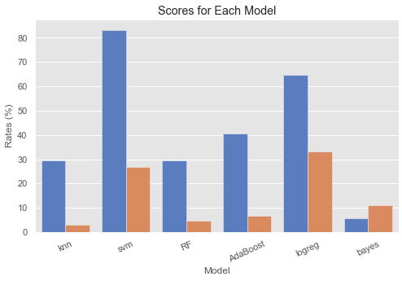
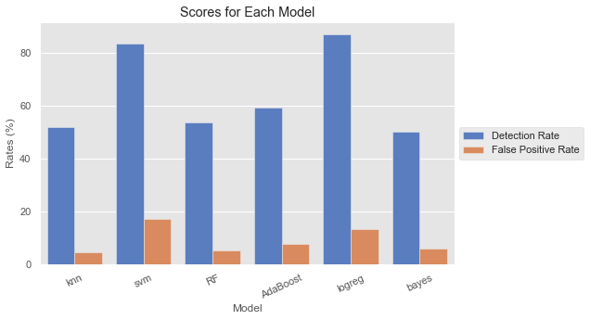
Machine Learning Models: Baseline Cognitive Tests
Baseline Cognitive Tests Detection Rates and
False Positive Rates by Model
Support Vector Machines
83% detection and 27% false positive
Other models inaccurate with no brain scan data

Slide 24
Recommended Usage
Patients that are predicted as high-risk using baseline cognitive test SVM model
Refer patient for brain scans
Recommend patient begin early treatment as recommended by medical practitioner
Suggest continued monitoring of symptoms and regular exams

Slide 25
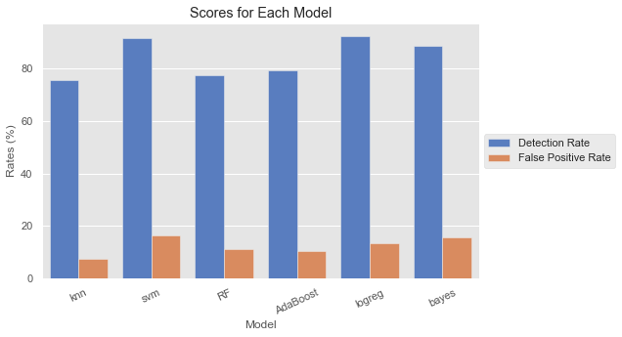
Machine Learning Models: Baseline Biomarkers (Cognitive tests and brain scans)
Baseline Biomarkers Detection Rates and
False Positive Rates by Model
High Value Models
Over 85% detection rates and less than 20% false positive rates
Support Vector Machines
Logistic Regression
Naïve Bayes
Every model over 75% detection
Every model under 20% false positive

Slide 26
Recommended Usage
Patients that are predicted as high-risk by the baseline biomarker models
Recommend patient begin early treatment as recommended by medical practitioner
Suggest continued monitoring of symptoms and regular exams

Slide 27
Machine Learning Models: Change in Cognitive Tests
Change in Cognitive Tests Detection Rates and
False Positive Rates by Model
High Value Models
Detection Rates over 80% and false positive rates 15-17%
Support Vector Machines
Logistic Regression
Other models not as accurate

Slide 28
Recommended Usage
Patients that are predicted as high-risk using change in cognitive test models
Refer patient for brain scans
Recommend patient begin early treatment as recommended by medical practitioner
Suggest continued monitoring of symptoms and regular exams

Slide 29
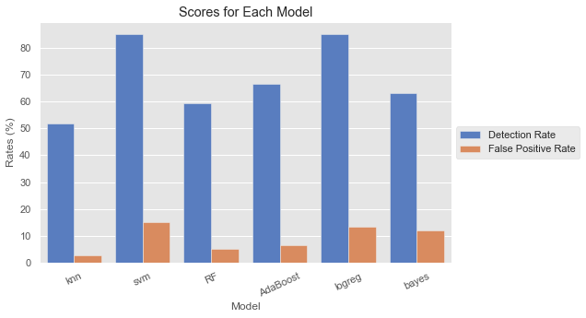
Machine Learning Models: Change in Biomarkers (Cognitive tests and brain scans)
Change in Biomarkers Detection Rates and
False Positive Rates by Model
High Value Models
About 85% detection rates and less than 15% false positive rates
Support Vector Machines
Logistic Regression
Other models not as accurate

Slide 30
Recommended Usage
Patients predicted as being high-risk by the change in biomarkers models
Recommend patient begin all early treatment options as recommended by the patient’s medical practitioner
Suggest continued monitoring of symptoms and regular exams

Slide 31
Model Tuning
Hyperparameters were chosen using 5-fold cross validation
Feature selection tools
Built-in attributes of models
Feature selector module
Principal component analysis
Ultimately made little improvement over the basic model
Ensemble model comprised of the best performing models

Slide 32
Ensemble Models
Individual models showed high detection rates and low false positive rates
The best models were combined into ensemble models
These were generally 85% or higher detection and 20% or lower false positives
Majority voting by individual models decides the prediction for each patient
Ensemble models should be better at generalizing to new patient data

Slide 33
Ensemble Models
Baseline Biomarkers
Change in Biomarkers
Support Vector Machines (SVM)
Logistic Regression (LR)
SVM with 9 principal components
LR with 9 principal components
LR omitting 2 features
Support Vector Machines
Logistic Regression
LR omitting 2 features
* Only three models with high enough detection rates

Slide 34
Ensemble Model Performance
Baseline Biomarkers
Change in Biomarkers
92% detection rate
15% false positive rate
85% detection rate
14% false positive rate
These are the recommended models to use when there is data for cognitive tests and brain scans

Slide 35
Practical Applications
High detection rates make the model useful
Low false positive rates mean not unduly alarming patients
Early detection -> early treatment -> better outcomes

Slide 36
Baseline First Exam Decision Chart
Start
Avoid $$ brain scans
First exam
cognitive tests
Machine learning
baseline cognitive model
Early treatment
Brain scan referral
Exceeds
cognitive threshold
Continued monitoring
Machine learning
baseline model

Slide 37
Continued Monitoring Decision Chart
Start
Avoid $$ brain scans
Continued monitoring
cognitive tests
Machine learning
cognitive change model
Early treatment
Brain scan referral
Exceeds
cognitive change threshold
Continued monitoring
Machine learning
changes model

Slide 38
Final Thought: Better Early than Late
"Although the adage, 'better late than never' certainly applies, waiting for a full blown diagnosis of Alzheimer’s disease before making healthy diet and lifestyle changes, is not a very effective prevention plan."
Quote: alzheimers.net
Full project available at https://github.com/chuktuk/Alzheimers_Disease_Analysis

