Slide 1
Project 6&7
吴璠 柴子婕
Project 6
Design Implementation of Speech Recognition Systems
Notes:
Hello! Everyone! Now Let us show you what we have done in the first project. My name is …. And this is my partner ….

Slide 2
Problem 1

Slide 3
Data Structure
Digit 1 | Digit 2 | Digit 3 | Digit 4 | Digit 5 | Digit 6 | Digit 7
Template 0 | Template 1 | Template 2 | Template 3 | Template 4 | Template 5 | Template 6 | Template 7 | Template 8 | Template 9
State 1 | State 2 | State 3 | State 4 | State 5
Notes:
First, to solve problem 1, we use a two dimension array to update DTW distance. This two dimension array, can be seen like this. It will have 7 digit, for each digit, there are ten templates, and for each templates there are five states. Between every digit, there will be a dummy state which can be connected with backward path.

Slide 4
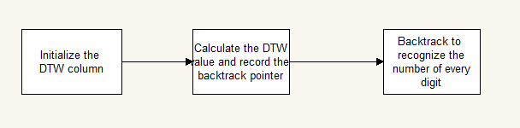
Process Of The Program
Things to notice:
The number can neither be 0 nor 1, so for the first digit, the node cost of the templates 1 and 0 will be INF
The number of digit can be 7 or four. So, The 4th digit and the 1st digit will start with the same smallest cost.
Notes:
And the process of the program can be presented as the flow chart.
First we will initialize the two DTW column, that is the two arrays mentioned before. When initializing, except for the first digit and the fourth digit, distance of other states will be set to infinity. And in the first and fourth digit, for every first state of the templates, the distance will be the node cost we calculated before, and other distance will be set to infinite.
Then Calculate the DTW distance and construct the backtrack table.
Third, do backtrack according to the backtrack table. When encountering the path which is from dummy state, it means there is an end of a word, So we will get one of a phone number.

Slide 5
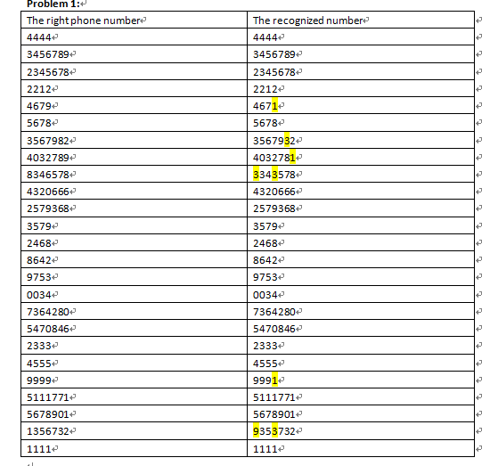
Result Of The Program
Word accuracy:
94.1%
Sentence accuracy:
76%
Notes:
This is the result of random 25 phone number. We can see that, in this case, the word accuracy is 94.1%, and the sentence accuracy is 76%

Slide 6
Problem 2

Slide 7
Data Structure
Two arrays used to update
(2) one array to record the flag.. The first dimension is the frame number, the second dimension is the digit number, and the third dimension is the end state number.
(3) The array will record the source of every first state. When backtrack, we will use this array to determine the backpointer.
Notes:
In problem two, the whole process is the same as the problem one. But instead of storing whole backtrack matrix, we will store a backward pointer. The back ward pointer is store in the second array, startFrame. In this array, it will store the source of every end state for every template. So the first dimension is …Read ppt. The third array record the source of every first state of every templates. It has two dimensions, first dimension is the frame count, second dimension is the digit count. when the path of the first state is horizon path, the value will be set to -1, and when the path of first state is from dummy state, then the value will be the end state of a template in the last digit. When backtracking , we first find the start frame of the number in the second vector, And get the number,then we look up the backwardPtr vector to find the source and move the previous flag.

Slide 8
Problem 3
Notes:
Then is the problem 3

Slide 9
Data Structure
Template 0 | Template 1 | Template 2 | Template 3 | Template 4 | Template 5 | Template 6 | Template 7 | Template 8 | Template 9 | Silence HMM
State 1 | State 2 | State 3 | State 4 | State 5
Notes:
The whole process of this problem is similar with problem1. But because we do not know the digit number of the speech, we only need ten isolated word as ten templates. In this part we also add the silence template.

Slide 10
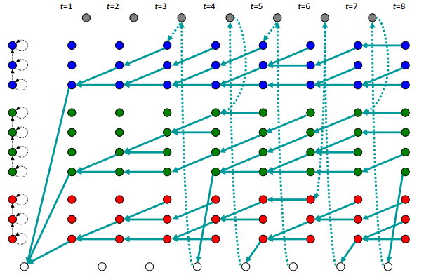
Process of the program
Notes:
And we will use a backward path to decide the end of one word. we will add a backward penalty when update the first state of every template. So when the path of a first state of a template is backward, the distance will be calculated by adding the node cost, the backward Penalty and the miniCost from last column.

Slide 11
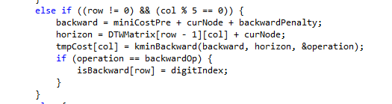
Update With Backward Penalty

Slide 12
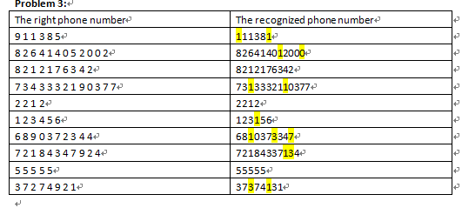
Result
Word accuracy: 83.5%
Sentence accuracy: 30%
Notes:
And this is the result of recognition, we can see that by using asolated word hmm, the word accuray is 83.5%, however the sentence accuracy is only 30%. Then my partner will present the Problem 4&5

Slide 13
Problem 4 & 5

Slide 14
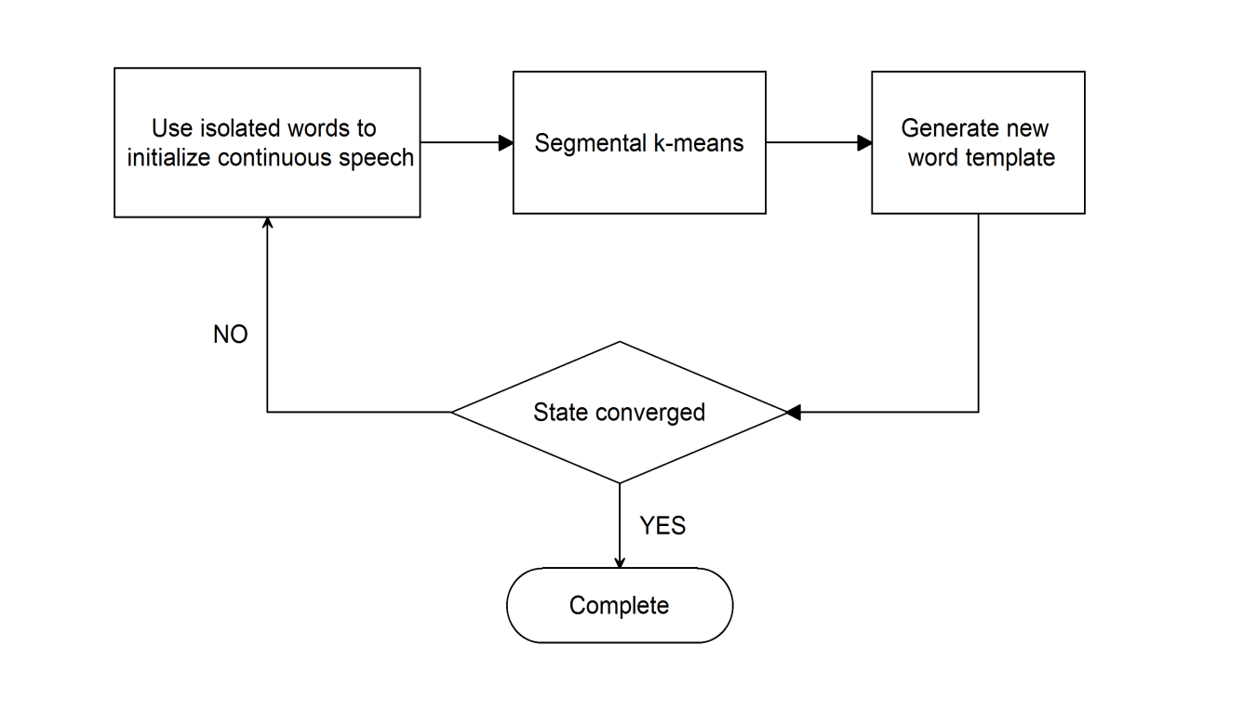
Flow Chart

Slide 15
Result
The right phone number | The recognized phone number
9 1 1 3 8 5(6) | 911385
8 2 6 4 1 4 0 5 2 0 0 2(12) | 826414052002
8 2 1 2 1 7 6 3 4 2(10) | 8212176342
7 3 4 3 3 3 2 1 9 0 3 7 7(13) | 7343332190377
2 2 1 2(4) | 2212
1 2 3 4 5 6(6) | 123456
6 8 9 0 3 7 2 3 4 4(10) | 66890372344
7 2 1 8 4 3 4 7 9 2 4(11) | 72184347924
5 5 5 5 5(5) | 655555
3 7 2 7 4 9 2 1(5) | 37274921
Word accuracy: 97.6%
Sentence accuracy: 80%

Slide 16
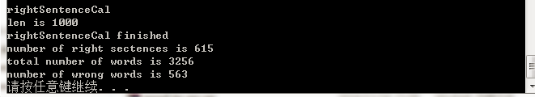
Result
Word accuracy: 83%

Slide 17
Thanks for your listening
Now is time for demonstration.

