Slide 1

Kernel内存布局 BSP team Wu Ping 吴平

Slide 2
预览
Kernel
head.s
Start_kernel
Setup_arch
Fixmap_init
……
Memblock_init
do_one_initcall
Notes:
CVBS

Slide 3
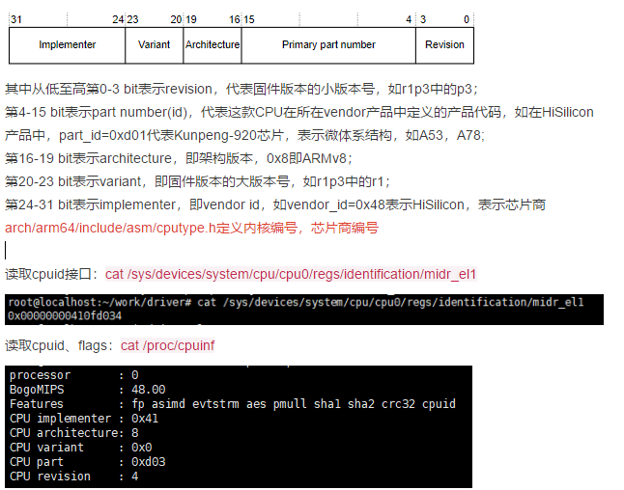
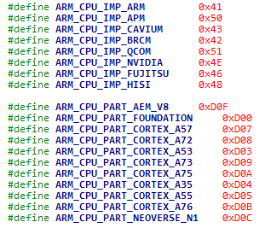
CPUID
Notes:
CVBS

Slide 4
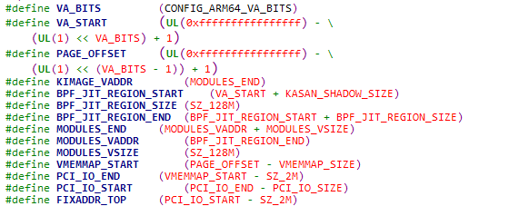

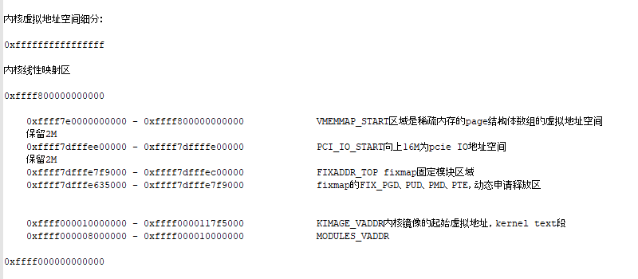
Fixmap
虚拟地址位宽CONFIG_ARM64_VA_BITS=48时：
Notes:
CVBS

Slide 5
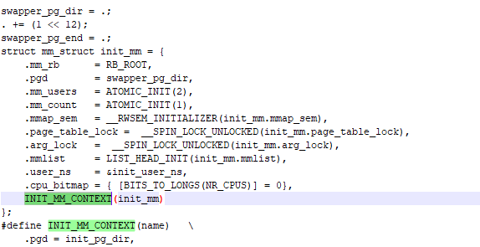
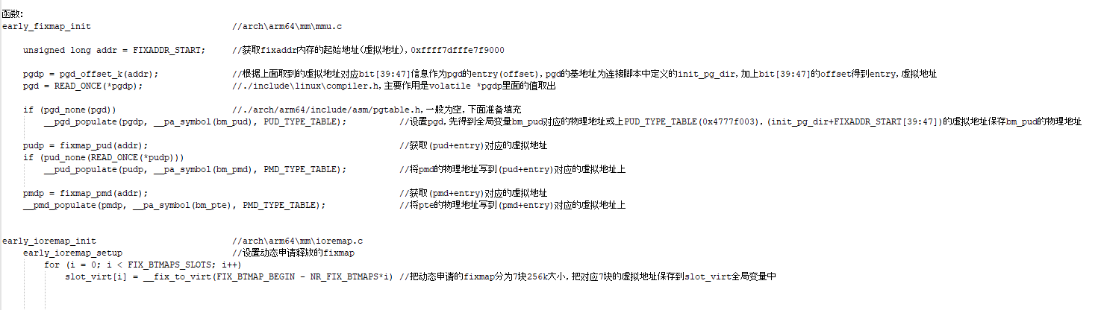
Fixmap
Notes:
CVBS

Slide 6
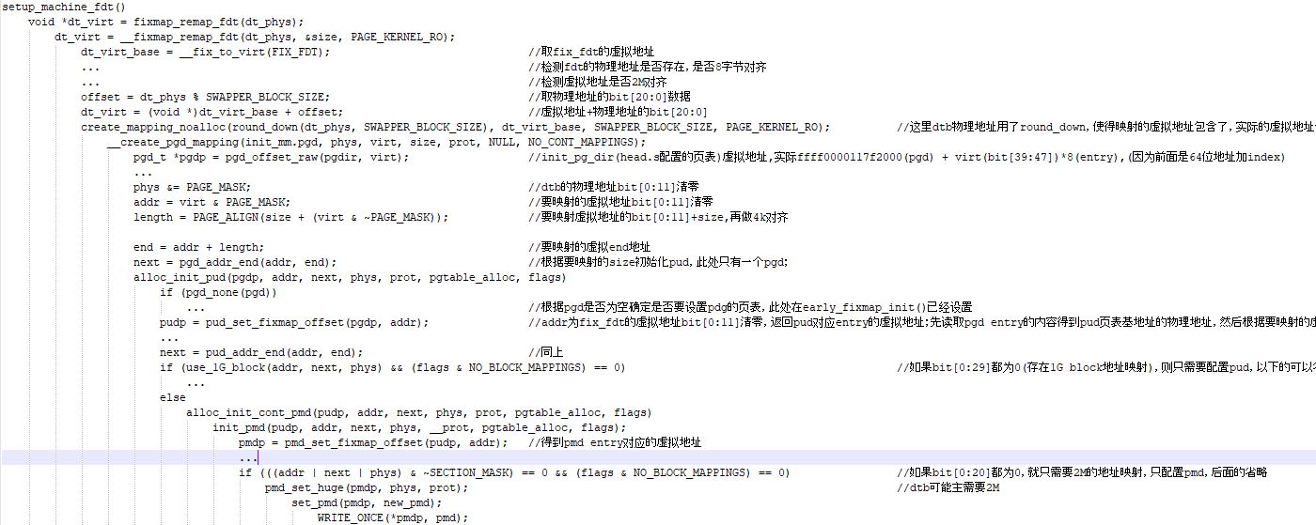
Fixmap
Notes:
CVBS

Slide 7
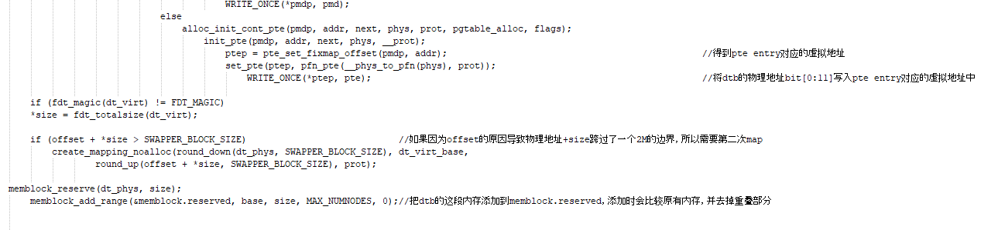
Fixmap
Notes:
CVBS

Slide 8
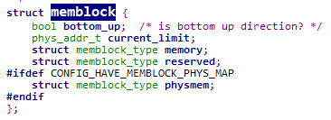
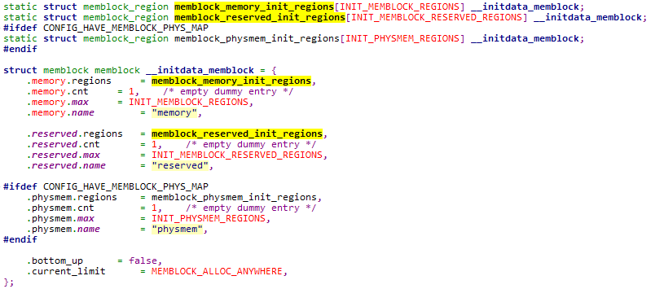
Memblock
Notes:
CVBS

Slide 9
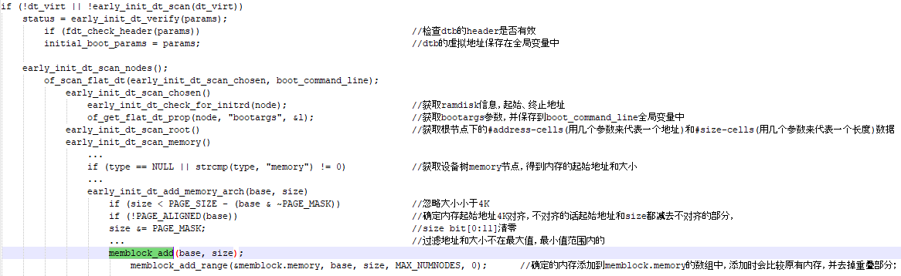
Memblock

Slide 10
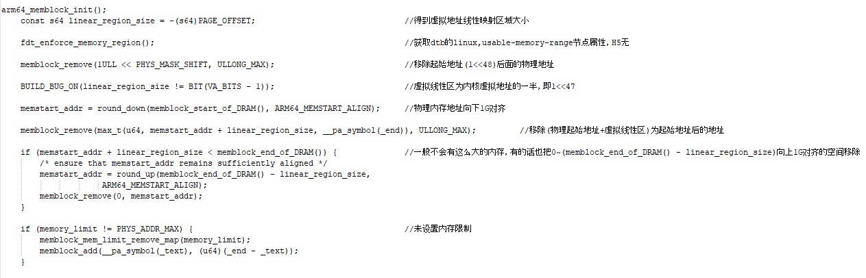
Memblock

Slide 11
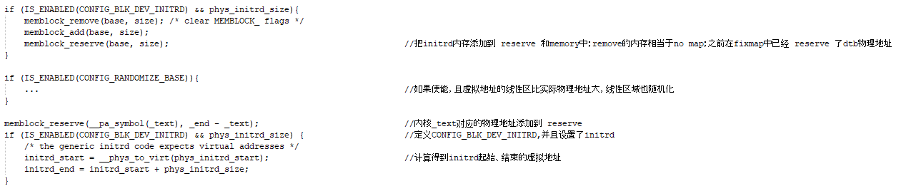
Memblock

Slide 12
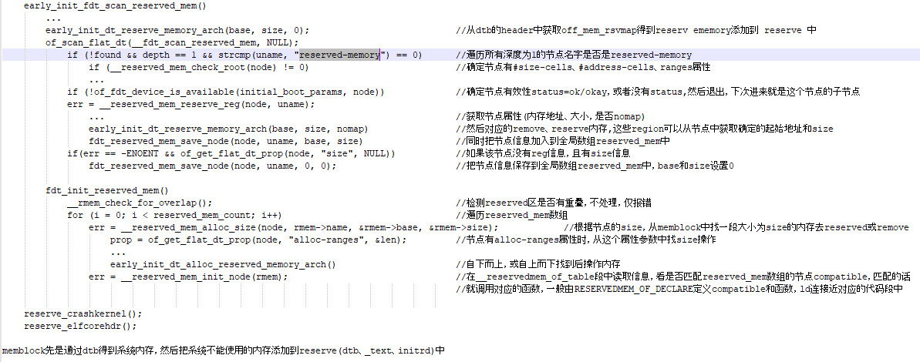
Memblock

Slide 13
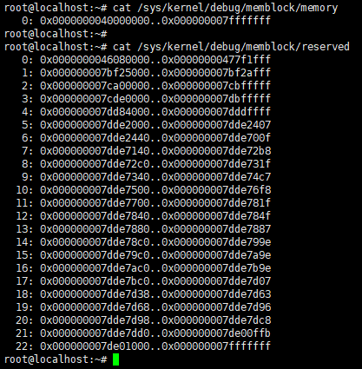
Memblock

Slide 14

Q&A
Thank You

