Slide 1
预览
Kernel
head.s
Start_kernel
Setup_arch
Fixmap_init
……
Memblock_init
do_one_initcall
Notes:
CVBS

Slide 2
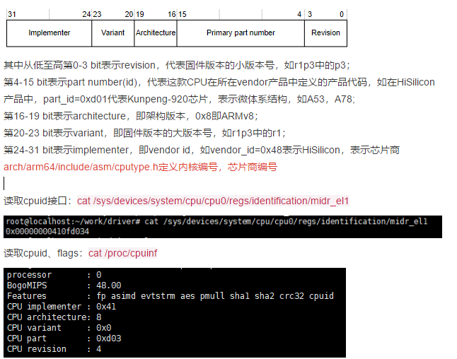
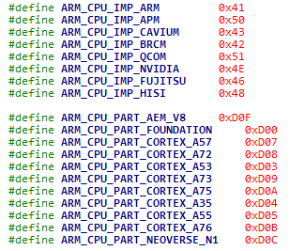
CPUID
Notes:
CVBS

Slide 3
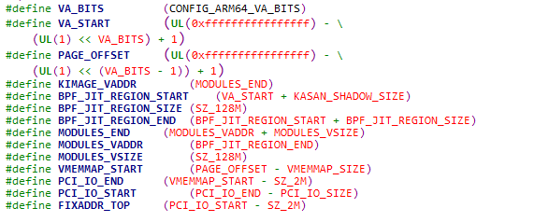

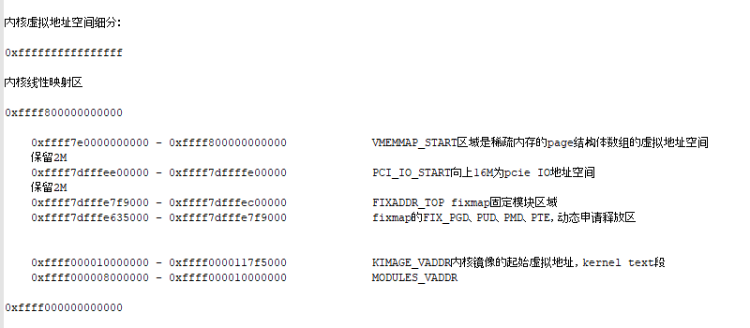
Fixmap
虚拟地址位宽CONFIG_ARM64_VA_BITS=48时：
Notes:
CVBS

Slide 4
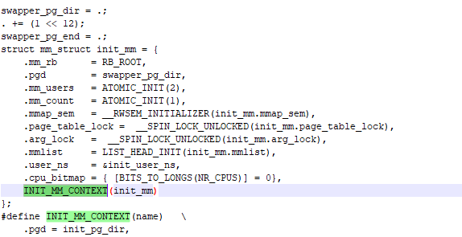
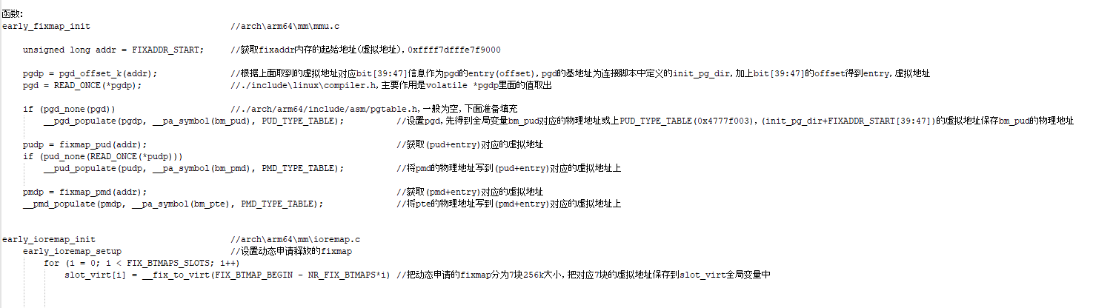
Fixmap
Notes:
CVBS

Slide 5
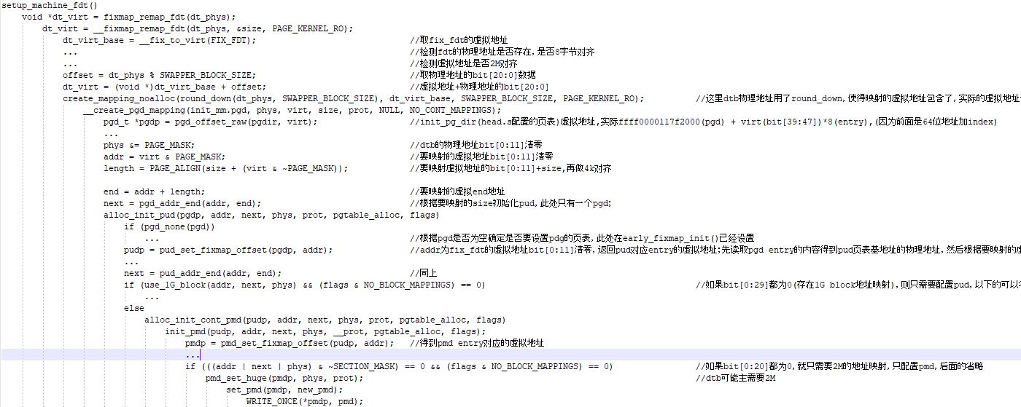
Fixmap
Notes:
CVBS

Slide 6
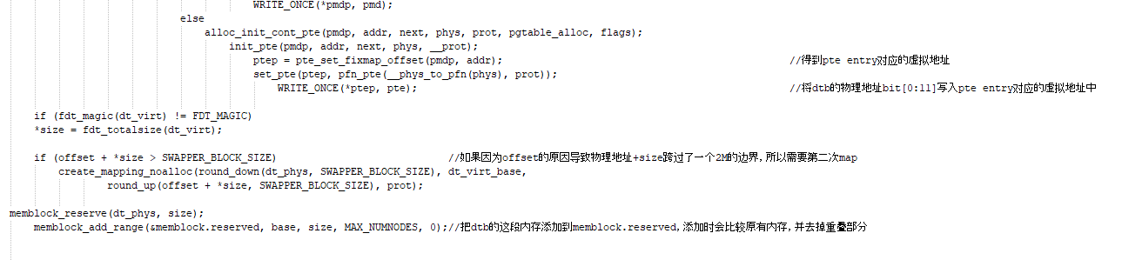
Fixmap
Notes:
CVBS

Slide 7
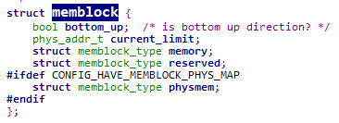
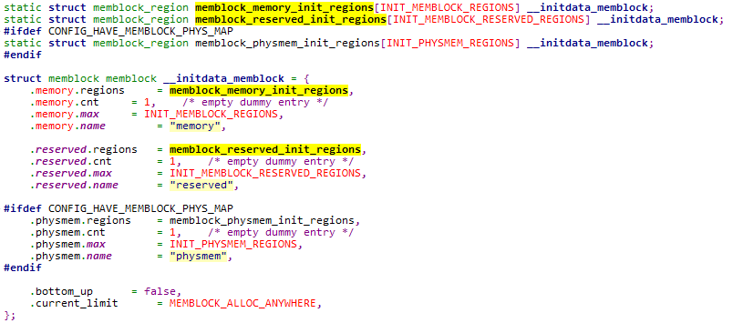
Memblock
Notes:
CVBS

Slide 8
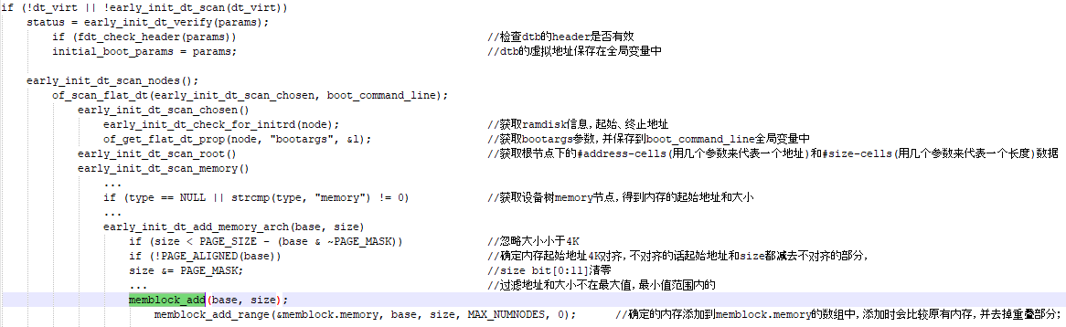
Memblock

Slide 9
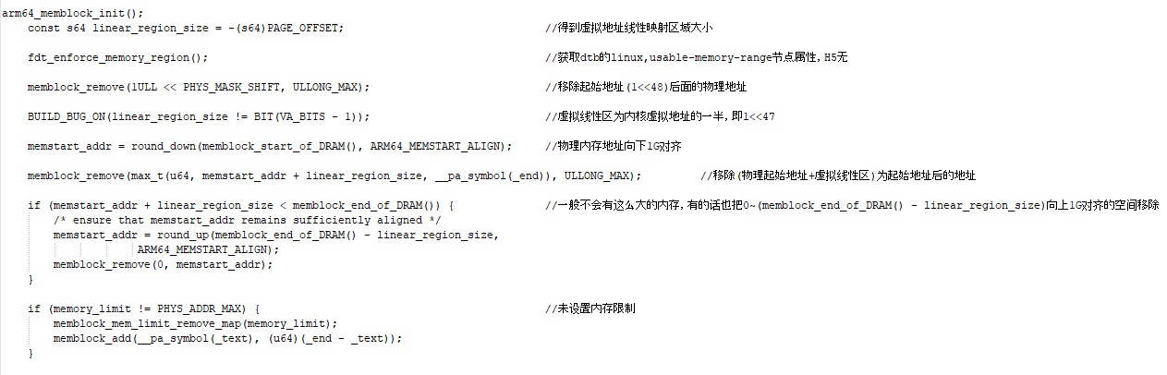
Memblock

Slide 10
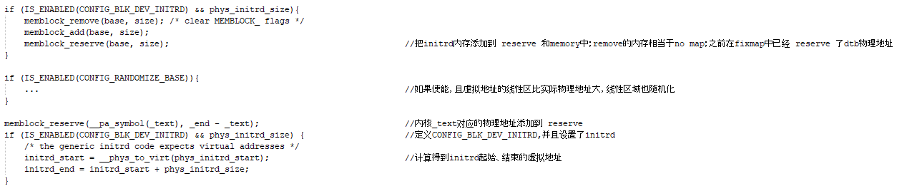
Memblock

Slide 11
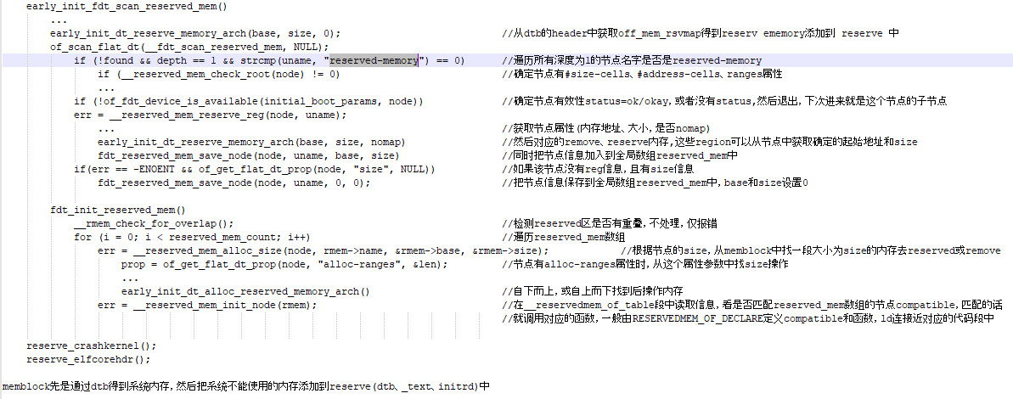
Memblock

Slide 12
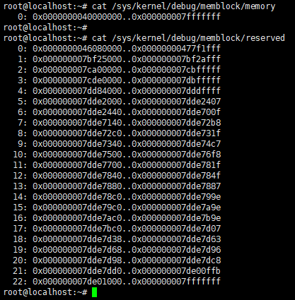
Memblock

Slide 13

Q&A
Thank You

