Slide 1
BakerGina_GPA1-B
Intro to SAS
Due: 1/12/2025

Slide 2
THIS FILE HAS BEEN CHANGED 4/7/2025

Slide 3
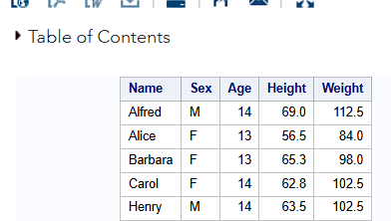
Step no. 9

Slide 4
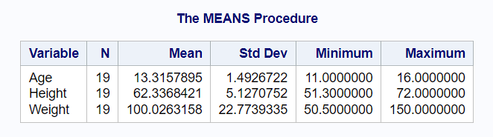
Step no. 13

Slide 5
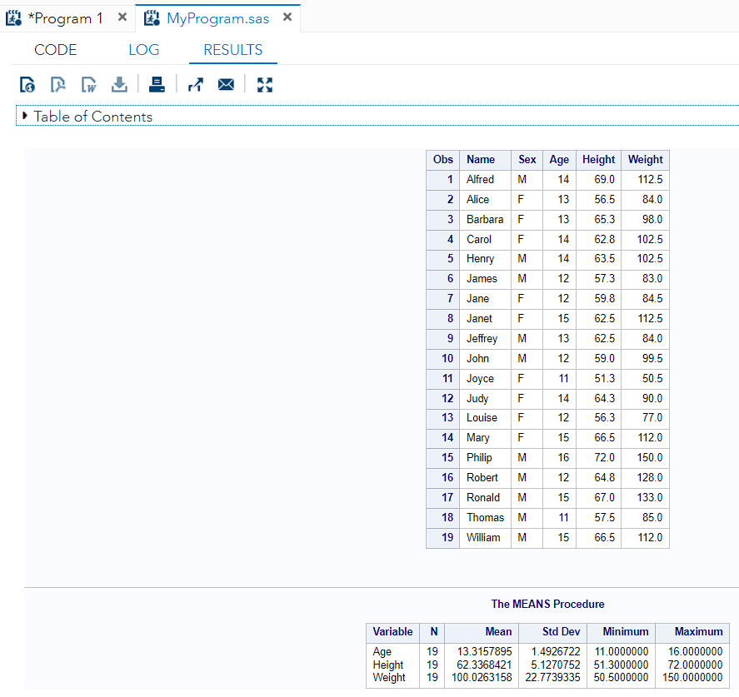
Step nos. 17/18

