Slide 1


Tic Tac Tactic

Slide 2
Main Task:
- 2 player mode
- take moves after each other using the numerical keyboard
- AI for help

Slide 3

The tasks we implement first
- draw a game board
- players can add their names
- determine whitch player is „x” and „o”
- use numerical keyboard
- winner
- error messages
- when the player try to use letter instead of numbers
- when the position is already taken

Slide 4
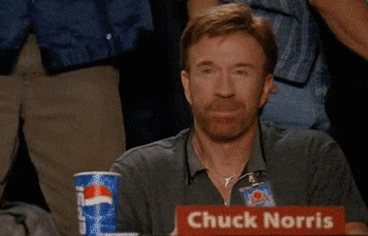
Future plan?
- AI help
- new game
- choose between „x” and „o”

