Slide 1
Data Governance & the Sidewalk Toronto Smart Cities Project
Teresa Scassa
Canada Research Chair in Information Law and Policy
Faculty of Law, University of Ottawa
March 8, 2019

Slide 2
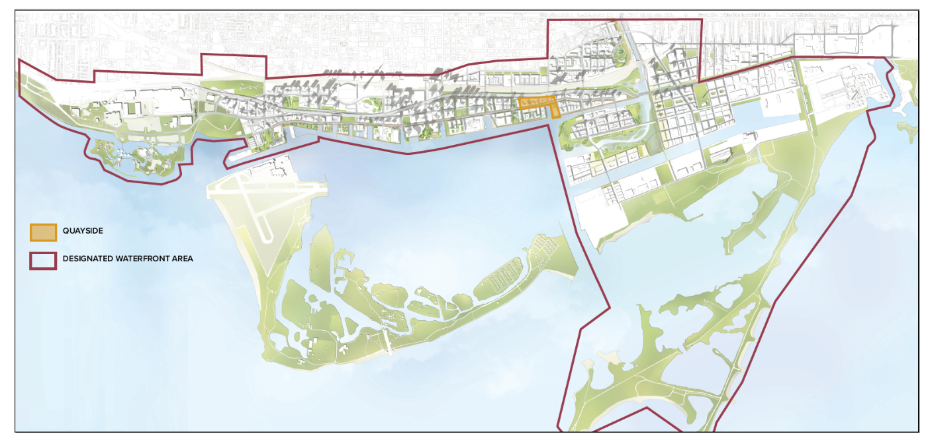

Quayside and Waterfront Toronto

Slide 3
Timeline
RFP (March 17, 2017) and selection of successful bidder (October 2017)
Framework Agreement (October 16, 2017)
First Sidewalk Toronto ‘Community Town Hall’ (November 2017)
Sidewalk Toronto Public Roundtables (March 2018 to present)
Creation of Waterfront Toronto Digital Strategy Advisory Panel (April 2018)
PDA (July 31, 2018)
Sidewalk Labs Digital Governance Proposals (October 2018)
First Waterfront Toronto “Civic Lab” (November 23, 2018)
MIDP – First draft “early 2019”

Slide 4
Data governance challenges
Hi-tech/innovation dimensions of project completely overshadowed human dimensions
Real-estate component remains a complicating factor
Project conception bred mistrust and caused inherent governance problems
Privacy by design approach was entire initial privacy response
U.S./Canadian culture shock (?)/rejecting data colonialism (?)
Inadequate law and policy infrastructure at provincial and federal levels in Canada

Slide 5
Sidewalks Lab proposal: Civic Data Trust
Promise | Problem
Civic Data Trust | Data or Digital Trust? What is a civic data trust? Consistency with Canadian law? Who is responsible for creating it and who pays?
To control collection and use of “urban data”; possibly to host the data | What is included/excluded from this definition? How to reconcile with public sector data protection laws?
Responsible Data Use Guidelines Responsible Data Impact Assessment | How can this be reconciled with the role of the public sector?
Open by default | Cost recovery or other model?
Independent Governance | Independent from whom? Who governs? On what terms? Set by who and how?
Rules applicable to all parties collecting or using data in the physical environment in Quayside | How are “all parties” defined? Government? Journalists? Researchers? Citizen science?
Collection and use guided by a charter focused on benefits to the community | Defined how and by whom?

Slide 6
Urban data
Defined by Sidewalk Labs as : “data collected in a physical space in the city”, including:
Public spaces (streets, squares, plazas, parks and open spaces)
Private spaces accessible to the public, such as building lobbies, courtyards, ground-floor markets, and retail stores
Private spaces not controlled by those who occupy them (e.g. apartment tenants)
Potentially hugely overinclusive (e.g.: why would security camera footage in a building lobby go into the data trust and be considered for reuse?)
Potentially greatly underinclusive (e.g.: what infrastructure, utility or other data might have a broader public interest)?
What underlies/motivates this conception of “urban data”?

Slide 7
Thank you!
tscassa@uottawa.ca

